Slide 1



Staff & Student Q&A Session
Sasha Contreras
2026 Virtual TracCloud Conference

Slide 2
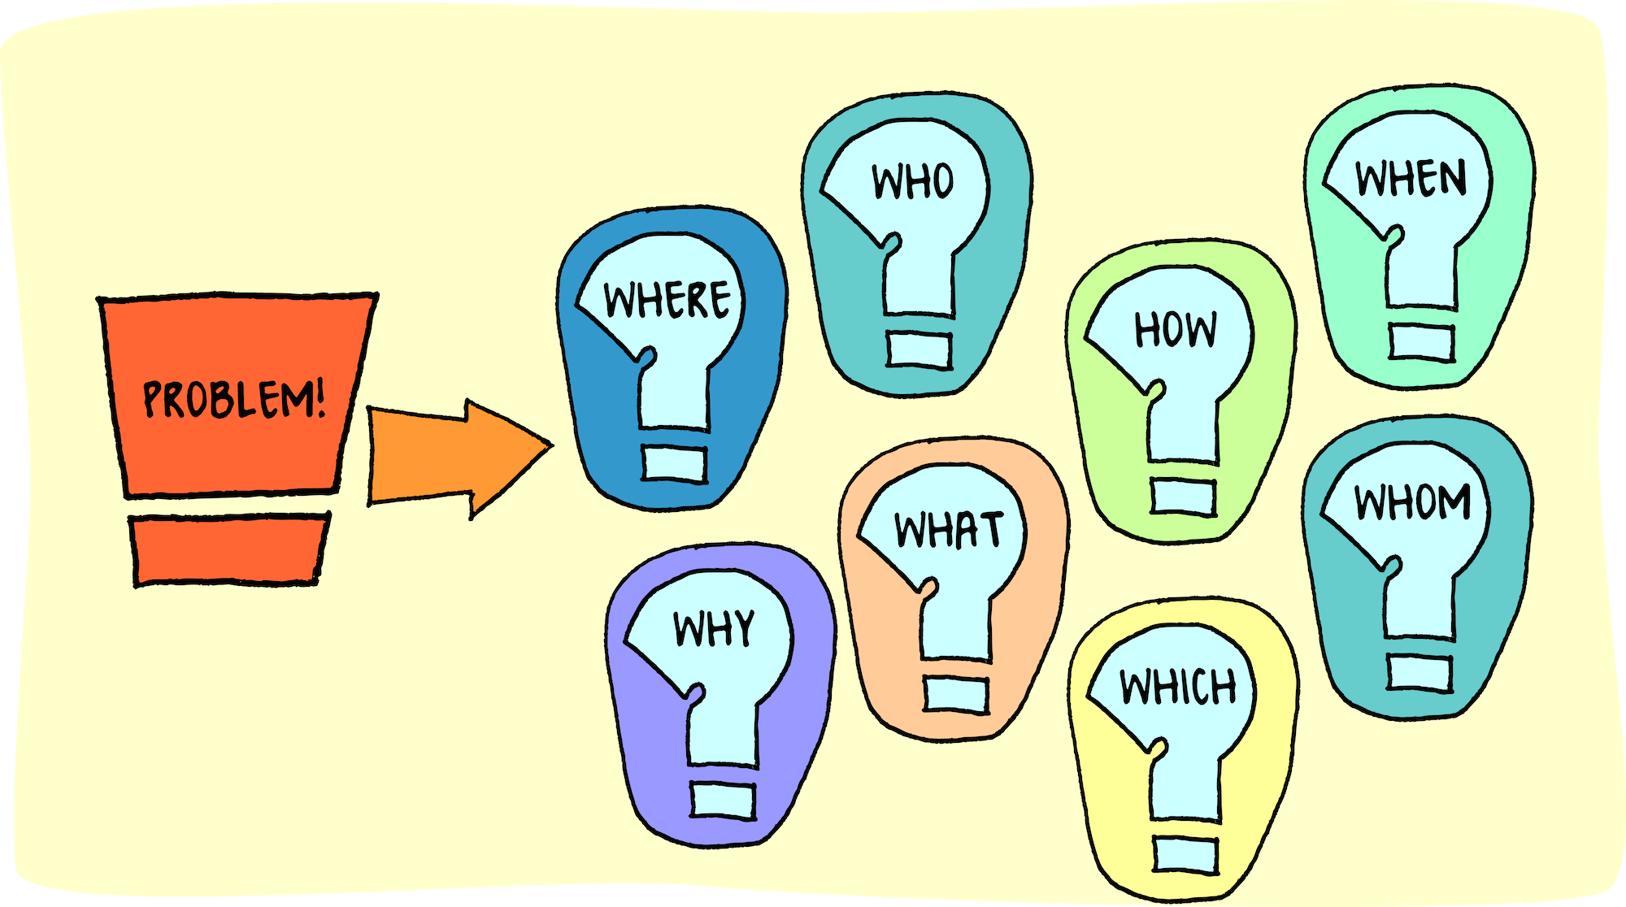
No question is a “stupid” question.
Sasha Contreras
Your question might be someone else's solution!
Ask away!
2026 Virtual TracCloud Conference

Slide 3

Have more detailed questions?
Please send us a ticket at helpdesk@go-redrock.com or schedule a training session with one of our Redrock Tech Members.
Respectfully,
Sasha Contreras
2026 Virtual TracCloud Conference

