Slide 1
Welcome!
Redrock’s 18th
Annual Conference
Notes:
Welcome to conference.
Now to bring up a few need-to-know items for this conference.
You will have access to Redrock staff at help desk in the foyer and Laura for any additional questions. Sign up at my registration desk for these one-on-one appointments.
If you have not already connected, the WIFI password is Meeting and Helpdesk will have it if need to reconnect. It is also on the back of your name badges. I encourage you to pull out your laptop or tablet now and log into your system. You can follow along with the demo or other sessions. For my demo, your system may look different as you might not have access to all the features. If you see something you’d like, take notes. We included pen and notepad in your registration bag.
We have a Wiki you can use to download any PowerPoint and handout guide related to the sessions you see throughout the conference or if you miss one, we have you covered. You can get to that by going to our URL, click on support, and then Wiki.
We are excited to announce a discount for all the modules. 10% off any new feature if I have the payment or PO by 5/15/25. See me for a quote.
Events: Dinner included- tonight we have dinner by the pool with a band at 5pm, Thursday, come join the Redrock staff for dinner in Maricopa room at 5pm.
Last items, please help us by filling out the session evaluation forms after every session you attend.

Slide 2
TracCloud history
30+ Years of Design & improvements
Platform:
Web-based, cloud-hosted
Versatile:
Single center/multi-campus
Purpose:
Track student interactions & increase student success
Laura Reed
Notes:
History
Redrock Software, Corp was created more than 30+ years ago when local CC came to Kelly for a need in their fitness center, then tutoring, then advising…
Unique aspect: Only scheduling and reporting software designed specifically for universities and colleges. Features and functions added by suggestions from clients. Something you want it to do? Ask us, There is a good chance Kelly can make it happen.
Platform: web-based (not app) and cloud (AWS) Nic has session at 4 about security and the cloud.
Versatile: hammer analogy. Not only versatile in function, but pricing options as well
Purpose: Track student interactions to increase student success. This is done through recording appointments, visits, attendance in class or at special events, surveys, early alerts, success plans, and more.

Slide 3
What’s new? A lot What’s Coming? A Lot More
Eliminated set-up fees and moved to a tiered pricing structure.
Conditional questions in SurveyTrac.
Stacked availabilities.
Class Attendance Tracking.
Scheduled Announcements.
Improved Workshop/Events Functionality.
New Custom Fields.
And more
Notes:
What's New: Aidan has a whole session on What’s New at 3 today, so I’ve only listed some here. There are over 250 from the past year.
What’s Coming: Kelly time to think?

Slide 4
4 Tiers (but flexible)
TracCloud tier
Essentials Tier
Retention Tier
Kiosk Function
Scheduling
Reporting
TextAlerts & Emails
Automated imports
Work Visits
Skills & Accommodation Tracking
TracCloud Tier + the following:
Certification Tracking
Mail Server
Payroll Tracking
SurveyTrac
Q2 Study Tables
Task Manager
Whiteboard
Tier 1&2 + the following:
Attendance Tracking
Campus Customizations
Resource Management
SAGE Early Alerts
Success Plans
Work Plans for Staff
Workshops/Events
Enterprise tier: API, Cross-campus reporting, and A new Feature in 2025
Notes:
We restructured pricing and features the end of 2024, so the tiers you see listed may not apply to you exactly. Many of you are in our grandfathered pricing. Moving forward, purchases will look take place in the tiers, but we are flexible.
Will start on the dashboard, but we will review items based on the tier they are available in, so we will jump around when looking at the dashboard.
This list of features does not list everything in TracCloud, just some of the highlights. Widgets, TracFlows, photos, announcements, and more are features in TracCloud, but not listed here.

Slide 5
Dashboard: Staff View
Status Charts: quick click to see Visits by…
Announcements
Welcome Message
Watch List
Center Status
Utilization
Consultant Time Check
Notes:
Now begin demoing. For most of the pages, my demo will show what it looks like from as sys admin view.
This demo show WHAT TracCloud can do, not HOW to do it. The remaining of the conference is the How-to part.
Another building analogy for you. Much like entering a building on your campus, there are several ways you can get to various features in TracCloud. The dashboard gives us quick access to some of our most common features.
Define a widget.
The first three widgets on the dashboard are the announcements (the green box), Welcome message (the one with the clock and “TracSystems by Redrock Software” box, and then the Watch lists.

Slide 6
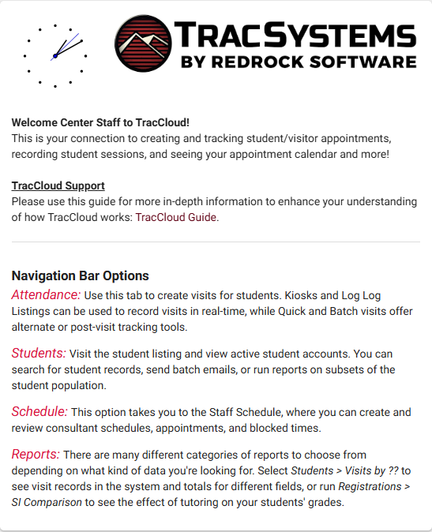
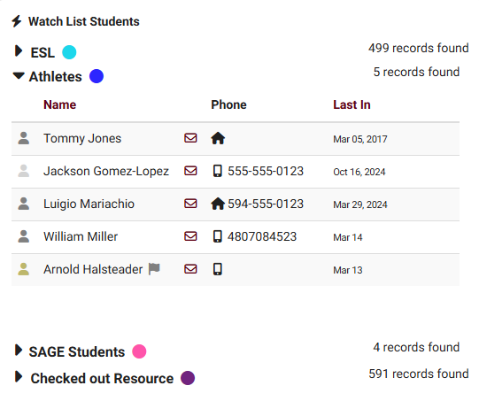
Dashboard: Announcements Welcome Message Watch List
Notes:
Announcement: This can be any announcement you create. This can let staff and students know about upcoming holiday’s, any special workshops, weather related adjustments, etc…It can be a video, pictures, words. The messages can be scheduled and displayed for a certain amount of time.
Welcome Message: Another way to provide information to users on how to navigate the system. Typically stays the same, but you can change as often as you’d like. This can look different based who you are. Staff and students can have different messages.
Watch list: Watch list allows you to create a specific group of students you’d like to monitor and run reports on. You can also create a color identifier along the dashboard and other areas in the system. One example is student athletes.

Slide 7
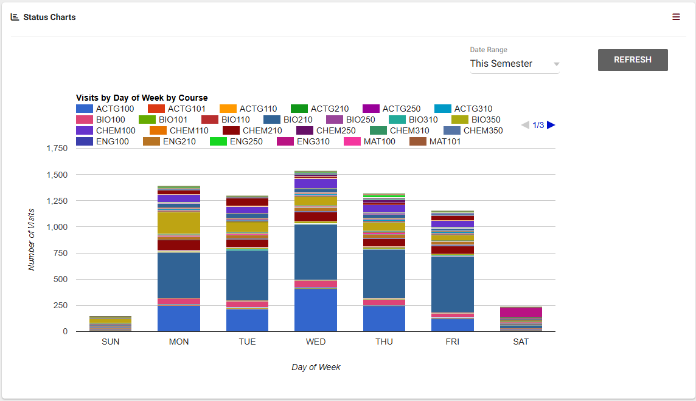
Dashboard: Status Charts
Visits by
Month by Course, Month by Subject, Day of Week by Course, Reason by Course, Reason by Subject, Center by Reason, Subject by Course, Day of Week by Center
Notes:
Status charts give a quick way to users with that level of access to run a quick report on the dashboard. This feature and ALL reports are standard in TracCloud.
I’m showing day of week by course and then chose “this semester”. This helps you see if there are days of the week that your center is busier than other days. The report is interactive so you can hover over the graph for details.

Slide 8
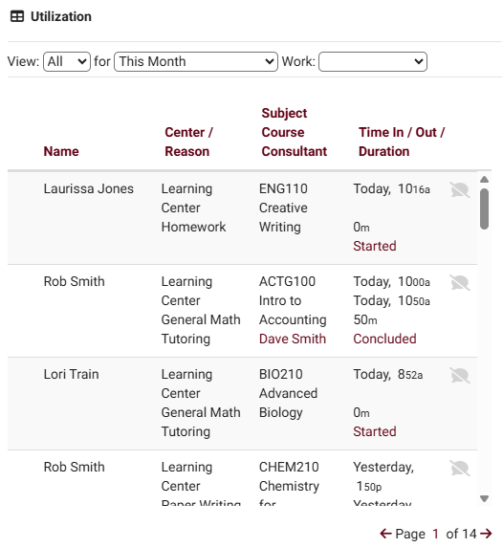
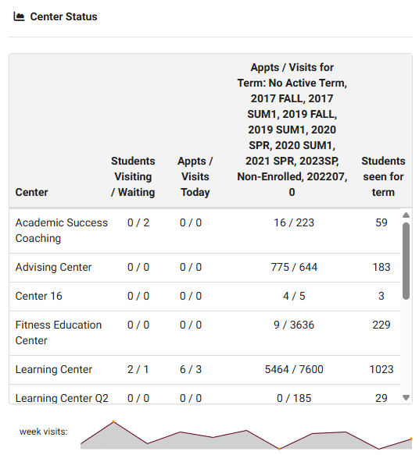
Dashboard: Center Status & Utilization
Notes:
Center Status
This is a quick way to see center data. A graph at the bottom is a quick visual for every week in that term. If you want to see that same graph but for only one specific center, you can click on that center and the graph changes. My graph is showing the advising center data.
Utilization
The utilization widget/button is a quick way for instructors to access and see any visit records, notes, and interactions. They can quickly access those visits, add notes, or even add custom notes. If there are notes, the icon will be green instead of grayed out.
Consultant Time Check: Allows staff members to view a Time Check-style menu on their dashboard, showing a quick summary of their recent work visits. If enabled, you can also choose the number of weeks shown in the Time Check window.
Any questions?

Slide 9
Schedule: admin View
Notes:
Scheduling: In TracCloud, you have a sys admin level, profile admins, and staff. Typically, sys admins have access to everything. Profile admins have access to reasons and items pertaining to their profile, and staff are like the worker bees, but you determine what they have access to. Permission groups are used to determine who has access to what data. For the demo, I’m not going to go into the schedule or staff set-up.
In person, remote, asynchronous. Walk-ink, schedules, etc…
Green- one-on-one
Yellow-group
Blue-drop in
Purple-asynchronous
Appointments can be moved dates if rescheduling is needed. Normally, our demos are more involved with the scheduling features, but we have an entire session on this tomorrow at 10am, so I’ll move on.

Slide 10
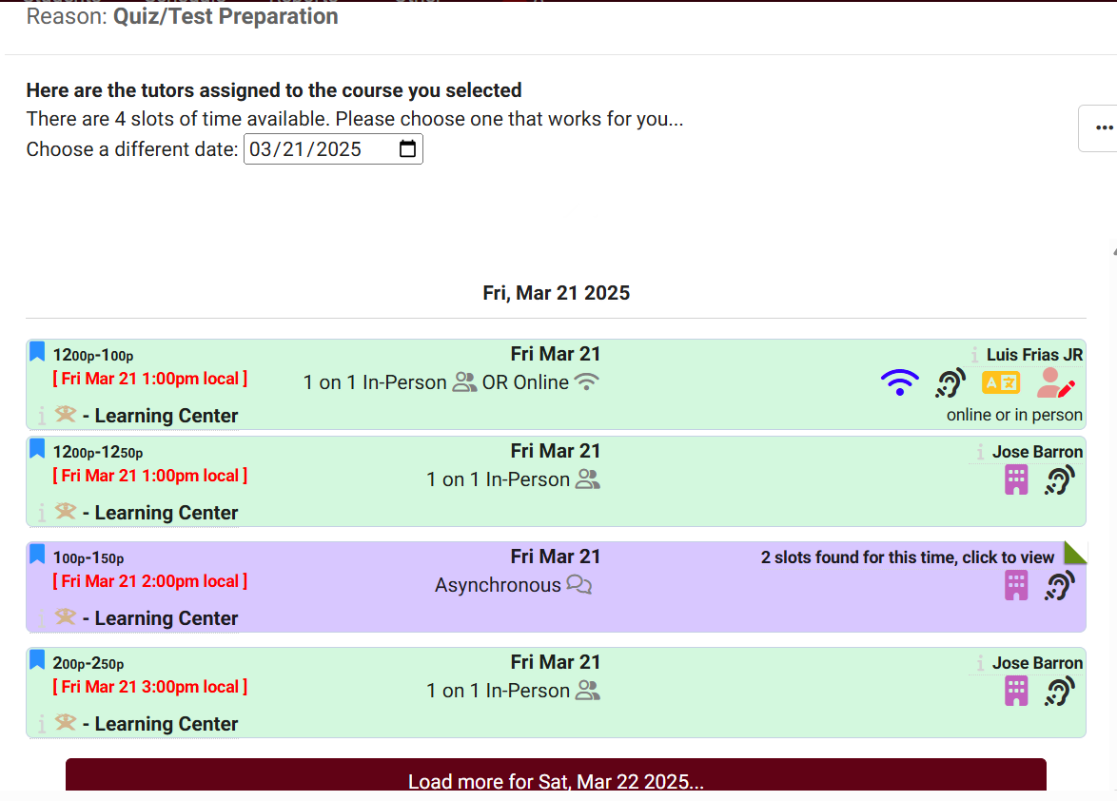
Schedule: Student View
Tutoring by Subject and Reason
Advising by Service/Reason
KIOSK-Log in with QR Code or Other
Notes:
Schedule an appointment. Tutoring by subject and reason. (You set what fields you’d like students to need to choose from).Accounting, quiz, search. A list will populate with the options with consultants able to provide help in those courses.
Green- one-on-one, Yellow-group, Blue-drop in, and Purple-asynchronous
Each of the bolded fields can be clicked on or hovered over for more information. Once the student finds a date and time that works, they click on it. If you allow, they can choose the modality (in-person, online, phone). They can add context, upload documents, or list any skills or accommodations needed. If no date and time works for them, they can submit that so you have a better idea of when it is needed or find a time that does. Once they schedule an appointment, it will show on their dashboard. If they asynchronous meeting, they can see the progress on the dashboard as well. The red circle shows an unread message. You can either have TracCloud allow students to conclude the session or the staff. To see more on the student view, there is a session tomorrow morning at 8:55am

Slide 11
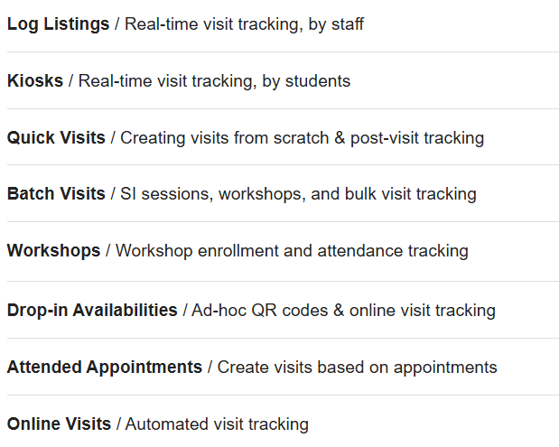
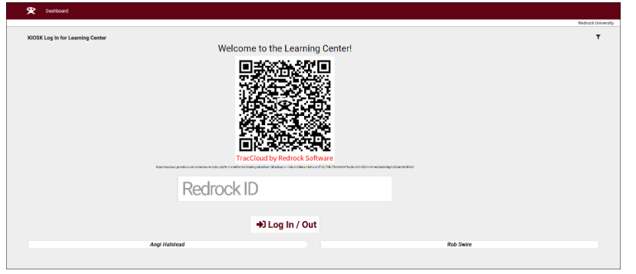
Visits
Visit Types
Kiosk
Notes:
Student Visits allow you to record when your students met with consultants. There are several options available for creating these visits, including real-time options like the Log Listing or Kiosk, used by staff and students respectively. Quick Visits can be used to create visits from scratch, and Batch Visits provides several tools for recording visits in bulk. There are even automated options for online appointments or when a staff mark appointments as attended manually
Read Visit Types
See Kiosk QR code option
For more details on visits, you can see Iliana’s session tomorrow at 11 am.

Slide 12
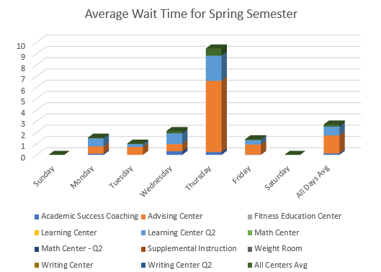
Reports
Notes:
We have an entire session devoted to just reports, so I will just to a high lever overview. You can create a report on any field in TracCloud. Creating custom reports can be daunting, so we have dozens of already created reports in TracCloud.
Reports can also be automated and emailed.
If you have a report used often, you can save it as a favorite.
I had this report export to a CSV.
Erick’s session on reporting is tomorrow at 1pm and Luis on Friday at 1pm.

Slide 13
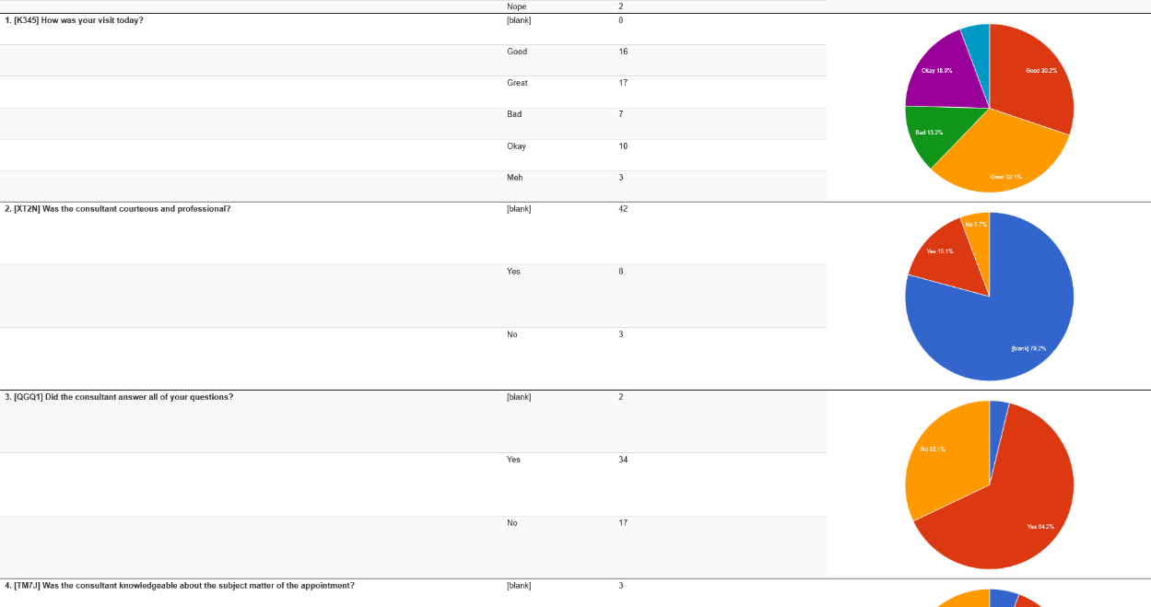
Essentials: SurveyTrac
Features:
Unlimited ?s
Manual or Automatic
One student or many
Endless possibilities and types
Notes:
The SurveyTrac feature allows you to send surveys to students and staff to collect information about their recent visits, Success Plans, or manually send a survey to a list of students. These surveys can contain an unlimited number of questions, be initiated by over a dozen different criteria, and you can report on responses after the fact. There are practically endless combinations of survey types and questions available to create.
More important than just taking the survey, is acting on those results. Reports.
The SurveyTrac session is tomorrow at 8:55am.

Slide 14
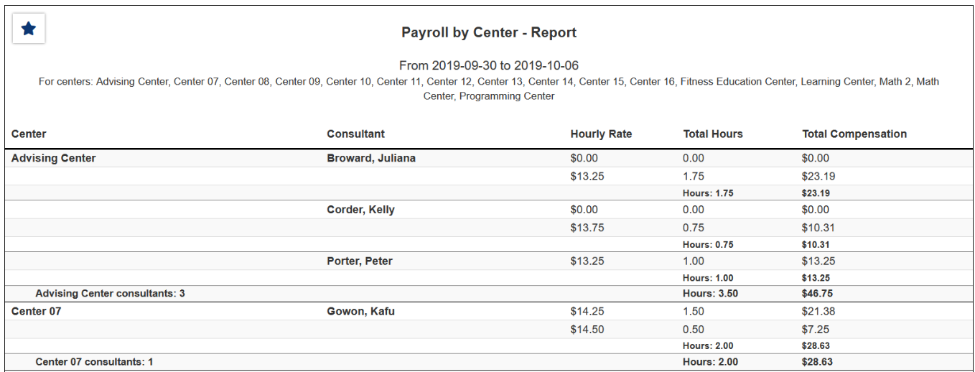
Essentials: Tracking (Payroll & Certifications)
Payroll
Payroll by:
Center, Fund Type,
Consultant
Can be exported into a CSV
Certifications
Notes:
TracCloud provides the ability to track the hours and pay rates of your consultants based on different work types and pay bases. You can then base other system functionality on whether or not a consultant is logged in for work, and report on this payroll data after the fact. Funds can also be used to define pay rates and to group data in reports.
Certifications: You now have one area to manage your staff certifications, such as CRLA certifications, nursing accreditations, or skill endorsements.

Slide 15
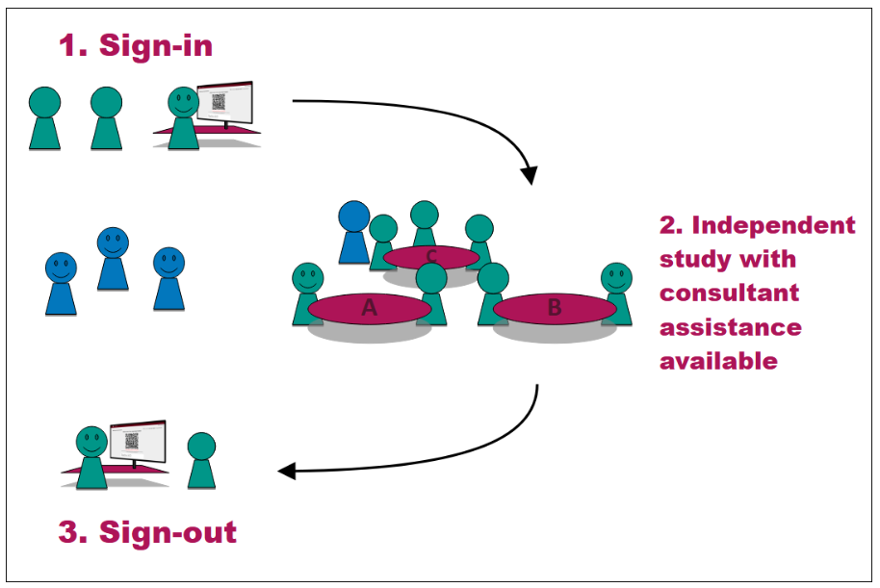
Essentials: Whiteboard
Live or Asynchronous Environment
Share Documents-Add Suggestions
Chat Window
Q2 Tables
Live or Asynchronous Environment
Students Can Virtually Raise Their Hand
Notes:
Whiteboard provides a live virtual environment for students and consultants to work together in tutoring, writing, or advising scenarios. Whiteboard provides tools for consultants and students to work out mathematical graphs and equations, review papers, or share documents.
Q2 Tables offers a unique approach to attendance tracking specifically for study table centers, tracking the total time a student spends in the center in addition to recording the individual table visits where students received help from consultants. Students begin their center visit studying independently while having the ability to request assistance as needed. (Session on Q2 study tables tomorrow at 10am.)

Slide 16
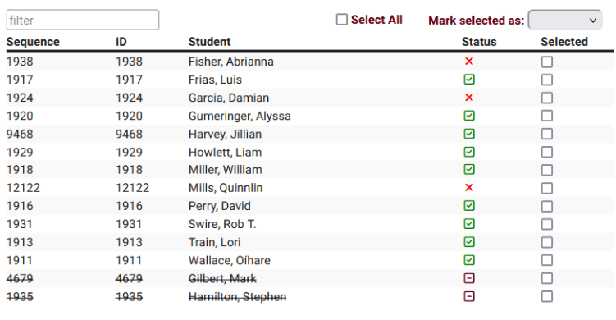
Retention: workshops & events
Notes:
Other Options: Workshops. If you have any type of workshop or even where you want to track attendance or have students reserve their spot, you can with TracCloud. This could be for registration events, prospective student events, subject based workshops, and more.
For an event, a QR code is created in the batch visits and students can just log in and if you’d like, log out. Reports on these events are available.
Or Track enrollment and attendance separately at special events (such as new student orientation or class events) and workshops. You can view and report on how many students were signed up and what percentage actually attended. With our events and workshops tracking, student engagement increases.

Slide 17
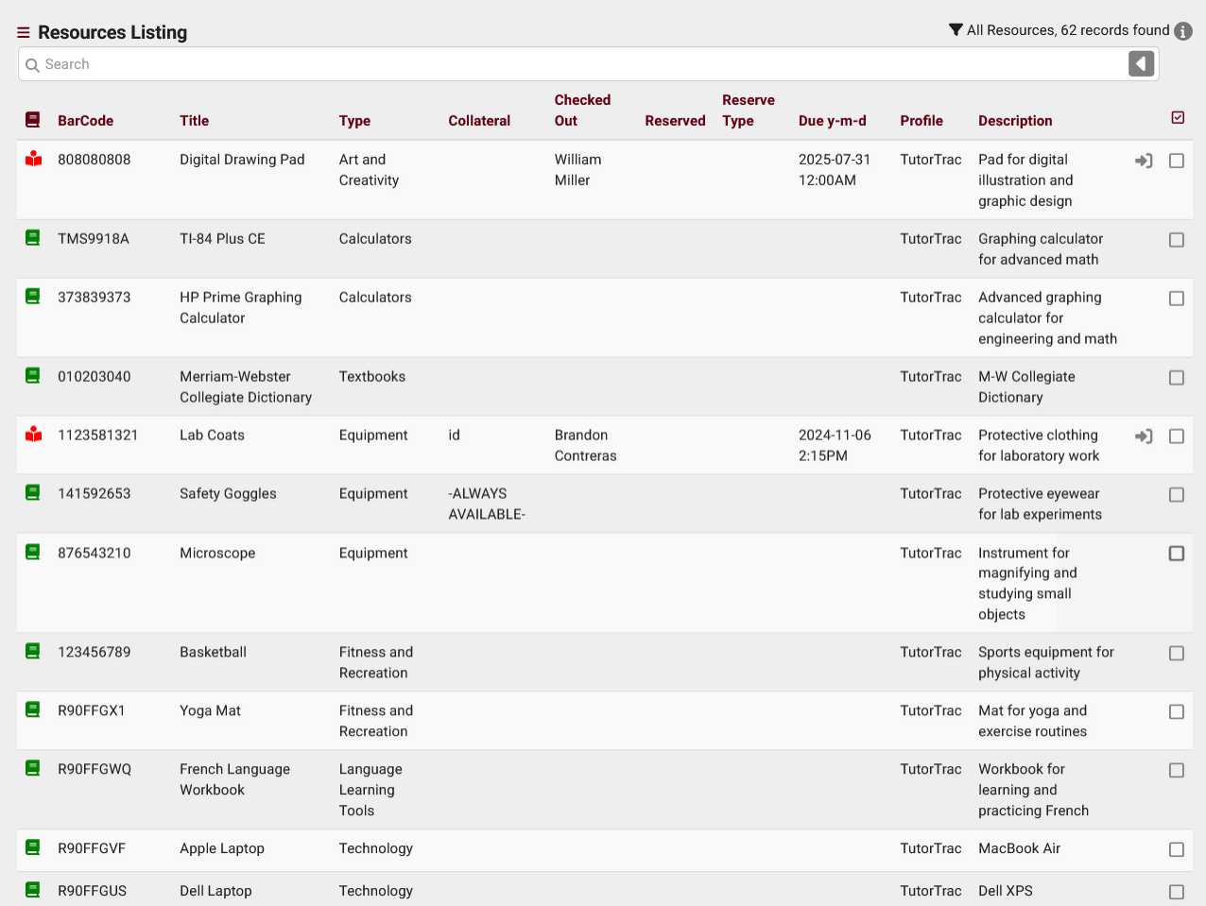
Retention: Resources
Notes:
Resources: TracCloud gives you the capability to track resources, such as graphing calculators, laptops, or CPR dummies.
Can be reserved ahead of time.
Also shows on student’s dashboard.

Slide 18
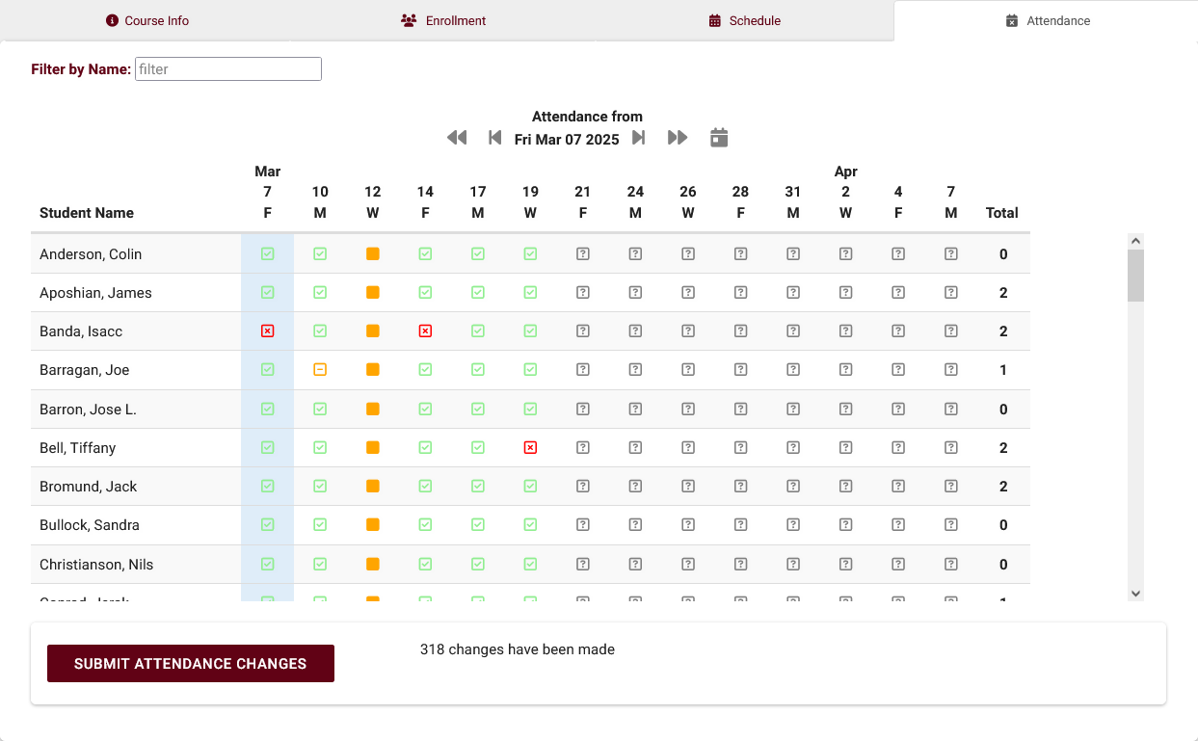
Retention: Attendance Tracking
Notes:
A new feature is our attendance tracking. Attendance and absences can be recorded by staff members or faculty. Institutions can use this data to predict patterns of behavior that lead to changes in retention rates.

Slide 19
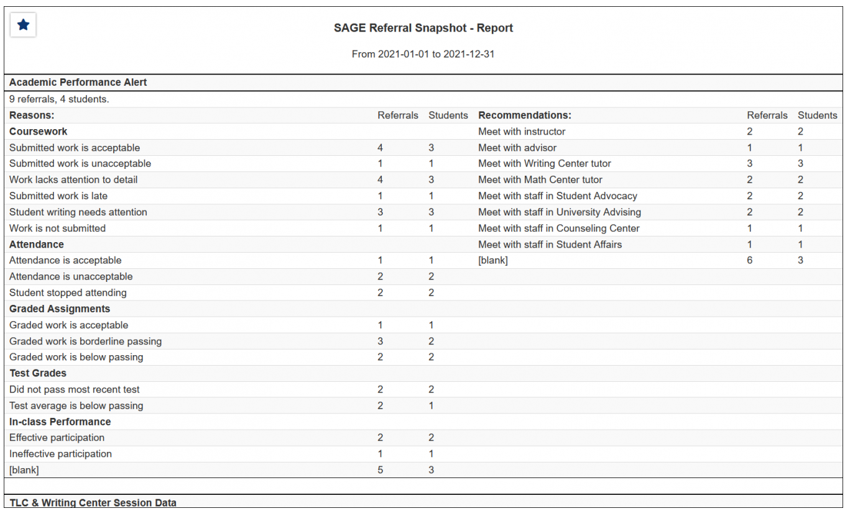
Retenti0n: SAGE (early alert referrals)
Faculty and Staff create referral reasons
Automatic actions taken
Track student behavior
Report
Notes:
SAGE (Student Alerts and Grouped Events) is our early alert/referral features. It allows your faculty members to submit referrals, progress reports, or evaluations for the students enrolled in their courses. Based on the choices made while creating the referral, an automated email could be sent out to the student's assigned advisor, a professor, or otherwise, that way you and your staff can be as proactive as possible in helping your students.
Like many features, SAGE can be as simple or robust as you’d like. You can have a single button where faculty hit referral, or have many different referral options and reasons that get sent to different people. :am
Iliana will be presenting SAGE on Friday at
ASK: For those using SAGE, what are some of your referral reasons?

Slide 20
Retention: Success Plans
Meet with Consultant
Complete Wellness Survey
Attend Study Session
Success Plan 1-Due 4/16 (Meet with Consultant, Complete Wellness Survey, Attend Study Session)
Success Plan 2-Due 5/16 (Meet with Sr. Advisor, Complete Graduation Form, Submit End-of-Year Survey)
Success Plan 3-Confirm Graduation Requirements
Work Plans: Success Plans for Staff
Notes:
SuccessPlans allows you to create a plan with a series of steps. These steps could be a visit to a center, meeting with a specific consultant, uploading a document, or spending X amount of time at a center. Once a student has a plan assigned, they can receive emails regarding the next steps. The student can see the due date and progress on their dashboard. Staff can see that information and run reports as well. Once a plan is complete, you also have the option of having a second plan in place and ready to go. Aidan will be presenting more on Success Plans tomorrow at 3:05pm.
Work Plans is similar to Success Plans, but for staff. Our customer, Latrice Bowman, will be showing how they use work plans in her session tomorrow at 2pm.

Slide 21
Retention: Tying it all together
Attendance:
Missed more than 3 classes in 2 weeks
SAGE:
TracFlow creates Referral created to meet with advisor
Success Plans:
Plan created to increase engagement
Notes:
Define TracFlow: TracFlows enable you to automate a wide range of actions within TracCloud, functioning as a programming language specifically designed for TracCloud. TracFlow automations can be used to dynamically configure TracCloud to execute a series of actions that replicate processes at your campus. These actions can be scheduled events or triggered by specific actions within the system. When activated, a TracFlow can perform various tasks, including sending emails, modifying records, and creating new referrals or surveys.
So, what can TracCloud do for you? It depends on how you use the tool.
Will you build a bookshelf or a house?

