Slide 1
Streamlining Success:
A Deep Dive into TracCloud List Management
Luis Frias Redrock Software Corp.

Slide 2
Today’s Topics
Static List
Dynamic List
List Options
Visit Listing
Staff Listing
Student Listing
Appointment Listing
Registration Listings

Slide 3
STATIC LISTS
Static Lists are manually created and manually managed lists. Students can be individually added to a Static List from their Student profile, or multiple students can be added in batches from the Student Listing. Students can be removed in batches from a Static List through the Student Listing as well.

Slide 4
Dynamic Lists
DYNAMIC LISTS
Dynamic Lists within TracCloud are automatically adjusted according to specified criteria set during their creation. These lists cannot be manually altered or managed. When utilized effectively, Dynamic Lists become a powerful tool in TracCloud, enabling the automation of various processes within your Trac System.

Slide 5
Key Features:
Display of all student records uploaded to your Trac System.
Ability to manage student data in bulk.
Actions include creating lists, sending emails, and submitting SAGE referrals.
Individual student profiles can be accessed for detailed management.
Student Listing
Search Bar:
Quick search functionality for finding specific students.
Right-click in the search bar to access a list of available student fields.
Example Searches:
Search by ID: Students.ID=1931
Search by name: Day, Rob
Multiple field search: Students.Major=Mathematics Students.Class=Sophomore
Custom field search: #sql:InState#=Yes
Date search: Students.BirthDate=1993-07-16

Slide 6
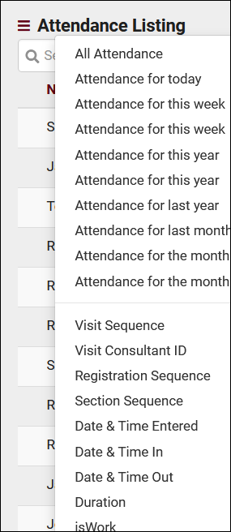
Visit Listing
Overview:
The Attendance Listing in your Trac System tracks every visit made by students or staff to your center.
A visit is distinct from an appointment, representing the actual presence of the student or staff member at a specific time and for a particular reason.
- Include an illustration or screenshot of the Attendance Listing interface.
Located under the Attendance tab > Attendance Listing.
Provides a comprehensive view of all visits, where they can be viewed, created, or edited.
Search Functionality:
Use the Search Bar for quick searches of specific visits.
Right-click in the search bar to access a list of available visit fields.
- Image illustrating the search bar.
Example Searches:
Find a visit by Student ID:
Students.ID=1931
Search by Center Name:
Learning Center
Multiple field search:
Students.ID=1931 Centers.Name=Writing
Search in Custom Fields:
#sql:Student_Remarks#=Great
Date searches (formatted as YYYY-MM-DD):
Visits.TimeIn=2022-03-15
Date ranges:
2022-06-01...2022-07-01
Exact time:
Visits.TimeIn="2022-03-15 15:30:00"
True or False value search:
Visits.IsWork=1
Find visits that conflict with a student's section schedule:
Visits.CustomData/isLoggedDuringClass=1

Slide 7
TracCloud Reporting With Lists
TracCloud offers three distinct options for generating reports on lists, providing flexibility and efficiency in data retrieval:
Utilize Current list of Student Records : Retrieve information based on a pre-existing list of student records.
Utilize Current list of Visit Records: Access data from a previously created list of visit records.
Select a Custom Saved List: Choose a personalized list that you have created and saved within the system.
These options prove particularly useful when seeking visit and/or student data specific to a particular list of students.

Slide 8
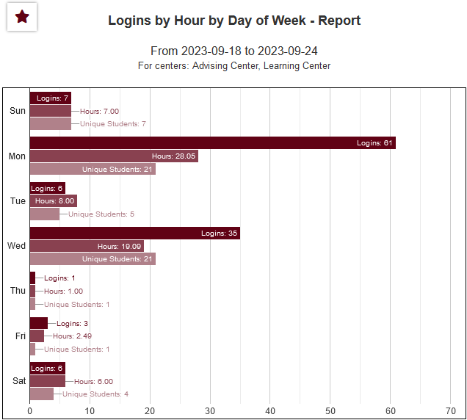
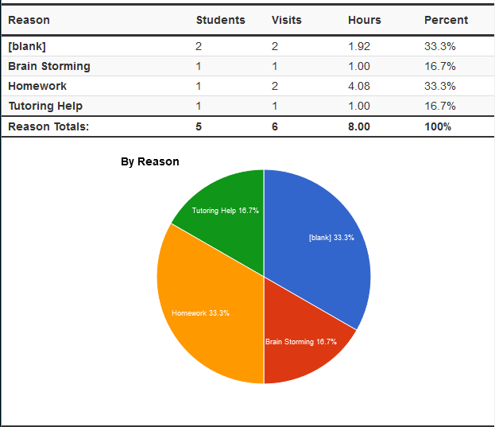
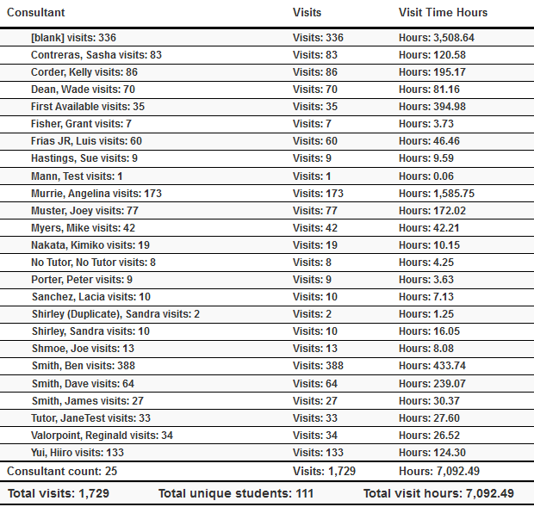
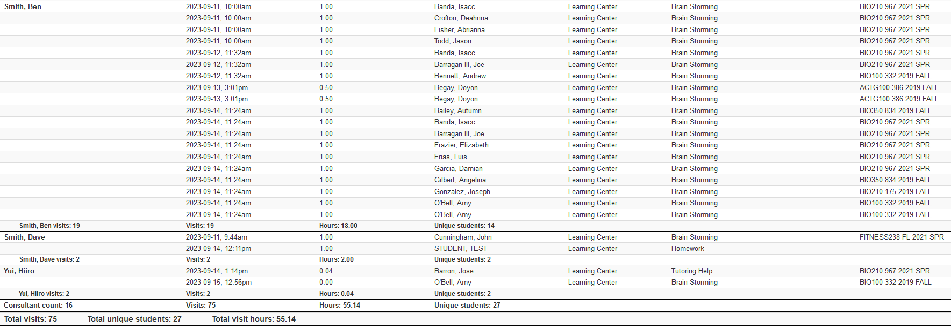

Slide 9
Contact Information
Phone: 480-752-8533 ext. 201
Email: Helpdesk@go-redrock.com
Email: Sales@go-redrock.com
HelpDesk: Helpdesk@go-redrock.com
Redrock Wiki: Wiki.go-redrock.com

