Slide 1


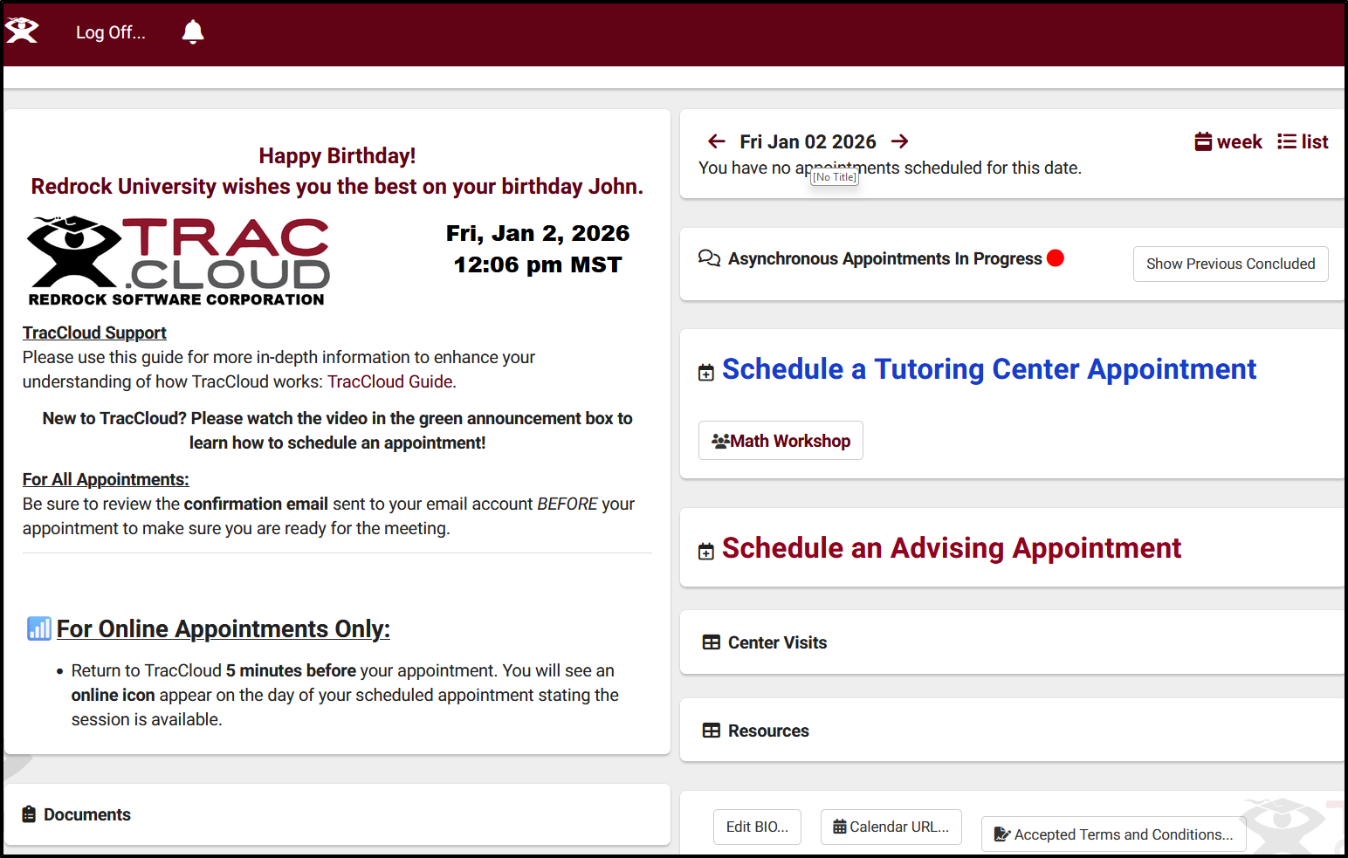
Through the Student Lens
Navigating TracCloud
Erick Martinez
2026 Virtual TracCloud Conference

Slide 2

New Features
Assessments
Peer Mentor feature
Custom Forms
Automatically block student class schedule during Availability Search
Prevent Visit Sign in During Class Time
Student Time Check will now show total number of visits
2026 Virtual TracCloud Conference

Slide 3
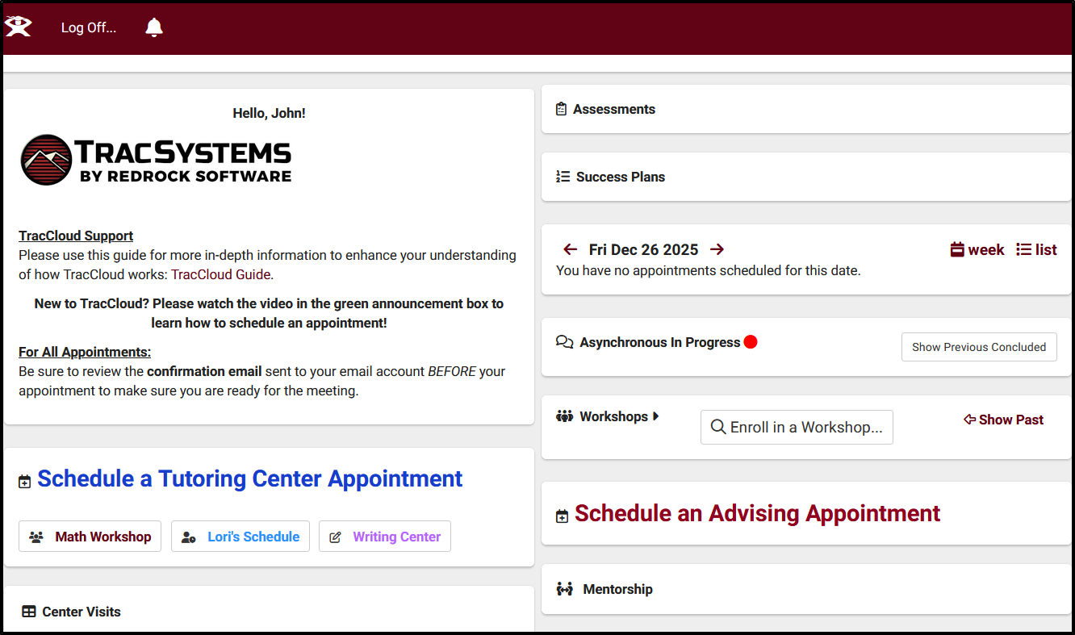
Student Dashboard
Confirm Bio
Announcements
Welcome Message
Upcoming Appointments
Asynchronous Communications
Availability Search Widgets
Workshops
Past Visits
And More…
2026 Virtual TracCloud Conference

Slide 4
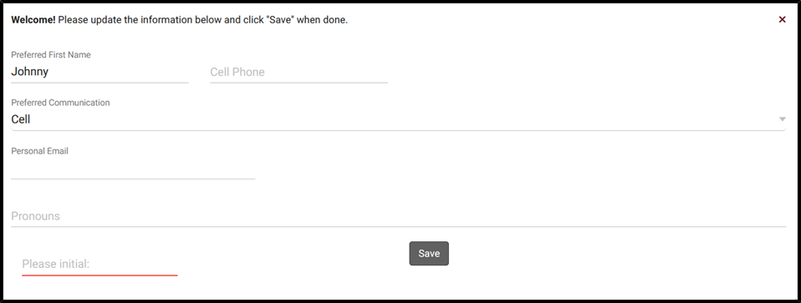
Student Confirm Bio
Allows students to manage their own information, what they’re allowed to view and edit is at your discretion.
Helps ensure that Student records contain the most current information, even if the information doesn’t match the data in your import file.
Students have the option to edit their bio at their convenience using a widget on their dashboard
2026 Virtual TracCloud Conference

Slide 5
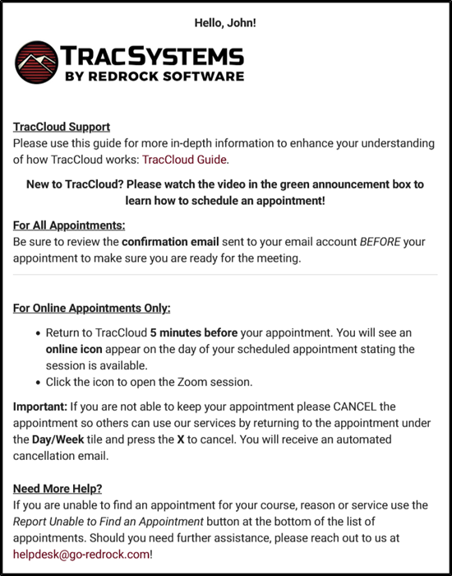
Welcome Message
Provide students with a customized message on their TracCloud Dashboard
Twig & HTML supported messages
Allows you to embed images, vides, or redirect students to another web page.
2026 Virtual TracCloud Conference

Slide 6
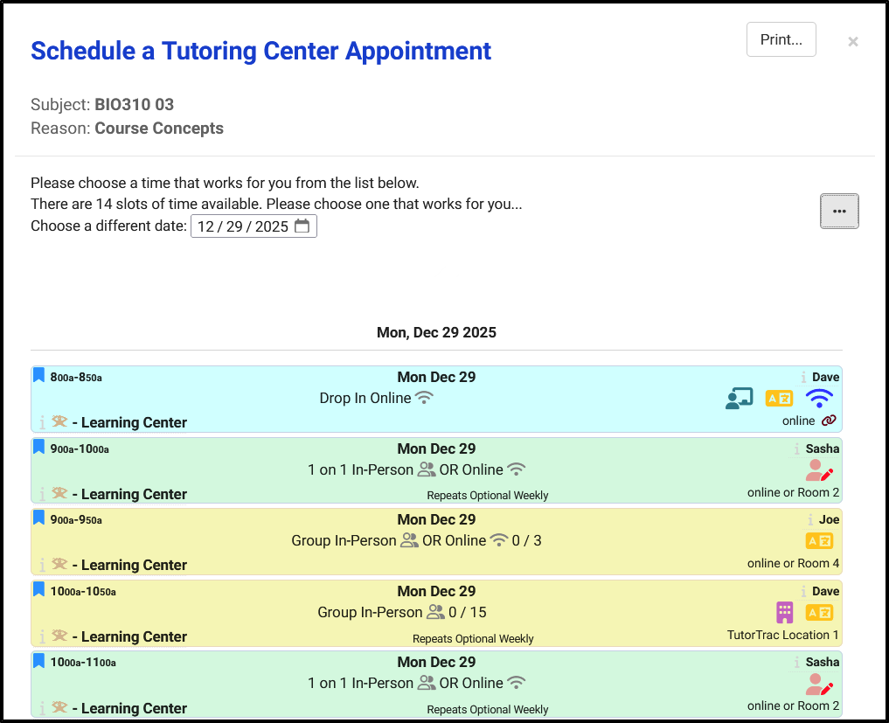
Availability Search
Search Availability Widget & Search Appointment Link
What information is provided to students when they search for an availability?
Search Availability Badges
Appointment details are provided on the Appointment Display widget on the Student Dashboard
2026 Virtual TracCloud Conference

Slide 7
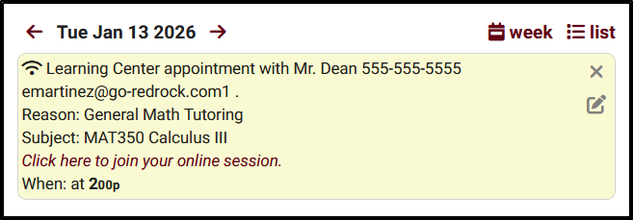
Appointment Display
Students can view upcoming appointments from their TracCloud dashboard.
Customize the format and content of the appointments and their details
2026 Virtual TracCloud Conference

Slide 8
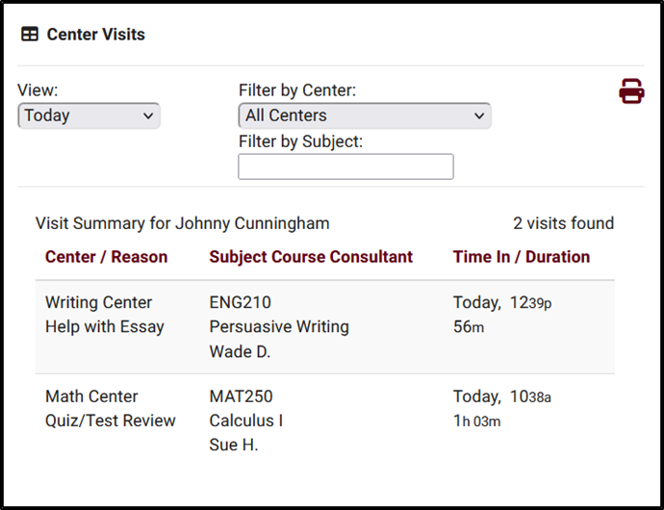
Center Visits
Provide Students with details regarding previous Visits directly on their dashboard
Filtering options provided to find Visits based on selected criteria
Provides the option for students to print out their Visit Summary
2026 Virtual TracCloud Conference

Slide 9
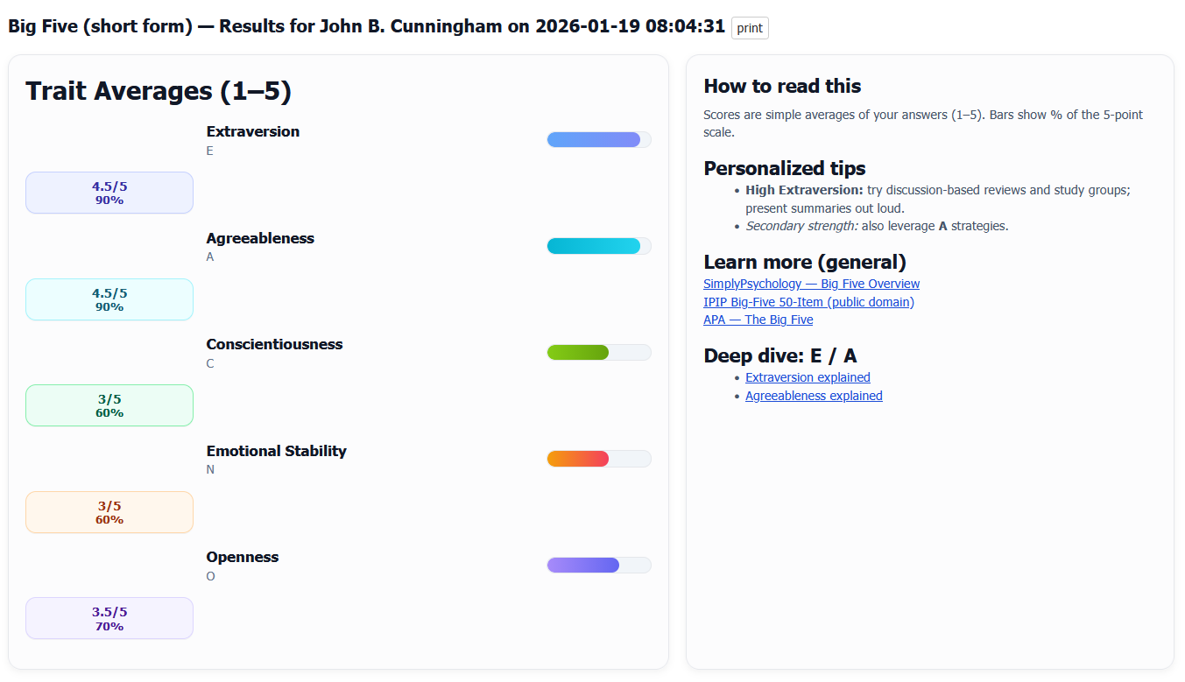
Assessments
Create customizable questionaries for a variety of purposes.
Provide personalized feedback and targeted support in areas where students may need improvement.
Self-assessments can be generated from the TracCloud Dashboard or by using a link/QR code
View past assessment results from the dashboard widget provided
2026 Virtual TracCloud Conference

Slide 10
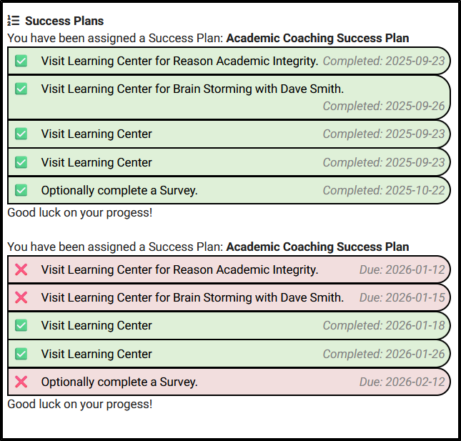
Success Plans
Students who are assigned a Success Plan can be shown details on their dashboard
Information and formatting can be customized using Twig and HTML
Success Plan Emails can be sent for Plan assignment, completion of a Plan, and to provide reminders for individual steps and upcoming due dates.
2026 Virtual TracCloud Conference

Slide 11
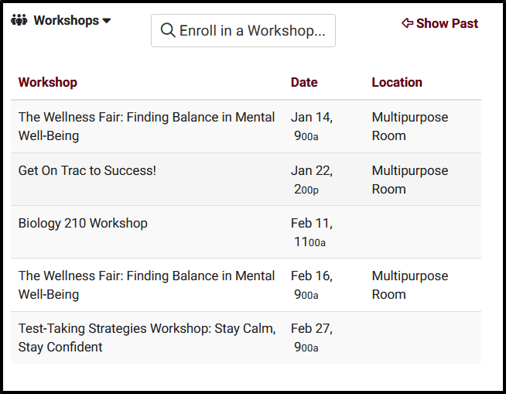
Workshops
Allow students to search for and enroll themselves in workshops
Using the Workshop Labels students can quickly find workshops available to them.
Workshop Widget will display the students enrolled workshops
2026 Virtual TracCloud Conference

Slide 12
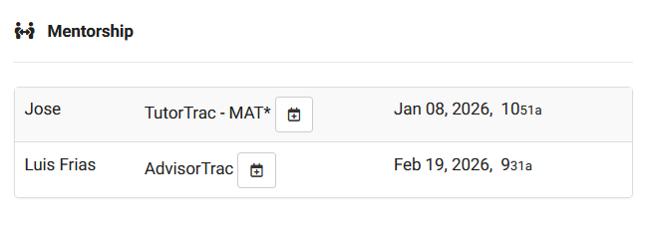
Mentorship
Link Mentors to mentees (students)
Mentorship widget on the dashboard allows both parties to communicate and share documents between each other
SMS and email notifications can be sent to both parties if configured in Profile preferences.
2026 Virtual TracCloud Conference

Slide 13
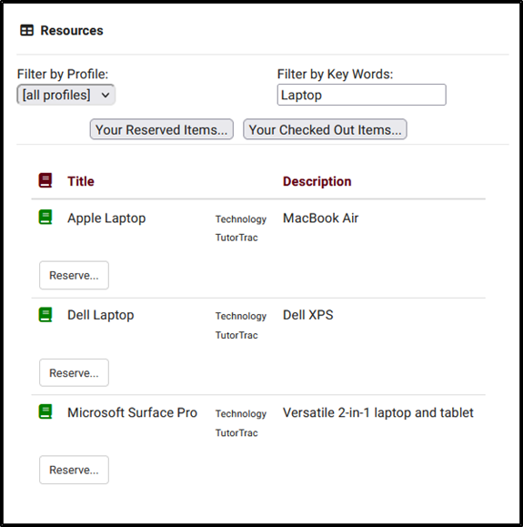
Resources
Allow students to reserve resources from their Student dashboard
Students can review Resources they have reserved and the Resources they have checked out from their Dashboard.
Configure the limit for reservations
Block Students assigned to a List from being able to reserve items
2026 Virtual TracCloud Conference

Slide 14
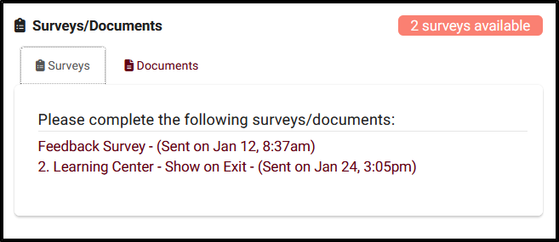
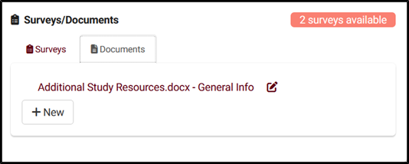
Surveys
Surveys/Documents
Documents
Students can access pending surveys from their TracCloud dashboard
Allow Students to view and upload documents from their Dashboard
Student must have access to viewing documents
2026 Virtual TracCloud Conference

Slide 15


Related Sessions
Personalizing Cloud
Communicating with Users
2026 Virtual TracCloud Conference

