Slide 1
Decoding TracCloud: A Guide to System Terminology.
I need to add new reasons for attending.
Can I add a center into your program?
I think you need a profile instead.
I can’t find my appointment on the schedule.
Do I record
visits or the appointment?
By Sasha Contreras

Slide 2
TracCloud Terminology
Terminology is important in any professional setting.
Using the correct vocabulary can assist with the following:
Provides a deeper understanding of how the TracCloud system works.
Aids Redrock support in getting the quickest response and resolution.
Assists in seamless communication between staff, students, and users when using TracCloud.

Slide 3
Where to Start?
License is used for a production or test system. The purchase of a license comes with a custom URL configuration and one profile.
Profiles are an additional layer of configuration where scheduling rules, reasons, and kiosks can be managed. Profiles set the foundation on what is allowed for rules in the centers. A license can have multiple profiles, each with their own configurations.
Centers represent location – physical or virtual. Centers are used to document visit and appointment data. Centers are connected to profile.
License
Profile
(AdvisorTrac)
Profile
(TutorTrac)
Center
Center
Center
Center

Slide 4
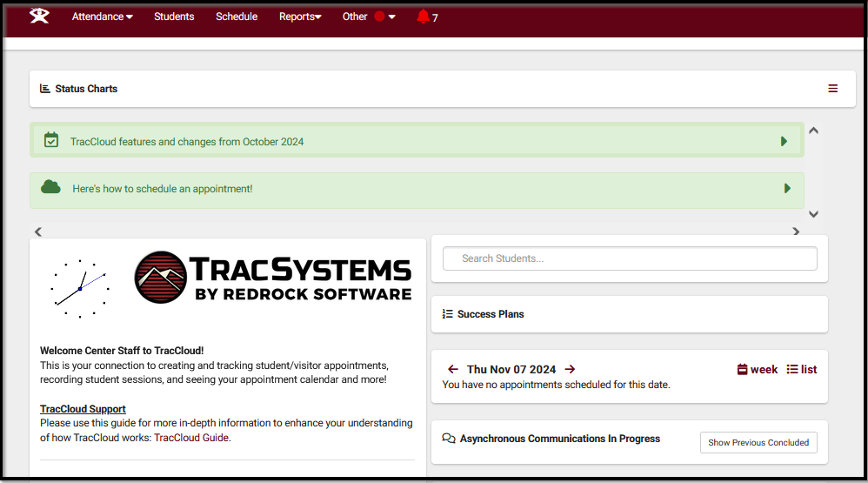
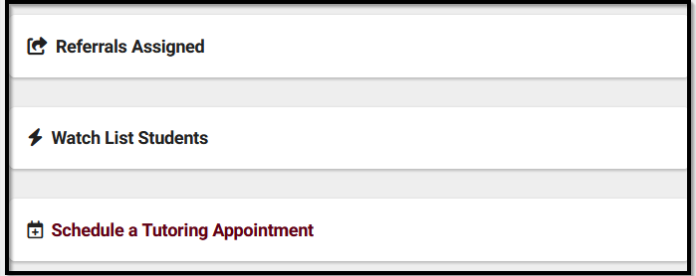
Navigating The TracSystem
Dashboard
Widget
Hamburger Icon
Accessible, Quick Link features located on Dashboard.
This drop down contains all listing options.
Homepage for system.
Listing
Navigation Search
List of related records.
Used to search in every listing. Right clicking provides additional options for search filters.

Slide 5
Account Types
Staff have access to visit and appointment data. The limit on which centers a staff account can view this data is configured in their group settings.
Profile Admins are users with extra access to the system than a staff account. They have additional permissions to adjust profile and group settings. These settings also include adjusting centers, email templates, and reasons.
A SysAdmin is a user with full access to the system. This includes all user data, profiles and global settings. The number of users in this group is usually limited based on the “super user” access.

Slide 6
Account Types
(continued)
Students are the clients searching for availabilities and booking appointments.
Faculty are the instructors of the courses that are linked to student registrations/enrollments.
Staff Consultants would have access to create their own availability slots/visits. Examples of users that would need staff consultant accounts would be working directly with the student population such as tutors, consultants, advisors, coaches, etc.

Slide 7
Groups
Groups are used to define what data each user has permissions to access in the system, or limit the amount of information that is seen.
Staff groups are created throughout set-up training. The number of groups created in your system is based on each institution and their specific needs.
Groups determine right of entry to center access, student data access, schedule access, reports, etc…

Slide 8
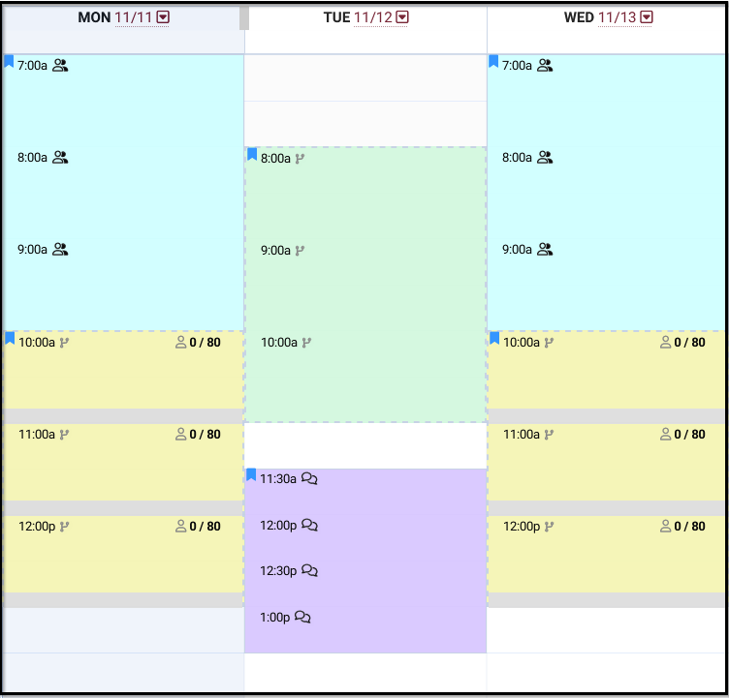
Availability
Time slots that designates a consultant is available for their service.
4 types of availability:
On-on-one, Group, Drop-In, and Asynchronous.
All availabilities can be seen by Students, Staff, and Faculty.

Slide 9
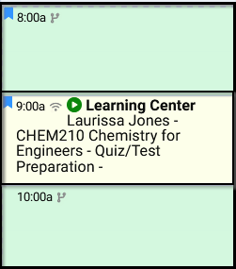
Appointments
Appointments are reserved times for a student(s) that has been booked. This record holds details of appointment time, modality, subject, consultant, and reason data.
Note: Appointments are NOT visits.

Slide 10
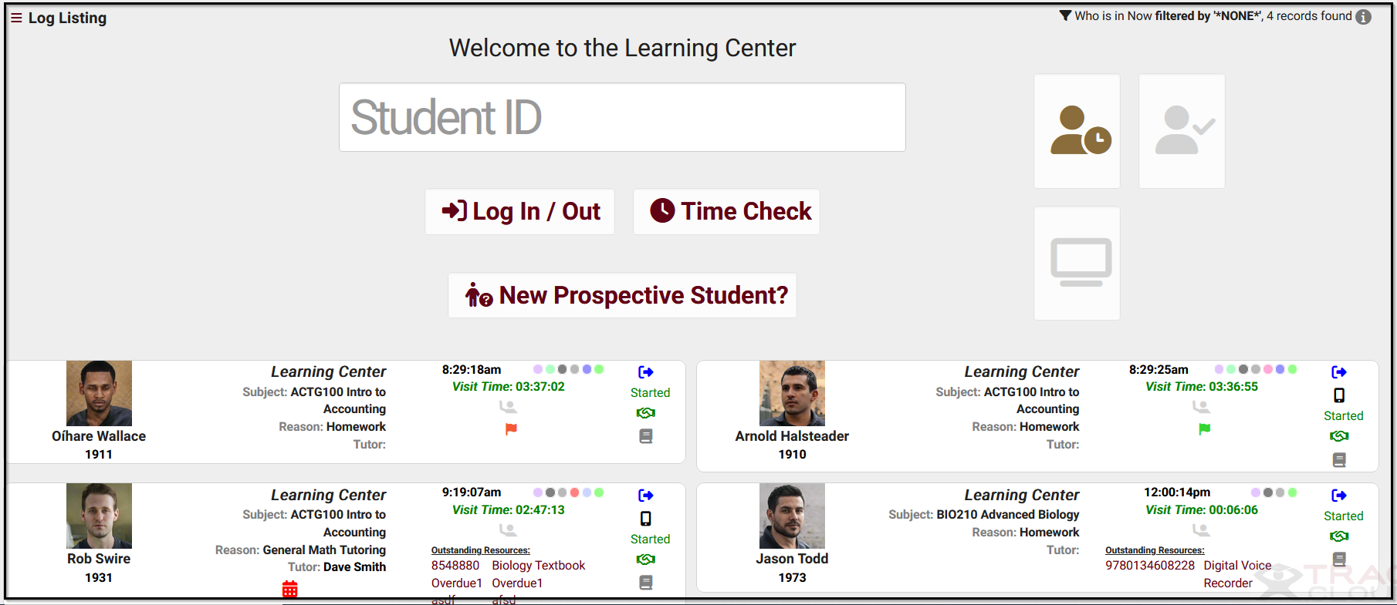
Visits
A visit identifies the actual interaction time between the student(s) and consultant.
Visits are recorded from drop-in sessions, independent study, and attending an appointment. It keeps documentation of the individuals going in and out of the physical or virtual center.
Log Listing
KIOSK
Visit records hold details of date, time, modality, location, subject, reason, notes, etc…

Slide 11
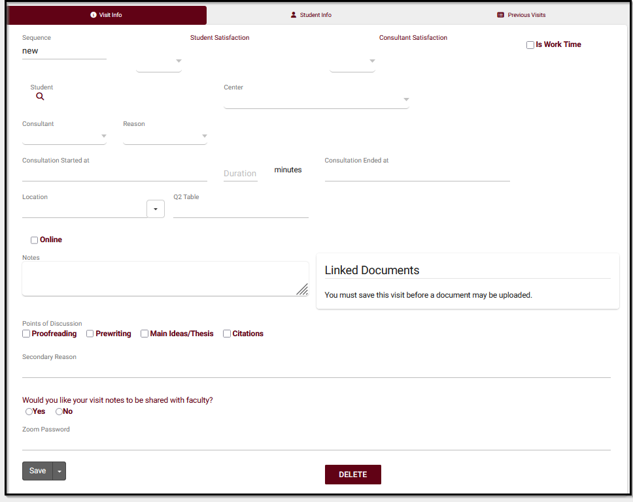
Quick Visits
Quick Visits allows a user to manually enter a visit. This is used if we want to get a visit into the system for reporting purposes. These examples would include an undocumented visit, a phone call session, or email communication.
This form can record data that a normal visit record would capture – including log out questions , custom fields, and more.

Slide 12
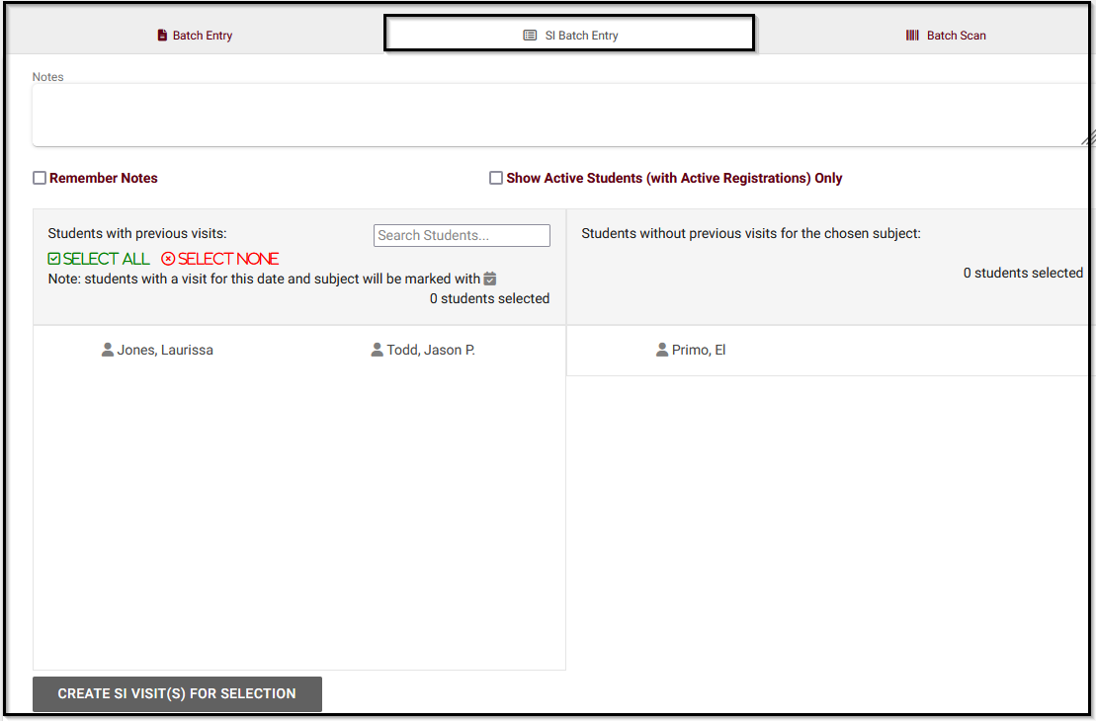
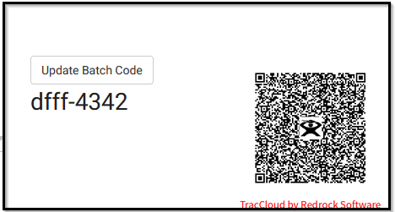
Batch Visits
Batch Visits allows the user to capture visit records for multiple students at one time. Details such as consultant, date, time, subject, and reason would remain the same for all records recorded.
Effortlessly record attendance for large numbers during SI Sessions or Workshops in addition to any class sessions that would take place outside of the classroom or center.
Generate a special QR code to have students or staff record attendance with their smart device!

Slide 13
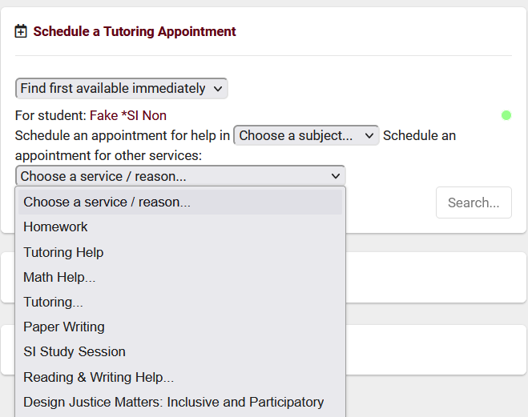
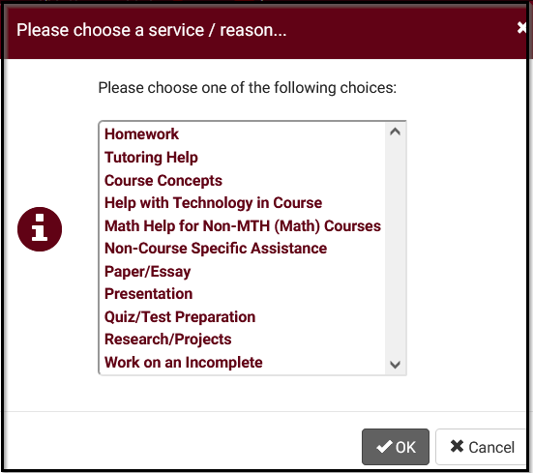
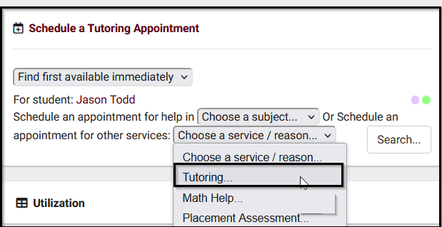
Reasons
Reasons are used to filter out report information. Students can use reason to filter services they are looking for assistance with when booking appointments.
Reasons can be grouped into categories to further streamline reasons students are booking a session. At the same time, it will allow a subcategory of reasons to appear for more detailed reports.

Slide 14
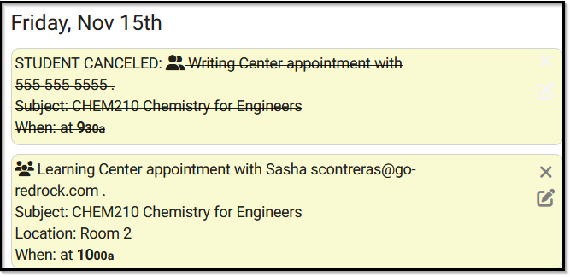
Appointment Display
The appointment display widget will display for both students and staff when they log into their dashboard.
This shows future appointments, and will also display the information of canceled appointments.
The details that are displayed are based on the HTML and TWIG coding that is constructed in your profile preferences.
Online appointments will allow students to join the virtual session from their dashboard based on the profile preferences threshold for entry into online appointment session.

Slide 15
Lists
Static List
Dynamic List
Lists of students that are manually created using a value field. An example would be to search for students based on ID number or email address.
Lists of students that are automatically added or removed from a list based off a student search. An example would be students in a specific sport or an assigned advisor.
Watch List
A color identifier that is added to an existing list. This color dot can display in multiple areas of the system such as student listing, login for a visit, scheduling an appointment, displaying in dashboard listing and more.

Slide 16
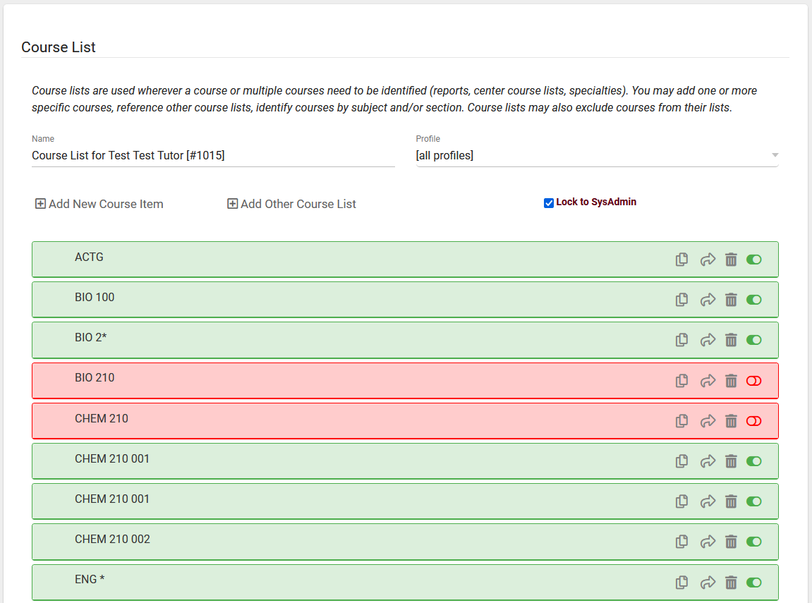
Course Lists
Course Lists are used to identify the subjects offered by a consultant, center, and even availability.
It also specifies the subjects for which a consultant or center does not provide services.
Wildcards (*) are used to define the rest of a statement.
For example, ENG* means that all ENGLISH courses are offered by this course list.

Slide 17
Registrations
Registrations are the official records for student enrollment. These records can be marked Active or Inactive by your institution, depending on the students current/past enrollment.

Slide 18
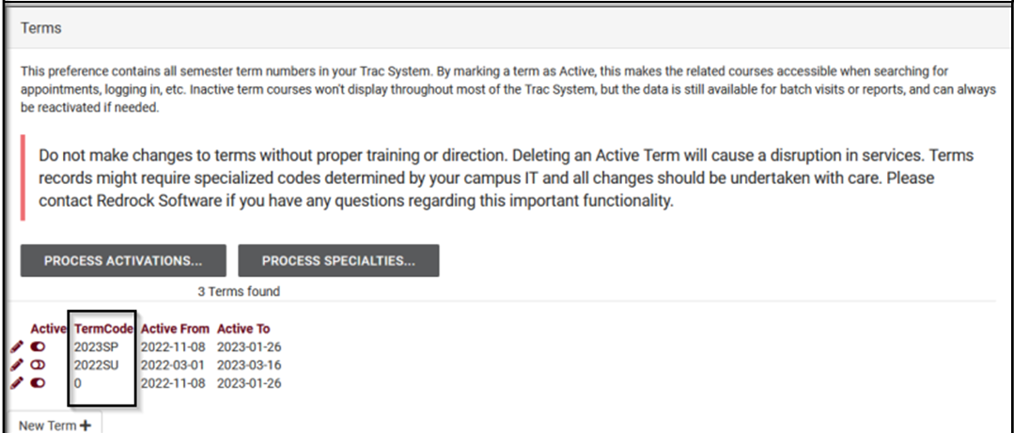
Terms
Terms represent semesters or lengths of time in the system. All active and inactive terms will be here.
Terms are used to determine how long sections and registrations should be active for.

Slide 19
Modules
SurveyTrac
SAGE Early Alert
Success Plans
Text Alerts
Q2 Tables
Starfish Export
Whiteboard
“Modules” provide additional functionality to your system.
These modules are added to your TracCloud system at a additional cost.
Please reach out to sales for pricing information (laura@go-redrock.com)

