Slide 1
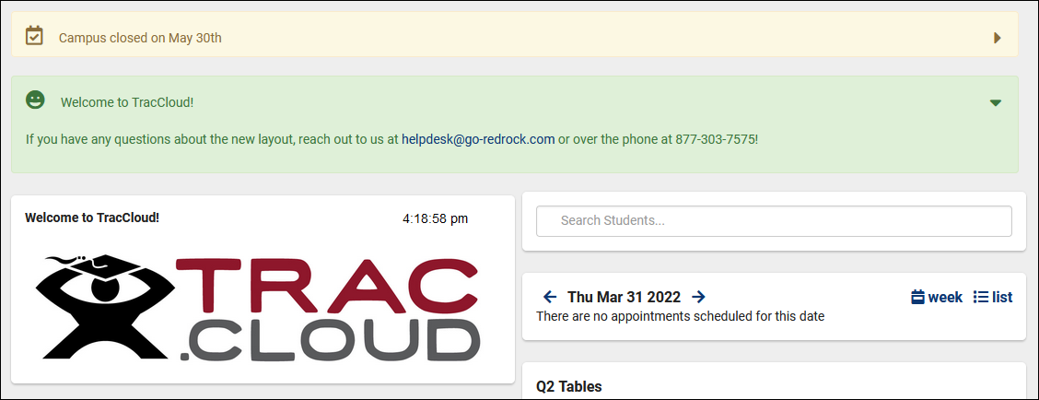
Personalizing traccloud
Customizing your theme, messages, and more with twig and html
Aidan Murray

Slide 2
How you can personalize traccloud
Logo and System Theme
Welcome Message & Announcements
Center Descriptions
Introducing Twig
Kiosk Messages
Emails
Appointment Display
And more…

Slide 3
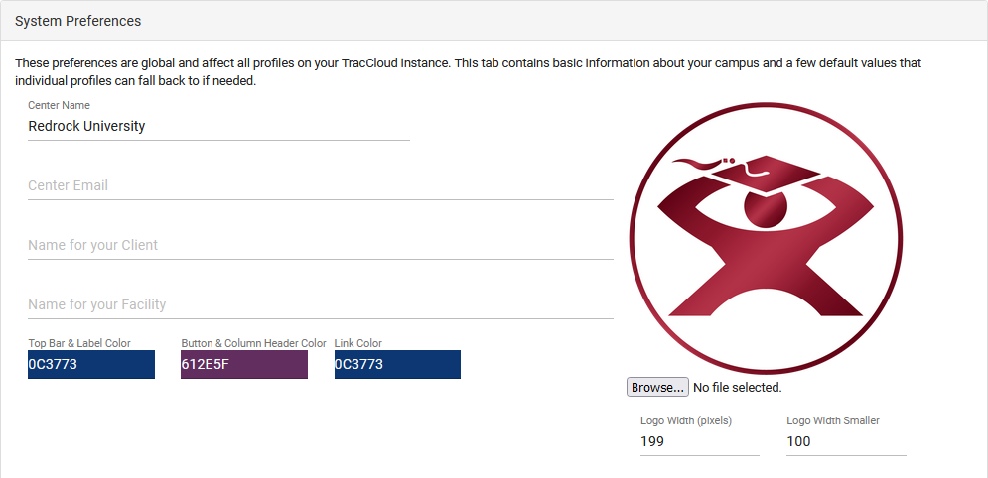
Logo and theme
Changing the logo and color scheme of your Trac System allows you to more closely relate the platform to your campus website.

Slide 4
Messages and announcements
Welcome messages and announcements can be used to convey information to your students and staff, both support HTML and Twig.
Welcome Messages are typically static, or updated once per semester. These messages can be unique for Students, Staff, and Faculty, and are displayed on the dashboard.
Announcements are typically dynamic, allowing you to configure messages that display for a certain amount of time, then expire at a set date. These messages can be unique for Students, Staff, Consultants, and Faculty.

Slide 5
Center descriptions
Center descriptions can be used to provide information about your centers to students while booking appointments, allowing them to quickly view the location, hours, and general information about the chosen center.
Center Descriptions can be created on a per-center basis, allowing you to create custom descriptions for each of your centers.
A Profile Center Description can also be created, acting as a default for all centers that don’t already have a custom description entered.

Slide 6
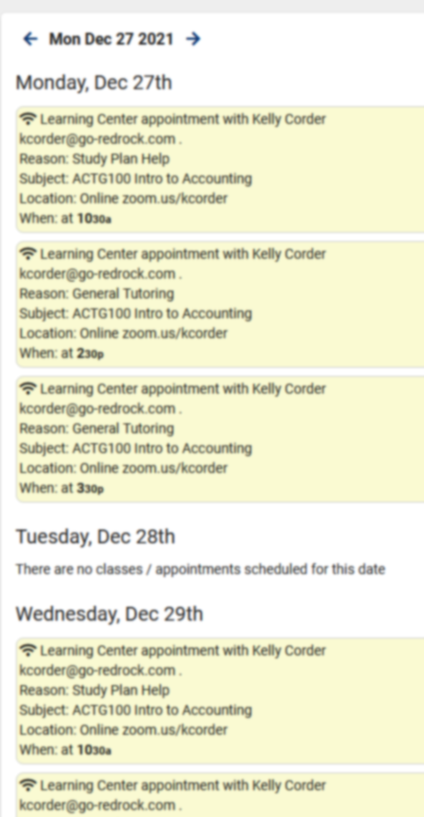
Appointment display
Change the look of upcoming appointments for both students and staff.
Utilize Twig and HTML to change the look and contents of the field.
Ensure that only the necessary information is visible to students and staff.
Further personalize your Trac System to make upcoming appointments streamlined for your use-case.

Slide 7
Kiosk and log listing messages
These messages are displayed to staff and students logging in for their visits.
Supports HTML and Twig
Messages can appear before or during login, providing several locations to welcome or inform students.

Slide 8
typical html usage in traccloud
What you enter
How it displays
<b>Hello!</b>
<i>Here’s a link:</i>
<a href=“https://www.go-redrock.com”>Clickable link</a>
<img src=“https://www.go-redrock.com/wp-content/uploads/2021/07/TutorTrac_icon_burgundy_gradient-01.png”>
Hello!
Here’s a link:
Clickable link

Slide 9
typical twig usage in traccloud
What you enter
How it displays
Hi {{Student.First_Name}}!
{% if Appointment.Online = “Online” %} This appointment is online! {% else %} This appointment is in-person! {% endif %}
Hi Alex!
This appointment is online!
A list of tags and more can be found on our wiki.
wiki.go-redrock.com/index.php/TracCloudGuideProfilePrefsTwig

