Slide 1
Asynchronous & Group Availabilities
Erick Martinez

Slide 2
What’s New
Prevent Students from re-opening concluded asynchronous appointments
Automated message sent at the start time of the asynchronous appointment
Choose your preferred phrasing for asynchronous appointments to display on the student and staff dashboard.

Slide 3
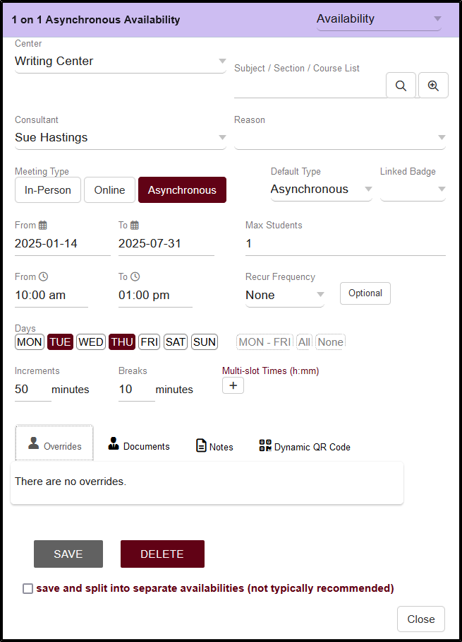
Asynchronous Availabilities
What are Asynchronous Availabilities
Asynchronous Meeting Type must be activated in the Profile Preferences
Creating Asynchronous Availabilities

Slide 4
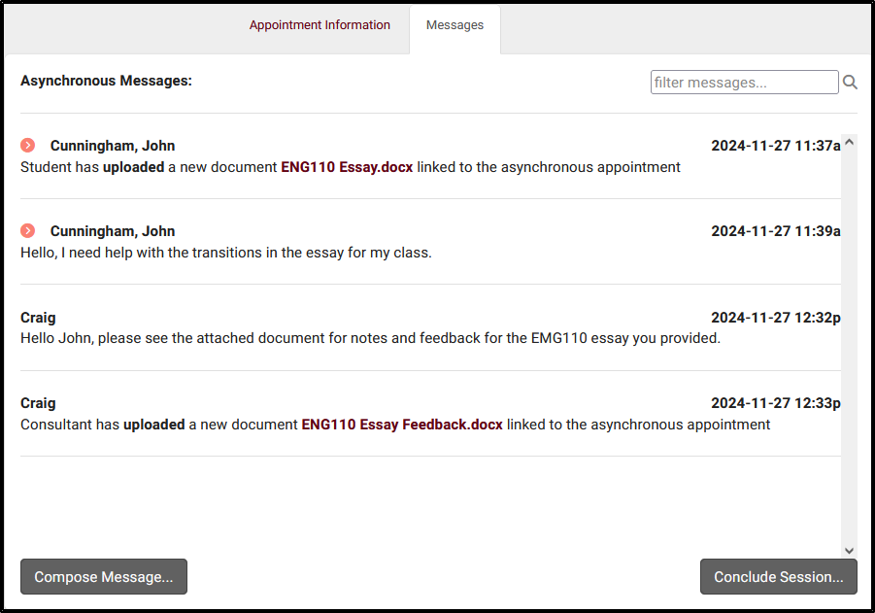
Asynchronous communications
Where to access and manage Asynchronous Appointments
Appointment Information and Messages
Student or Consultant can conclude the session at any time
Prevent Students from re-opening a concluded Asynchronous appointment
Students are provided the option of canceling a future Asynchronous Appointment

Slide 5
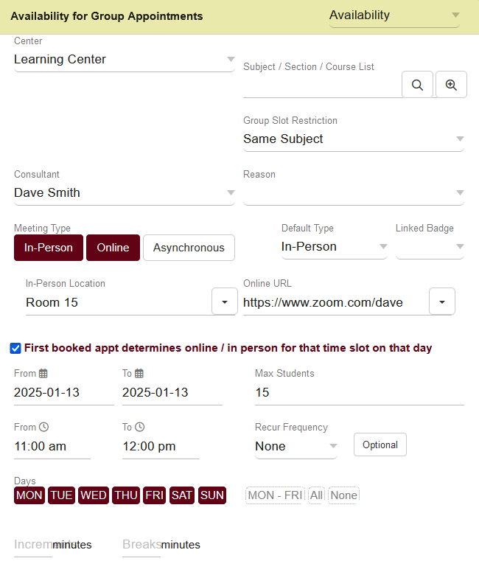
Group Availabilities
Group Slot Restriction determines what subject students can book for compared to the first student’s selection.
Group availabilities offering both in-person and online meeting types, can allow the first student who books the appointment to choose the session’s modality for everyone else.

Slide 6
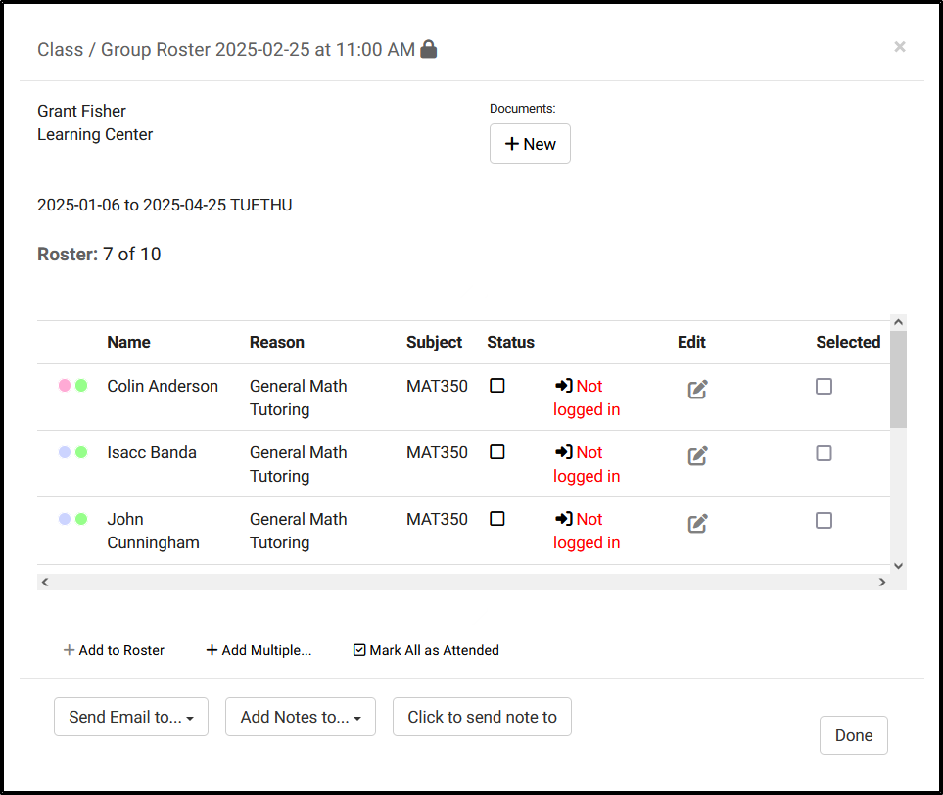
Group Roster
Reserved for Group Availabilities only
Manage Group Appointments before and after the session
Lock Group Roster to reserve slots or limit appointments for focused attention.
Add notes to the Visit Records for Students who attended the appointment

Slide 7
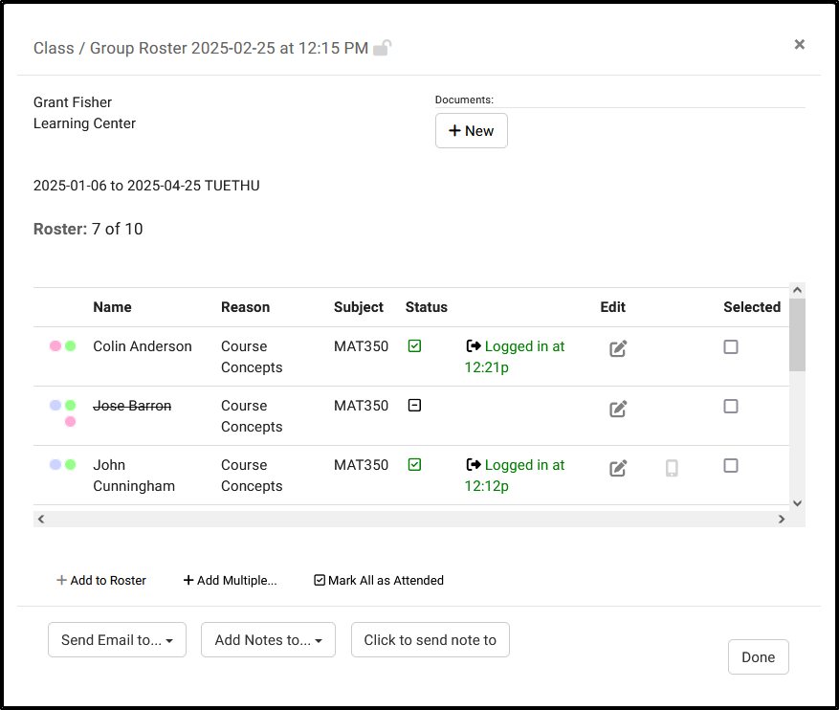
Group Appointment Management
Schedule Appointments directly from the Group Roster
Log students in/out for there Visit from the Staff Schedule
Email students directly from the Group Roster. Emails can be sent to all students, based on appointment status, or to selected students.

Slide 8
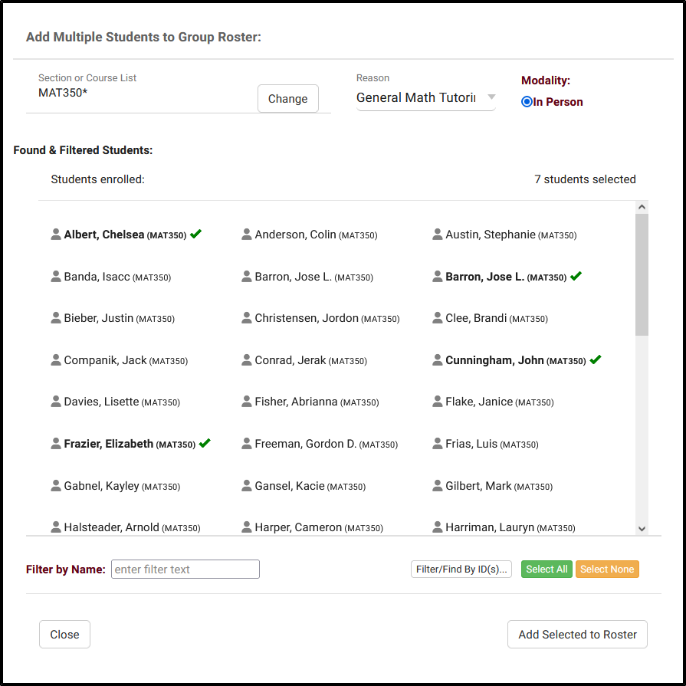
Group Roster “Add Multiple”
Add students to the Group Availability as a batch process
Search for Students Enrolled in specific courses.
Filter/Find Students based on the chosen ID field.

Slide 9
TracCloud Modules
SurveyTrac
TextAlerts
Provides the option to send a Survey/Quiz to student directly from the Group Roster
Based on SurveyTrac and Scheduling Access in Group Permissions.
Adds option to send SMS to students from the Group Roster.
Students must opt in to receive SMS Alerts, and have a cell phone number listed on their Student record.

