Slide 1
Communicating with users by email or text
Confirmations, cancellations, notifications and more over email and text

Slide 2
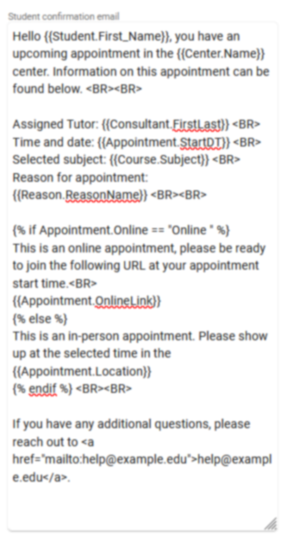
emails
Customizing your automated traccloud emails with twig and html
Add Twig Tags to dynamically pull information into your email templates.
Use Twig to add logic to your emails, making even entire paragraphs change based on appointment/visit context.
Use HTML to stylize the content of emails, changing font sizes, embedding images, and more.

Slide 3
Profile Email types
Confirmation – Typically sent the moment an appointment is booked.
Reminder – Typically sent the day before/morning of an appointment.
Cancellation – Instantly sent when an appointment is cancelled.
Missed Appointment – Sent when an appointment is set as Missed or automatically overnight.
Visit and Visit Duration – Optional additional emails tied to visits.
Send Visit Notes – A staff-initiated email that can be sent to any user.
Resource Checkout – Emails sent to confirm a resource checkout or notify when overdue.

Slide 4
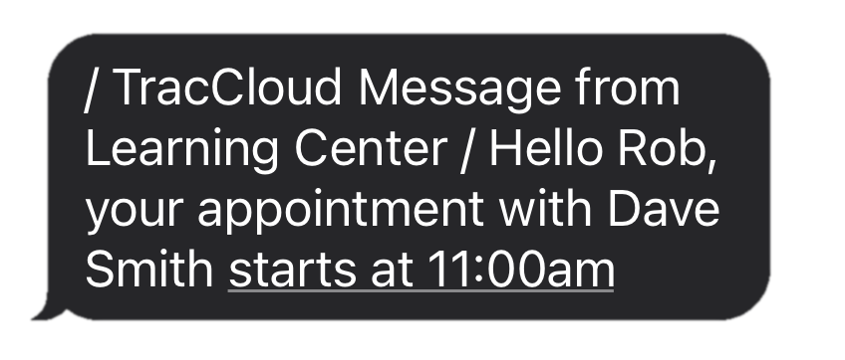
Textalerts allows you to:
Send appointment confirmations, cancellations, and reminders via text.
Send a text to students currently visiting your center.
Students can opt themselves in/out of TextAlerts via Confirm Bio.
Students can sign themselves up for drop-in availability reminders.

Slide 5
typical html usage in traccloud
What you enter
How it displays
<b>Hello!</b>
<i>Here’s a link:</i>
<a href=“https://www.go-redrock.com”>Clickable link</a>
<img src=“https://www.go-redrock.com/wp-content/uploads/2021/07/TutorTrac_icon_burgundy_gradient-01.png”>
Hello!
Here’s a link:
Clickable link

Slide 6
typical twig usage in traccloud
What you enter
How it displays
Hi {{Student.First_Name}}!
{% if Appointment.Online = “Online” %} This appointment is online! {% else %} This appointment is in-person! {% endif %}
Hi Alex!
This appointment is online!
A list of tags and more can be found on our wiki.
wiki.go-redrock.com/index.php/TracCloudGuideProfilePrefsTwig

Slide 7
Other trac system emails
Email Templates – Save pre-written emails that you can send later, including file attachments.
Document Emails – Emails can be automatically sent to students and/or consultants when a document is uploaded to an appointment.
Notifications – Allow your staff to send a notification to a student, which can be in the format of an email or a pop-up on the student’s dashboard.
Faculty Emails from Student Listing – Search for students, and send an email to faculty of their registrations.

Slide 8
Use lists to send emails to students
1. Search for your students – Search by student fields, or by related records like registrations, visits, and more.
2. Add your students to a list – Either a Static List where students are added/removed manually, or a Dynamic List, which TracCloud keeps up to date automatically based on your last search.
3. Send an email to your list – Open your new list from the student listing, and send a batch email from the hamburger menu.

Slide 9
textalerts discount
We like to reward our conference attendees! For those that attend the 2023 conference, we are offering a $600 discount on our new Student Success Module and 10% off all other modules and/or profiles for TracCloud if a quote is requested at the conference and purchase is made by 4/30/2023.
Please see Laura or email her at laura@go-redrock.com to request a quote!

