Slide 1



WORKSHOPS
MADE SIMPLE
Enrollment, Attendance, and Insights
Iliana Visser
2026 Virtual TracCloud Conference

Slide 2
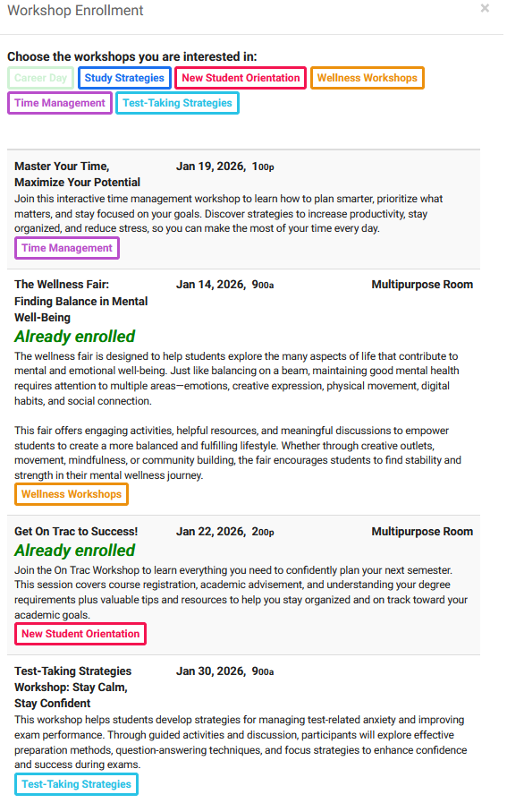
c
INTRODUCTION
The Workshops module in TracCloud helps campuses deliver smarter, more engaging workshop experiences that support student success. Designed to go beyond traditional batch visits, the module allows administrators to track enrollment and attendance separately, providing clearer insight into student participation. With features like enrollment limits, attendance marking, automated visit creation, credit assignment, and QR code self-enrollment, managing workshops becomes efficient and student-friendly.
By capturing detailed data on enrollment trends, attendance rates, and overall effectiveness, the Workshops module empowers campuses to make data-driven decisions that improve engagement and retention. Automated communications and robust reporting tools help institutions identify participation gaps, optimize workshop offerings, and ensure students are actively involved in supplemental learning opportunities.
2026 Virtual TracCloud Conference

Slide 3

What’s New Since Last Year
Workshops show as a reserved block on schedule for staff
Email templates to workshops, for creating email actions
Enrollment list will show a line through when cancelled
Added Center column listing, and the ability to search by center
Added more search options to the Workshops listing
Added an option to duplicate a workshop in the Workshops listing
For workshops visits, the visit location will match the workshop
2026 Virtual TracCloud Conference

Slide 4
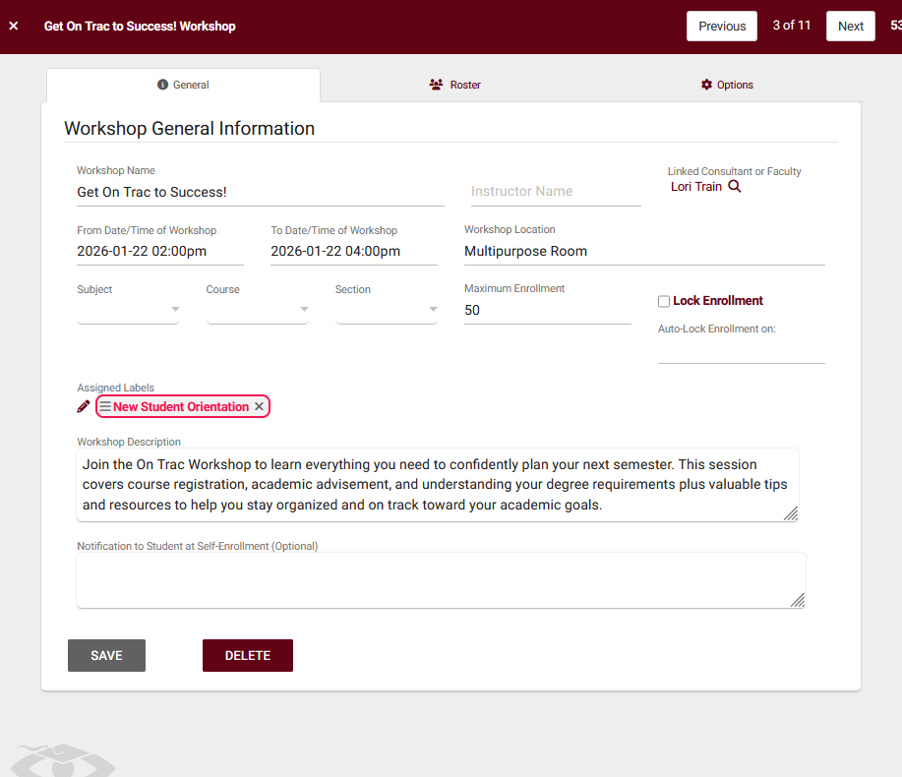
WORKSHOP
PREFERENCES
Defining the workshop name and instructor for listings and email communication, optionally link a consultant or faculty member to block schedules and assign visits, and set the date, time, and location for the workshop. Select the appropriate subject, course, and section to match student registrations, configure maximum enrollment and enrollment locking rules, apply labels for organization and reporting, and add a workshop description with HTML/Twig support. Finally, customize self-enrollment notifications to display messaging based on student eligibility.
2026 Virtual TracCloud Conference

Slide 5
ENROLL
STUDENTS
Enroll & Manage Students
Search and enroll eligible students
Optionally restrict enrollment to a linked list
Batch enroll using IDs or emails
Attendance Tracking
Scan student IDs/barcodes to record attendance
Auto-enroll and mark attended when allowed
Staff can override maximum enrollment
Enrollment Issues
Track failed enrollments (locked or full workshops)
View failed enrollment lists and detailed reasons
Roster Management
View enrolled students in one table
Mark attendance status individually or in bulk
Attendance may create visits or assignment completion
2026 Virtual TracCloud Conference

Slide 6
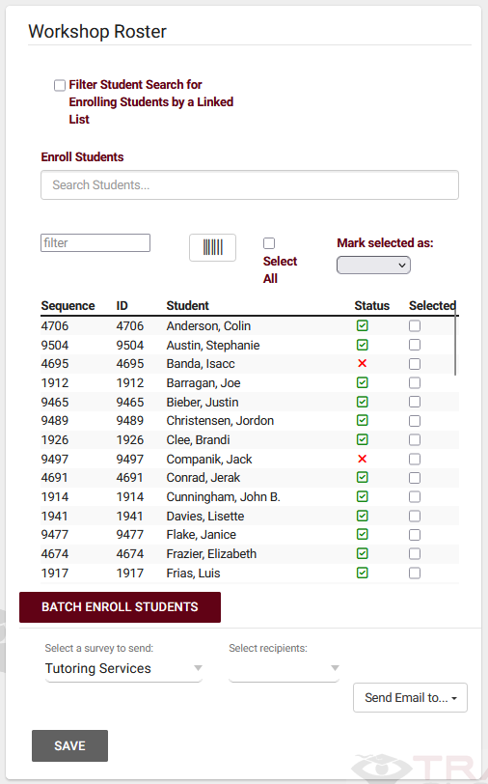

MANAGING
WORKSHOPS
Tracking student engagement is essential for campuses aiming to improve retention and success rates. The Workshops module helps achieve this by generating detailed reports on attendance trends, enrollment rates, and overall workshop effectiveness
Enroll students individually, by batch, or via ID/barcode scan
Track attendance and update statuses (attended, missed, canceled)
Monitor and manage failed enrollments (locked or full workshops)
2026 Virtual TracCloud Conference

Slide 7

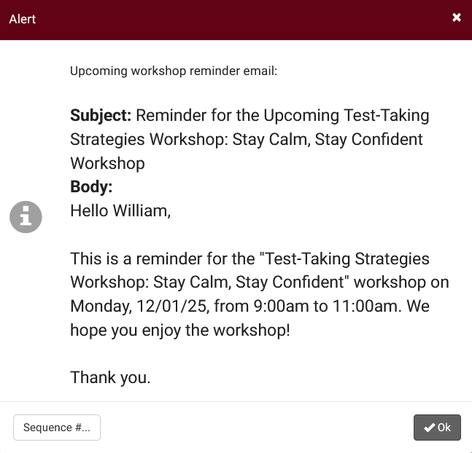
c
WORKSHOP
COMMUNICATION
Workshop emails automatically notify students when they enroll in a workshop, cancel their enrollment, and receive reminders before the workshop takes place. Administrators can customize email subjects and message bodies using Twig, enable optional SMS notifications (with the TextAlerts module), and choose to CC the profile email on confirmations, cancellations, and reminders. Reminder messages can be scheduled for the day before or the morning of the workshop and sent via email, SMS, or both.
2026 Virtual TracCloud Conference

Slide 8
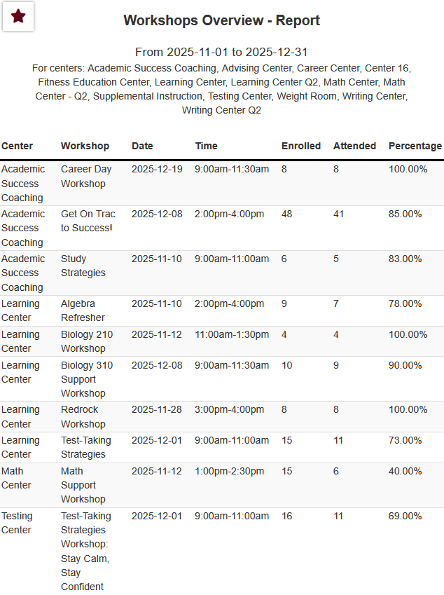
Workshop Reports
TracCloud offers three workshop reports to support tracking and analysis-
Student Workshop Attendance summarizes each student’s attendance by workshop along with overall totals
Workshops Overview provides high-level details for workshops within a selected date range, including enrollment, attendance, and attendance rates
Workshops Roster lists enrolled students for a specific workshop, showing enrollment dates, attendance status, and overall participation totals.
2026 Virtual TracCloud Conference

Slide 9
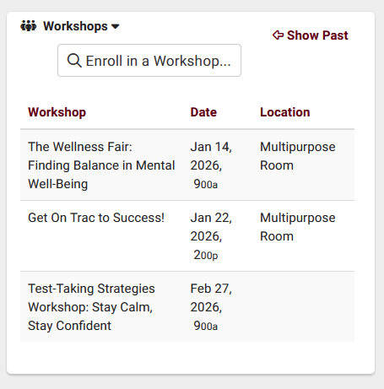
c
STUDENTS VIEW
WORKSHOP WIDGET
The Student Dashboard Widget allows students to search for and enroll in workshops directly from their dashboard using assigned workshop labels, which can be customized with unique colors. That will determine which workshops are shown to students. To enable dashboard enrollment, a workshop must have at least one label and the “Allow Student to Enroll via Dashboard Widget” option enabled. Once configured, students can filter workshops by label, enroll themselves, and view their enrollment directly on their dashboard.
Self-Service Workshop Enrollment
Label-Based Workshop Discovery
2026 Virtual TracCloud Conference

Slide 10

For pricing or support,
go to
Helpdesk@go-redrock.com
https://wiki.go-redrock.com/index.php/TracCloud:_Workshops
2026 Virtual TracCloud Conference

