Slide 1
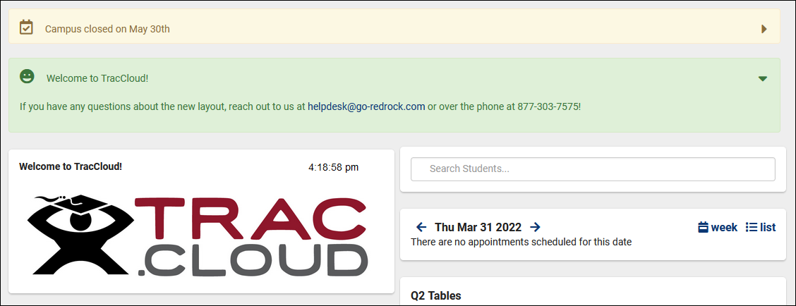
Personalizing traccloud
Customizing your theme, messages, and more with twig and html

Slide 2
What’s new?
• Set custom views as the default or exclusive view for a permission group.
• New scheduling features for announcements.
• Student photos now sync to linked staff accounts.
• “Is here for an appointment” field added to Log Listing fields.
• Custom fields can now be created in availabilities, documents, and resources.

Slide 3
How you can personalize traccloud
Logo and System Theme
Welcome Message & Announcements
Center Descriptions
Kiosk Messages
Appointment Display
Emails
Twig & HTML
And more…

Slide 4
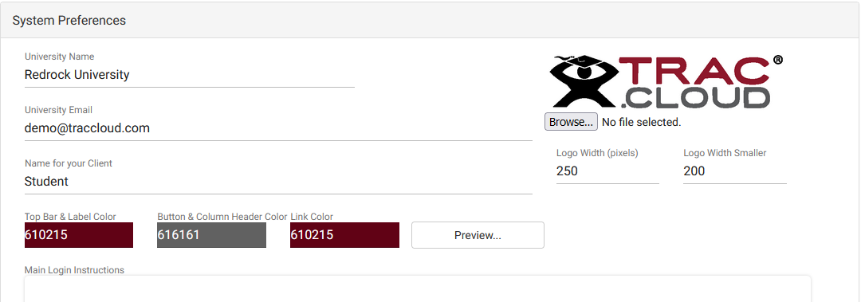
Logo and theme
Changing the logo and color scheme of your Trac System allows you to visually copy your campus website.

Slide 5
Messages and announcements
Welcome messages and announcements can be used to convey information to your students and staff, both support HTML and Twig.
Welcome Messages are typically static, or updated infrequently. These messages can be unique for Students, Staff, and Faculty, and are displayed on the dashboard.
Announcements are typically more dynamic, allowing you to configure messages that display on a set schedule. These messages can be unique for Students, Staff, Consultants, and Faculty. Multiple can be displayed at once.

Slide 6
Center descriptions
Center descriptions can be used to provide information about your centers to students while booking appointments, allowing them to quickly view the location, hours, and general information about the chosen center.
Center Descriptions can be created on a per-center basis, allowing you to create custom descriptions for each of your centers.
A Profile Center Description can also be created, acting as a default for all centers that don’t already have a custom description entered.

Slide 7
Custom Listing views
Modify the visible columns on the Students, Visits, Registrations, and Faculty Listings
Modify record fields directly from the listing page, including custom fields.
Export the list contents to a CSV file.

Slide 8
Welcome and goodbye messages
Supports HTML and Twig
Messages can appear before or during login, providing several locations to welcome or inform students.

Slide 9
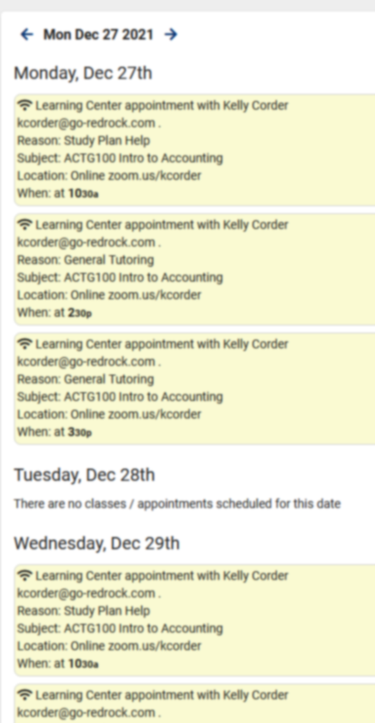
Appointment display
Change the look of upcoming appointments for both students and staff.
Utilize Twig and HTML to change the look and contents of the field.
Ensure that only the necessary information is visible to students and staff.
Further personalize your Trac System to make upcoming appointments streamlined for your use-case.

Slide 10
typical html usage in traccloud
What you enter
How it displays
<b>Hello!</b>
<i>Here’s a link:</i>
<a href=“https://www.go-redrock.com”>Clickable link</a>
<img src=“https://www.go-redrock.com/wp-content/uploads/2021/07/TutorTrac_icon_burgundy_gradient-01.png”>
Hello!
Here’s a link:
Clickable link

Slide 11
typical twig usage in traccloud
What you enter
How it displays
Hi {{Student.First_Name}}!
You have missed {{CalcMissedAppointments (Student.Sequence, Center.ProfileID)}} appointments this semester.
Hi Alex!
You have missed 3 appointments this semester. [uses System Pref date]
A list of tags and more can be found on our wiki.
wiki.go-redrock.com/index.php/TracCloudGuideProfilePrefsTwig

Slide 12
Additional twig examples
What you enter
How it displays
{% if Appointment.CustomData.cf_99 == "Blocked" %} You have been blocked from booking appointments. Reach out to[…] {% endif %}
{% if Student.Cell_Phone == "" %} You have not entered a cell phone yet, click on “Edit Bio” to update this. {% endif %}
You have been blocked… [Only displays if the criteria is met.]
You have not entered a cell phone… [Only displays if this field is blank.]
A list of tags and more can be found on our wiki.
wiki.go-redrock.com/index.php/TracCloudGuideProfilePrefsTwig

