Slide 1
Pencil Me In: TracCloud Scheduling
Appointments, Availabilities & Reports
Luis Frias
Redrock Software
This Photo by Unknown Author is licensed under CC BY

Slide 2
Topics We Will Cover
Creating Availabilities
In-Person, Online or Optional
Booking Appointments
Group Access
Global/Profile Settings – Center Bio
Report on data

Slide 3
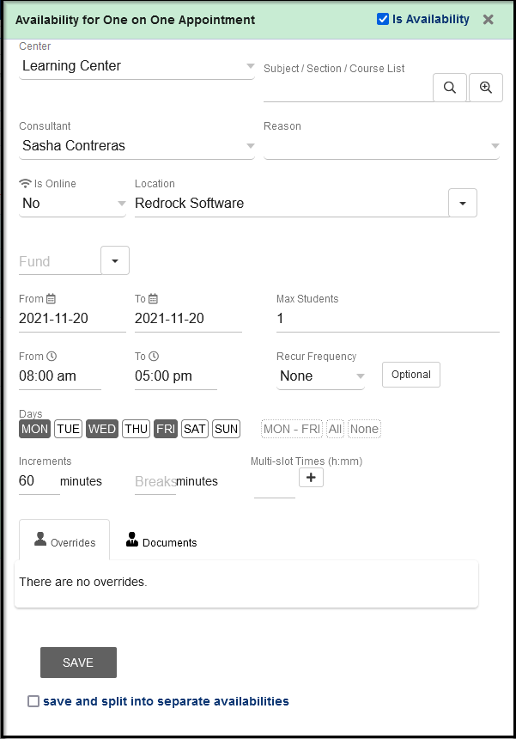
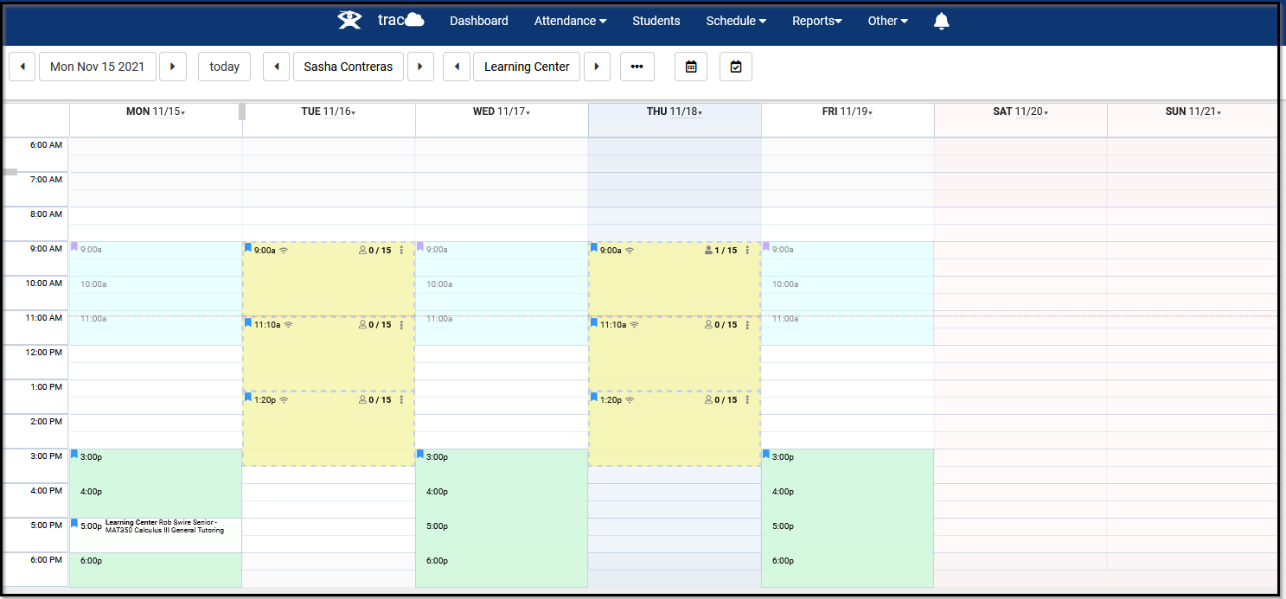
Availability Block Creation
Limit block to a specific subject or reason
Choose date range and days of week
Break apart slots into increments
Manage more then one center schedule for the staff member from one view

Slide 4
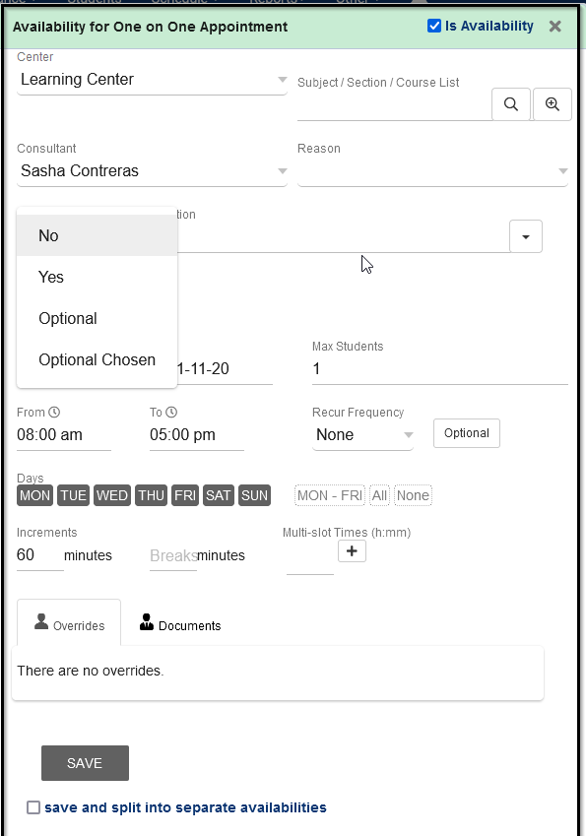
In Person, Online or Optional
No = In-Person (can display physical room location)
Yes = Online (will display online link for consultant that is saved in their profile)
Optional = Default is In-Person but can be booked as online
Optional Chosen = Default is Online but can be booked In-Person

Slide 5
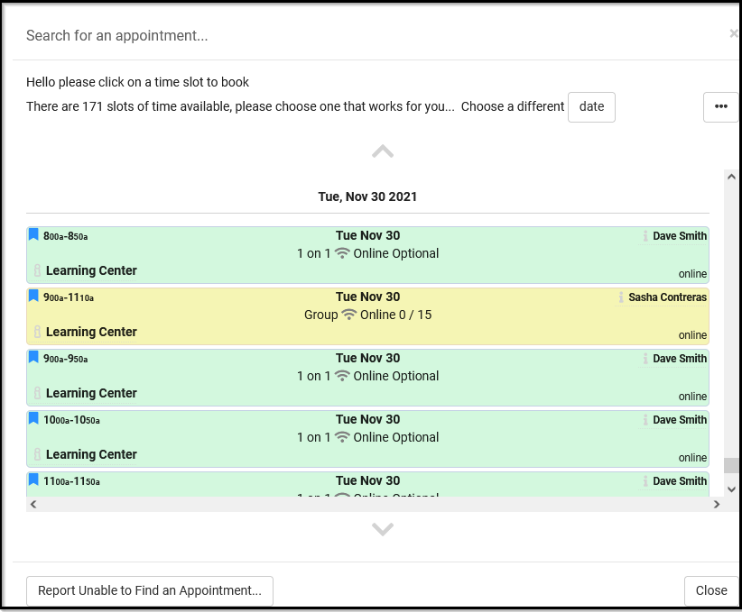
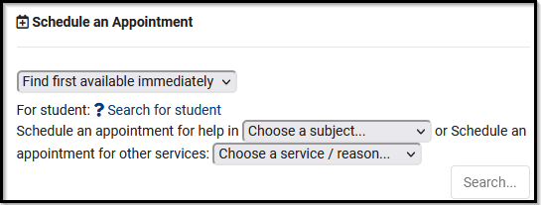
Scheduling Appointments
Staff will aid by choosing the student based off ID or name
Results will display for only the subject or reason selected. All center availability that matches criteria will show.
Students (and Staff) will choose a subject or reason to filter their results

Slide 6
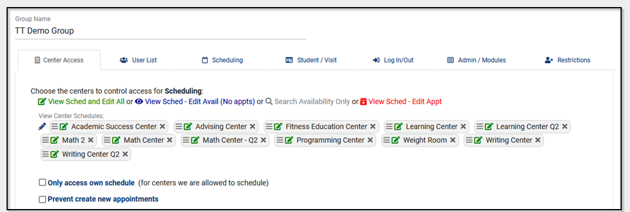
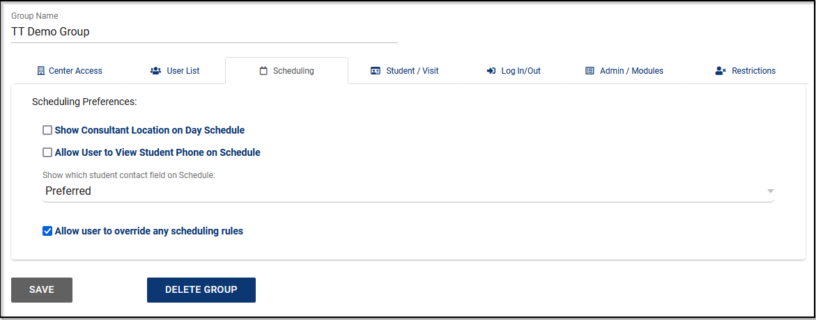
Group Access
Determine what centers your staff has access to view or schedule an appointment for.
Grant override scheduling rules per group permissions

Slide 7
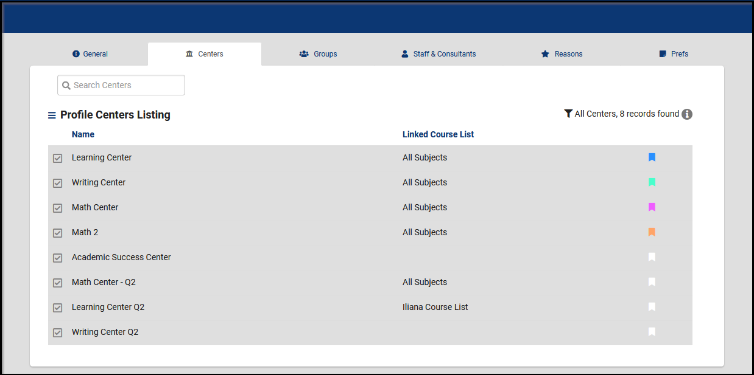
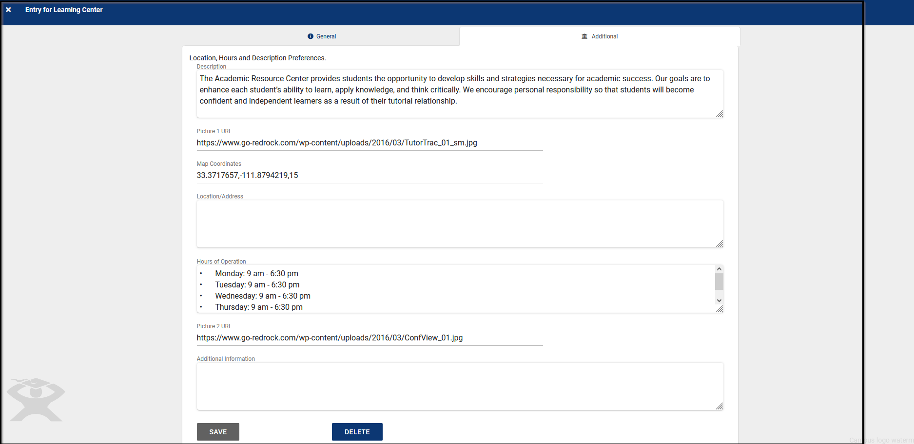
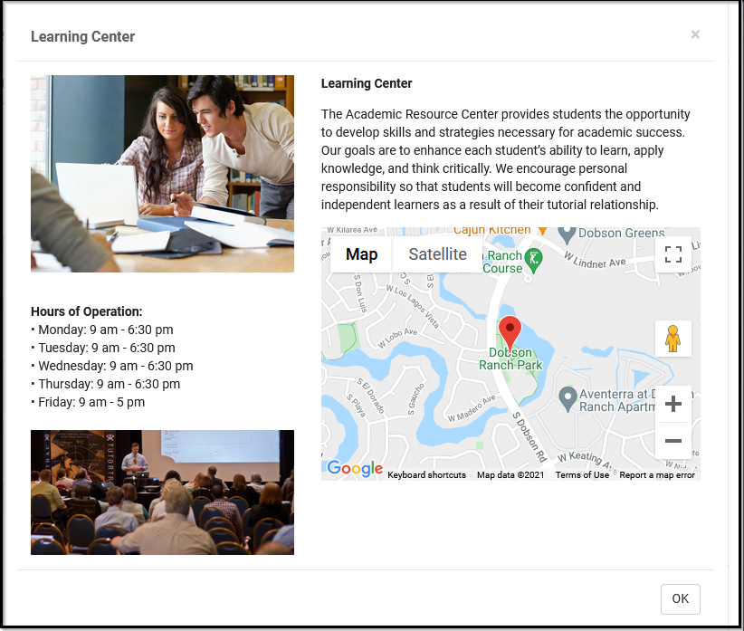
Center Bio
Color code your center(s). This will display as a color marker on the calendar for staff and display for both students and staff when booking an appointment
Create a Center BIO for each of your centers to provide additional details to your students such as location, hours of operation and more!

Slide 8
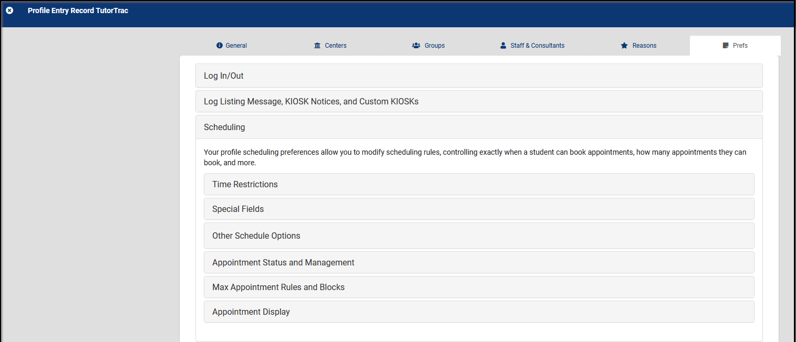
Global/Profile Settings
Time Restrictions is used to control how soon or how late an appointment may be booked or cancelled
Appointment status choices is used to list all the appointment statuses that you will use to track appointments
Special Fields is used to control which of the certain fields will be available for entry in Availabilities and Appointments for all centers linked to this profile
Max appointment rules are used to prevent too many appointments from being booked by a student or multiple students for a certain period of time
Other Schedule Options is used to control certain additional access restrictions to appointment scheduling functionalities
Appointment Display is used for controlling how an appointment is displayed to the various users using Twig commands.

