Slide 1
A Beginner’s Guide to Profile Configuration For Multiple Programs/Specific Student Populations
Kelly Juliano
University of Massachusetts Boston
Center for Academic Excellence Tutoring Program

Slide 2
Hello! I’m…
I am the tutoring program assistant at the University of Massachusetts Boston’s Center for Academic Excellence
The Center for Academic Excellence offers:
Peer Tutoring
Academic Coaching
Peer Mentoring

Slide 3
How We Use TracCloud
We have two profiles:
One profile is course based appointments for our peer tutoring program, and also houses two other tutoring programs on campus that have joined our TracCloud profile (ESL and SSS)
The other profile is reason based for coaching and peer mentoring

Slide 4
Today’s Topic
Challenge:
When you have sub-populations of students that need to be guided to specific programs/people, and your profile has more generalized settings. The examples I will be using to show how we have done it at UMass Boston are:
SSS (specific on-campus tutoring program)
Bilingual Tutors
ALEKS Math Placement Exam

Slide 5
Grouping Specific Populations With Specific Tutors
Challenge:
Grouping a specific population of students so that they can only book appointments with a specific group of tutors
One way that I have found works for this: create a new center
To create a new center: other → other options → profiles- select the profile that you want to create the center for
Click on the centers tab of that profile
Click the hamburger menu to create a center

Slide 6
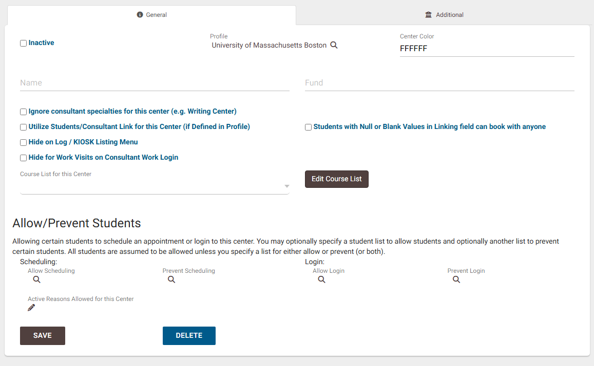
Grouping Specific Populations With Specific Tutors
Name the center, choose a color, etc.

Slide 7
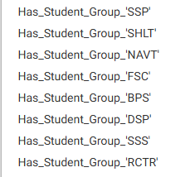
Grouping Specific Populations With Specific Tutors
A way to set up the center so that only certain students can book appointments:
Create a dynamic list for the group of students that you want to be able to book appointments (even easier if the grouping already exists in a student grouping)
The student grouping I am using in my example is called “SSS”
In the students tab, right click on the search bar of students, and scroll to click “has_student_group_” option and click the student group you are looking for (SSS) then fill in “Y” so that all students in that group are shown to you.

Slide 8
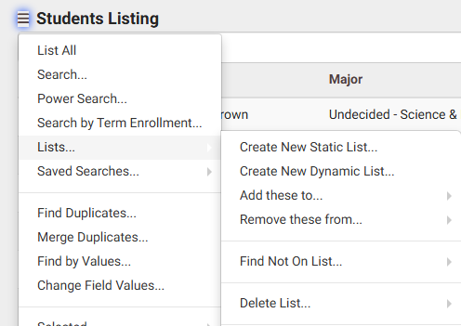
Grouping Specific Populations With Specific Tutors
From that list of students, click on the check mark on the righthand side, and click “activate all found records” to select all the students in that group.
Once the students are selected, click the hamburger menu, then go to lists → create new dynamic list to create a list for the students in that grouping

Slide 9
Grouping Specific Populations With Specific Tutors
A way to set up the center so that only certain students can book appointments:
Then you want to create a reason that will be specific to that specific population of students.
For my example, we created “I am an SSS student” so that students making SSS tutoring appointments will select that reason, which ONLY SSS tutors will have assigned to their profile.
To create a reason: other → other options → profiles (select profile you want to create this reason for)→ reasons
Click the hamburger menu and add a new reason that can be assigned to the specific group of tutors that are able to tutor this special population of students.

Slide 10
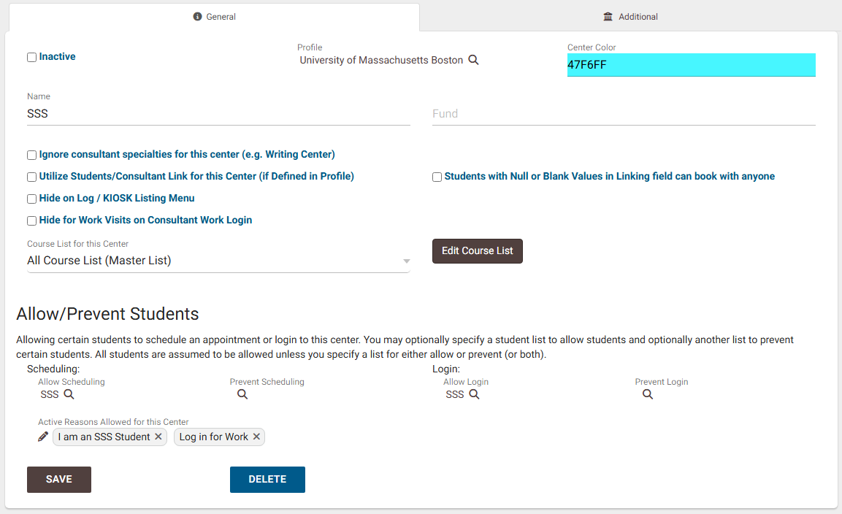
Grouping Specific Populations With Specific Tutors
In the center’s general tab, under allow/prevent students, click the magnifying glass next to “allow scheduling” and search for the dynamic list of students you made-add them, and also add that group under “allow login.”
Now only students in that grouping can book appointments for that center
Select the pencil next to “active reasons allowed for this center,” and select the reason that you created for the specific group of tutors
Make sure the tutors are assigned to that specific reason

Slide 11
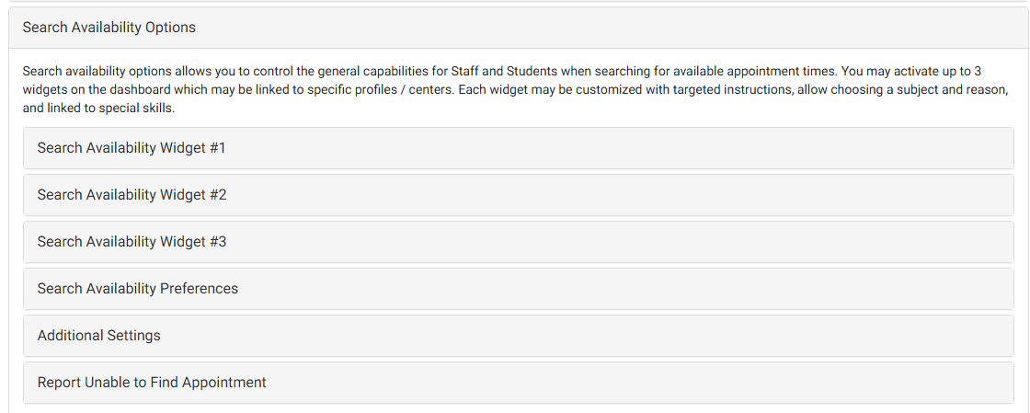
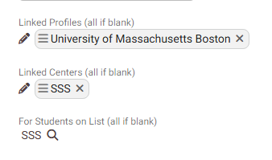
Grouping Specific Populations With Specific Tutors
To eliminate any confusion for students, we created a widget for this specific center so that only SSS students would see the widget and be able to book those tutors
Other → preferences → search availability options
At the bottom of configuring the widget, we linked the widget to the SSS center we created

Slide 12
Display Availability Badges
Another way we have helped special populations of students find tutoring with the best tutor for them is using display availability badges to show bilingual tutors when students are booking appointments

Slide 13
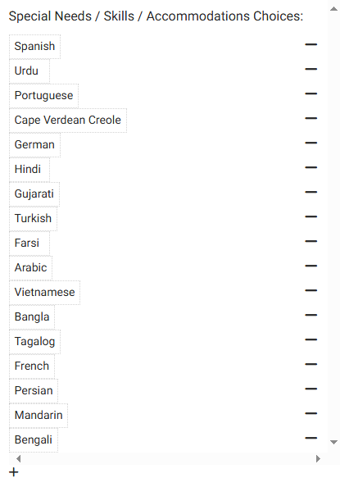
Display Availability Badges
The process:
Other → other options → preferences → special needs/skills/accommodations
Under “activation,” it should be “linked to consultant”
Click on the plus button, and “new item” will appear. Click on “new item” to rename it to whatever language/skill/accommodation you would like

Slide 14
Display Availability Badges
Once your language(s)/skills are inputted, you then need to create a badge for it.
Other → other options → profiles (choose profile you want) and then click on the “Prefs” tab.
Click scheduling → search availability badges → new availability badge

Slide 15
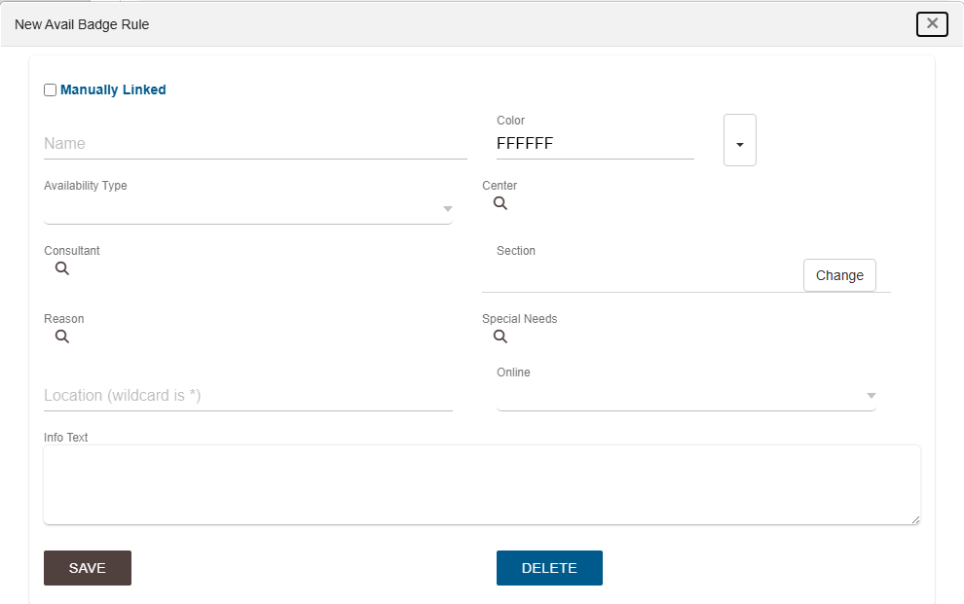
Display Availability Badges
Name the badge
Choose a color
To the right of the color, you can click the arrow button to choose an icon to go with it

Slide 16
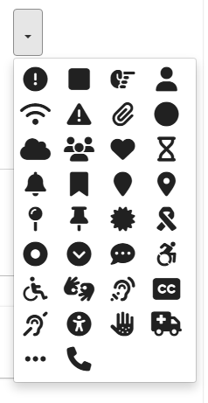
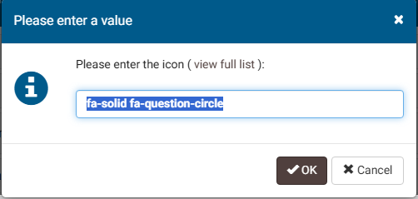
Display Availability Badges
If you want a different icon from what is shown, click the 3 dots at the bottom, and then click “view full list”

Slide 17
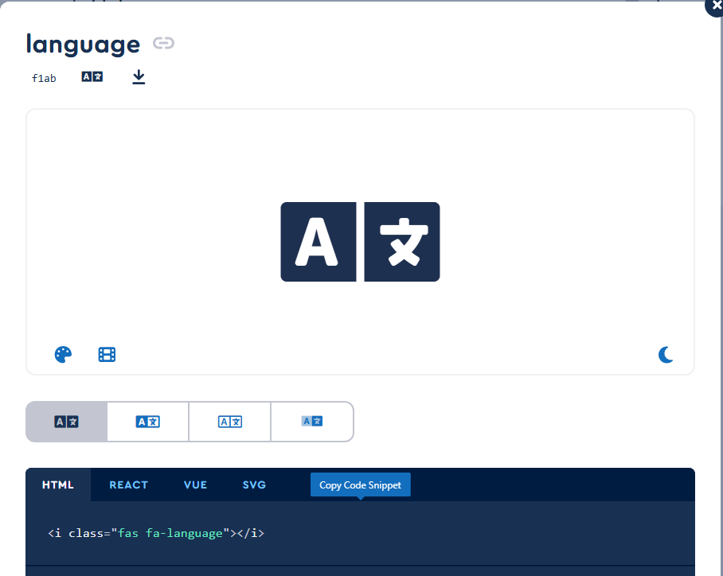
Display Availability Badges
You are then brought to another window where you can search for an icon on the website
I searched “language” and chose this icon.
You then hover over HTML and click “copy code snippet”

Slide 18
Display Availability Badges
Back in traccloud, you can paste the HTML into the textbox, but remove the quotations, and any other symbols/special characters that are outside of the quotation marks
Press OK, and the icon should appear. You can change the color of the icon as well

Slide 19
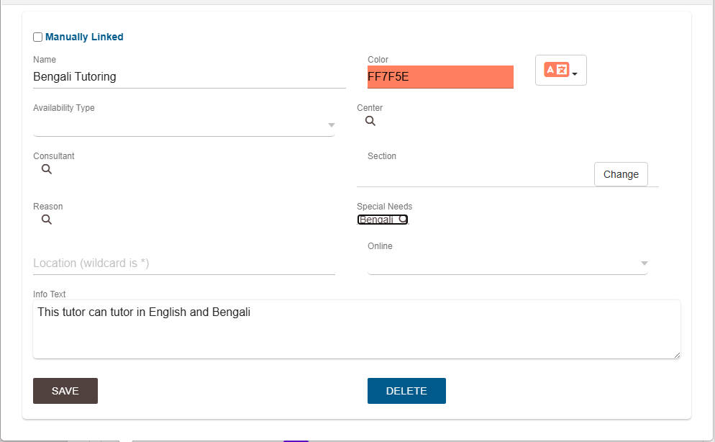
Display Availability Badges
Then click on the magnifying glass next to “special needs” and type in the corresponding language and click on that.
In the “info text” section, enter the info you want students to see when they hover over the badge.
Press save, and you should see the language listed now

Slide 20
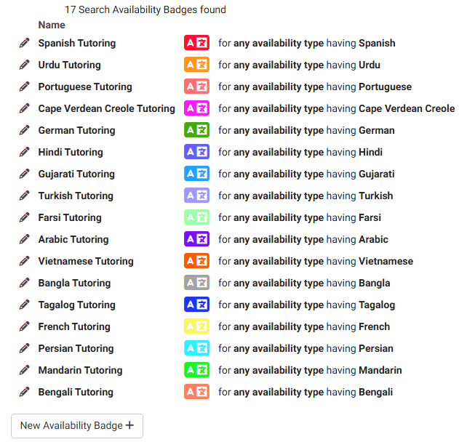
Display Availability Badges

Slide 21
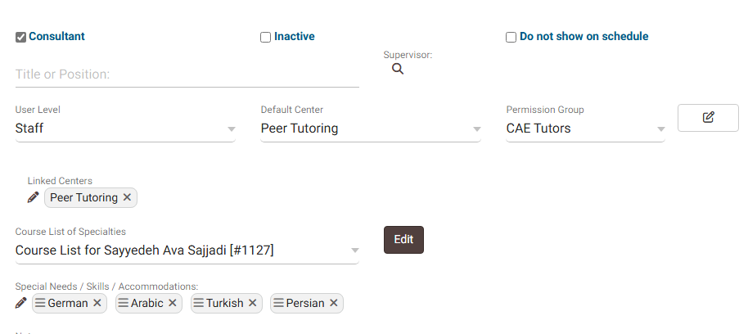
Display Availability Badges
Once the language/special skill and badge are created, you can now add it to a tutor’s profile.
In the consultant’s staff profile, at the bottom, click the pencil next to special needs/skills/accommodations and add whatever language(s) or skills you want for the staff

Slide 22
Display Availability Badges
Once the language/skill is added to the staff profile, students will see it when booking appointments.
When students hover over the icons, they will see whatever you wrote in the info text ex: “This tutor can tutor in English and Farsi”

Slide 23
Non-Enrolled Courses
If your center is course/section based, and you need to have appointments for a population of students for a service that is not technically a course, you can create a non-enrolled course that all students will see that will allow them to book appointments for that “course”/service, but that falls under the “course/section” rules of your profile.
ALEKS is not a course at our university, but we wanted students seeking help with the ALEKS math placement exam to be able to book appointments just like regular courses

Slide 24
Non-Enrolled Courses
The TracCloud Wiki has an in-depth explanation https://wiki.go-redrock.com/index.php/TracCloud:_Non-Enrolled_Courses that explains it better than me :)
Steps:
Create a new course- other → listings → courses → new course → name the course
Create a term- → other → other options → preferences → terms → new term
Create a section- → other → listings → sections → new section
Select the course and term you just created, and then check non-enrolled and active box
Update course lists to assign to your center/consultants
Process specialties

Slide 25
Non-Enrolled Courses
We then created a reason that corresponds to the ALEKS exam prep course that is only assigned to tutors that can help students seeking ALEKS tutoring.
Students will only see availabilities for ALEKS tutoring if they select both the non-enrolled course and the correct reason when booking

Slide 26
Summary
TracCloud is a super adaptable software that is able to meet the needs of your specific programs and has many ways to ensure that students benefit from your services with ease!
Are there any ways that you plan to use TracCloud to better meet the needs of your students?

