Slide 1
Navigating TracCloud
A Review of Reports
Erick Martinez

Slide 2
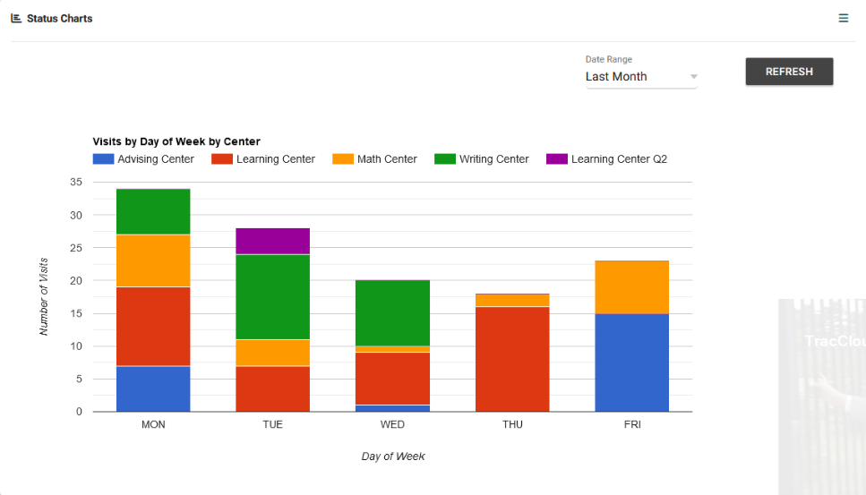
Todays Topics
Status Charts, Center Status
Overview of Report preferences
Visit Reports
Schedule Reports
Student Visits Cleanup Data

Slide 3
Visit Reports
TracCloud provides a variety of Visit Reports. You can find Reports related to Visits in either the Students or Management Sections from the Report drop-down menu. Examples of Visit Report options include the Usage Snapshot, Attendance by Hour, Students Visits Summary, and the Visits by ?? Report.

Slide 4
Scheduling
You can find Scheduling-related Reports in either the Students or Management Categories in your Report drop-down. Some of the Reports include:
Appointment Slot Utilization Date Comparison
Center Schedule
Visits/Appointments by??

Slide 5
New Reports
Student Fields
Student Search Availabilities
Visits by Week by Center
Optional: In-Person vs Online Appointments

Slide 6
Related Sessions
Let’s Review the Data – Luis
Let’s Talk about your Data Q&A - Luis

