Slide 1



Student Consultations
Asynchronous & Group Availabilities
Erick Martinez
2026 Virtual TracCloud Conference

Slide 2

What’s New
Asynchronous Appointments displayed to consultants’ supervisors on the dashboard
Asynchronous title preference shown on Availability and Appointment entry
Consultant Schedule Summary email includes Asynchronous Appointments
Group Availability restricted to Special Skills
2026 Virtual TracCloud Conference

Slide 3
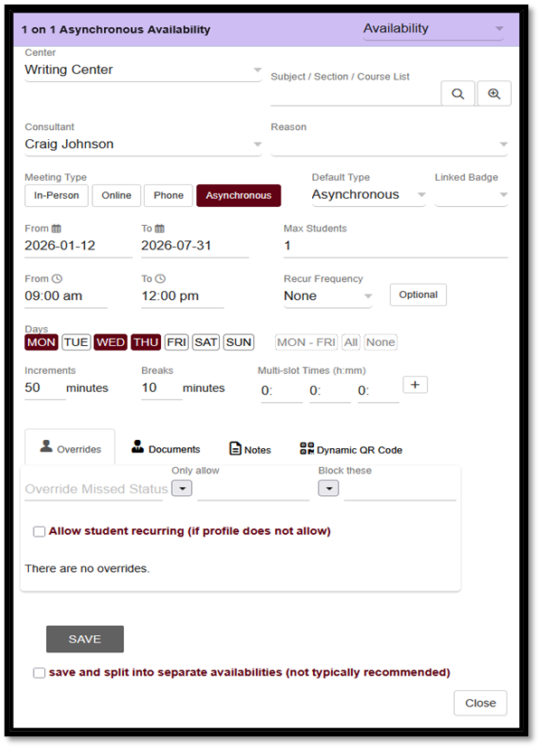
Asynchronous Availabilities
What are Asynchronous Availabilities
Asynchronous Meeting Type must be activated in the Profile Preferences
Creating Asynchronous Availabilities
2026 Virtual TracCloud Conference

Slide 4
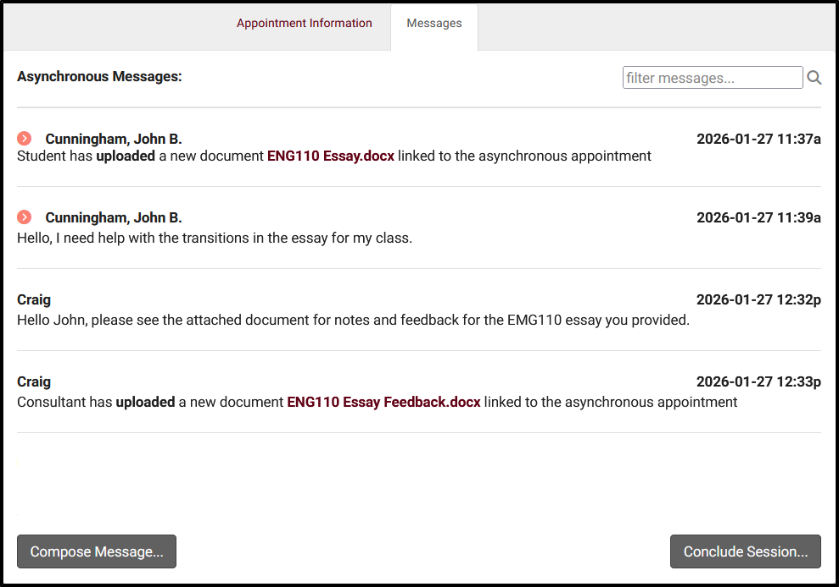
Asynchronous Communications
Where to access and manage Asynchronous Appointments
Appointment Information and Messages
Student or Consultant can conclude the session at any time
Prevent Students from re-opening a concluded Asynchronous appointment
Students are provided the option of canceling a future Asynchronous Appointment
2026 Virtual TracCloud Conference

Slide 5
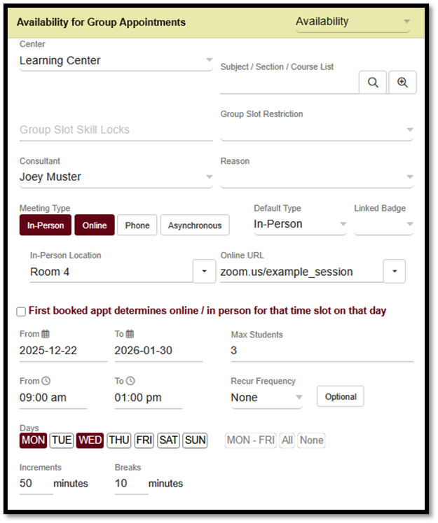
Group Availabilities
Group Slot Restriction determines what subject students can book for compared to the first student’s selection.
Group Slot Skill Locks allow staff to define skills/accommodations in group availabilities that when booked will lock the availability to the chosen skill.
Group availabilities offering both in-person and online meeting types, can allow the first student who books the appointment to choose the session’s modality for everyone else.
2026 Virtual TracCloud Conference

Slide 6
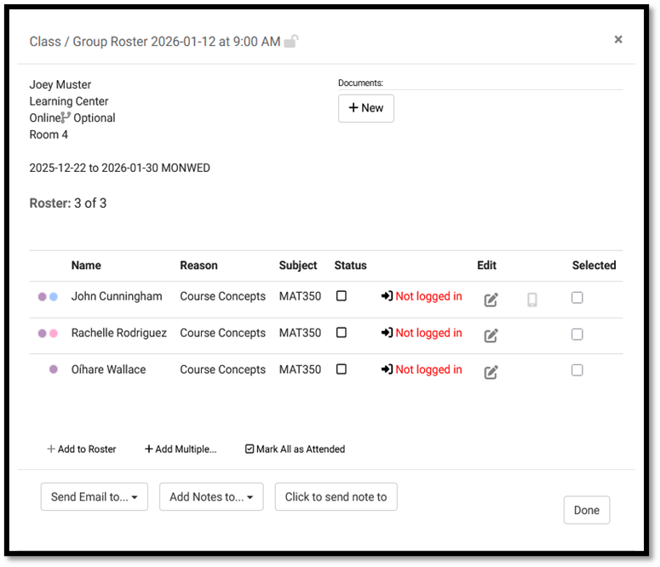
Group Roster
Reserved for Group Availabilities only
Manage Group Appointments before and after the session
Lock Group Roster to reserve slots or limit appointments for focused attention.
Add notes to the Visit Records for Students who attended the appointment
2026 Virtual TracCloud Conference

Slide 7
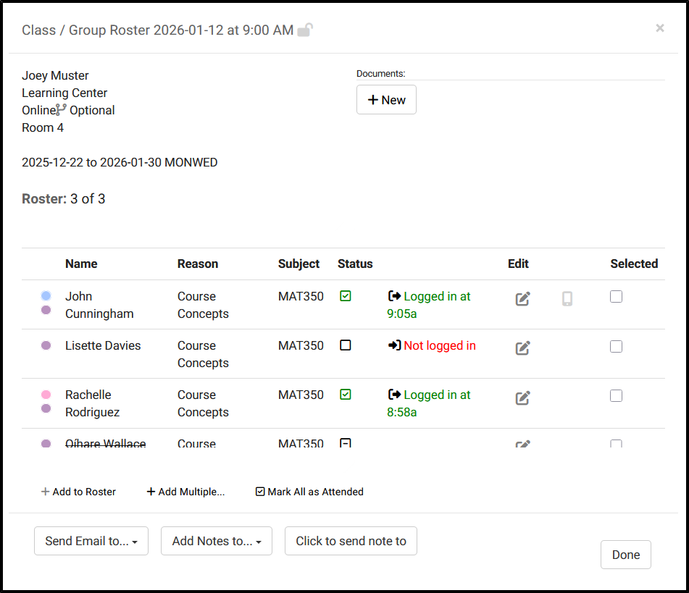
Group Appointment
Schedule Appointments directly from the Group Roster
Log students in/out for there Visit from the Staff Schedule
Email students directly from the Group Roster. Emails can be sent to all students, based on appointment status, or to selected students.
2026 Virtual TracCloud Conference

Slide 8
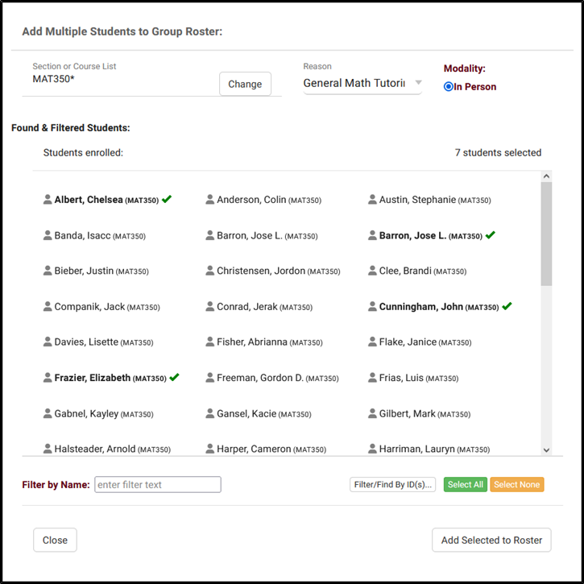
Group Roster “Add Multiple”
Add students to the Group Availability as a batch process
Search for Students Enrolled in specific courses.
Filter/Find Students based on the chosen ID field.
2026 Virtual TracCloud Conference

Slide 9
SurveyTrac
TracCloud Features
TextAlerts
Provides the option to send a Survey/Quiz to student directly from the Group Roster
Based on SurveyTrac and Scheduling Access in Group Permissions.
Adds option to send SMS to students from the Group Roster.
Students must opt in to receive SMS Alerts, and have a cell phone number listed on their Student record.
2026 Virtual TracCloud Conference

Slide 10


THANK
YOU
I appreciate your participation and look forward to any questions or discussions.
Questions
2026 Virtual TracCloud Conference

