Slide 1
Global Settings
Iliana Visser

Slide 2
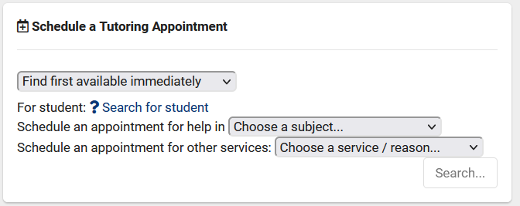
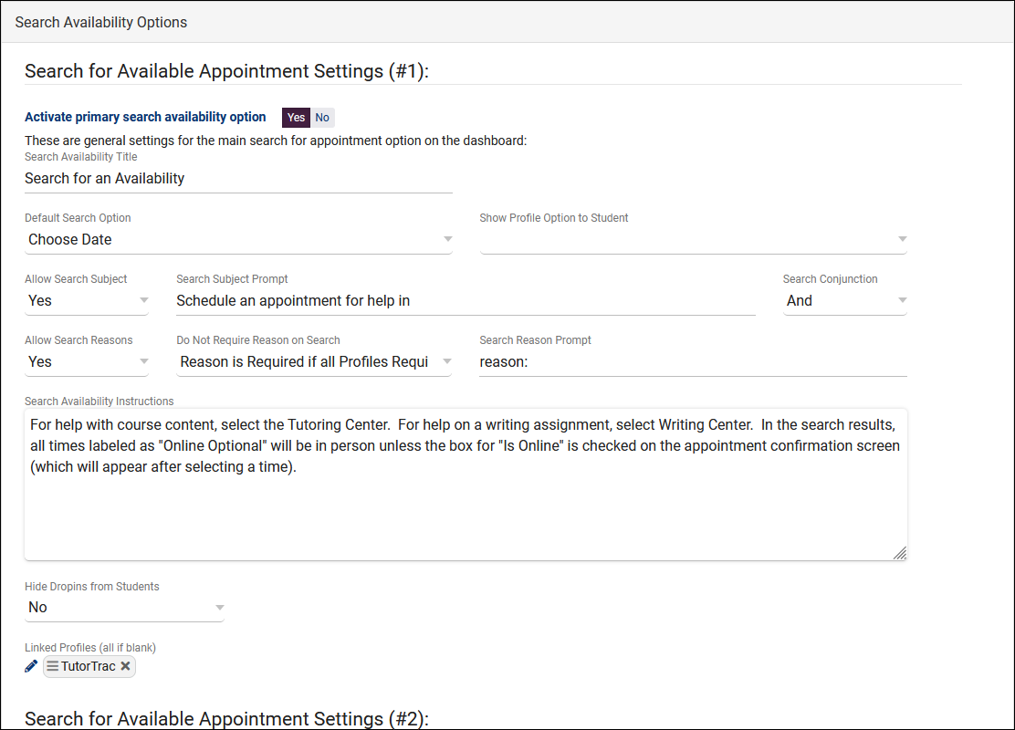
Search Availability Options
These preferences allow you to modify the behavior of the Search Availability widget on the dashboard. There are 3 sets of settings, as you can have up to 3 Search Availability widgets at once. For example, if you had an AdvisorTrac and a TutorTrac profile in the same instance, you may want reason to be a required search criteria for Advising, but only require Subject for Tutoring. These options allow you to offer a separate widget for each profile.

Slide 3
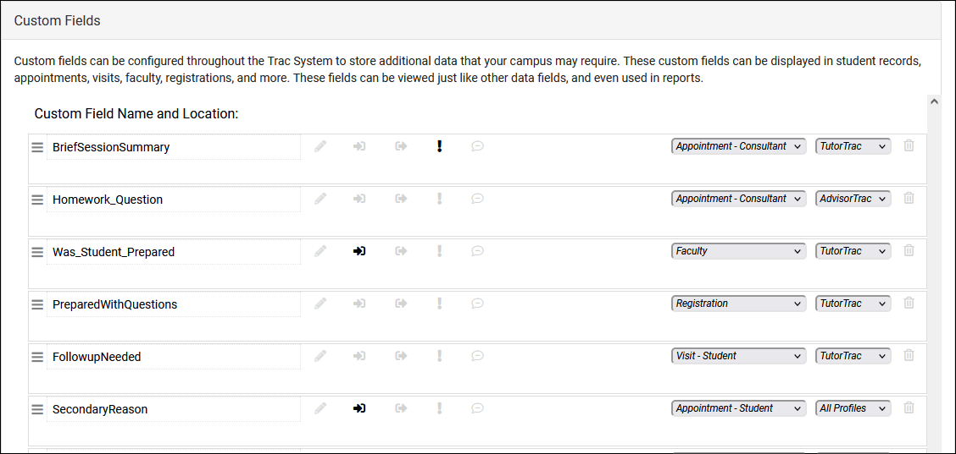
Custom Fields
Custom fields can be configured throughout TracCloud to store additional data that your campus may require. These custom fields can be displayed in student profiles, appointments, visits, faculty, registrations, and more. This data can also be imported from your Student Information System and reported on just like the rest of the standard fields.

Slide 4
Student Lists& Watch Lists
Custom can be used for a variety of reasons, from simply pulling up a set of students, running reports, or even limiting a permission group’s access to only a certain population of students. If you want to make a student stand out on the Log Listing or Student Listing, assigning them to a Watch List is a great way to accomplish this.
A Watch List can then be created for one of your existing Custom Lists, which will display a colored indicator for the individual students who have been assigned to the list.

Slide 5
Document Types
Documents can be uploaded directly to student profiles or to individual appointments, allowing students to share worksheets or assignments they need assistance with. These documents are assigned Types, these Types allow you to designate levels of access to different groups, based on what should or shouldn’t be visible to certain staff (or students themselves).

Slide 6
Task Types
Tasks can be created for students, displaying as a notification letting students know of something they need to complete. These tasks are assigned types, which are then assigned to permission groups to determine which staff members can create what tasks.

Slide 7
Special Needs, Skills, and Accommodations
Special Needs / Skills / Accommodations are used to refine search availability. Special needs may be tagged to either consultants or availabilities. Those linked consultant availabilities are found when searching for those accommodations or needs. As an example, let’s say a student wants to book an appointment, but requires either a tutor familiar with sign language or a translator to be present. We can setup an ASL accommodation choice, assign either the availability itself or the consultant’s profile to ASL, that way the student performing the search will only see relevant availabilities in their results.

Slide 8
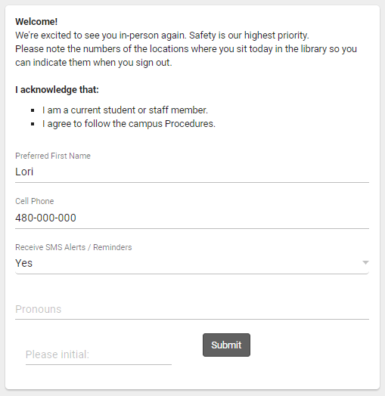
Student and Staff Confirm Bio
Confirm Bio allows students and staff to update their own information, either by following a URL sent to their email address after a KIOSK login, or within a prompt displayed in their browser after signing in.
Students and staff can also manually edit their bio at any time via a widget on their dashboard.

Slide 9
Favorite Reports Management
This utility allows you to manage and reassign Group Favorite reports. As an example, let's say a staff member who is no longer with your campus had a useful Group Favorite report. This allows you to reassign that report to a different user (or yourself) for further usage/modifications.
Within this menu, you'll find the name of the report, the current owner, and a - icon to delete the report. The owner drop-down will allow you to change ownership to another staff member. Changes are saved immediately.

Slide 10
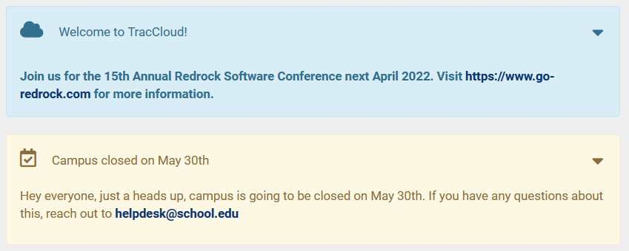
Announcements
Announcements are messages that can be displayed to different users on the dashboard of the Trac System. These messages can be set to only display during a specified date range, and can be formatted in several different ways to better support your campus.

