Slide 1
Through the Student’s Lens
Navigating TracCloud
Erick Martinez

Slide 2
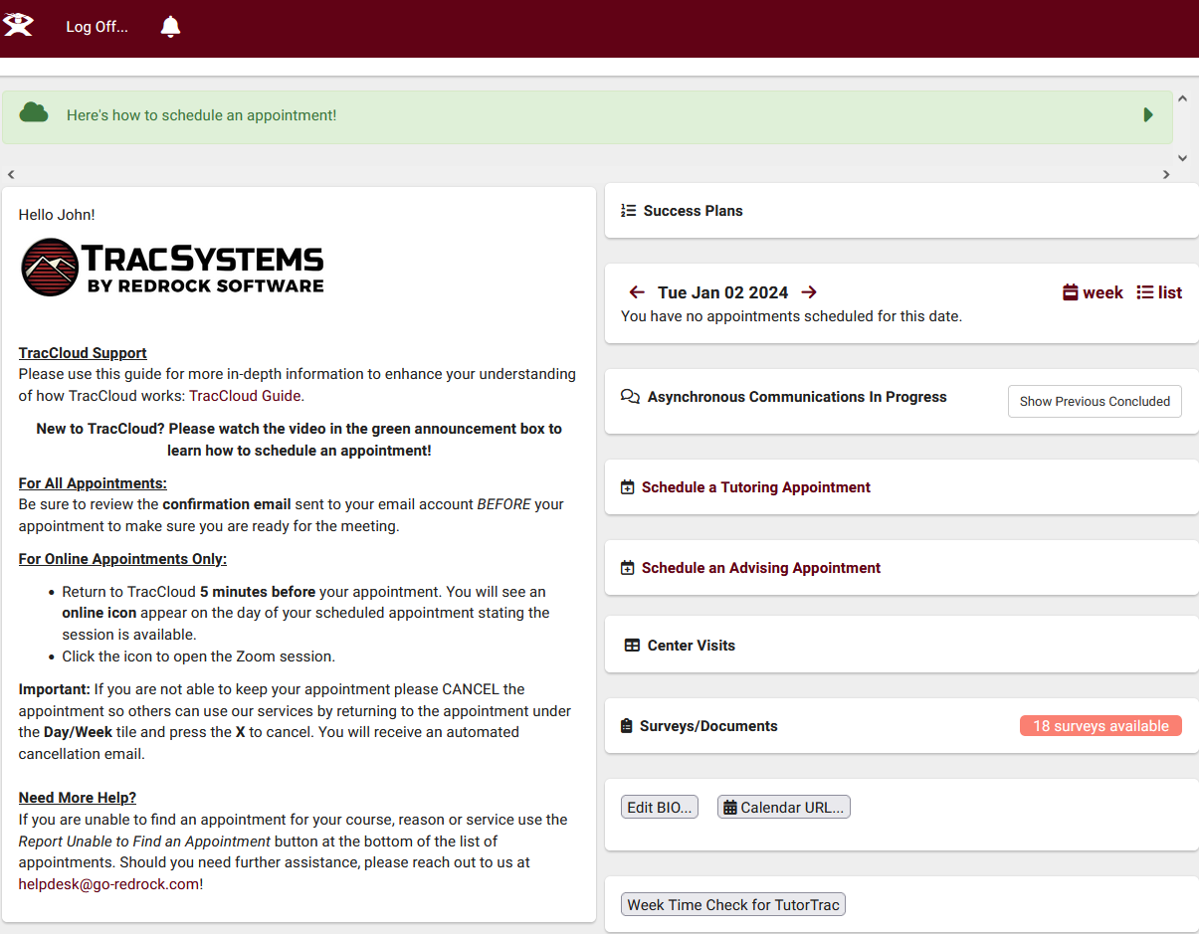
Student perspective
Welcome Message on Student Dashboard
Upcoming Appointments
Booking an Appointment & Asynchronous communications
Past Visits
Confirm Bio

Slide 3
Welcome Message
Provide student appointment booking instructions
Twig & HTML supported messages for the Dashboard
You can embed images and videos, or redirect students to instructional videos

Slide 4
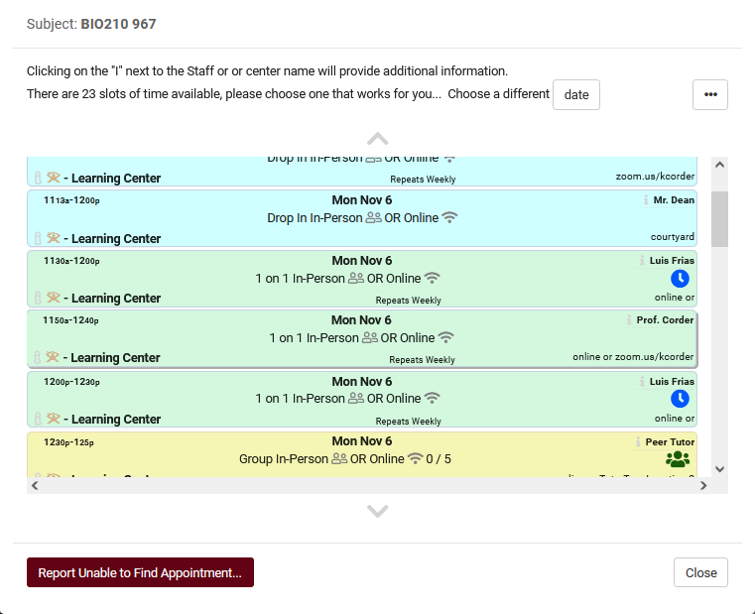
Availability Search
Search Availability Widget
What details are shared with students when they are searching for an availability?
Search Availability Badges and Profile Name/Badge
Appointment Display on Student Dashboard

Slide 5
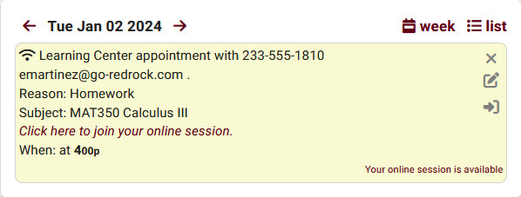
Appointment Display
Students are able to view their appointments on their dashboard.
The format and content of these appointments and their details can be customized in your profile settings, ensuring you can present the information needed in a visually pleasing manner

Slide 6
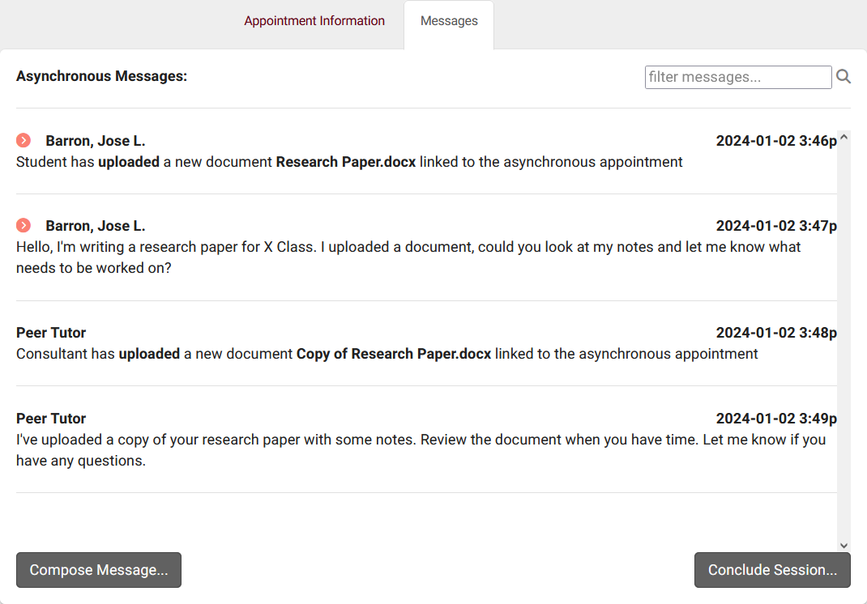
Asynchronous Appointments
Student Dashboard’s Asynchronous Communication Widget
“Messages” displays the ongoing text chat between the student and the consultant, including a log of document uploads and deletions
When is the Asynchronous Appointment concluded?

Slide 7
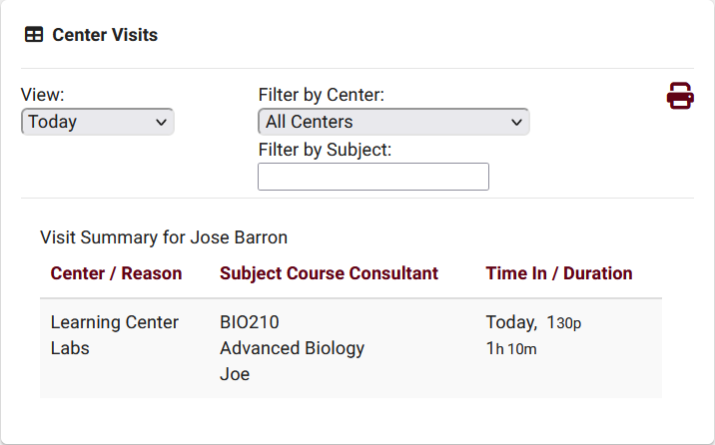
Center Visits
Provides Students with information regarding their previous Visits directly on their Dashboard.
Visits can be filtered based on the selected criteria
Students have the option to print their Visit Summary information

Slide 8
Student Confirm bio
Allows students to manage their own information, what they’re allowed to view and edit is at your discretion.
Helps ensure that users’ profiles contain the most current information, even if the information doesn’t match the data in your import file.
Students have the option to edit their bio at their convenience using a widget on their dashboard

Slide 9
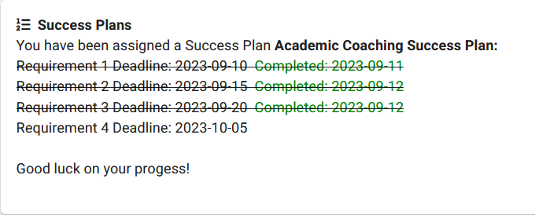
Success Plans
Students who are assigned a success plan can be shown information on their dashboard
Information and formatting can be customized using Twig and HTML
Requires the Success Plans TracCloud Module

Slide 10
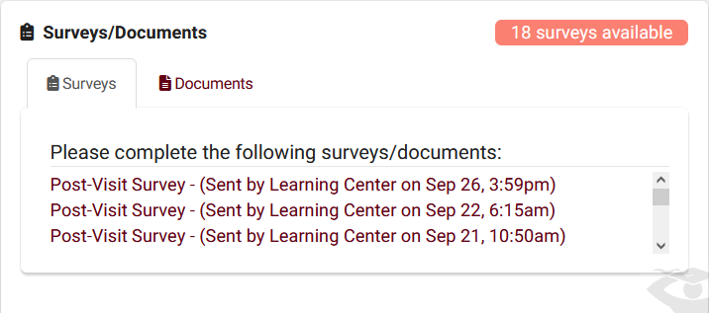
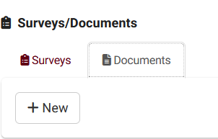
Surveys/ Documents
Surveys
Documents
Students can access pending surveys from their Dashboard
Students must have access to documents and widget enabled
Allow Students to view and upload documents within their own Dashboard

Slide 11
Related Sessions
Personalizing Cloud – Bill
Pencil Me In: TracCloud Scheduling - Luis
Success Plans- Aidan
SurveyTrac – Aidan

