Slide 1



Q2 Study Tables
Iliana Visser
2026 Virtual TracCloud Conference

Slide 2
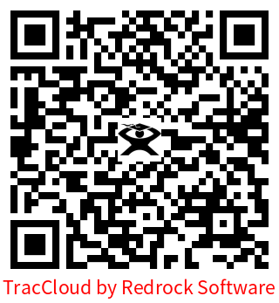
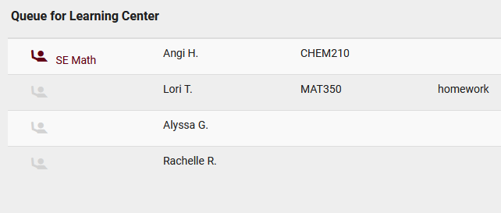
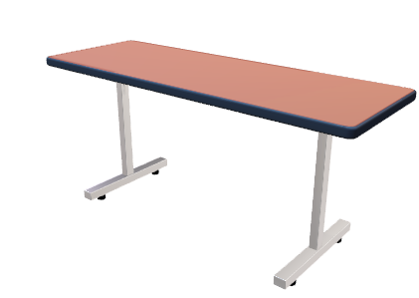
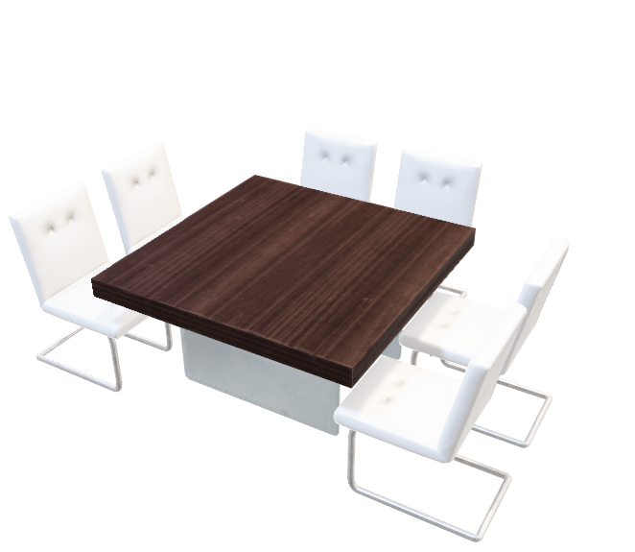

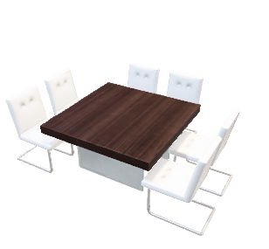





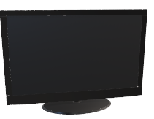



What Is
Q2 Study Tables?
Q2 Study Tables offers a unique approach to attendance tracking specifically for study table centers, tracking the total time a student spends in the center in addition to recording the individual table visits where students received help from consultants. Students begin their center visit studying independently, while having the ability to request assistance as needed. Q2 offers the ability for students to virtually raise their hand and specify what they need help with, which consultants will be notified of. Smartphones and tablets drive the queuing system, for both students requesting help and staff viewing which students need assistance while recording table visit time.
2026 Virtual TracCloud Conference

Slide 3
IS Q2 Study Tables useful for you?
Does your campus have a study hall?
Would you like to assist student online when they request tutoring help?
Do your Students that, in a single Visit, study in more than one Subject?
Do you have Consultants that float and assist Students requesting help for a specific subject?
Do you need to record individual interactions with Students that might occur throughout the visit?
2026 Virtual TracCloud Conference

Slide 4
How does a Center Use Q2 Study Tables?
STEP 1
When a student needs a tutor, one option is for the student to manually raise their hand or a staff member can help sign the student to the Q2 queue to receive help
STEP 2
STEP 3
Also, a student can virtually raise their hand by scanning a QR code that is placed on the table or going to the URL from an email that was sent when they first log into the Center.
STEP 4
Once again, a Tutor will see the student in the Q2 queue and if that Tutor can help in the subject, the Tutor will now go to the designated table to work with the student.
In this space tutors will be monitoring the Q2 queue via phone, tablet, or computer. Once a Tutor gets an alert on their device that a student needs help, the Tutor will now go to the designated table to work with the student.
2026 Virtual TracCloud Conference

Slide 5
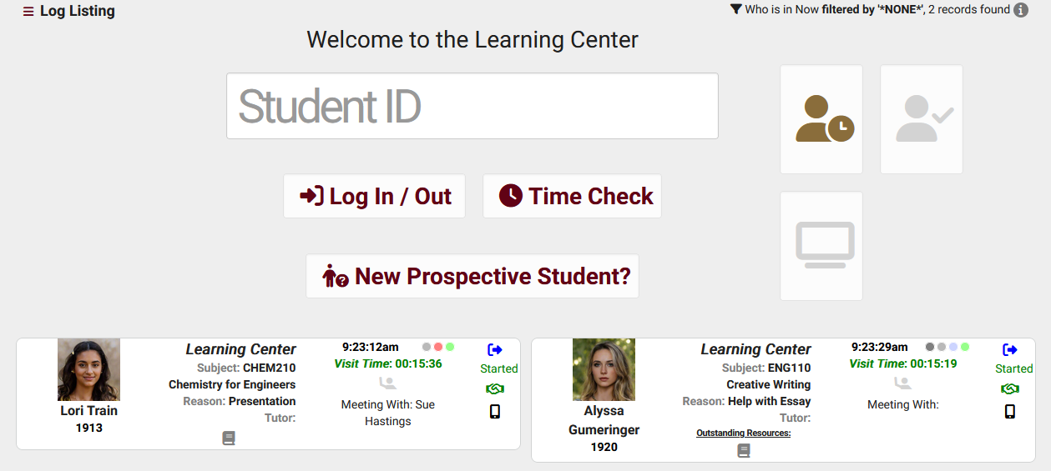
Staffs/Front Desk View – Log Listing
From the Staff/Front Desk perspective, you can quickly see who has requested for help and if a consultant is now meeting with the student.
Log List Customization allows you to add additional Q2 fields
2026 Virtual TracCloud Conference

Slide 6
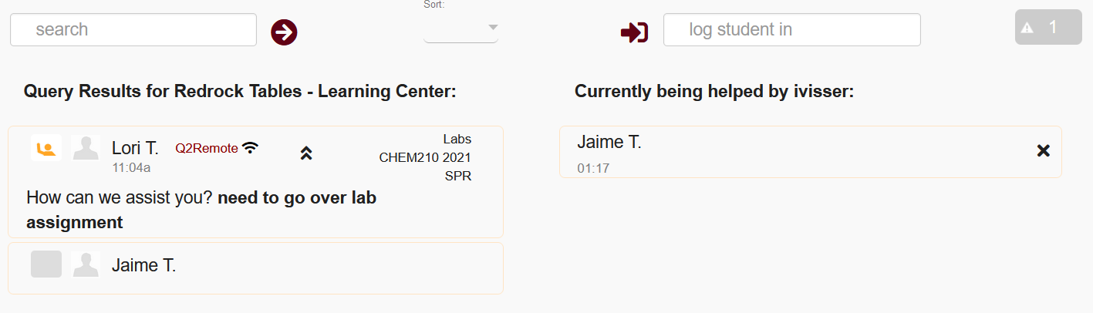
Staffs/Consultant View –
Q2 Config
The staff Q2 Dashboard is split into two separate views. On the left, students in the Queue working independently, and whether or not they're currently raising their hand requesting assistance. On the right, students currently being helped by staff.
2026 Virtual TracCloud Conference

Slide 7
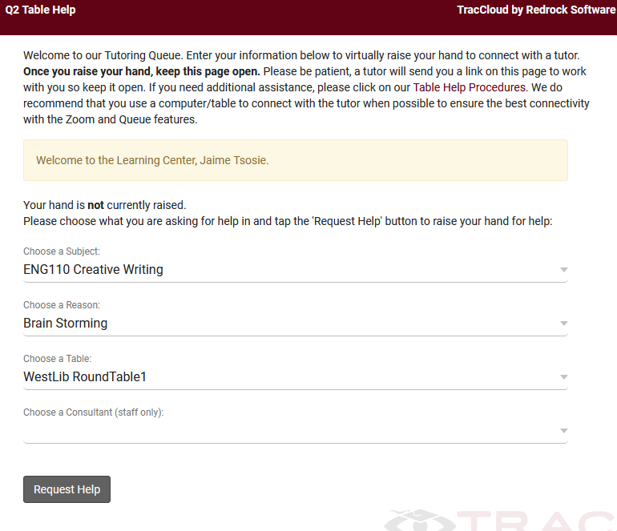
Student View – Request Help
The option to select a Subject and Reason can be toggled on or off in your Q2 settings. If the option to ask for Subject and Reason are disabled, the student will simply be prompted to click the “Request Help” button to request assistance.
Once the request for help has been submitted, the student will be moved into a queue only visible from the consultant’s perspective, which will display all students currently requesting help, indicated by a raised-hand icon.
2026 Virtual TracCloud Conference

Slide 8
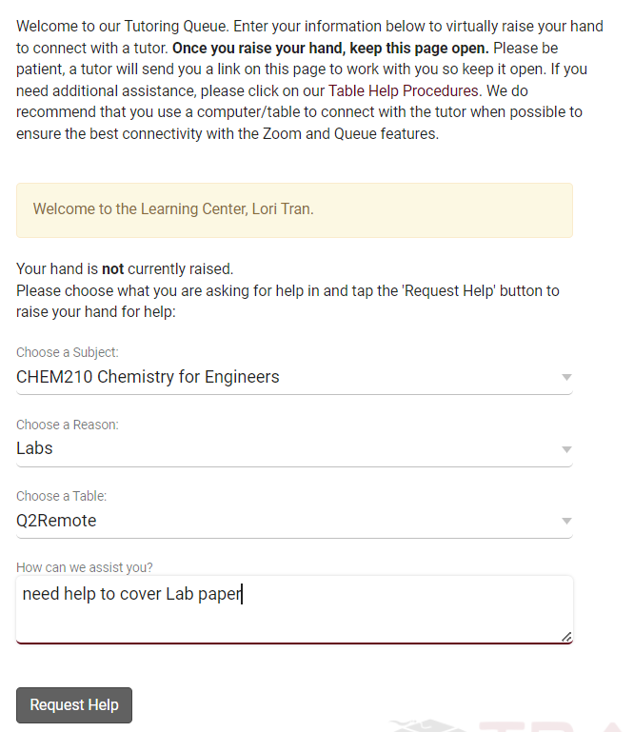
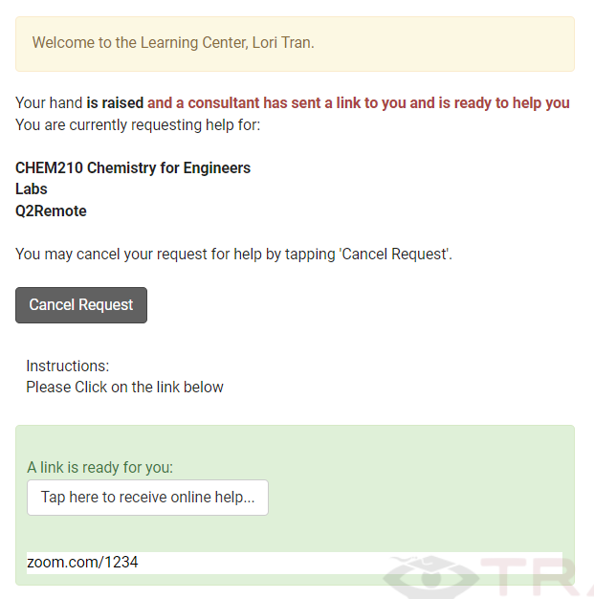
Student View – Q2 Remote
As a student, you can search for and click on this Drop-in session. However, clicking 'Enter Online Session' in this case will take the student to the following Q2 form rather than a meeting room.
This allows the student to specify what the student needs help with and virtually raise the student hand in the Q2 config , waiting at this form until a link is ready
As a staff member monitoring this Q2 config, the staff will see the student has their hand raised for a remote session. Clicking on that entry prompts the staff to send the student a remote meeting link, such as a Zoom or Webex room.
2026 Virtual TracCloud Conference

Slide 9
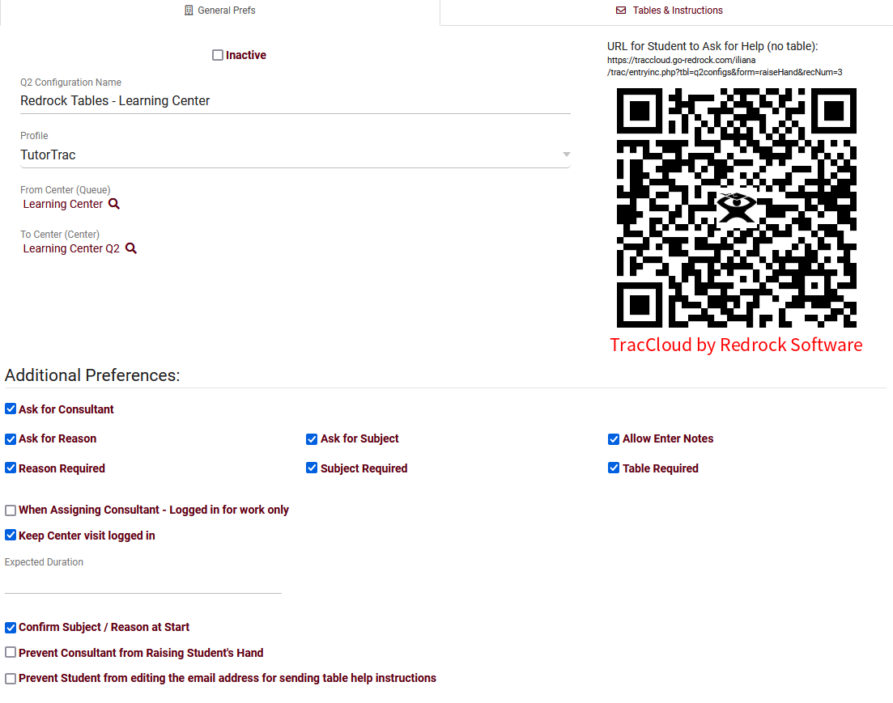
Q2 Configuration – General Prefs
Q2 requires two centers, a From Center and a To Center (Table). The From Center is where the Trac System will record the total time a student spends in the center.
The To Center/Center is where the Trac System records each individual contacts a student has with a staff member, or "Micro-Visits.“
Determine what information is asked when a student raises their hand
2026 Virtual TracCloud Conference

Slide 10
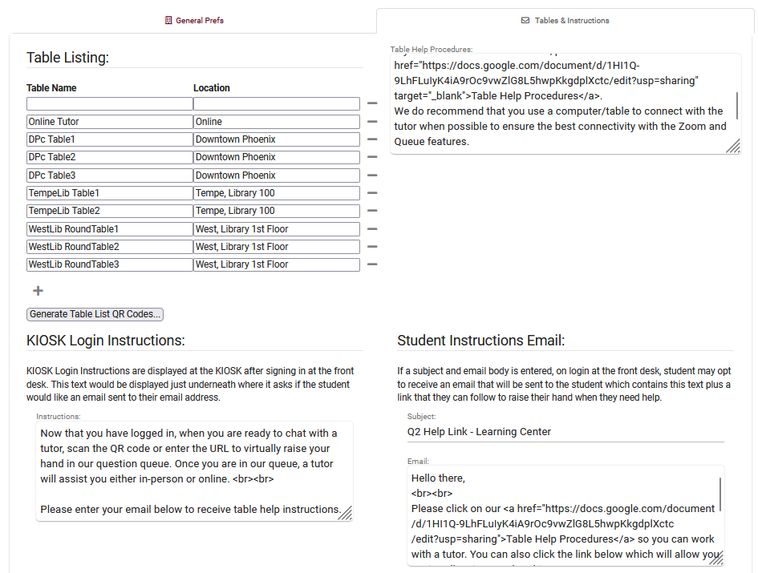
Q2 Configuration – Tables & Instructions
Table Listing-This is where you can define the individual tables that students can request help from. Use Generate Table List QR Codes to display the QR codes for these specific tables. Table Locations can also be defined, which will be recorded for reporting purposes.
Also, this is where you can customize the contents of the email sent to the student and what is displayed.
2026 Virtual TracCloud Conference

Slide 11
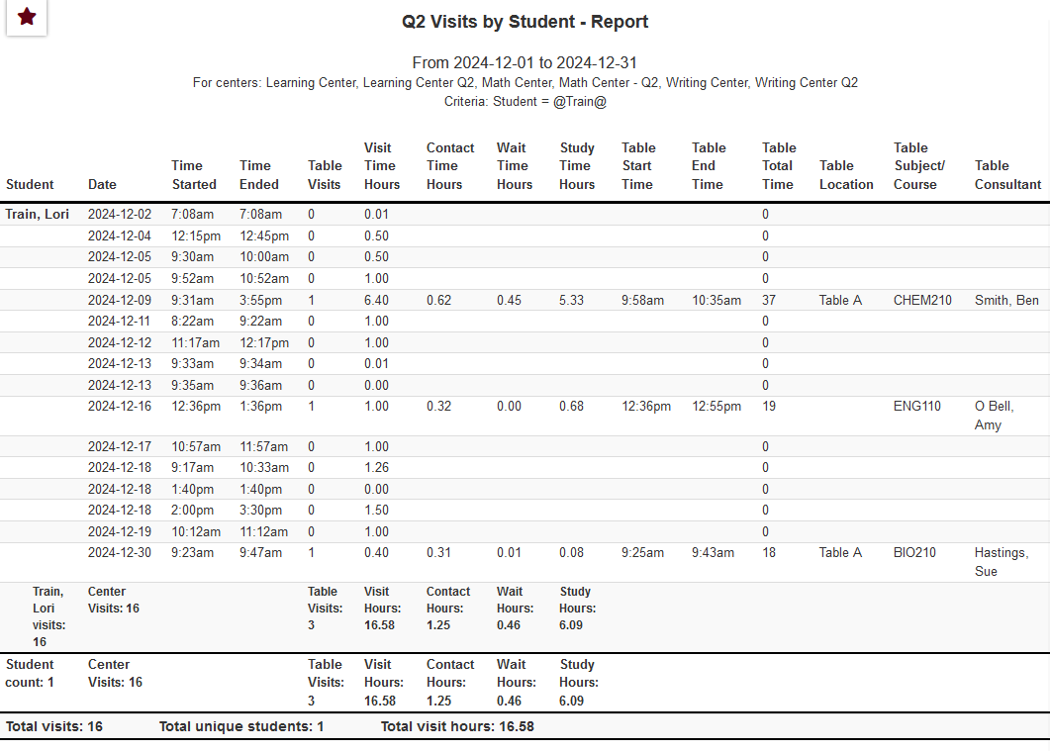
Q2 Study Table reports
Q2 report can display Visit Time, Table Time, time spent Waiting, Locations, and more.
2026 Virtual TracCloud Conference

Slide 12


For pricing or support,
go to
Helpdesk@go-redrock.com
https://wiki.go-redrock.com/index.php/TracCloud:_Q2_Tables
2026 Virtual TracCloud Conference

