Slide 1
Tracking Work hours and payroll data
Tracking consultant hours using visits or schedules, calculating pay rate, and running reports on that data.
Aidan murray

Slide 2
Payroll configuration
Pay Basis – The method of calculating work hours.
Pay Codes – Link consultants to their correct Pay Rate.
Work Types – The criteria to determine Pay Rate.
Work Reasons – Additional info for Cons. Work Time.
Funds – Payment source for reporting purposes.
Work Visit Tracking
Reports

Slide 3
Pay Basis
The purpose of the Pay Basis option is to choose what data source you’re using to calculate consultant hours. A consultant’s linked visit time may differ from their total appointment time, etc.

Slide 4
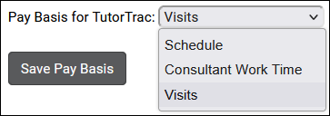
Pay basis
Pay Basis determines how your consultant’s work time is calculated. This is a profile-wide preference.
Consultant Work Time – Consultants log in and out for work hours, similar to how a student logs in and out for their visits. Entirely separate from student-related records.
Visits – Consultant work time will be calculated by the student visits they’re assigned to. If Jane Doe worked with student Sam Smith for 90-minutes, that would be 90-minutes of work time for Jane.
Schedule – Work time will be calculated based on availabilities and appointments. This allows you to assign different pay rates based on booked vs un-booked availabilities, and more.
Other > Other Options > Profiles > [Your Profile] > Prefs > Pay Basis

Slide 5
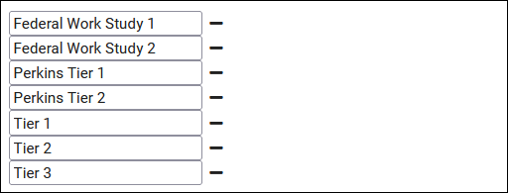
Pay codes
Pay Codes are used to represent tiers of consultant pay rates. Each consultant can only be assigned to one Pay Code, but each Pay Code can be assigned different pay rates based on Work Types.
Other > Other Options > Preferences > Pay Codes

Slide 6
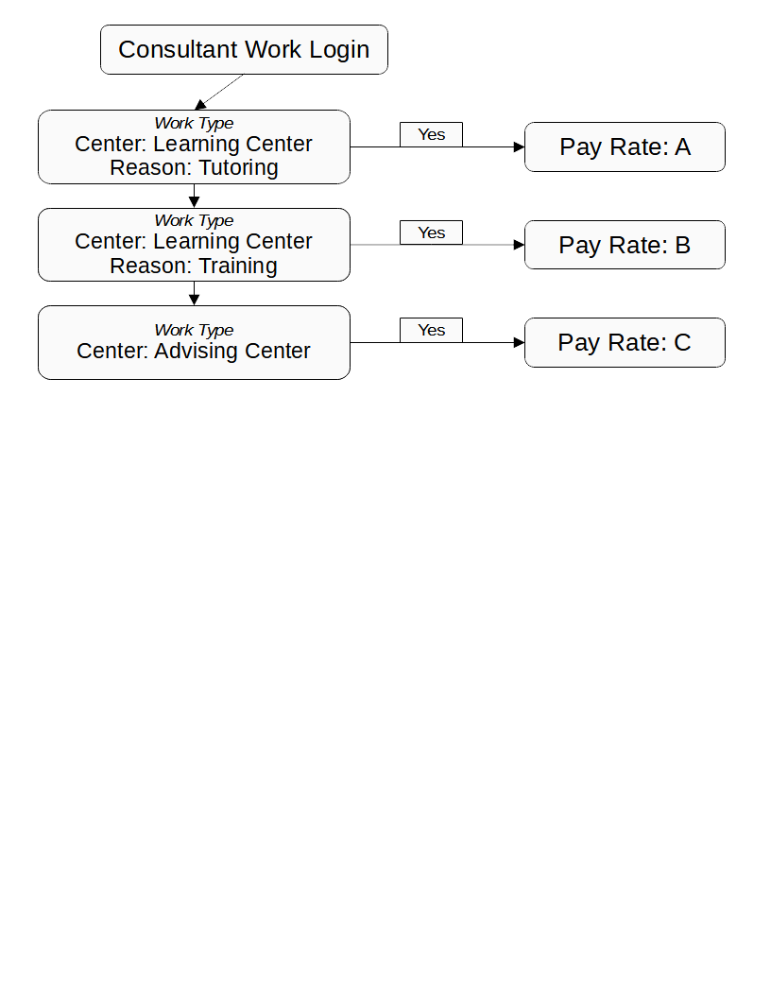
work types
You can think of Work Types like a flow chart for Pay Rates. If Dave Smith is working in the Learning Center for Training, they should receive pay rate B based on the Work Types below.

Slide 7
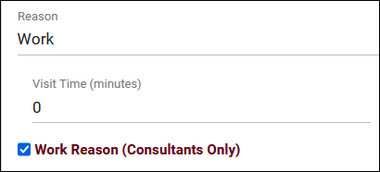
work reasons
Work Reasons can be used to specify the purpose of a Work Visit, either for reporting or for Work Type filters.
This option is only used if Consultant Work Time is your Pay Basis.
Other > Other Options > Profiles > [Your Profile] > Reasons

Slide 8
Fund
A designated payment source for work time. Fund can be assigned to any of the records linked below depending on how fund is determined by your campus. If fund is stored in multiple fields at once, the following priority list decides which is used.
Student (Top Priority) Visit Appointment Availability Consultant Center (Lowest Priority)
Consultant and Center fund fields are enabled by default. Student Fund can be enabled by checking this option: Other > Other Options > Preferences > Student Entry Choices > Display Fund. Appt/Avail Fund can be enabled by setting “Fund” options here to “Yes.” Other > Other Options > Profiles > [Your Profile] > Prefs > Scheduling > Special Fields.

Slide 9
Group Permissions
There are several options relating to Work Visits and Payroll data within Group Permissions.
Allow user to access payroll reports.
User may view which work visits (All/Own/None)
Allow work logins from Dashboard.
Allow work logins from Kiosk.
Allow staff to view Work Visits on schedule.

Slide 10
Consultant work time tracking
There are two ways that a consultant can login for work if the Consultant Work Time Pay Basis is used.
From Dashboard
From Kiosk/Log Listing

Slide 11
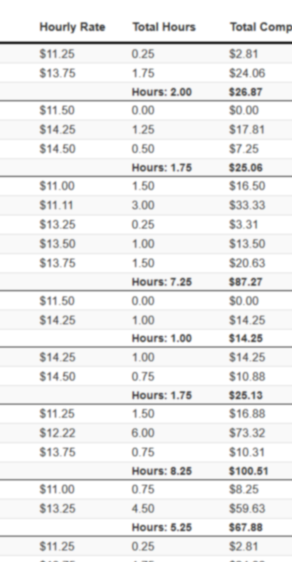
Payroll reports
generating total hours and compensation based on your consultants’ work time

Slide 12
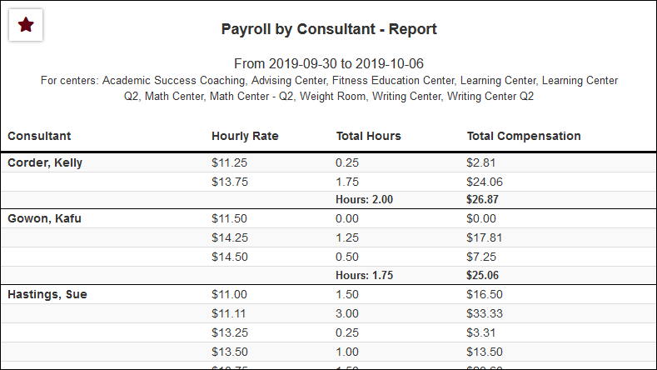
Report: Payroll
The Payroll report is used to export total hours, compensation, and hourly rate in a single page. You can also expand this to include individual visits, funds, and more.

Slide 13
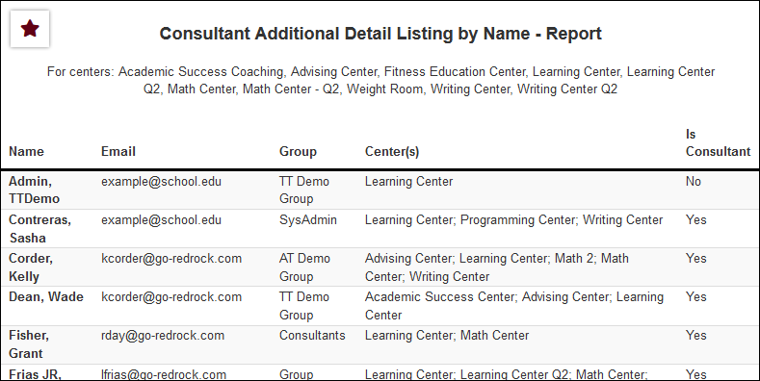
Report: Consultant additional detail listing
The Consultant Additional Detail Listing report is used to export a list of your staff with additional fields from their profile. Assigned Centers, Group, Funds, etc.

Slide 14
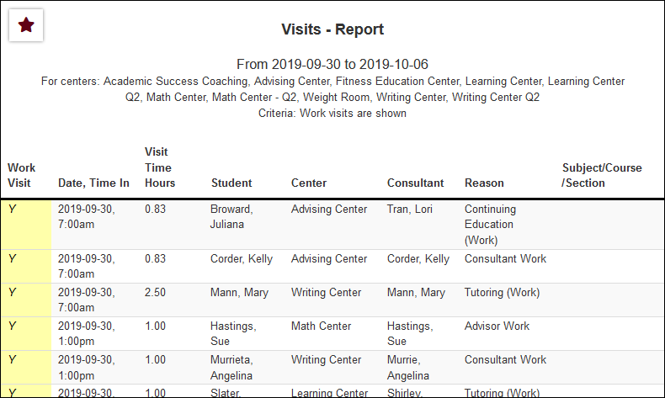
Report: visits by ??
The Visits by ?? report in the Students category can also be used to export Work Visits. Make sure “Show Work Visits” is checked in your report settings. [Only applies for Pay Basis: Consultant Work Time]

Slide 15
Resources for assistance
The TracCloud Wiki wiki.go-redrock.com/index.php/TracCloudGuideBasicsPayroll
Request Training www.go-redrock.com/help-support/request-training
Email our Helpdesk helpdesk.go-redrock.com
Call our Helpdesk 877-303-7575, option 1

Slide 16
Module & profile discount
We like to reward our conference attendees! For those that attend the 2024 conference, we are offering 10% off all modules and/or profiles for TracCloud if a quote is requested at the conference and purchase is made by 5/15/2024.
Please see Laura or email her at laura@go-redrock.com to request a quote!

