Slide 1
Transitioning to TracCloud: A Year In the Life
Alaina Peters (she/her/hers)
University of Cincinnati | Learning Commons
Notes:
introduce self and role at Learning Commons (Peer Tutoring, Success Plans, TracCloud SysAdmin)

Slide 2
Presentation Outcomes
Participants will...
Learn how the UC Learning Commons made changes to improve our TracSystem for both students and staff members
Learn how we adapted our approaches towards change to effectively balance progress with stability (including some change management theories!)
Apply components of this workshop to improve their own transition, troubleshooting, and communication processes for your TracSystem
Notes:
Jacob

Slide 3
UC Learning Commons
Large public university in Cincinnati – and growing!
36,402 undergrads, 11,512 grad/prof
1 "main" campus + 2 regional campuses
Free centralized academic support for UC students through various services
Provides services to help students and enhance their academic toolbox
13 Professional Staff, 6 Graduate Staff, & 300+ student staff
3 "Buckets", 10 Programs
First Year Experience
Content Support: drop-in tutoring, appointment-based tutoring, Supplemental Instruction, other group services
College Success: pre-scheduled one-on-one and group success skills-building
Notes:
Alaina

Slide 4
Transition Context
Summer 2022: Trac 4.0 --> TracCloud TutorTrac
2 SysAdmins: Courtney & Hannah
August 2022: Courtney leaves
January 2023: Hannah leaves
2 new SysAdmins: Alaina & Daniel
Notes:
Alaina

Slide 5
Road Map
Big Picture Transition: Trac 4.0 to TracCloud
Lewin's Change Management Model (Aktas et al., 2022)
Smaller Transition After TracCloud Implementation (Course-Based Reporting)
Kotter's Change Management Model (Kotter, 2023)
Long-Term Plans
Kotter's Change Management Model (Kotter, 2023)
A Few Other Changes We've Made
Take-Aways & Discussion

Slide 6
The Big Transition
Trac 4.0 to TracCloud: Summer 2022

Slide 7
Lewin's Change Management Model (Aktas et al., 2022)
Unfreeze
Change
Refreeze
Accepting changes
Understanding a change is needed
Opportunity for values clarification
Focus on short-term wins and communication strategy (share publicly!)
Becomes "business as usual"
Gathering everything required to make the change
Not always easy or welcome!
Can feel uncomfortable or uncertain

Slide 8
Applying Lewin's Model: Making the Transition to TracCloud
Unfreeze
Change
SysAdmins introductory trainings w/ TracCloud
Refreeze
Frustrations with Trac 4.0
Spent Fall 2022 using the platform as-is
TutorTrac "Meeting of the Minds" Group (Spring 2022) explored options
Opportunity to focus on student user experience
Training for all staff
Focus on the urgent/priority needs
TracCloud Working Group makes minor adjustments needed
Eventual plan to create manuals/FAQ's for staff users
Notes:
Unfreeze
Frustrations with trac 4.0: system outages, delays, appearance, slowness
Meeting of the minds explored both big-picture changes (researched other platforms) and small changes to make in the moment
Student user experience – values clarification
Change
Urgent/priority needs – creating the opportunities for students to connect with services and removing those barriers: creating profiles (one per service to allow for more diversification in how we create scheduling options for students. For example, Academic Coaching uses differen scheduling options than Peer Tutoring). Creating student and pro-staff profiles, creating schedules, uploading subjects for tutors
What we didn't prioritize: course specific reporting (took out a code that specifies course offered at one college from another with assumption that the code had to be viewable to students and would cause confusion). Also didn't prioritize thinking about SI/batch visit upload process (because that's not a barrier for students)
Esp important b/c of only 3 weeks in between spring and summer semesters
Refreeze
Make minimal changes – only maintenance-oriented fixes such as scheduling rules not being set up correctly
Opportunity to really monitor things as they are and establish consistency – esp important b/c traccloud is not our full-time job!

Slide 9
Smaller Changes
Course-Based Reporting

Slide 10
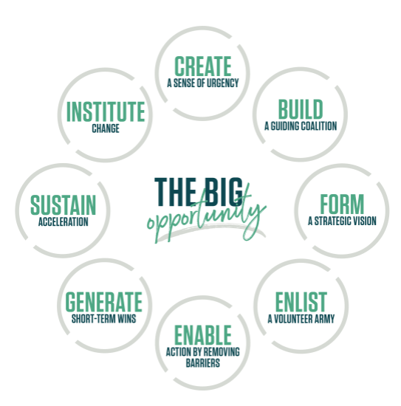
Kotter's Change Management Theory (Kotter, 2023)

Slide 11
Applying Kotter: Course-Based Reporting
Sense of Urgency (Spring 2023)
identifying scope of the problem using multiple stakeholders
14% incorrect faculty on Group Review Session weekly visit report
Courses not showing up on Supplemental Instruction weekly reports
Challenges reporting service usage to faculty & advising
Notes:
Urgency created by 1.) the student user experience going pretty well and 2.) the platform becoming more trusted and therefore SI and Group Review Sessions wanting to use TracCloud to report out to campus partners and faculty about their services' visits

Slide 12
Applying Kotter: Course-Based Reporting
Enable Action by Removing Barriers
"clear the way for people to innovate, work more nimbly across silos, and generate impact quickly“ (Kotter, 2023)
Identifying why issues took place
screenshots, videos, meetings, & spreadsheets!

Slide 13
Applying Kotter: Course-Based Reporting (cont.)
Enlist a Volunteer Army
Working with IT and TracCloud staff to remove those barriers
Deactivating old registrations
Re-inserting college code
Involve other Learning Commons staff in continually identifying issues and creating workable temporary alternatives
Notes:
Involving other LC staff: Associate Director for data helping develop work-arounds to stitch different data points together to provide the reporting needed

Slide 14
Applying Kotter: Course-Based Reporting (cont.)
Generating Short-Term Wins
Keeping internal and external partners updated on timelines
Reporting to staff when changes are made (staff meetings, campus partners)

Slide 15
Long-Term Plans

Slide 16
Applying Kotter: Long-Term Plans
Sustain Acceleration
SysAdmin meetings, office hours, & update document
Clarifying reporting/troubleshooting process & empowering professional staff
First pro-staff (screenshots + examples), then SysAdmins, then TracCloud

Slide 17
Applying Kotter: Long-Term Plans
Institute Change
Next Steps: create TracCloud pro-staff and student-staff user manuals and troubleshooting guides

Slide 18
A few other changes we made!

Slide 19
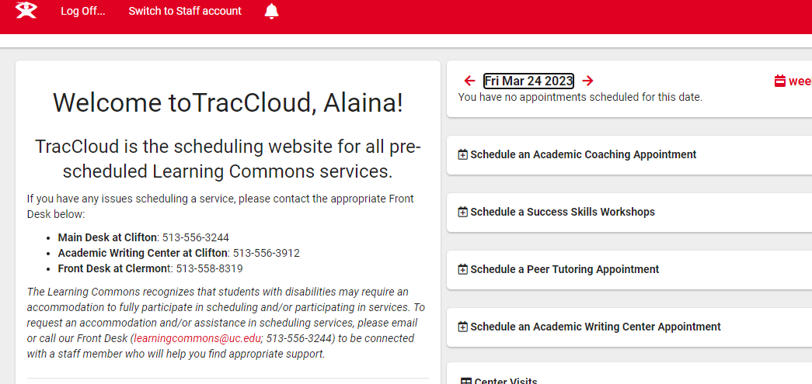
Other Changes Made: Accessibility Statement

Slide 20
Other Changes Made: Separate Scheduling Widgets

Slide 21
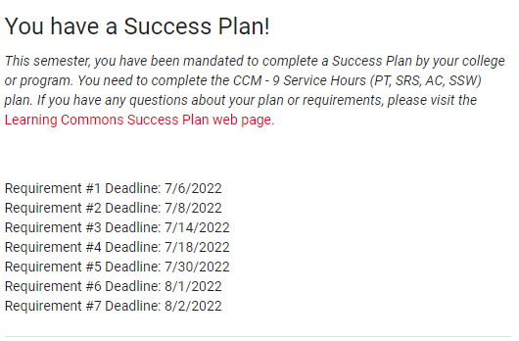
Other Changes Made: Student View of Success Plans

Slide 22
Take-Aways
Use questions to create policy/procedure documents for users
TracCloud transition presented opportunities.
Improved student experience
More customizations --> more opportunity for staff user errors!
Define urgency
Empower non-SysAdmin staff
Communicate!
Internal staff: changes as they come & SysAdmin expectations
Campus partners: how to use new platform & reporting
Sustain momentum.
Document changes
Create a troubleshooting/triage process.
TracCloud: well-documented feedback
Expanded reporting options
Notes:
Traccloud transition presented many opportunities
Improved student experience: much less technical difficulties/outages, seeing usage up in general, studens can view Success Plans in somewhat real time, students see TracCloud as integrated with other university websites
Expanded reporting options – CSV files, comfort sending directly to more campus partners
More customizations (separate profiles) --> more opportunity for staff user errors. For example, if changing a link on our website, we have to change that in all of our appointment-based centers' emails rather than just one
Create a troubleshooting/triage process
Define urgency (values-based). Example of Front Desk supervisor saying that ALL students were counted as no-shows for online appts one day. Looked into the fact that 1.) this wasn't true and 2.) was only impacting a small number of students. Defining urgency as hundreds of students being blocked from scheduling (Teams message) vs everything else can be an email – again, this isn't our full time job
Empower non-SysAdmin staff: when SysAdmins troubleshooting, show pro-staff what they could do to solve the problem the next time
Communicate
Internal staff: share changes as they are happening (in case this impacts other programs or gives them ideas) and share what they can reasonably expect of SysAdmins and how they want communication (email if it can wait 1-2 days, Teams if it's urgent)
Campus partners: how to use new platform (letting them know where instructional video is on website) and how they can receive reports on services – and options they have (for example, campus partner wanted to know whether their students were attending services online or in-person – simple click of a button!)
Traccloud: well-documented feedback – screenshots, multiple examples, what we've tried already
Sustain Momentum
Document changes – what we want to do
Use questions to create policy/procedure documents for users – summer project – esp important for anticipating staff turnover

Slide 23
Discussion
Transition
How does your team identify TracSystem transition needs?
Troubleshooting
How does your team triage troubleshooting needs in your TracSystem?
What are SysAdmin roles versus other staff roles in the troubleshooting process?
Communication
How does your team document and report on TracSystem changes?
How does your team implement TracSystem changes?
How does your entire team maintain TracSystem knowledge (not just SysAdmins)?

Slide 24
Lewin's Model (Aktas et al., 2022)
Kotter's Model
(Kotter, 2023)
Unfreeze
Change
Refreeze
Accepting changes
Understanding a change is needed
Opportunity for values clarification
Focus on short-term wins and communication strategy (share publicly!)
Becomes "business as usual"
Gathering everything required to make the change
Not always easy or welcome!
Can feel uncomfortable or uncertain

Slide 25
References
Aktas, M., Mert, R., Erdem, S., Gokce, S., & Kurban, C. (2022, December 27). Lewin's Change Model - Everything You Need To Know. UserGuiding. Retrieved March 28, 2023, from https://userguiding.com/blog/lewins-change-model-theory/#:~:text=Lewin%20developed%20the%20change%20model,into%20a%20new%20state%20altogether!
Kotter, J. (2023, March 8). The 8-step process for leading change: Dr. John Kotter. Kotter International Inc. Retrieved March 28, 2023, from https://www.kotterinc.com/methodology/8-steps/

Slide 26
Questions?
Alaina Peters | University of Cincinnati Learning Commons
Peer Tutoring Supervisor, Success Plans Manager, & TracCloud Co-SysAdmin
alaina.peters@uc.edu

