Slide 1
Training, Work Plans and Reporting
How we keep track of our consultants
Latrice Bowman • University of Alaska Fairbanks

Slide 2
Overview
Some Changes Affecting our Usage
Our Employees
Training/Onboarding
Work Plans
Reporting

Slide 3
Dept Math and Stat to…
New Student Success Center
Some early successes
Expanded tutoring and resources from math and stat to most of our undergraduate population
Doubled the number of student visits from Fall-to-Fall numbers
Improving collaboration between the different centers

Slide 4
Our Employees

Slide 5
Our Student Success Center “Consultants”
Tutors
Teaching Assistants (~35)
Undergraduates(~20)
Faculty (~10)
Professional (~5)
Other Staff
Academic Coaches
Advisors
Supervisors

Slide 6
Training and Onboarding

Slide 7
Training and Onboarding
Fall Training
Go through TracCloud
Set up profiles
Kiosks
Appointments
Logging Hours
Work Plans
The student-side
Center specifics
Specifics of Tutoring
In-person
online
UAF Trainings
Timesheets
Schedules/Time-off

Slide 8
Training and Onboarding
Spring Training as needed for other hires
Go through specific information in individual meetings
Kiosks
Appointments
Logging Hours
Schedules
Timesheets/Time off
Have some online modules in Canvas

Slide 9
Work Plans

Slide 10
Work Plans
Pros
Easily send out to all employees
Easy to keep track of
Can run a report to see completion
Cons
Some bugs to work out
uploading their documents
Would like some other options

Slide 11
Work Plans
Four types
New UA Employee Trainings
Recertification of Employee Trainings
New Semester Availability
Special Availabilities

Slide 12
Work Plan Examples
New UA Training
Schedule Availability

Slide 13
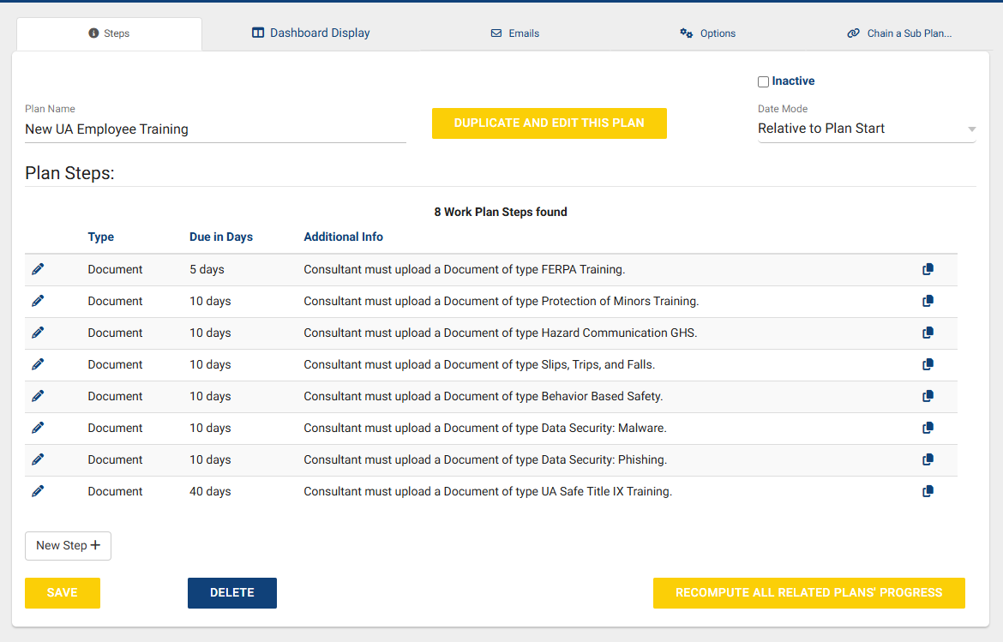

Slide 14
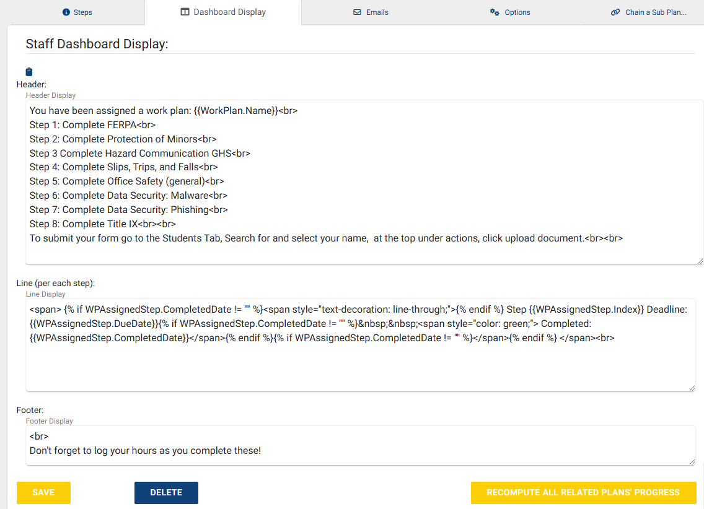

Slide 15
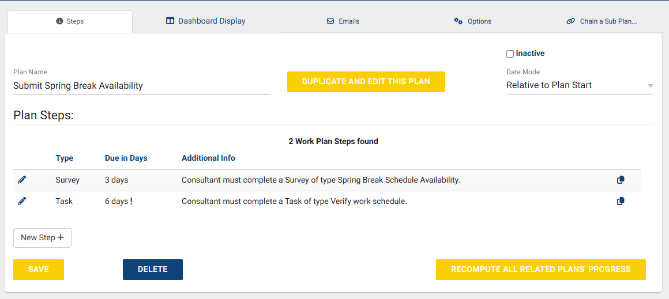

Slide 16
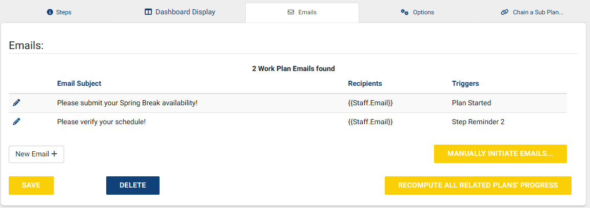

Slide 17
Reporting
and
Reporting Demos

Slide 18
Reporting: DMS/SSC
What is needed
Day/time Information (Visits by week by center)
Who is using (Visits by/Appointments by?, Visits by Faculty/subject)
What is missing (Outstanding appointment request)
Comparison to other semesters (Appointment Utilization Comparison, Usage Snapshot-Date comparison)
Budgeting (Payroll)

Slide 19
Reporting: For supervisors and other stakeholders
Payroll
Training
Certifications/Documents/Work Plans
In Person vs Online Appointments
Initial Visit
Center Usage

Slide 20
Next steps
Implementing Q2 Tables
Mostly for math/stat in-person drop-in center to track mini-visits but also to include online students in our drop-in center.
Improve Work Plans
Tutors cannot currently upload their certifications into a work plan, we have a work around using documents but this is still very manual for the supervisors.
Re-implement Student Success Plans
This was put on hold as we opened the SSC.
Better Utilization of Surveys
We have some that we are using but have areas where more input from students would be beneficial.

Slide 21
Thank You for attending this presentation
Dr. Latrice Bowman
lnbowman@alaska.edu
University of Alaska Fairbanks

