Slide 1





Scheduling Settings & Configuration
Appointments, Availabilities Settings & Reports
Luis Frias
2026 Virtual TracCloud Conference

Slide 2


Topics We Will Cover
What's new with Scheduling Rules
Profile Settings – Center Bio
Group Access
Profile Scheduling Rules
Search Availability Options (Global)
Report on Scheduling data
2026 Virtual TracCloud Conference

Slide 3

What's New With Scheduling Rules
November 2025
Allow the Asynchronous title preference to be shown on availability and appointment entry
September 2025
Added a new functionality for choosing a staff record in lieu of a student record for appointments
Added ability for stacked availabilities to differentiate recurring appointment settings per center
June 2026
Added ability for students tutors to show their classes on the schedule
March 2025
Added ability for staff to create new outstanding appt requests
April 2025
Added Custom Fields to Outstanding Appointment Requests
Added Saved Searches, Selection capability and Show these Students to the Outstanding Appointment requests
2026 Virtual TracCloud Conference

Slide 4

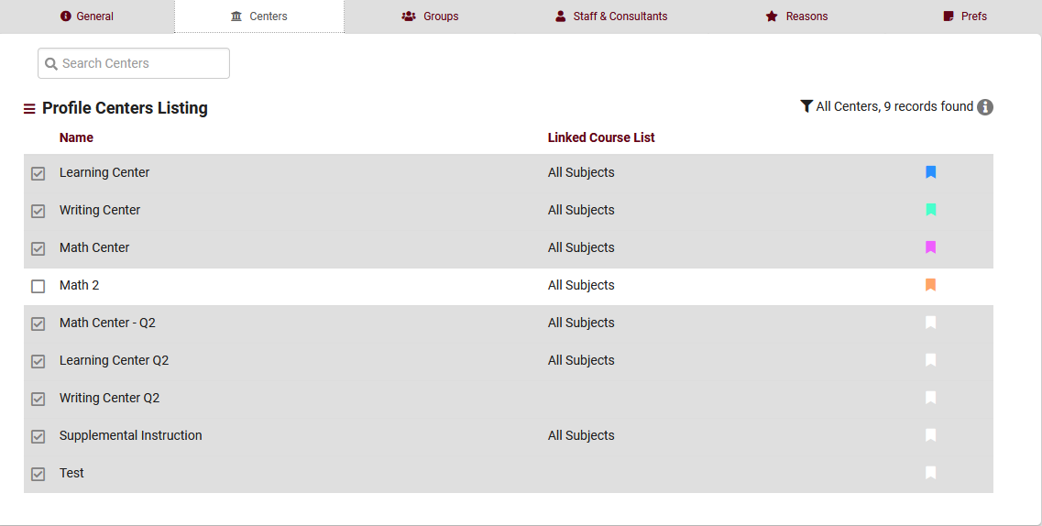
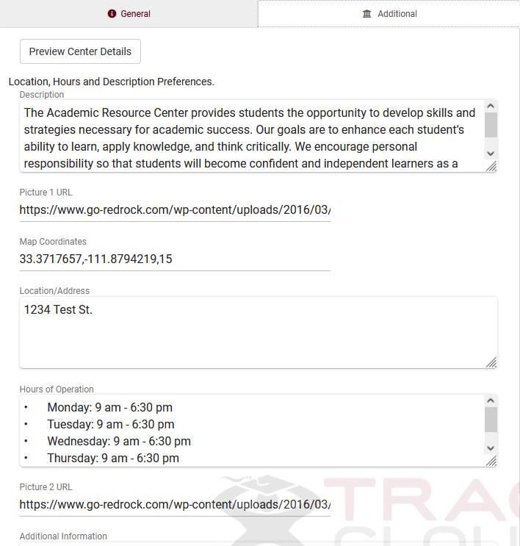
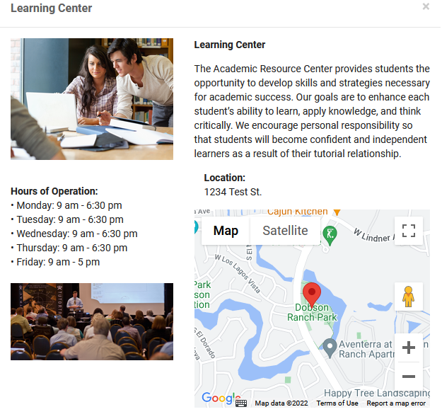
Center Bio
Create a Center BIO for each of your centers to provide additional details to your students such as location, hours of operation and more!
2026 Virtual TracCloud Conference

Slide 5

Profile Settings
Time Restrictions is used to control how soon or how late an appointment may be booked or cancelled
Special Fields is used to control which of the certain fields will be available for entry in Availabilities and Appointments for all centers linked to this profile
Other Schedule Options is used to control certain additional access restrictions to appointment scheduling functionalities
Appointment status choices is used to list all the appointment statuses that you will use to track appointments
Max appointment rules are used to prevent too many appointments from being booked by a student or multiple students for a certain period of time
Appointment Display is used for controlling how an appointment is displayed to the various users using Twig commands.
2026 Virtual TracCloud Conference

Slide 6

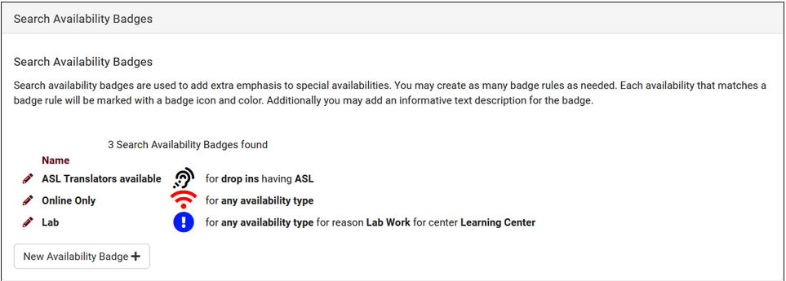
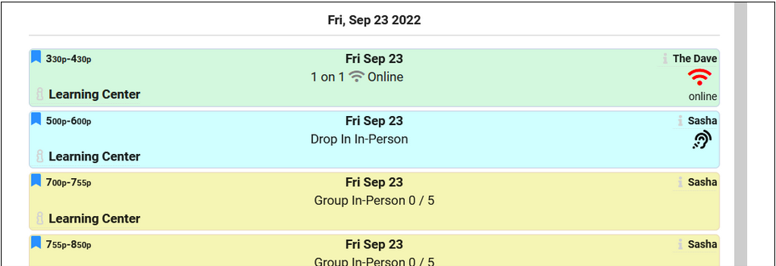
Search Availability Badges
Search Availability badges can be used to add information and indicators to availability slots. Each badge can appear in specific contexts, based on center, section, location, skills/accommodations, etc.
2026 Virtual TracCloud Conference

Slide 7

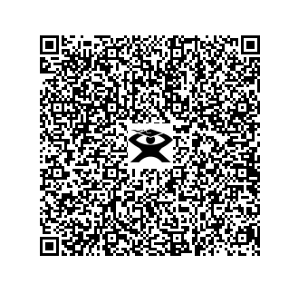

Schedule with Me
Student Information:
Password: 1918
User: 1918
2026 Virtual TracCloud Conference

Slide 8

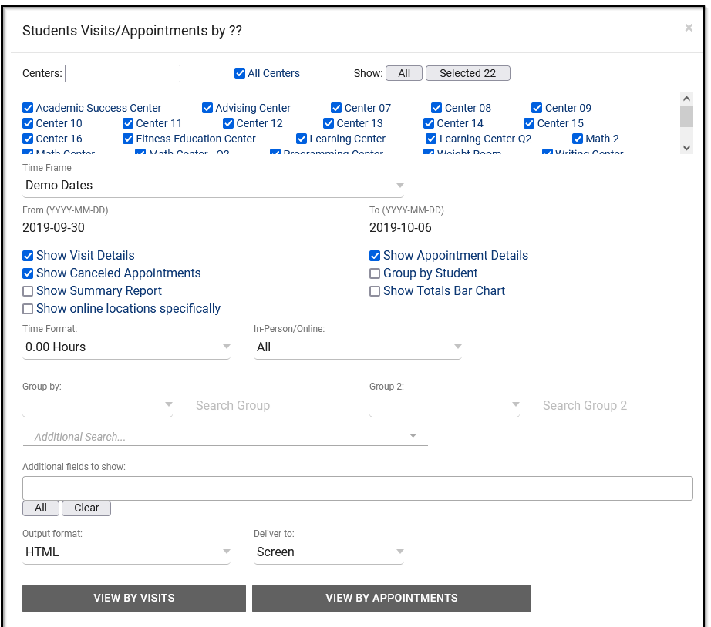
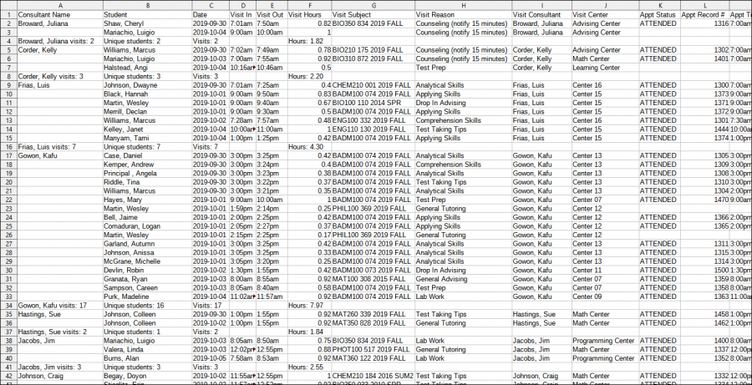
Reports
Consultant Specialties- List the Subject or Subjects and sections each staff member specializes in. This Report can even specify which specialties for which consultants in a specific center.
Outstanding Appointment Request – Will allow you to view all outstanding request for appointments. Any student who was not able to find an availability can report and then request assistance
User Detail – Report - This report will display Each Staff and the details of there account. The is useful to ensure all staff have a group, Email, and phone numbers assigned to their account.
2026 Virtual TracCloud Conference

Slide 9

THANK
YOU
I appreciate your participation and look forward to any questions or discussions.
Questions
2026 Virtual TracCloud Conference

