Slide 1
Staff Account Setup & Management:
A Guide for Creating Staff Accounts
Luis Frias

Slide 2
What's new with Staff Accounts
Added options to Link Supervisor
Added “Title or position”
Staff Listing – Duplicate Staff Option
Staff Listing added “Search Active Only” option
Search Staff by Subject and Reason specialties
Staff Bio text editor can add embedded images & Hyperlinks
Student photo can be shared to linked Staff acct
Option to navigate directly to staff account

Slide 3
User Levels
Staff accounts can access different parts of the system, edit visit/appointment data, and create availability/appointments, etc. However, this user level cannot access the Center Profiles or Global Settings.
Profile Admins can have all the same permissions as a staff account, along with the ability to access and manage the List and Center Profiles. However, this user level will not have access to the Global Settings.
SysAdmin accounts have even more permissions than staff. SysAdmins can edit Staff profiles and Group Settings, as well as have full access to delete options, lists, and more. SysAdmins will have the ability to edit and view everything in the system, including the Center Profiles and Global Settings.

Slide 4
Groups
Groups allow you to edit the permissions for a collective of staff accounts.
Choose the profile, centers, visits, student data, data tables, etc. that a staff member in this group can edit and view.
There is no limit to the number of groups you can create, so feel free to create as many groups as needed for your institution.

Slide 5
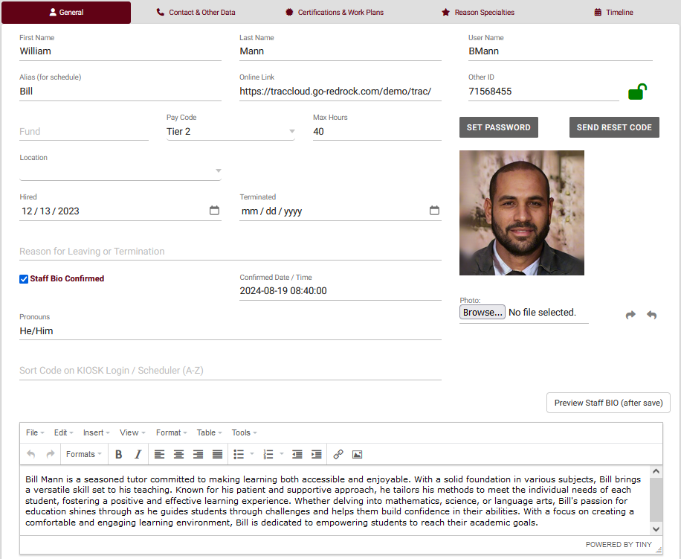
Creating a staff account
Other > Listings… > Staff > > New Staff Member
Fill in the details for this staff ! Items to note:
If this is a student staff worker, ensure the username matches their student account.
If you want to display a name for this consultant without revealing their real name, create an alias.
If this staff will be meeting with Student check the Consultant Check box.

Slide 6
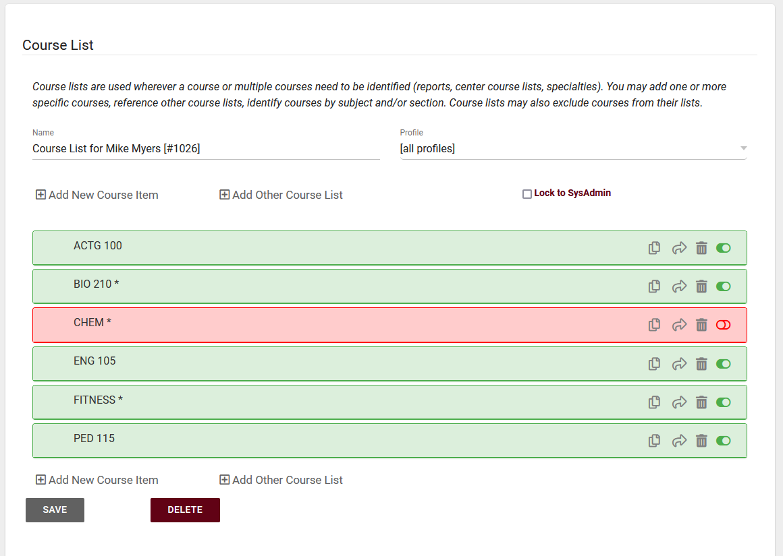
Managing Course List
Course Lists allow you to define what courses a consultant can and can not assist with.
We can use wildcards to broaden what a staff can assist with and to save time with creating the course list.
After saving a course list, we can see all courses that the staff has been assigned to.

Slide 7
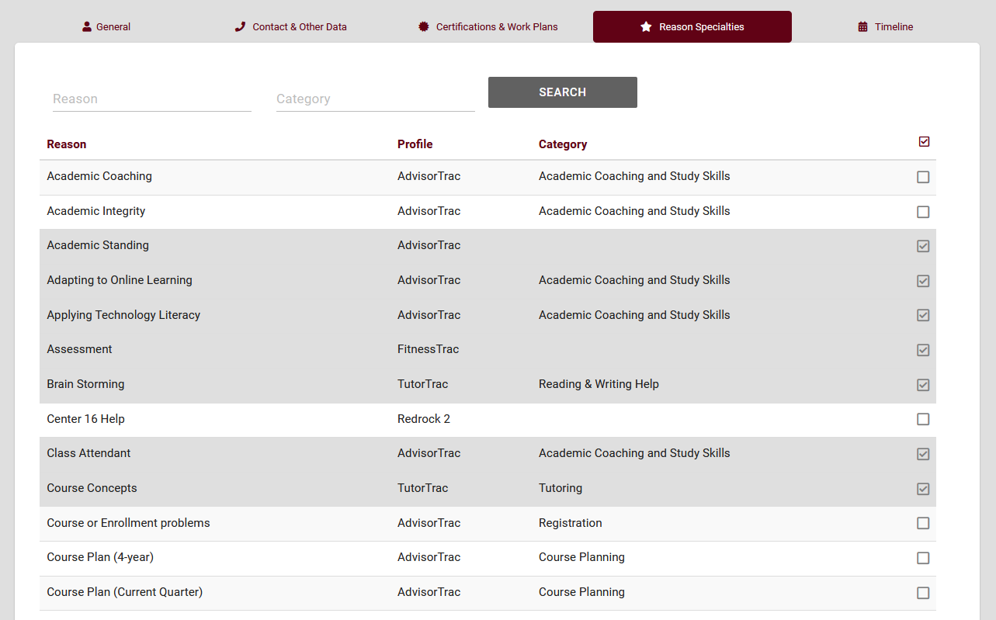
Reason Specialties
The ‘reason specialties’ tab allows us to assign reasons to a staff member. Reasons allow staff to specify the services they specialize in.
Reasons will work alongside the staff’s course list when a student searches for availability.

Slide 8
Certifications and work plans
Work plans are assignable multi-step plans that allow staff to track their progress towards a goal. Each step can be based off of visit time, number of appointments, tasks, and more!
Certifications allow you to track and manage different certifications a staff has right into TracCloud.

Slide 9
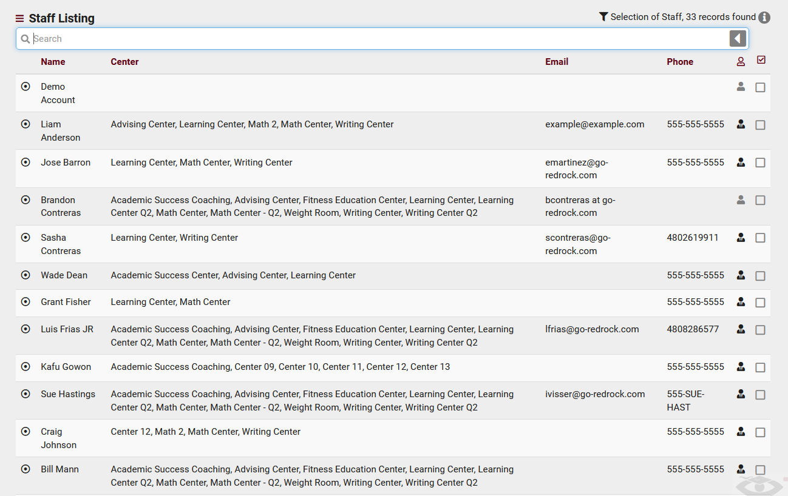
Staff listing
You can view staff information, search for staff, send batch emails, and much more!
If you want to view specific staff information on this page, you can change the view and even export the listing as a CSV!

Slide 10
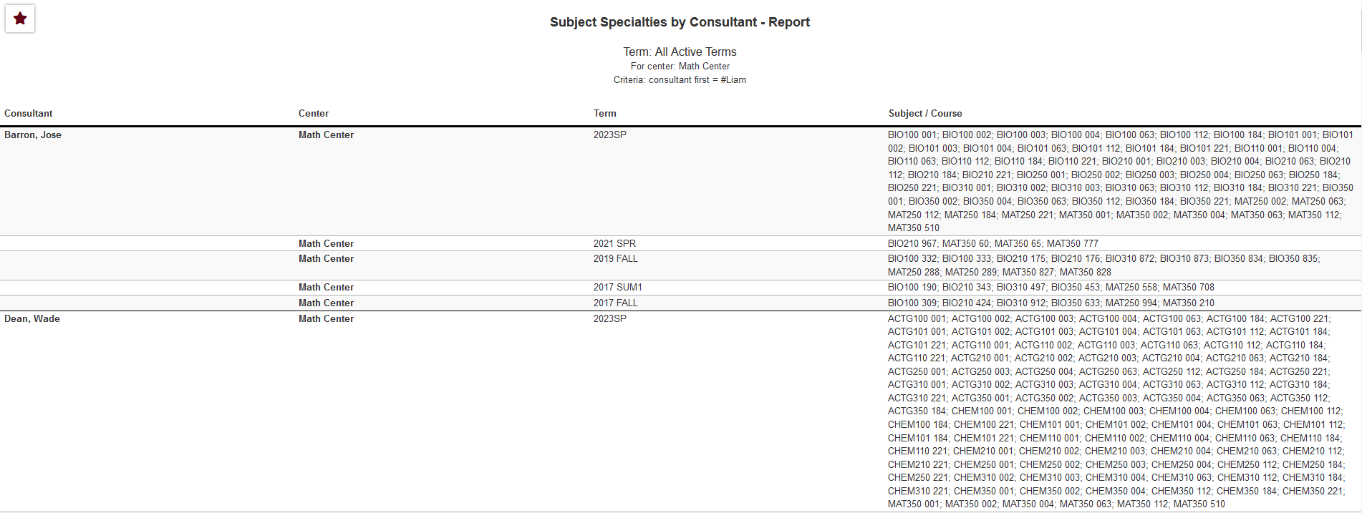
Staff Reports
You can run reports that allow you to get more information on all subjects/reasons our consultants can assist with, their availability, visits with students, appointments, and work visits.
Higher level staff such as SysAdmins and Profile Admins can run additional reports, such as payroll.

