Slide 1
Visits Setting and Configurations
Iliana Visser

Slide 2
New Since Last Year
Added total visit records count to Center Visits widget for students on main menu
Added another time format for visit information display
Added ability to show a calendar icon on Visit Log Listing when visit is linked to a pre-scheduled appointment
Added Student Flag icons as an option for the Log Listings and KIOSK Listings
Added the option to choose This Week or Last Week for dashboard status charts
Added online to custom KIOSK options
Added Sort by Reason to the Log Listing sort options
Added new group privileges to prevent access to batch visits
Added ability to auto log a student in at KIOSK if single record found on ID or ID2 match occurs
Added an option for preventing KIOSK QR Codes from being clickable

Slide 3
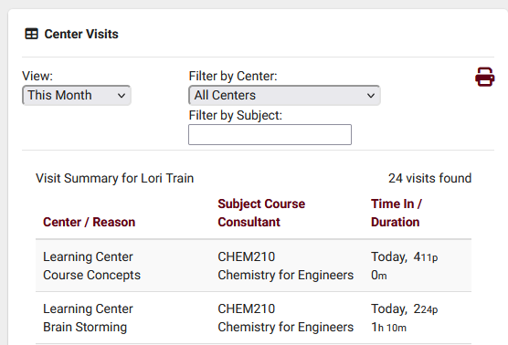
Added total visit records count to Center Visits widget for students on main menu
Visit Summary will list total visits for the Students Center Visits widget

Slide 4
Added another time format for visit information display
Standard Time (g:i:sa) option be added to the date/time format with no date information.

Slide 5
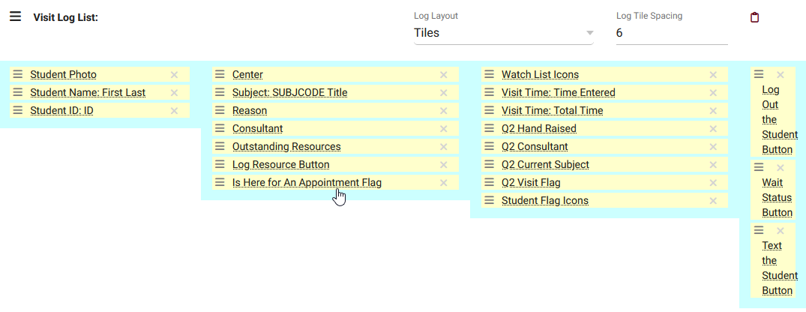
Added ability to show a calendar icon on Visit Log Listing when linked to an appointment
A calendar icon on Visit Log Listing will appear when the visit is linked to a pre-scheduled appointment

Slide 6
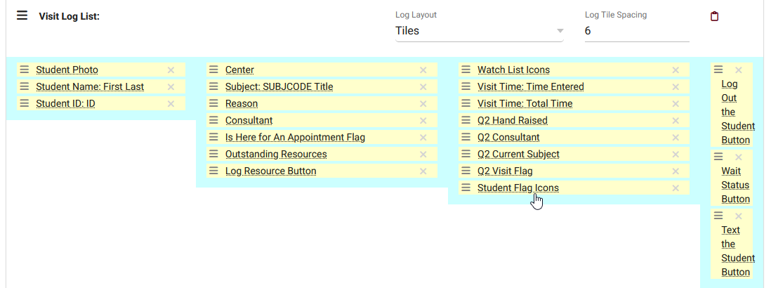
Added Student Flag icons as an option for the Log Listings and KIOSK Listings
System preferences allow you to set different colored flags based on the value found in the Students "Flag Information."

Slide 7
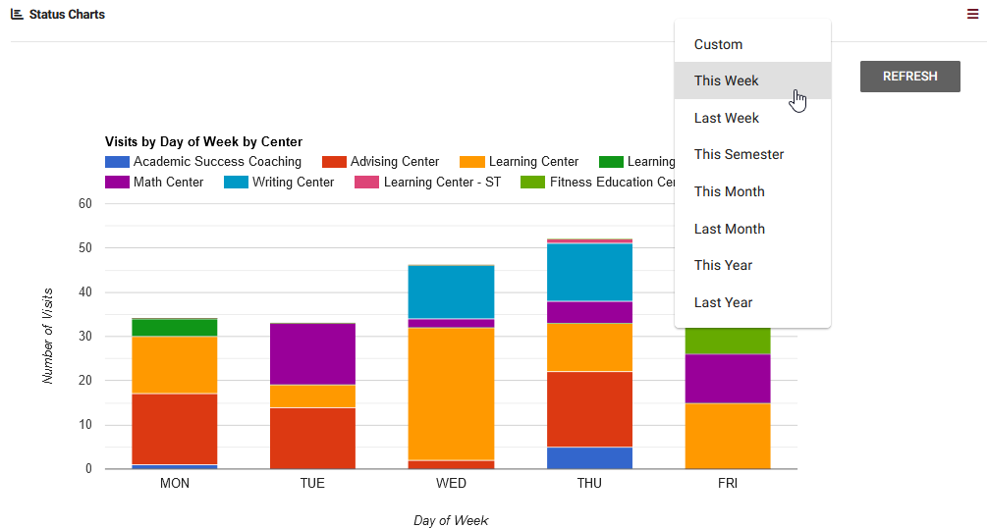
Added the option to choose This Week or Last Week for dashboard status charts
You can now select “This Week” or “Last Week”

Slide 8
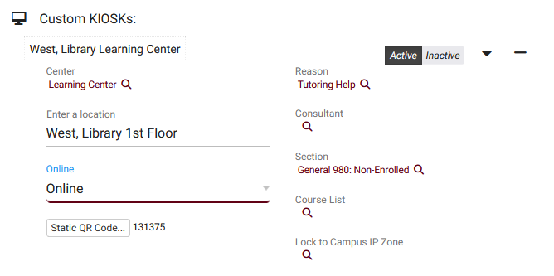
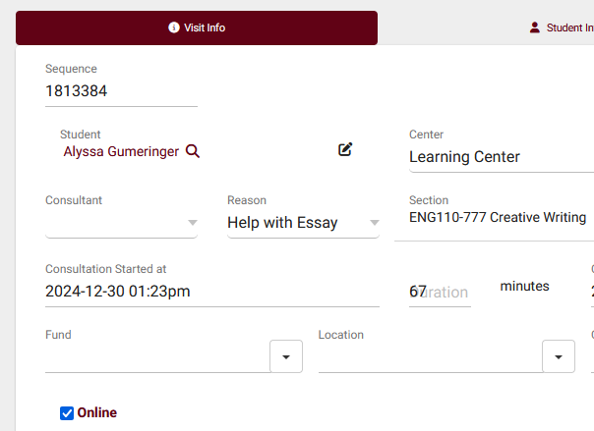
Added online to custom KIOSK options
You can now preselect the Meeting Type (Online/In-Person)

Slide 9
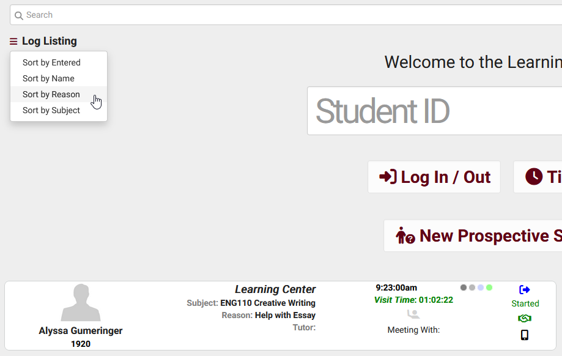
Added Sort by Reason to the Log Listing sort options
The button can be used to sort the log listing by other fields.

Slide 10
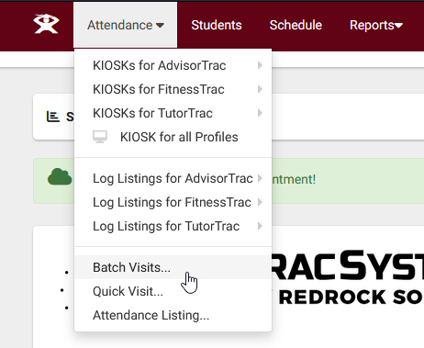
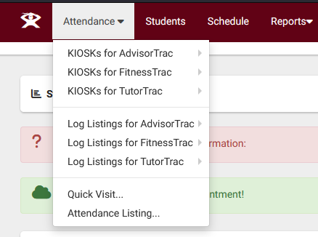
Added new group privileges to prevent access to batch visits
If checked, users in this group will be unable to record visits with the Batch Visits utility.

