Slide 1
Onboarding Essentials: Staff Management, Scheduling, and Reporting.
By Sasha Contreras

Slide 2
Who can contact Support?
The two main sysadmin contacts on file are able to reach out for support
If your approved contacts needs to be adjusted, please contact Laura Reed (laura@go-redrock.com)
Support includes Demos, 1 hour training calls, helpdesk ticketing system (helpdesk@go-redrock.com) and helpdesk phone number (877-303-7575)

Slide 3
Where to Start?
Request A Demo: https://www.go-redrock.com/demo/
Redrock Wiki: https://wiki.go-redrock.com/index.php/Main_Page
Contact Support by HelpDesk at https://go-redrock.helpspot.com/
Schedule A Training: https://www.go-redrock.com/help-support/request-training/
Contact Support by Phone: 877-303-7575 option 1
(Emergency – System down, can’t access anything! Option 3!)

Slide 4
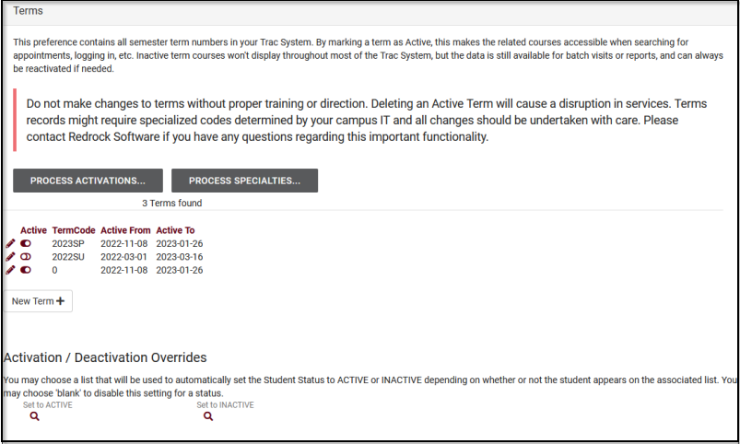
New Semester Changeover
Other > Preferences > Terms
Have IT send new student and registration files to the SFTP
Deactivate Old term
Active New term
Process Activation > Process Specialties

Slide 5
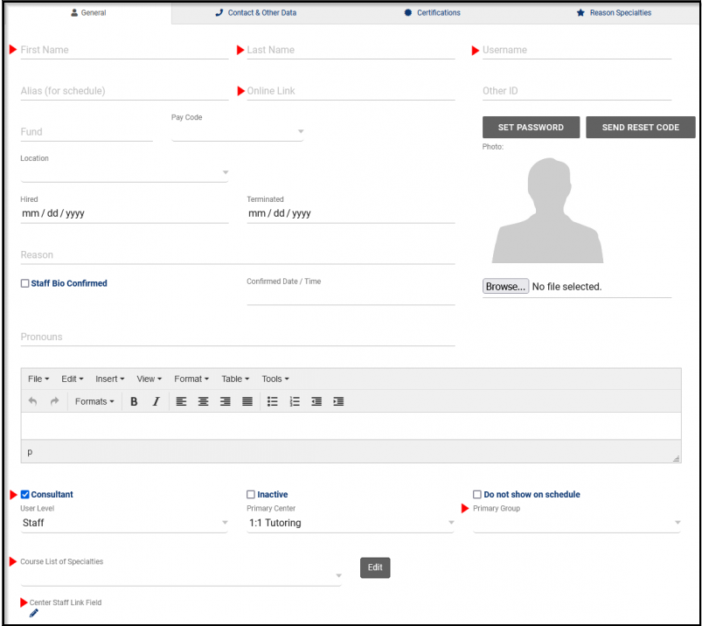
Managing/Creating Staff
Other > Listings > Staff
First Name
Last Name
Username
Online Link
(used for virtual appointments)
User Level/Consultant Box
Primary Group
Course List of Specialties (Tutoring)
Reason Specialties (Advising)
Center Staff Link Fields

Slide 6
Staff User Level
SysAdmin, Profile Admin or Staff
Unique to SysAdmin Accounts
SysAdmin accounts provide the highest level of access in your Trac System, that includes potentially sensitive data, utilities to modify data in bulk, and the ability to edit technical aspects of your TracCloud instance on a global setting (terms, search widgets and welcome messages).
Profile Admin
Profile Admins still have access to many important settings and functions in TracCloud. Profile Preferences and Group Management are still available, but potentially dangerous or sensitive utilities are hidden.
Profile Admin is normally restricted to one or more profile to manage and make changes for (scheduling rules, login and out rules, email reminders, etc)
The global preferences are hidden.
Staff (User)
Staff will have the access in the system based off the permission group they have been assigned to. This can give them access to Loging in Students for a visit, scheduling an appointment or running reports. OR it can limit the staff to only search for open availability but not compleating the booking process.
Staff (Consultant)
Staff (Consultants) will allow the staff to follow the access based off of group permissions. Checking the box for consultant will allow this induvial staff member create their own availability block or have the SysAdmin create the available time slots that staff is available for.

Slide 7
Deactivating Old Staff
All inactive staff are still in the system for data purposes. If needed they can always be re-activated.
Note: Never delete staff records as they are used to identify the staff member the student worked with in reports.

Slide 8
Checking or Editing Group Permissions
Permission groups determine what kind of access your staff have to various elements of TracCloud. Each group represents a set of permissions and what “rules” they follow when being able to access areas of the system.

Slide 9
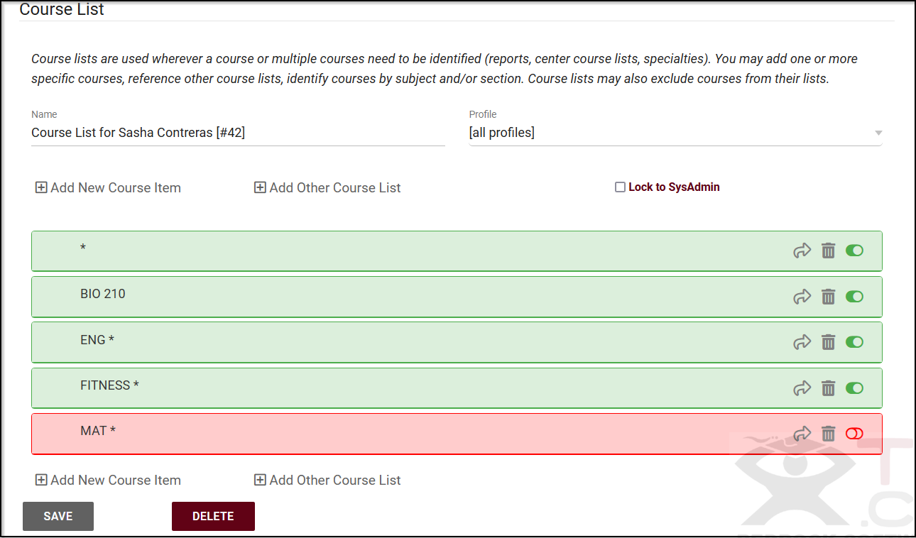
Update Course List(s)
Other > Listings > Course Lists
Course Lists act as assigned sections or specialties in TracCloud, allowing you to determine which courses each of your consultants can assist with, and which courses are available in each center

Slide 10
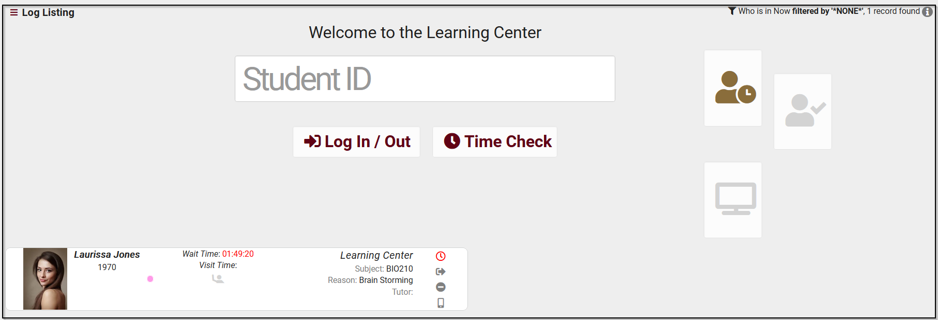
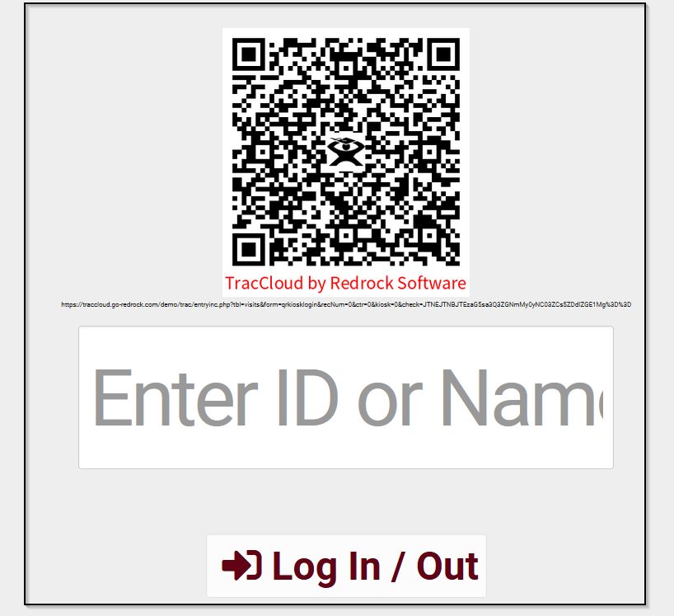
Recording Visit Data
Attendance
KIOSK
Log Listing
Used as student facing login. KIOSK can have a QR code displayed for touchless sign in (using mobile device).
Students can also use a barcode scanner to log into a center if that campus has one.
Used by staff to view students who are currently logged in to the system for a visit.

Slide 11
Creating a List Of Students
Centers may require that only certain students are allowed to log a visit to the center. This can be done by adjusting the preference in the center entry screen to constrain logging visits to students from a certain list.
Centers may also require that only certain students be allowed to book an appointment in a particular center.
Lists might be used for grouping certain student populations, like students that participate in a particular sport - this list of students might be particularly important to a coach.
Lists might also be used to categorize students that qualify for a certain program where those students need to be reported on easily.

Slide 12
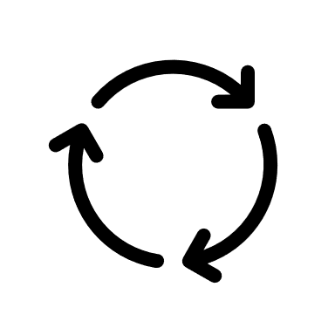
Static and Dynamic Lists
Dynamic Lists
Dynamic Lists are lists where you provide search criteria that describes the students that belong to the list. Each time the list is displayed the stored search criteria is executed to find the list of students that match the criteria. Students will be added or removed from the listing automatically in the system based on the specific search criteria that was selected.
Example: A nursing Major being dynamically listed in “Nursing,” this means that anytime the value of the Major changes for a student, the student is automatically added or removed to this list based on that dynamic identifier the list was created for.
Static Lists
Static Lists are a list of students that you are created by manually adding or removing students.
The student(s) will stay on the list until you remove the student manually.

Slide 13
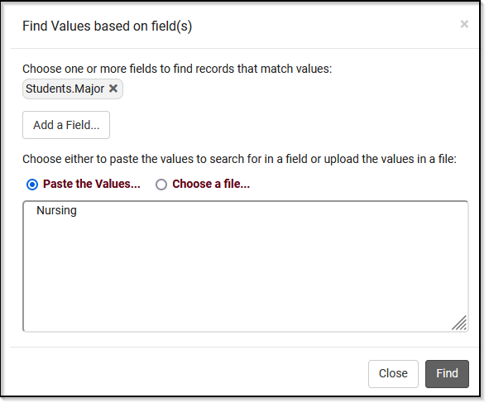
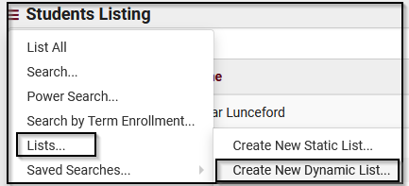
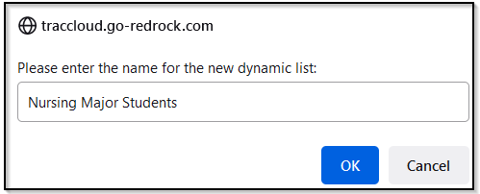
Searching for Students
Adding students to a list

Slide 14
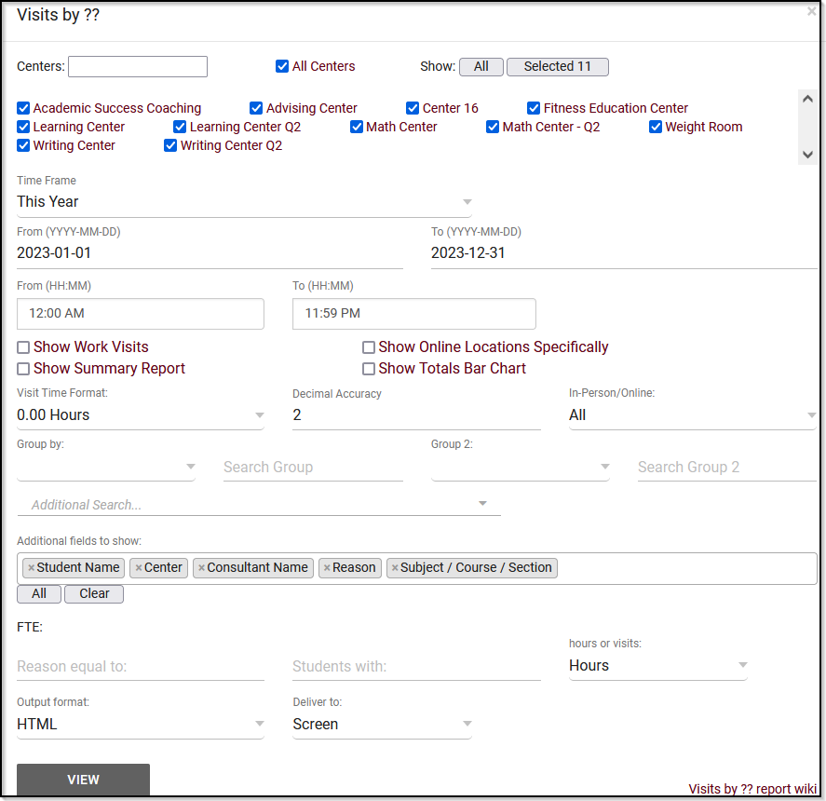
Reports
Any report can be saved as a favorite and automated.
Reports will also have the option for CSV exports!

