Slide 1
Navigating Traccloud
Getting Started with TracCloud Reports
Erick Martinez

Slide 2
What’s New
New Permission Group for Report access
Average Logins added to the Logins by Hour by Day of Week Report.
Email Consultants from Visits By?? Report
Group visits by week/month in Visits by??
Group by meeting type in Visits/Appts by??

Slide 3
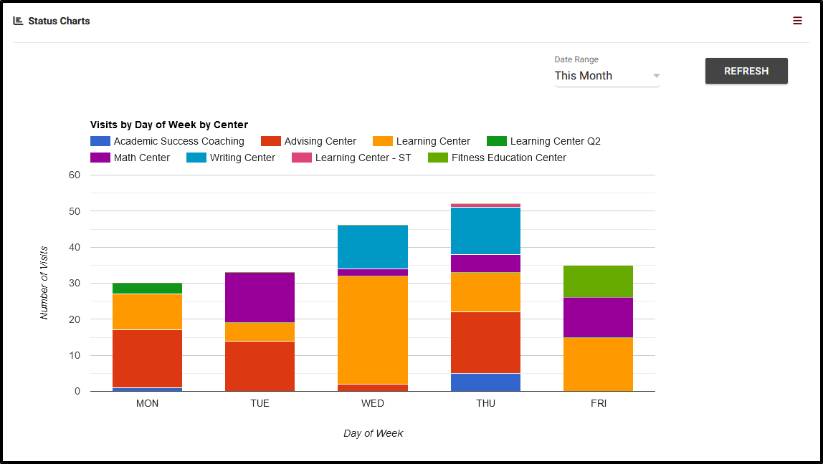
Topics
Status Charts, Center Status
Overview of Report Preferences
Visit Reports
Schedule Reports
New TracCloud Reports

Slide 4
Report Preferences
The Reports Access, found in Group Permissions, allows administrators to manage access to reports, allowing full, limited, or no access to specific reports. Some reports are restricted based on User Levels regardless of group.

Slide 5
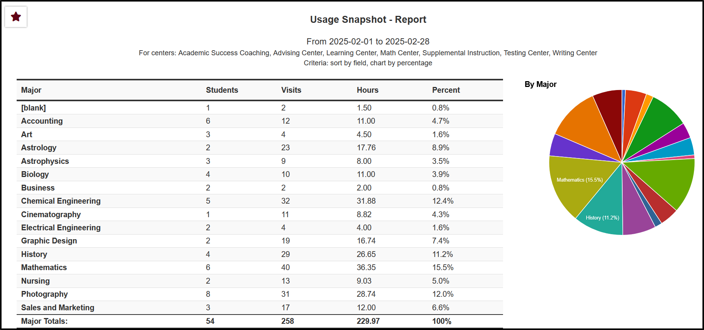
Visit Reports
TracCloud offers a range of Visit Reports, accessible through the Report drop-down menu in either the Students or Management sections. Examples of available Reports include the Usage Snapshot, Logins by Hour by Day of Week, Students Visits Summary, and the Visits by ?? Reports.

Slide 6
Scheduling Reports
Scheduling related reports are available in the Scheduling or Students categories within your Report drop-down menu. Some of the Scheduling Reports include:
Appointments/Availabilities by Hour by Day of Week
Optional: In-Person vs Online Appointments
Students Visits/Appointments by ??

Slide 7
New Reports
Resource Listing
Average Wait Time
Visits by Week by Center
3 New Workshop Reports:
Students Workshops Attendance
Workshops Overview
Workshop Roster

