Slide 1


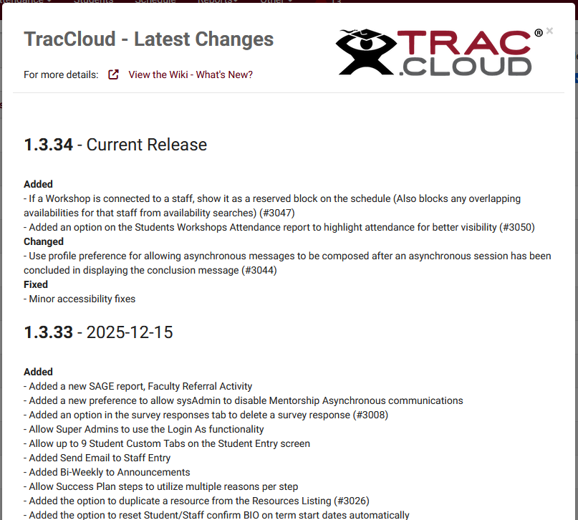
What’s new?
Part 1:
Assessments, Custom Forms, TracFlow, and Peer Mentoring
Aidan Murray
2026 Virtual TracCloud Conference

Slide 2

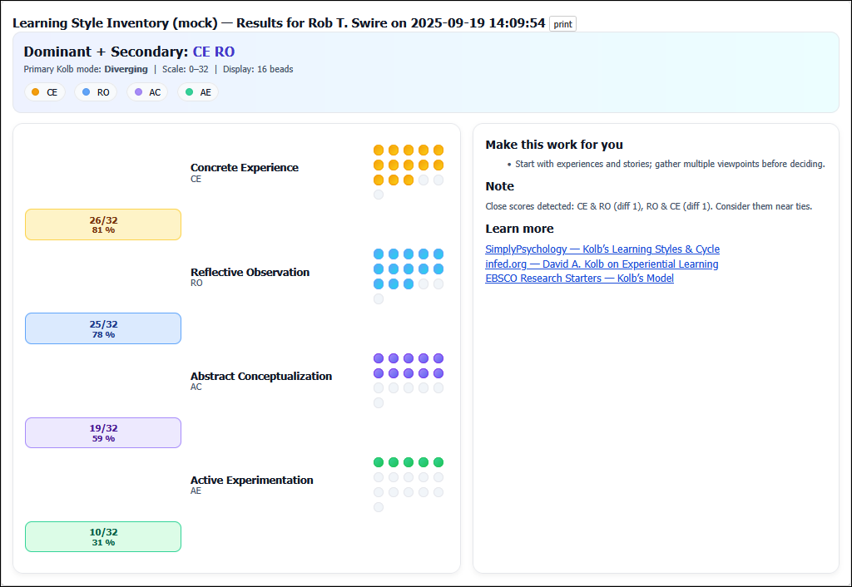
Assessments
Assessments allow you to create customizable questionnaires that can be used for a variety of purposes, from evaluating learning styles and study habits to exploring cognitive abilities. After completing the questionnaire, students receive personalized feedback and targeted support in areas where they may need improvement.
Students and staff can generate a self-assessment from their dashboard with the Assessments widget, or a link/QR code can be shared with them to initiate an assessment
2026 Virtual TracCloud Conference

Slide 3
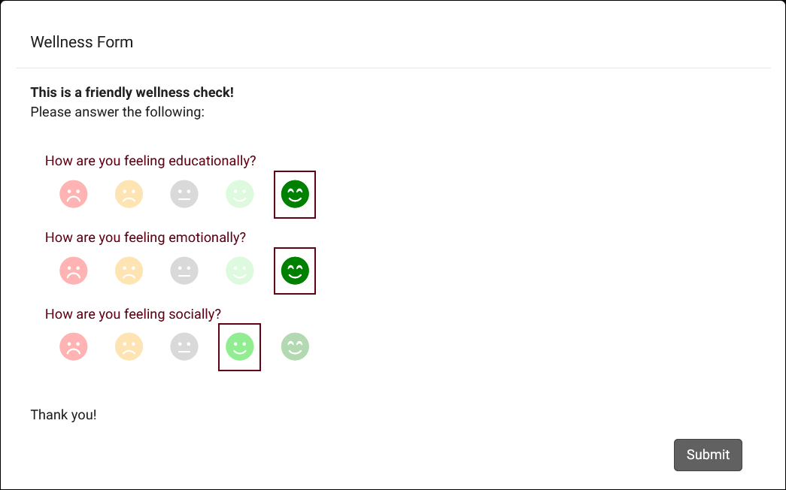
Custom Forms
Custom Forms offer extensively customizable forms that can be displayed to students, staff, or faculty. Forms can periodically be displayed to recipients or they can be manually initiated via a button on the main menu. These forms have three uses:
1. Wellness Check-ins
2. Reflective Prompts
3. Custom Forms – Ask any questions you’d like.
2026 Virtual TracCloud Conference

Slide 4
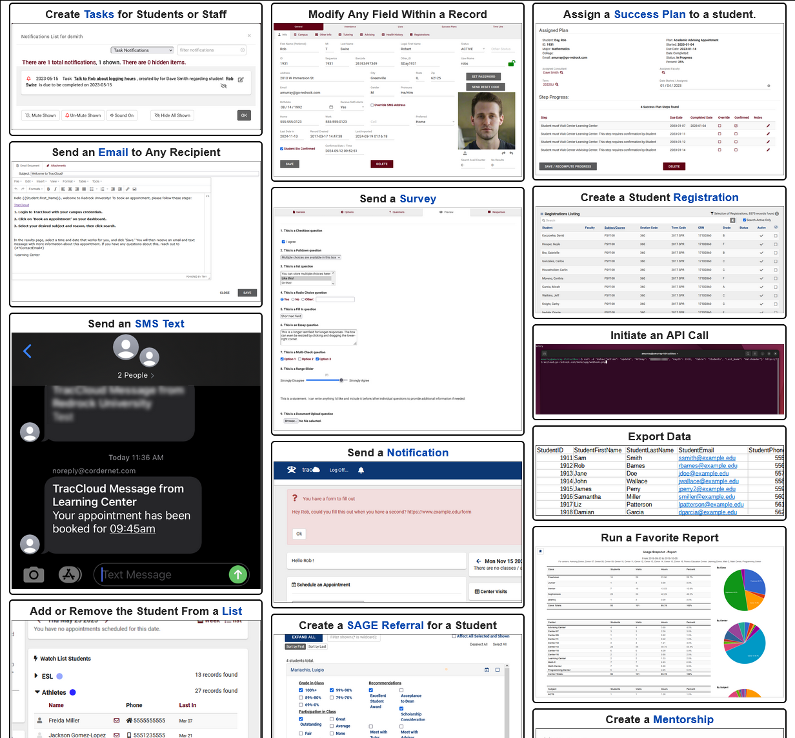
TracFlow
TracFlows enable you to automate a wide range of actions within TracCloud, functioning as a graphical programming language specifically designed for TracCloud. TracFlow automations can be used to dynamically configure TracCloud to execute a series of actions that replicate processes at your campus. These actions can be scheduled events or triggered by specific actions within the system. When activated, a TracFlow can perform various tasks, including sending emails, modifying records, and creating new referrals or surveys.
2026 Virtual TracCloud Conference

Slide 5
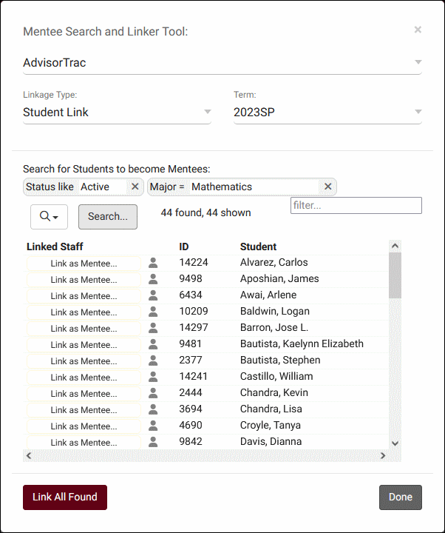
Peer Mentoring
TracCloud's Peer Mentoring feature allows you to link mentors (a type of staff account) to mentees (students). This will provide a mentorship window to both parties where they can communicate and share documents between each other. Mentors (and their supervisors) will additionally be able to easily see the mentees appointment and visit history from the mentorship window.
2026 Virtual TracCloud Conference

