Slide 1


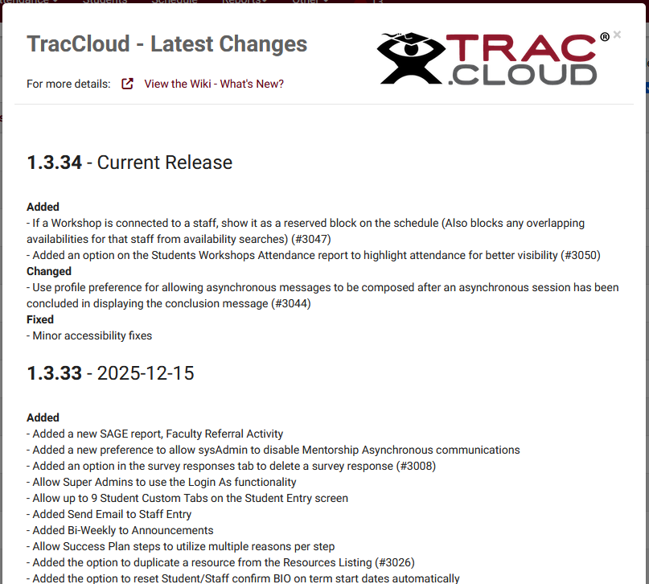
What’s new?
Part 2:
Career Center Management, Heatmaps, Custom Widgets, TracInsights
Aidan Murray
2026 Virtual TracCloud Conference

Slide 2

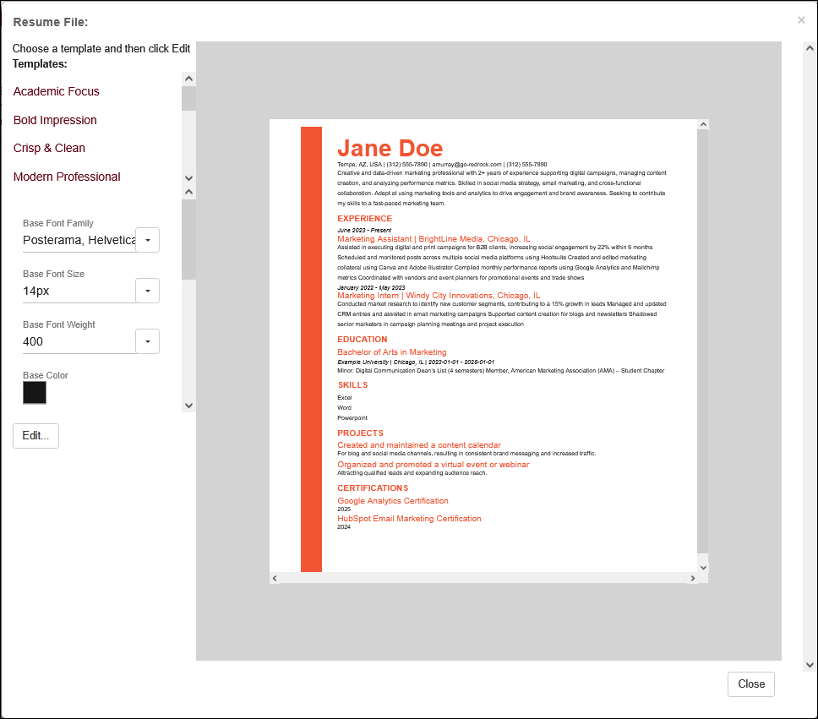
Career Center
Management
TracCloud's Career Center Management Module allows people to build and generate resumes for themselves with various templates available, search for relevant job listings, and even submit resumes to those listings. Recruiters and organization contacts are then notified when a resume has been submitted for one of their listings so they can review and follow-up with candidates. This wiki article covers how you can configure and utilize this feature in TracCloud.
2026 Virtual TracCloud Conference

Slide 3
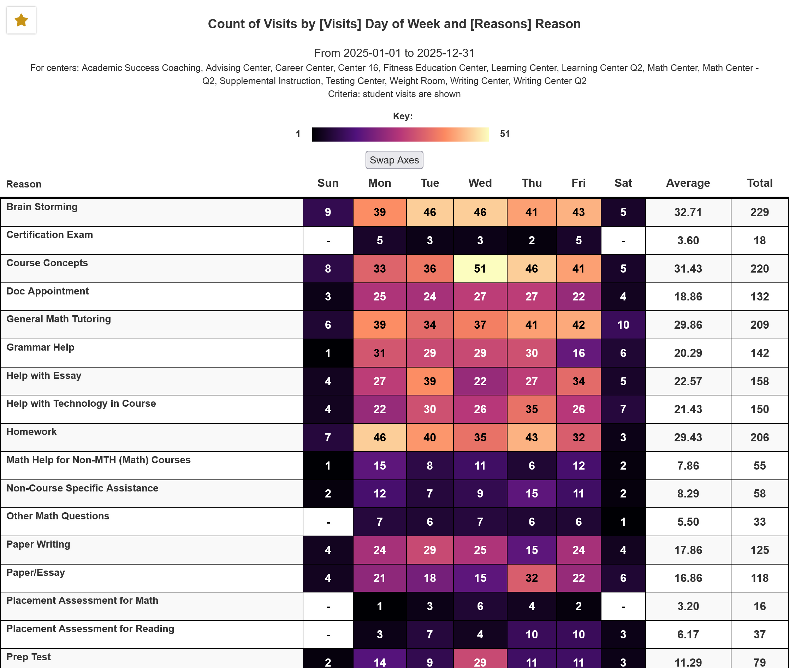
Heatmap
Generator
The Heatmap Generator report found in the Retention category can be used to tally records by two criterion. A heatmap color scheme will be used to highlight extremes in the data and alerts can be automated to notify a recipient when a condition is met in the data.
2026 Virtual TracCloud Conference

Slide 4
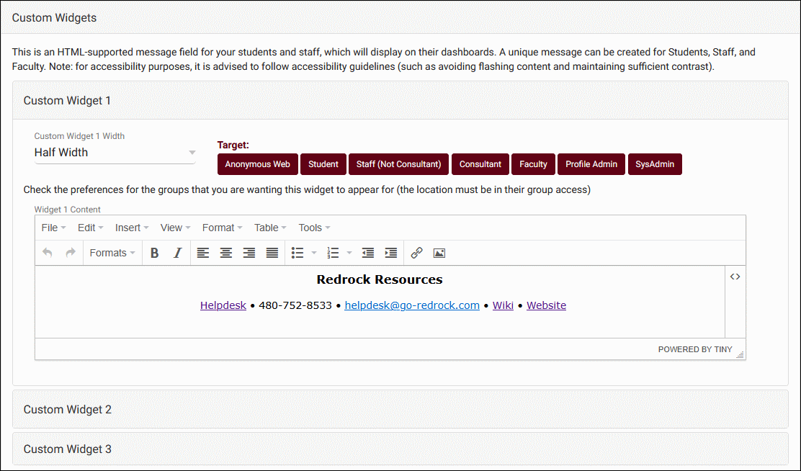
Custom Widgets
Custom widgets can be used to add additional messaging to the dashboard of your Trac System for various user types. Additionally, these widgets can be made accessible anonymously for the purpose of being embedded in other websites as an iframe.
2026 Virtual TracCloud Conference

Slide 5
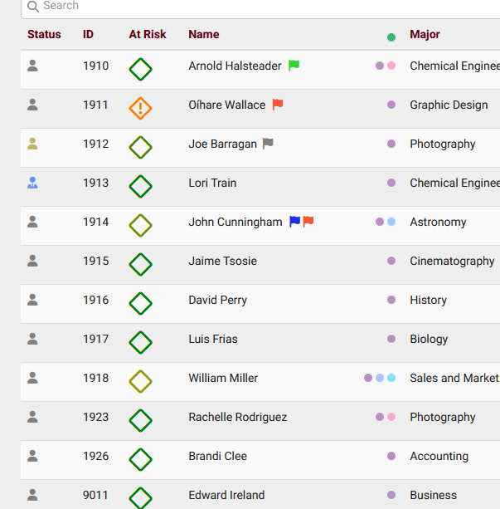
TracInsights
TracInsights can perform predictive analysis on your data. This includes predicting if students will enroll in the next semester, if they will receive a passing grade in a course, and if they will not drop a course. Results are shown in student accounts and on the student listing.
2026 Virtual TracCloud Conference

