Slide 1
All You Need to Know About Visits: Tracking and Customization
Iliana Visser

Slide 2
What’s New With Visits?
“This Semester” date range added to attendance listing
Group permission to prevent staff from creating batch visits
Option to require consultant choice during logout
Barcode/scanner support for consultant work visit login
Group options to restrict when staff members can login for work
Custom kiosk “is online” field
Log Listing can be sorted by visit reason
g:i:sa time format in log listing customization
Student flag can be added to log listing
Custom notice for “all profiles” kiosk
Barcode scanner support in batch code window
“is here for an appointment” field added to Log Listing customization
Other ID/ID2 no longer prompt for selection

Slide 3
Why Should You Record Visits?
Student Visits allow you to record when your students met with consultants or dropped into your center. There are several options available for creating these visits, including real-time options like the Log Listing or Kiosk, used by staff and students respectively.
This session will be going over the different options such as Kiosk, Quick Visit, Batch Visit and how you can utilize them for your TracCloud.

Slide 4
Why Should You Record Visits?
-To capture meaningful data for detailed reports
-Track Center Usage
-Visit Data Can be Collected by:
Logging Students In and Out
Quick Visits
Batch Visits
SI Batch Visits
Kiosks
Custom Kiosk

Slide 5
Why is it Important for your Center to record Visits?

Slide 6
What is a Kiosk?
The Kiosk is used by students to log themselves into or out of your center. This page generally operates similarly to the log listing, but with much stricter permissions and fewer visit management utilities, as we're expecting students to be interacting with this page directly.
Center Kiosk - When you create a new center, both a kiosk and a log listing will be made available by default, unless specifically disabled in the center OR if your TracCloud only allows custom kiosks to be used. Students who are logged in on these kiosks will have their visits assigned to the selected center.
Custom Kiosks - In addition to the default center kiosks, you can also create custom kiosks, which are already linked to a specific center/consultant/reason/etc. These are frequently used for workshops or SI events, but they can be utilized for any visit tracking where a field needs to be predefined.
Kiosk for [Profile] - This option operates similarly to standard center kiosks, except it includes all centers that your permission group has access to. When a student logs in on this type of kiosk, the first question they will be asked is what center they want to log into.

Slide 7
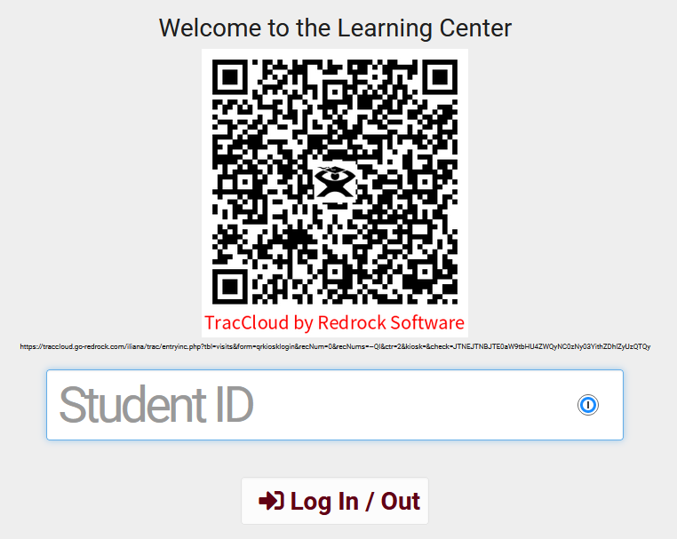
Kiosk
Allow students to sign in entering the student ID, using a barcode reader or scanning the QR code using the student's mobile device.
Options are available to personalize the Welcome message and even the size of the QR code.

Slide 8
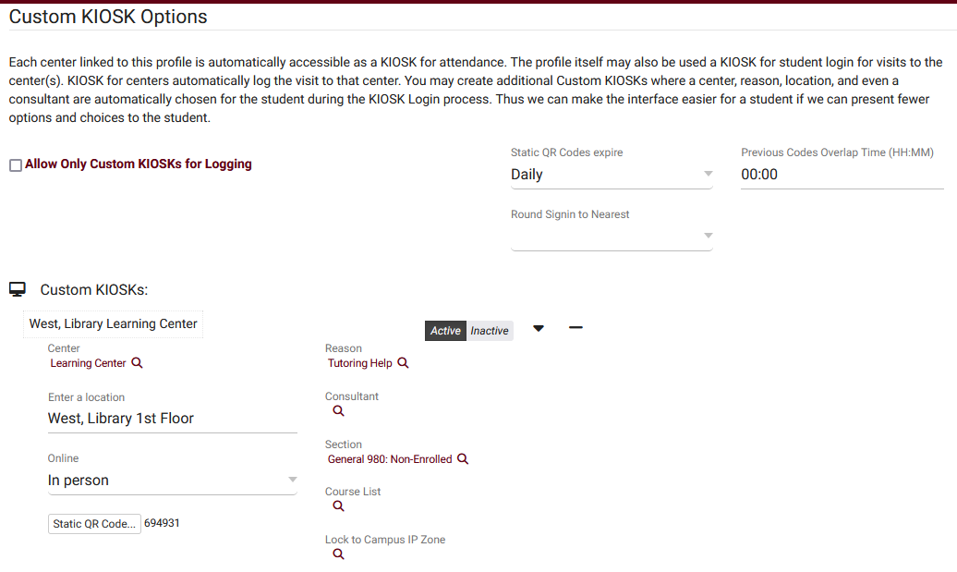
Custom Kiosk
Custom kiosks can be configured for specific visit scenarios. For example, if one of your kiosks is only going to be used for a specific Center/Reason combination, you can use a Custom Kiosks to make sure students are logging in with those fields predetermined. You can also select a Location, Consultant, Section, Meeting Type (Online/In-Person), and even IP address zone.

Slide 9
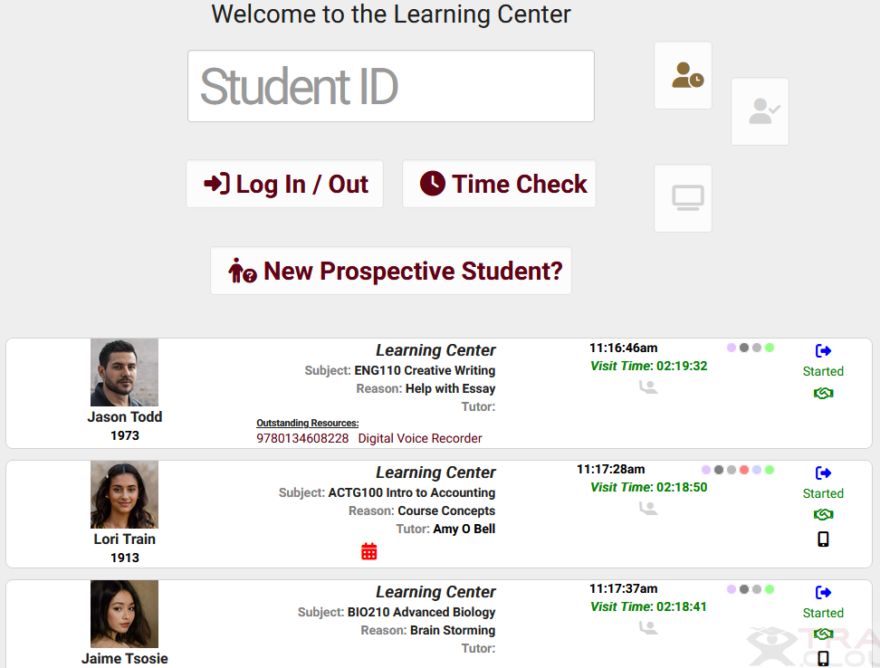
Log Listing
Log List Customization - These settings control how student data is displayed from the KIOSK and Log Listing views.
Show Consultant Login Button – allow the tutors to now sign into work by clicking on a designated Work button.

Slide 10
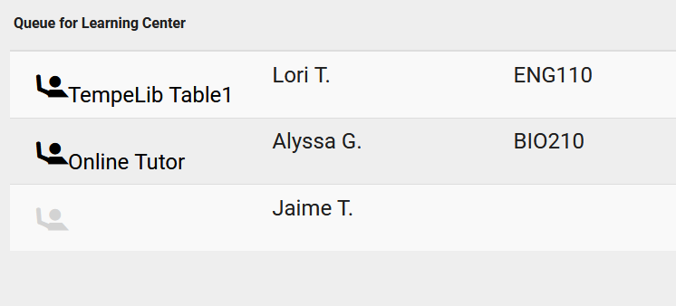
Queue List
A Queue List can now be accessed from a Kiosk or Log Listing page, allowing you to view students who are currently waiting to be seen. An example use-case is in a Center you would have screen such as a TV, Tablet or Projector that is student-facing and display where students are in line waiting to be seen.

Slide 11
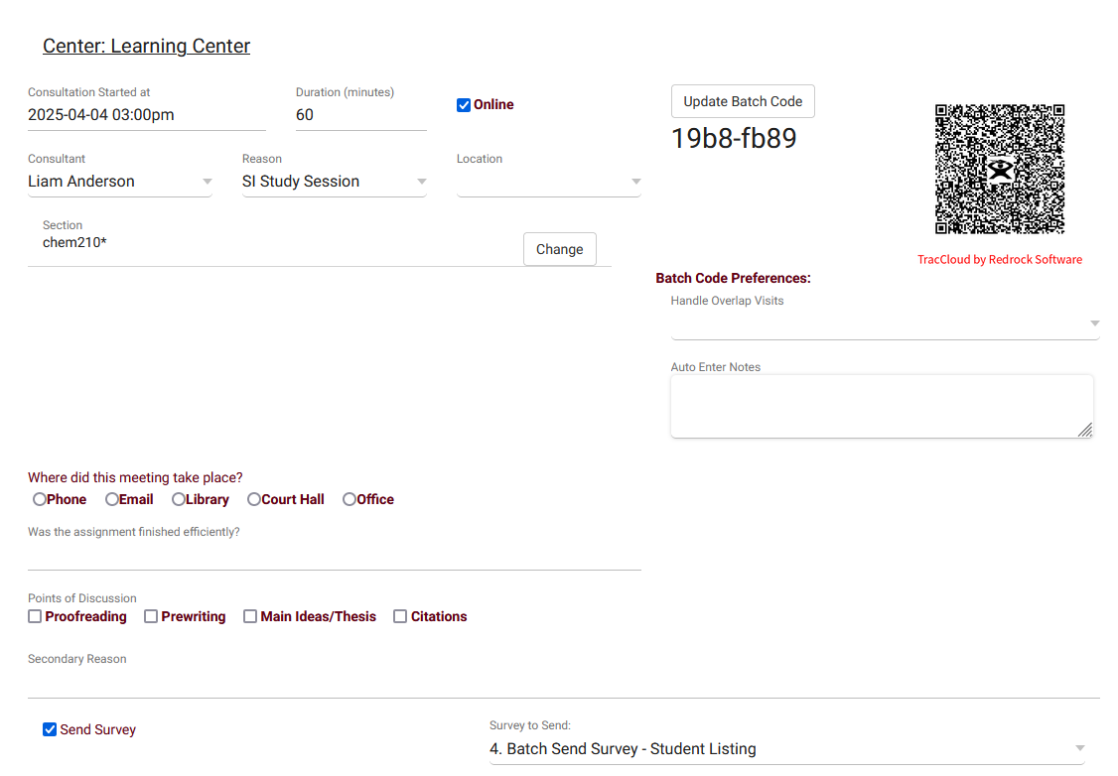
Batch Visits
Batch Visits can be thought of as a bulk version of Quick Visits, allowing you to create visits for many students at once. This feature can be found in Attendance > Batch Visits.

Slide 12
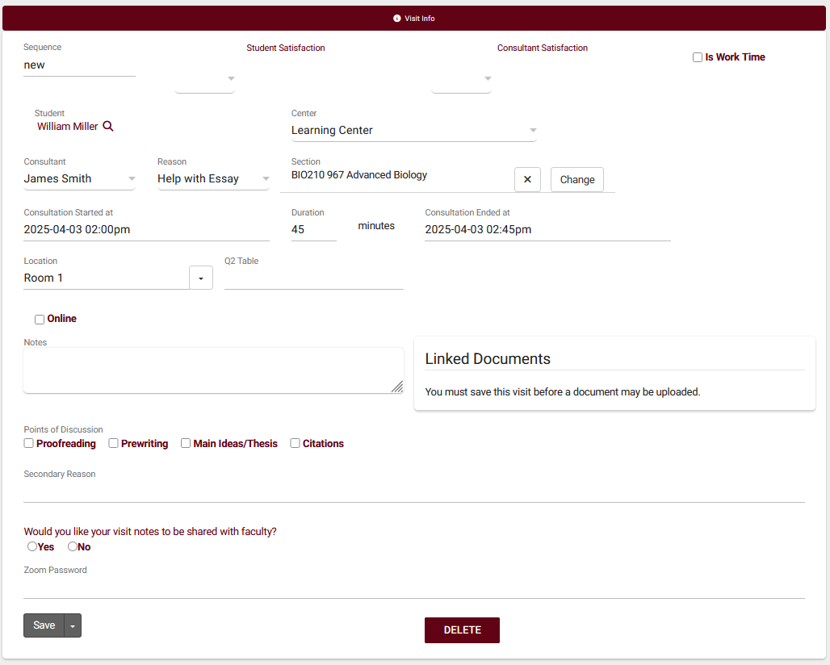
Quick Visits
Quick Visits allow you to create visits after the fact, maybe a student forgot to login, or a login station wasn’t available at the time, or even if you wanted to record a phone call or email conversation.

Slide 13
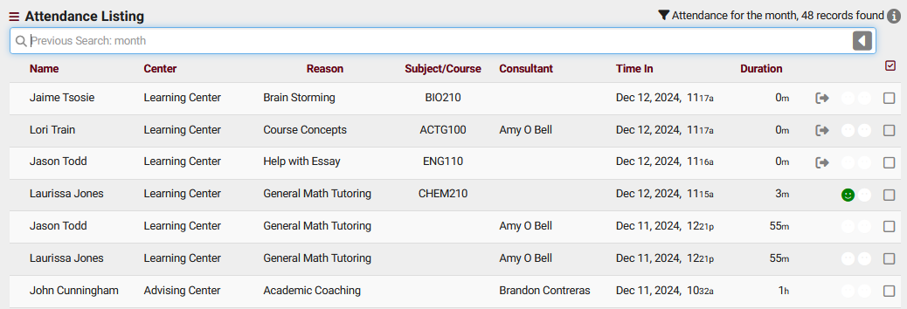
Attendance Listing
A Visit represents the log that the student was present at your center at X time, for Y subject, Z reason, etc. This is different from an Appointment, which is represents the reservation. If a student doesn't follow through with an Appointment, a Visit is never created. Every Visit in TracCloud can be viewed in this listing.

