Slide 1
New SysAdmin - A Guide To Getting Started.

Slide 2
Where to Start?
Request A Demo: https://www.go-redrock.com/demo/
Redrock Wiki FAQ: https://wiki.go-redrock.com/index.php/FAQ
Contact Support by HelpDesk/Ticket System: https://go-redrock.kayako.com/conversation/new
Contact Support by Phone: 877-303-7575 option 1
(Emergency – System down, can’t access anything! Option 3!)
Schedule A Training: https://www.go-redrock.com/help-support/request-training/

Slide 3
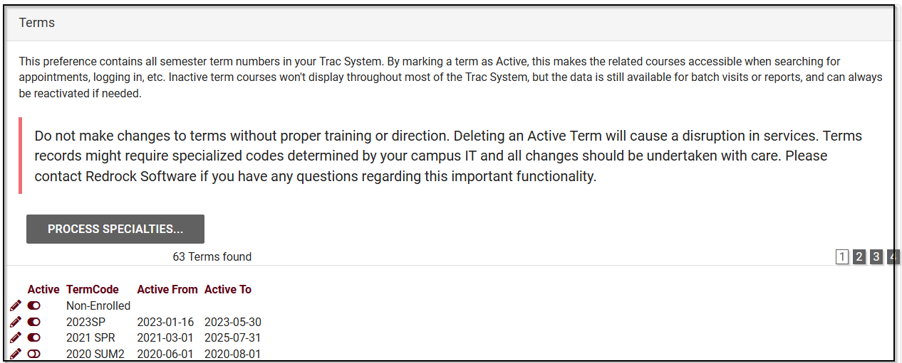
New Semester Changeover
Other > Preferences > Terms

Slide 4
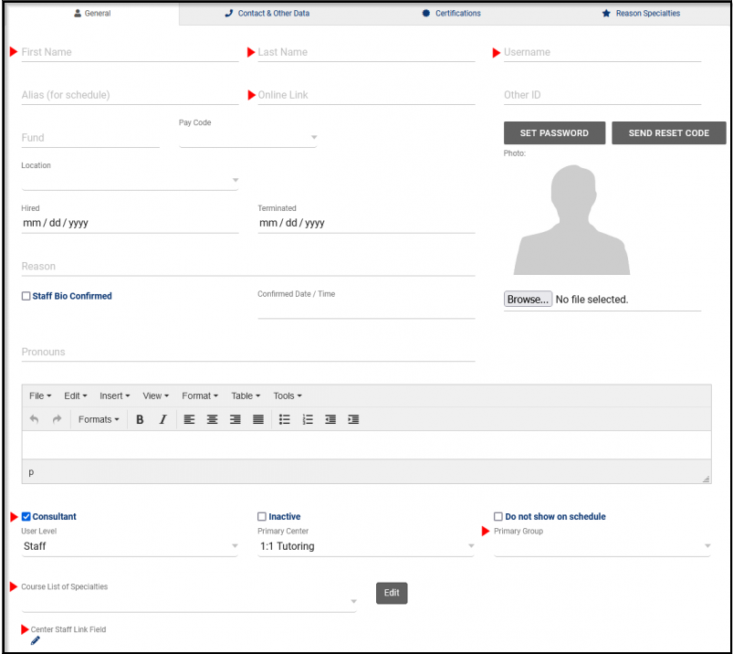
Managing/Creating Staff
Other > Listings > Staff
First Name
Last Name
Username
Online Link
(used for virtual appointments)
User Level/Consultant Box
Primary Group
Course List of Specialties
Center Staff Link Fields

Slide 5
Deactivating Old Staff
All inactive staff are still in the system for data purposes. If needed they can always be re-activated.

Slide 6
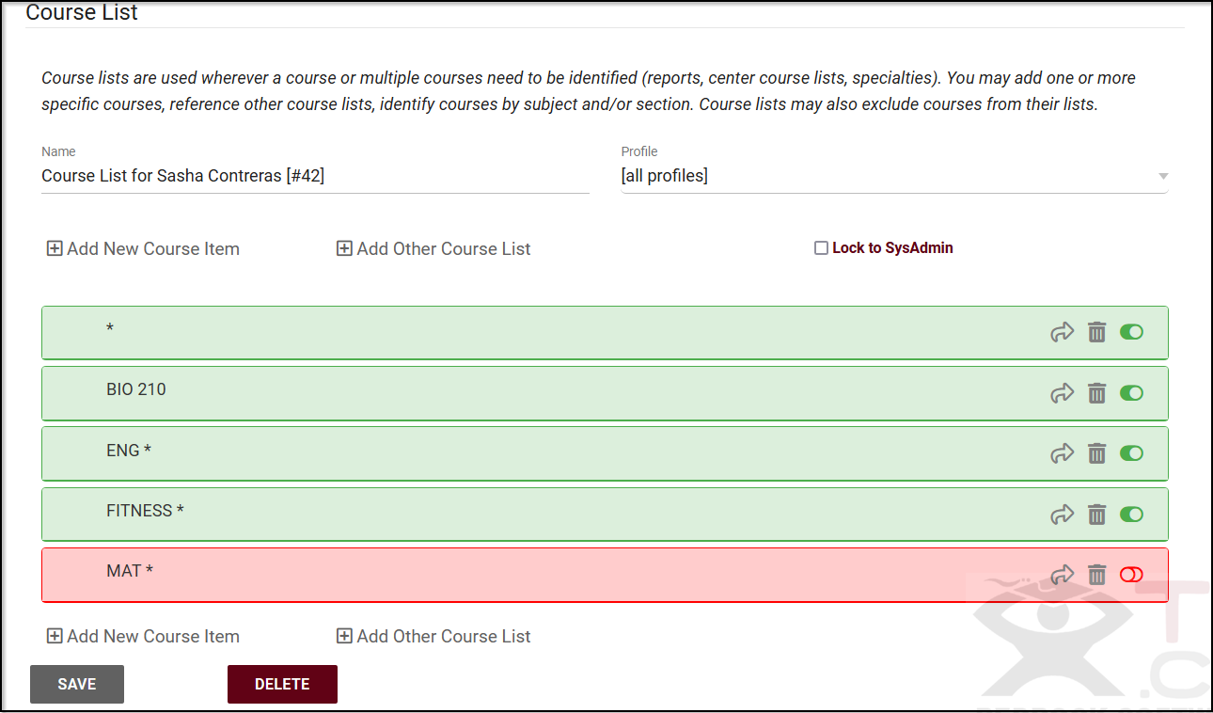
Update Course List(s)
Other > Listings > Course Lists

Slide 7
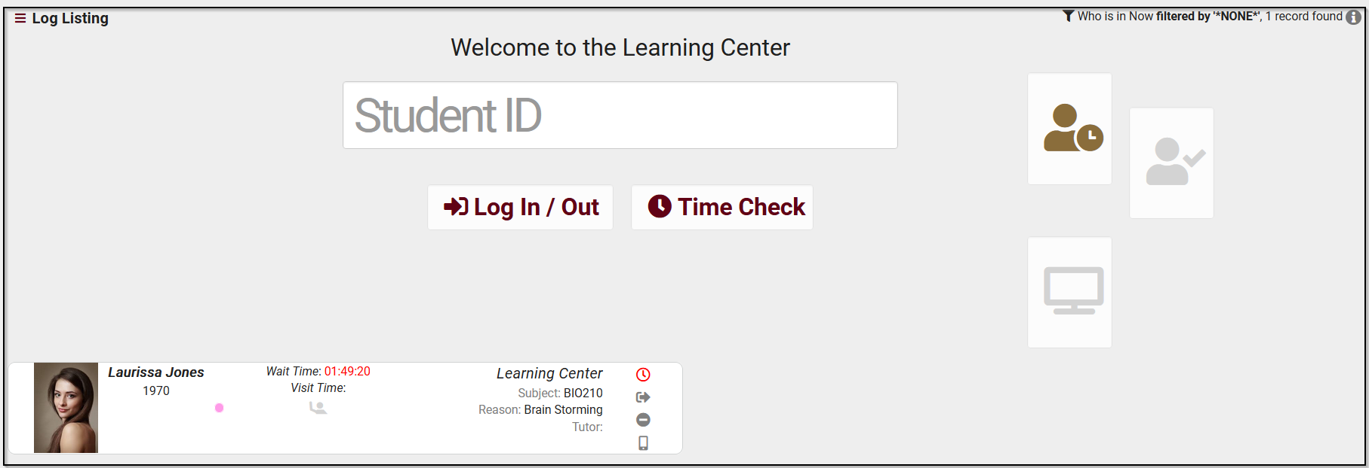
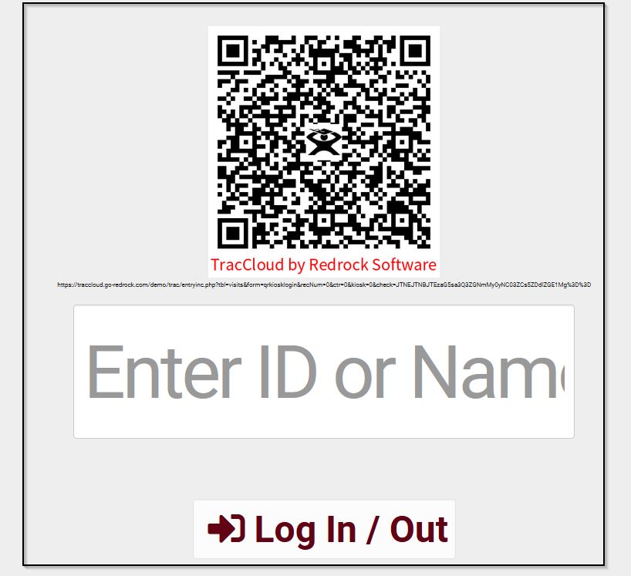
Logging Data
Attendance
Log Listing
KIOSK
Student facing login. KIOSK can have a QR code displayed for touchless sign in (using mobile device).
Students can also use a barcode scanner to login to a center if that campus has one.
Used by staff to view students who are currently logged in to the system for a visit.

Slide 8
Lists Of Students
Centers may require that only certain students are allowed to log a visit to the center. This can be done by adjusting the preference in the subcenter entry screen to constrain logging visits to students from a certain list.
Centers may also require that only certain students be allowed to book an appointment in a particular center.
Lists might be used for grouping certain student populations, like students that participate in a particular sport - this list of students might be particularly important to a coach.
Lists might also be used to categorize students that qualify for a certain program or be part of a special needs program where those students are reported on in a special fashion.

Slide 9
Static and Dynamic Lists
Dynamic Lists
Dynamic Lists are lists where you provide search criteria that describes the students that belong to the list. Each time the list is displayed the stored search criteria is executed to find the list of students that match the criteria. Thus the population of students can change from day to day, making this list very dynamic.
Example: A nursing Major being dynamically listed in “Nursing,” this means that anytime the value of the Major changes for a student, the student is automatically added or removed to this list based on that dynamic identifier the list was created for.
Static Lists
Static Lists are a list of students that you may manually add or remove. The student stays on the list until you remove the student manually.

Slide 10
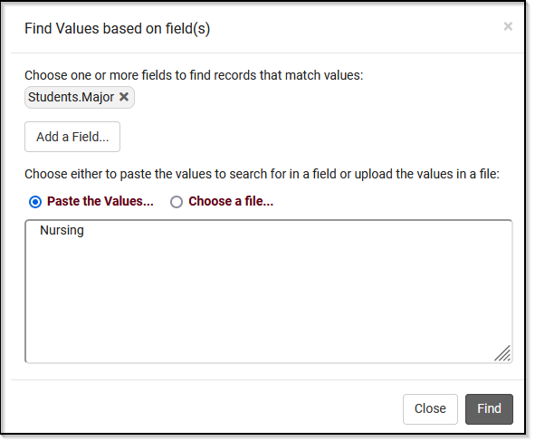
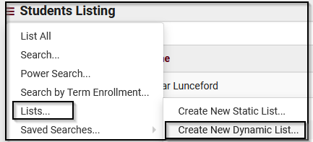
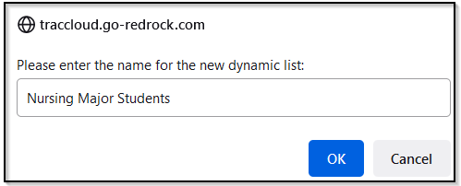
Searching for Students

Slide 11
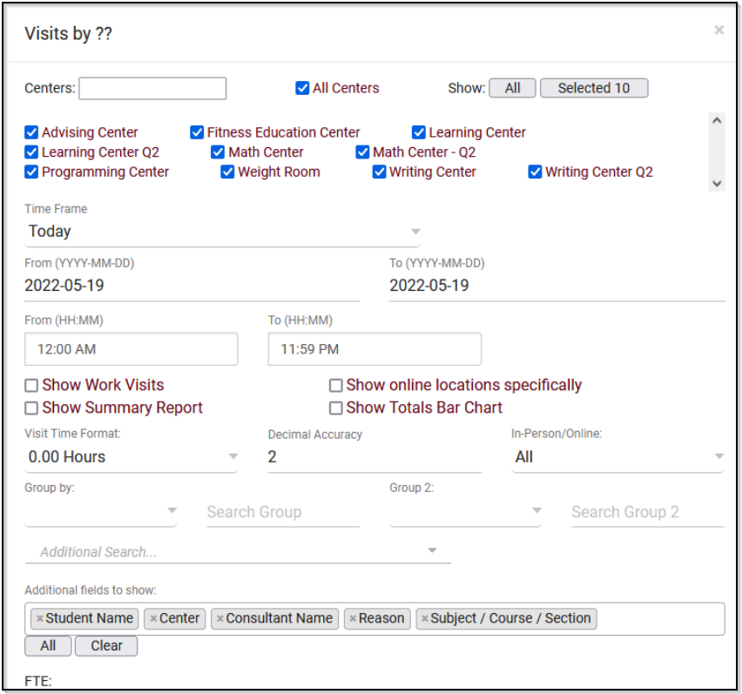
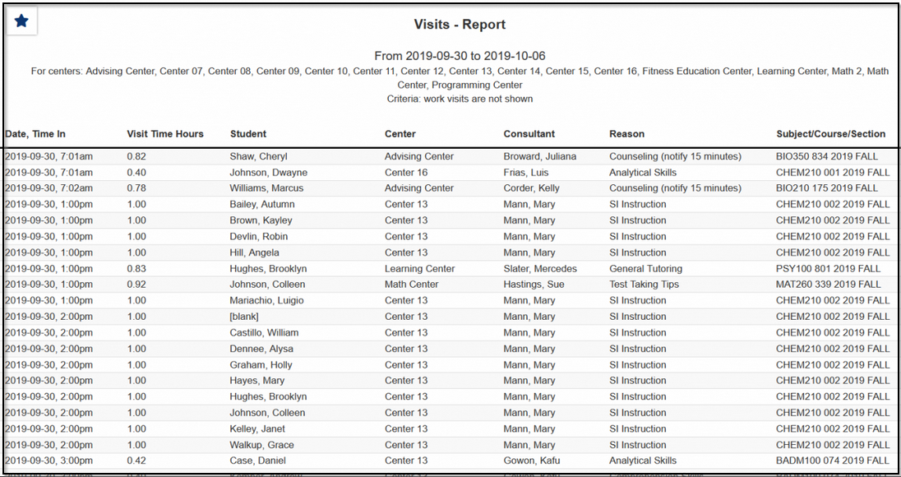
Reports
Any report can be saved as a favorite and automated.

