Slide 1
General Reports & Options
This Photo by Unknown Author is licensed under CC BY
TracCloud Reports
With Luis Frias

Slide 2
What's new With Reports?
-TracCloud reports have a totally revamped interface.
-All reports have the ability to exported directly into excel.
- Reports have the option to exported into a CSV Raw Data Format with or without Groupings.
-Reports will also come with the options to view pie charts or bar chart, which will provide a visual aid of the data.

Slide 3
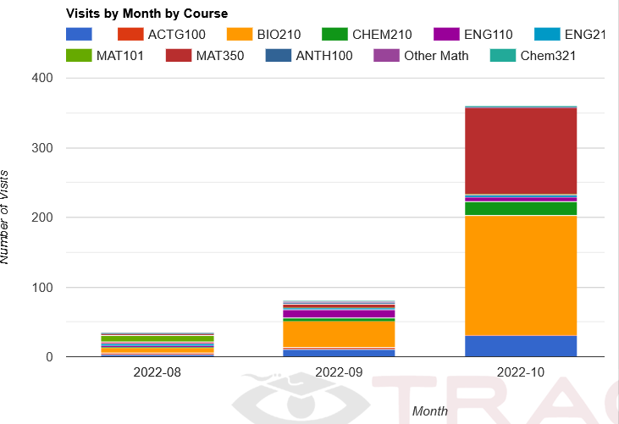
Topics We Will Cover Today
Status Charts, Utilization, Center Status
Layout & General Report options
Visit Reports
Schedule Reports
Usage/ Hotspot Reports
(Visit) Clean Up Report
Security Reports
Staff Reports

Slide 4
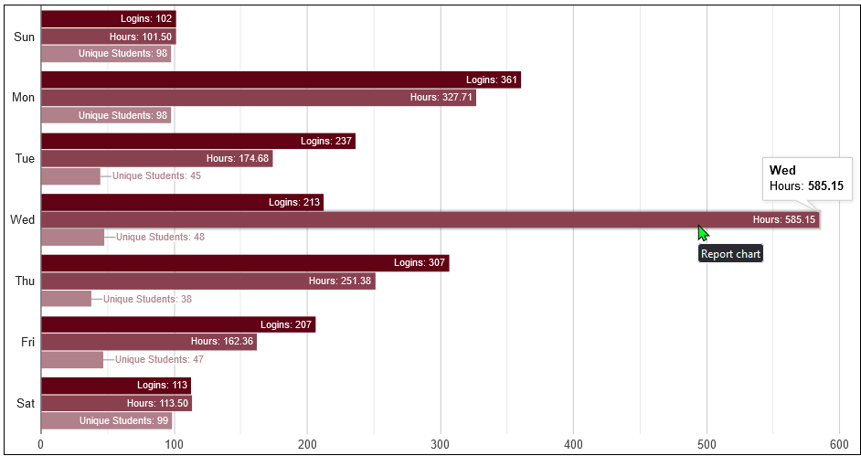
Visit Reports
There are several Visit Reports in TracCloud. Visit related Reports can be found in the Students or Management Categories of your Report Chooser drop down. Some of the most popular reports are Usage Snapshot, Attendance by Hour and the Visits by ?? Report.

Slide 5
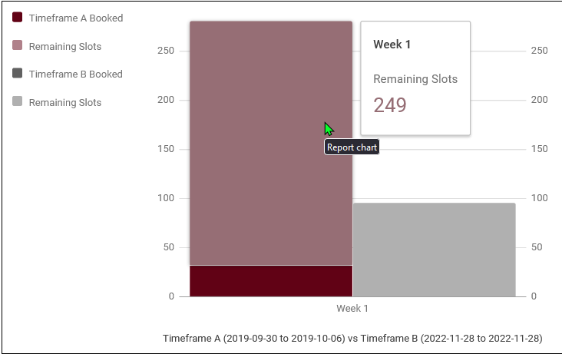
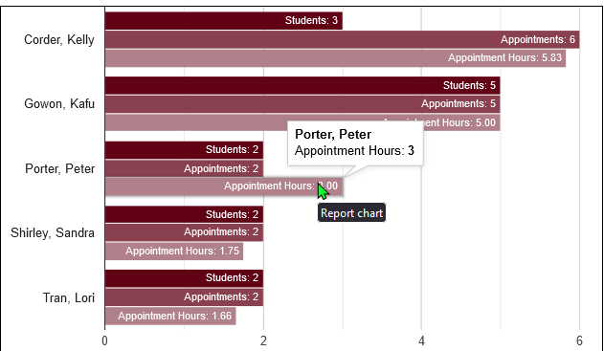
Scheduling Reports
There are a several Scheduling Reports in TracCloud. Scheduling related Reports can be found in the Students or Management Categories of your Report Chooser drop down. Some of the most popular reports are Center Schedule, Appointment Slot Utilization Date Comparison – Report and Students Visits/Appointments by ??

Slide 6
Related Sessions
Let’s review the Data Hopi 12:30-1:20pm
Reports Data & Scheduling Q&A Hopi 2:20-3:00pm

