Slide 1
Visit Settings & Configuration
Iliana Visser

Slide 2
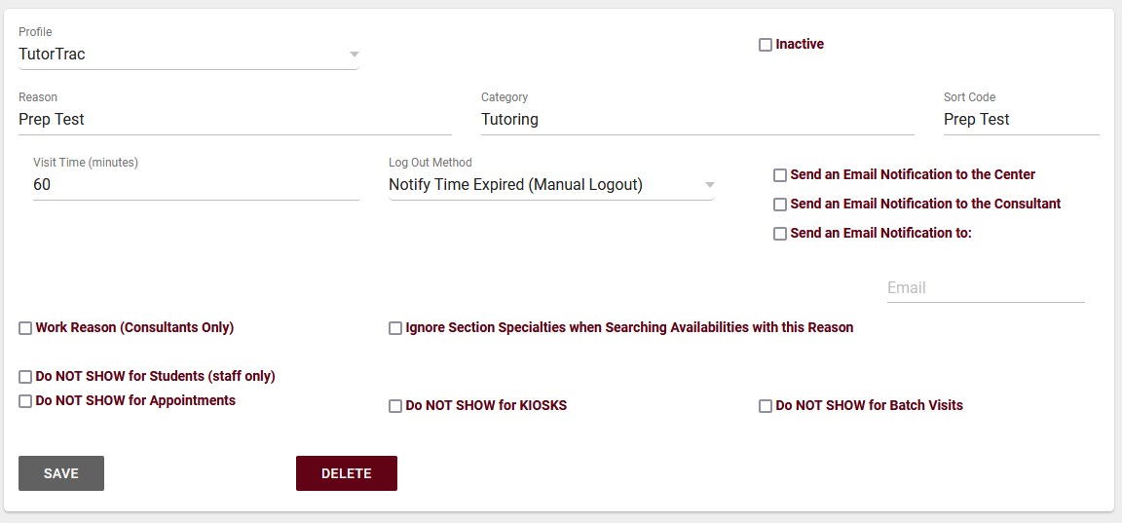
REASON Visit Settings
Reasons/Services allow your staff and students to provide additional information and reasons for booking an appointment. For example, reasons such as “Counseling,” “Study Plan Help,” or “Exam.” This would let the consultants know what the student needs help with, provide preparation details and information as needed, and gives your staff additional information.

Slide 3
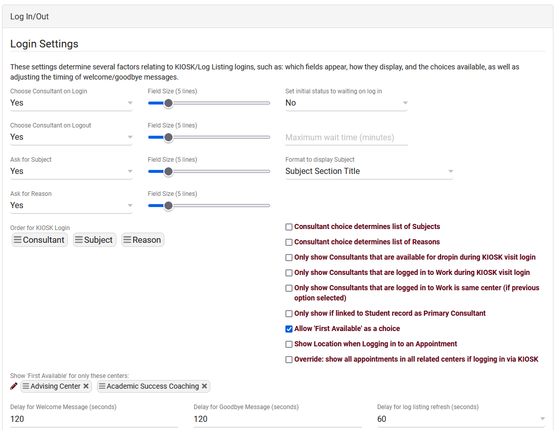
Profile Visit Settings
The first section of our “Prefs” tab contains our Log In/Out Preferences. These preferences control how the log listing displays, kiosk preferences, additional kiosk features, and more.

Slide 4
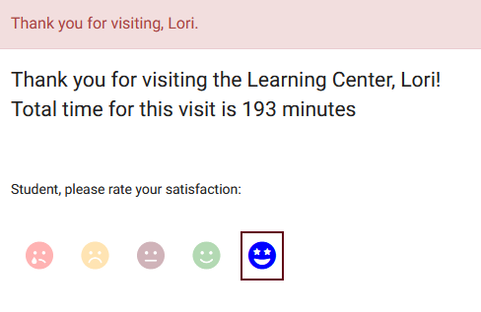
Profile Visit Settings
Ask Student Satisfaction on Logout & Ask Consultant Satisfaction on Logout
Enabling these options adds a "please rate your satisfaction" question to the logout process of both the log listing *and* kiosk. These responses are only accessible to groups who have been provided access to these fields in the 'Student / Visit' tab. Responses will be visible on the student listing and in reports such as Visits by ??.

Slide 5
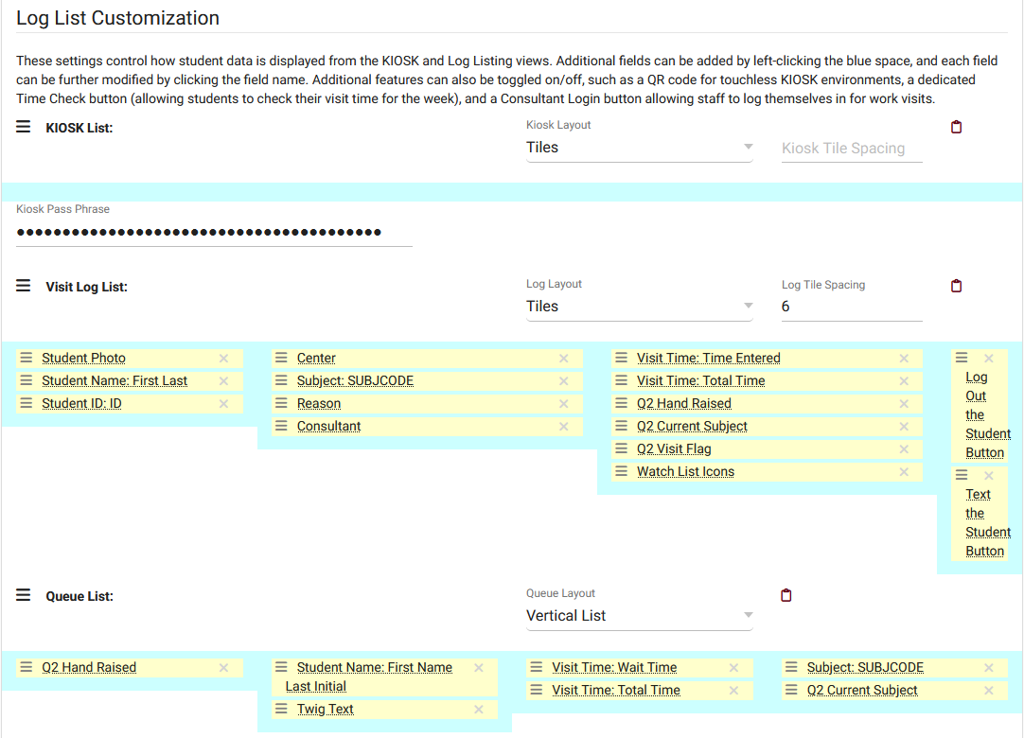
Profile Visit Settings
The Log List Customization can easily customize the Log Listing, Kiosk, and Queue determining what data shows up and how it displays.

Slide 6
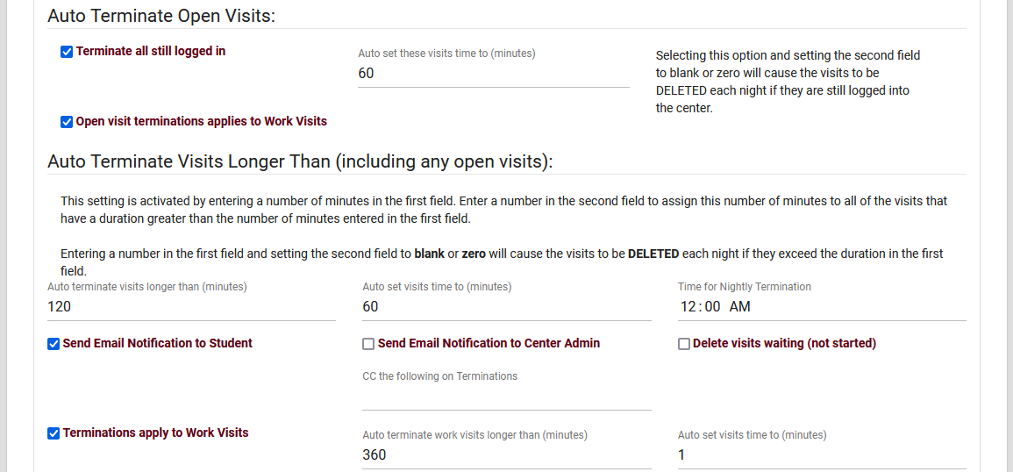
Profile Visit Settings
The Auto Termination process can automatically conclude ongoing visits at the end of the night and/or correct visits that have a longer-than-intended duration.

Slide 7
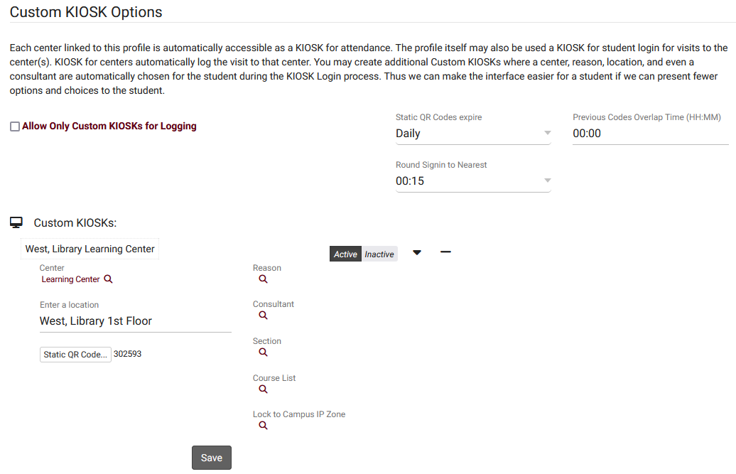
Profile Visit Settings
Custom Kiosks can be configured for specific visit scenarios. For example, if one of your kiosks is only going to be used for a specific Center/Reason combination, you can use a Custom Kiosks to make sure students are logging in with those fields predetermined. You can also select a Location, Consultant, Section, and even IP address zone.

Slide 8
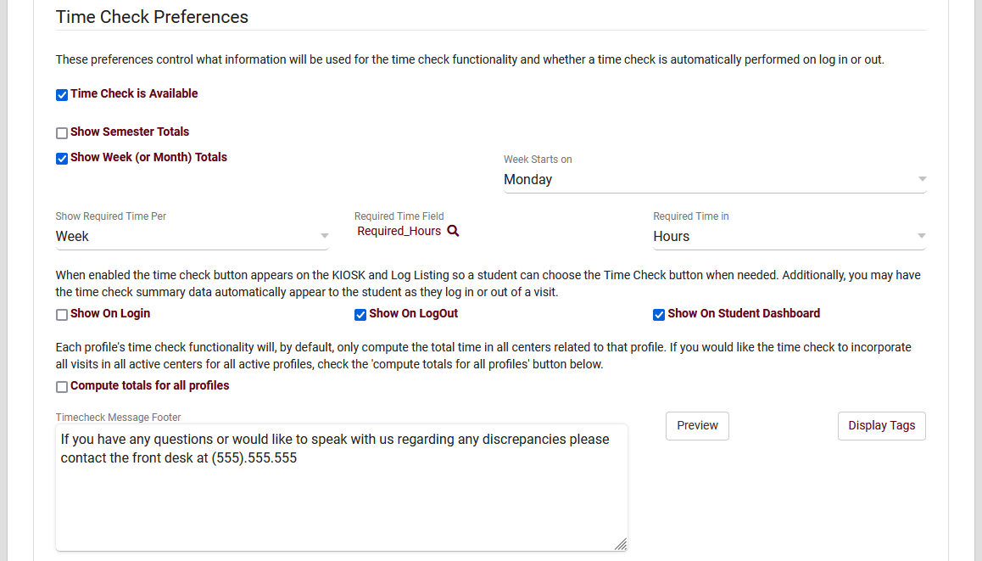
Profile Visit Settings
When students log in or out of a center, Time Check will allow them to view how many visit hours they have accumulated within a given time frame. This feature is typically utilized in athletic centers, where students may have a required hours per week or semester.

Slide 9
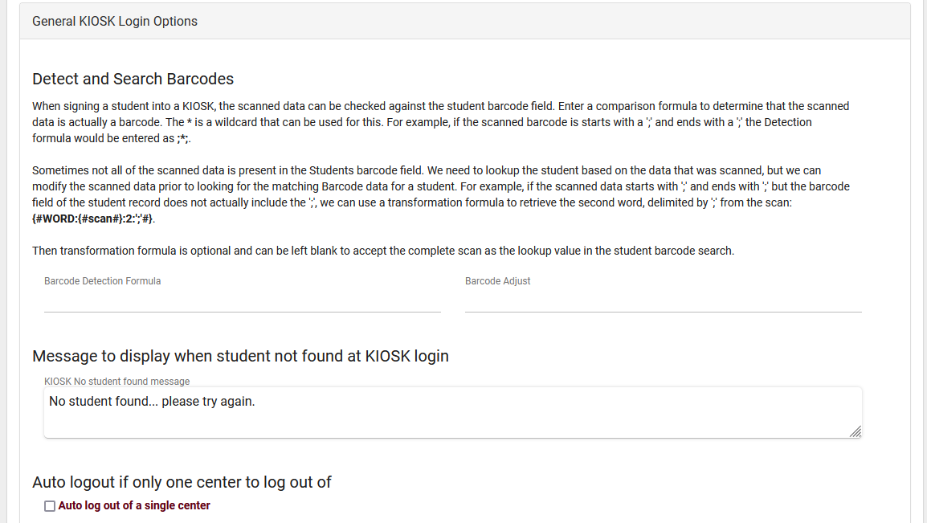
Global Visit Settings
Barcode Scanners and Magnetic Strip Reads can be utilized in TracCloud to allow students to scan their Barcode, ID, etc, to login for their visit. Global settings such as Barcode Detection Formula and Barcode Adjust allow you to use any barcode scanner.

Slide 10
Global Visit Settings
Show the Center Visits Tab on Main Menu to Students
Adds a dashboard widget allowing students to view their own recent visits.
Show/Allow Student Dashboard Documents on Main Menu to Students
Allows students to view and upload documents to their own profile.

Slide 11
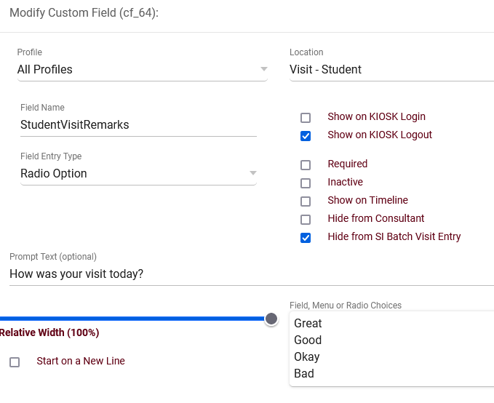
Global Visit Settings
Custom fields can be configured throughout TracCloud to store additional data that your campus may require. These custom fields can be displayed in student profiles, appointments, visits, faculty, registrations, and more.

Slide 12
Visit Reports
Attendance by Hour
Students Visits Center Grid
Students Visits Summary
Visits by ??
Faculty Student Visits
Logins by Hour by Day of Week
Usage Snapshot
Visits by Faculty and Subject
And more!

