Slide 1
What’s new in traccloud April ‘24 to April ‘25
Notable changes made in the past year
Aidan murray

Slide 2
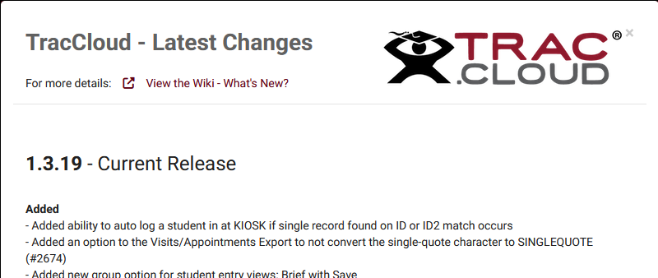
Where to learn about updates
• Monthly recaps on our wiki https://wiki.go-redrock.com/index.php/TracCloudWhatsNew • Full changelog in TracCloud: Other > View Latest Changes

Slide 3
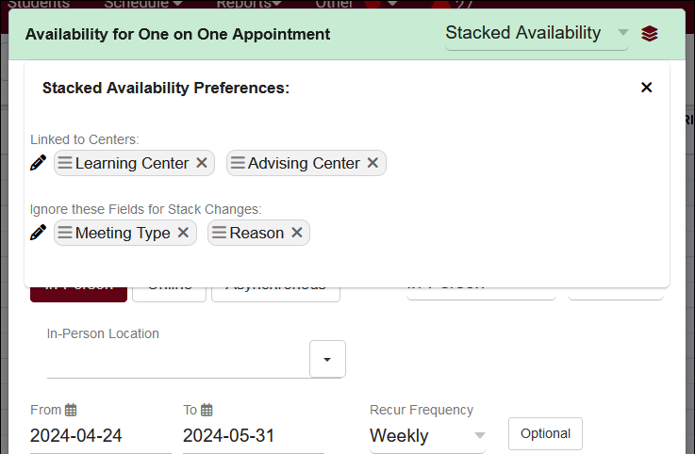
Stacked availabilities
You can now create stacked availabilities to easily build schedules across multiple centers at once. Choose which centers the availability is assigned to, and which fields you want to independently edit in each slot.

Slide 4
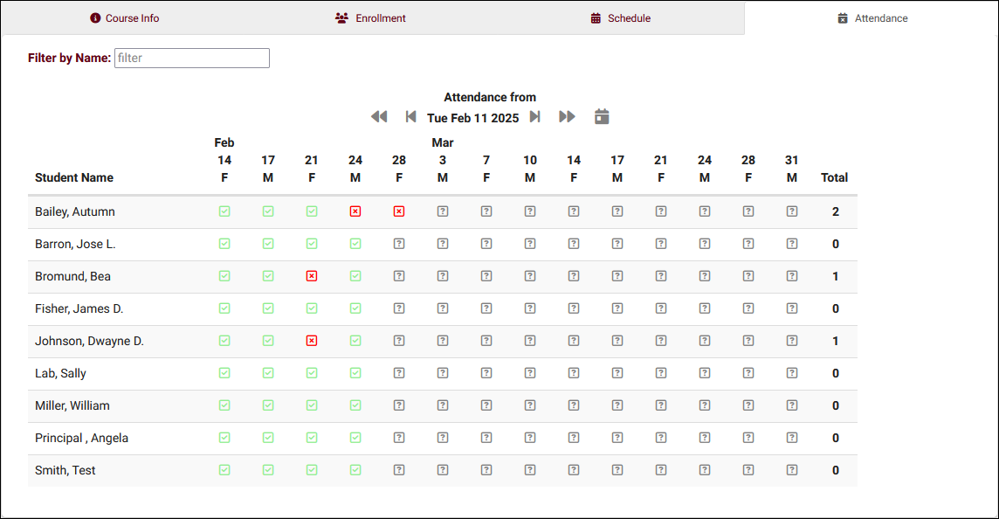
Section class attendance
All your faculty to record class attendance easily through TracCloud, along with new reports to review attendance data.

Slide 5
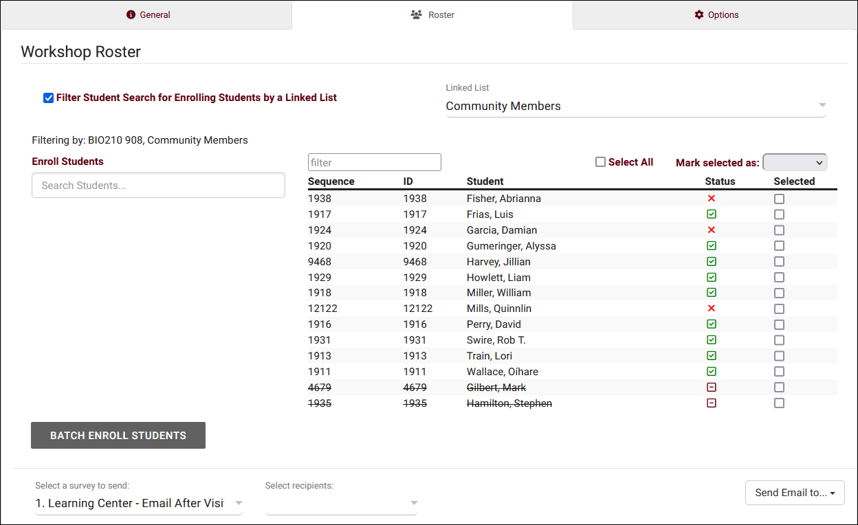
workshop improvements
Track workshop enrollment, allow your staff to record which students attended or missed, and automatically generate visit records for students.

Slide 6
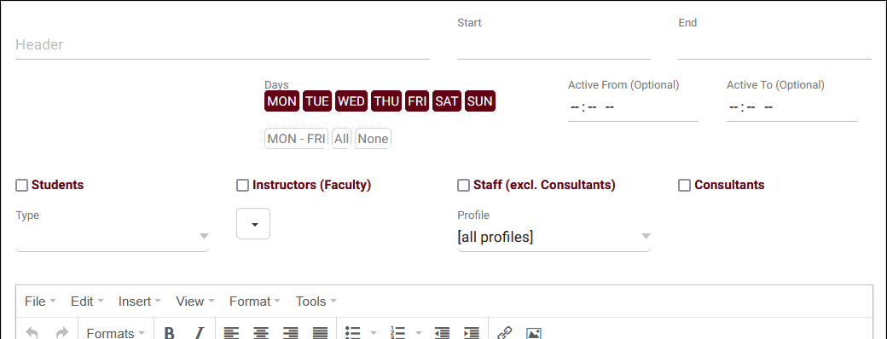
Scheduled announcements
Announcements can now be scheduled to appear based on day of week and time of day in addition to date range.

Slide 7
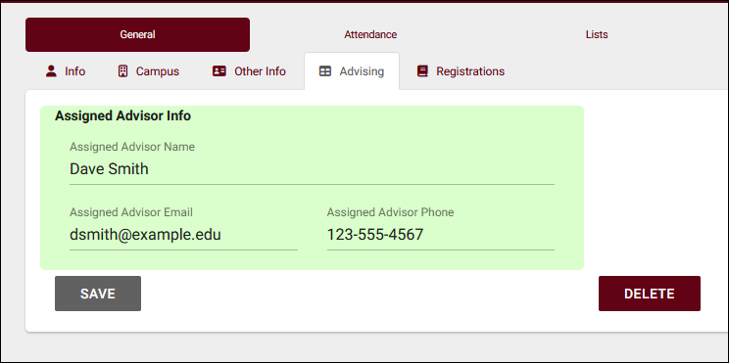
Custom field groups
Custom field groups can be used to bundle sets of custom fields, and to record multiple values in each field.

Slide 8
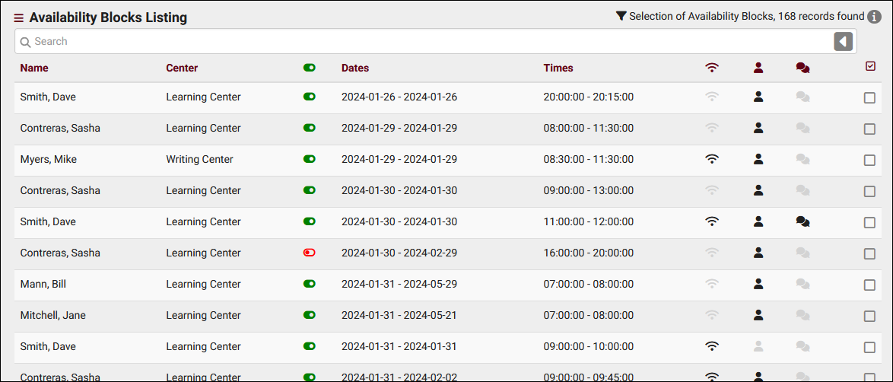
Availability blocks listing
There is now a dedicated listing page for Availability Blocks, providing a quick way to search for and modify your consultants’ time slots.

Slide 9
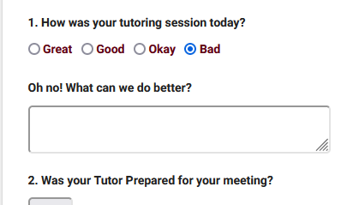
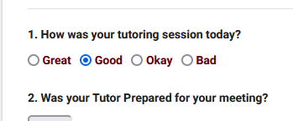
SurveyTrac conditional questions
SurveyTrac has new functionality allowing for conditional questions, allowing you to ask follow-up questions about previous responses.

Slide 10
New custom view group options
You can now make custom listing views the default view for a permission group, or even restrict that group to only seeing that specific view on the related listing.

Slide 11
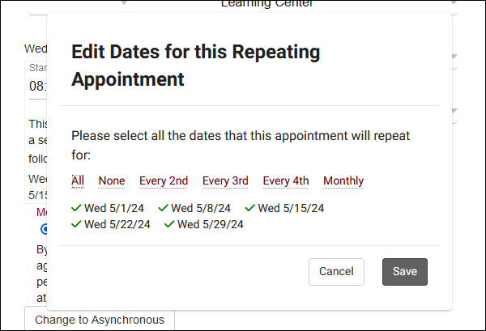
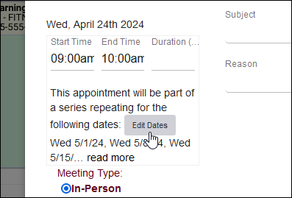
Edit recurring appointment dates
If your group allows this type of modification, it’s now possible to edit the dates of a recurring appointment series during the initial booking.

Slide 12
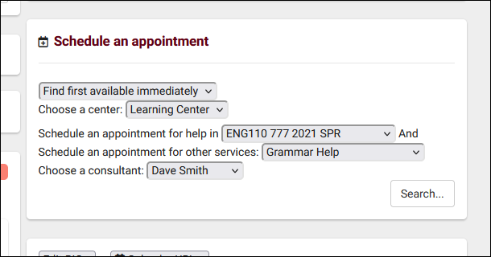
Center & consultant choice on search availability
Your search availability widgets can now be configured to ask which center and consultant the user would like to see results for, in addition to the existing subject and reason fields.

Slide 13
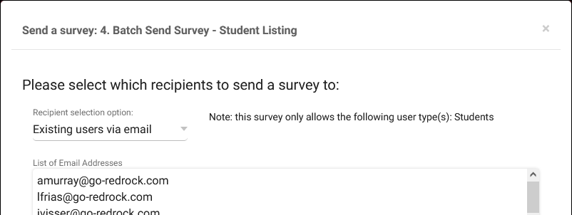
Send surveys from survey listing
Surveys can now be manually sent to users from the surveys listing, even if the user doesn’t have an account in TracCloud.

Slide 14
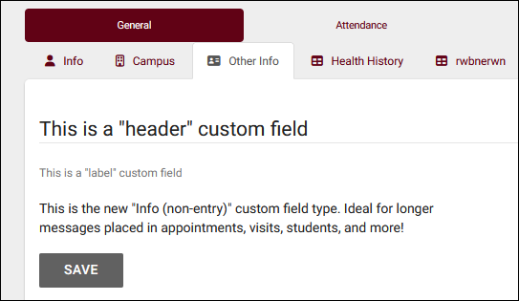
New Custom field type: info
There’s now a third non-entry custom field type, “Info.” This standard text is ideal for longer messages in any custom field-supported fields.

Slide 15
More changes
• Phone modality in availabilities and appointments
• Resource reservations
• Preset common searches on various listings
• New reports
• New permission group restrictions
• Search by specialties on staff listing
• Staff supervisor and title fields
• New custom field listing
And much more!

