Slide 1
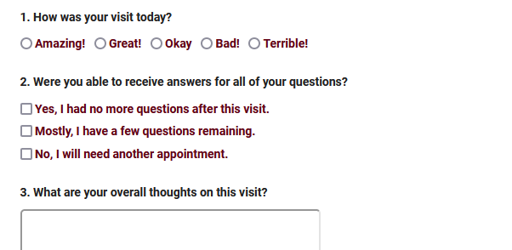
Surveytrac
Sending surveys through traccloud with the surveytrac module
Aidan murray

Slide 2
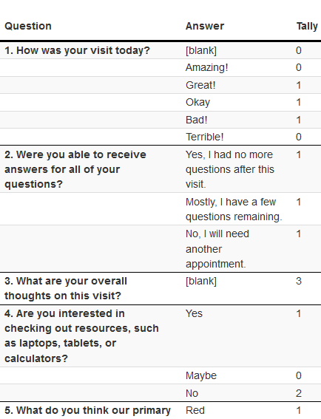
Surveytrac in traccloud
What is SurveyTrac?
Creating a Survey
Group Permissions
Reviewing Responses
Resending unanswered surveys

Slide 3
What is Surveytrac?
The SurveyTrac Module is an add-on module which enables surveys to be sent to users manually, or automatically based on an event such as a visit.
These surveys can be customized with different initiators, question formats, and more.
Surveys can be displayed within the TracCloud interface, or emailed to users directly.

Slide 4
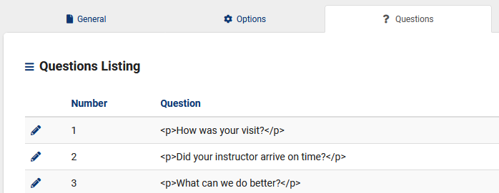
Creating a survey
Create and customize your own survey to determine the questions asked, when the survey is sent, who gets notified of responses, and much more. You can create an unlimited number of questions, as well as modify the layout and phrasing of the overall survey.

Slide 5
Group permissions
If additional staff members require access to Survey information, you will need to update their permission group.
Table Access to Surveys must be provided to give them access to any Survey information. This can be set to View and Edit or exclusively View.
We can also determine which surveys they can access from the same Admin / Modules tab of this group.

Slide 6
Reviewing responses
There are 3 ways to review Survey responses, outlined below.
Viewing individual responses from the Survey entry page, and resending if needed.
Running the Survey Snapshot report.
Exporting Responses to a flat-text CSV file.

Slide 7
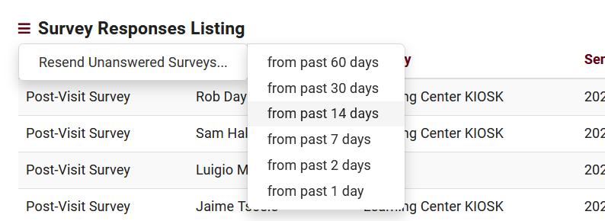
Resending unanswered surveys
You can resend individual surveys from the response list, or resend all answered surveys within the past several days.

Slide 8
Surveytrac discount
We like to reward our conference attendees! For those that attend the 2024 conference, we are offering 10% off all modules and/or profiles for TracCloud if a quote is requested at the conference and purchase is made by 5/15/2024.
Please see Laura or email her at laura@go-redrock.com to request a quote!

