Slide 1
What’s new in traccloud April ‘23 to April ‘24
Notable changes made in the past year
Aidan murray

Slide 2
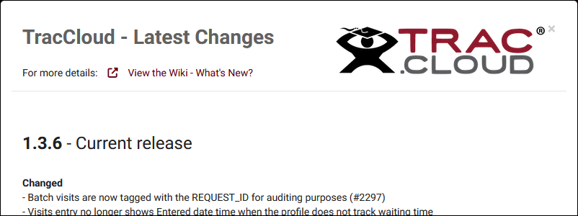
Where to learn about updates
• Monthly recaps on our wiki
https://wiki.go-redrock.com/index.php/TracCloudWhatsNew
• Full changelog in TracCloud: Other > View Latest Changes

Slide 3
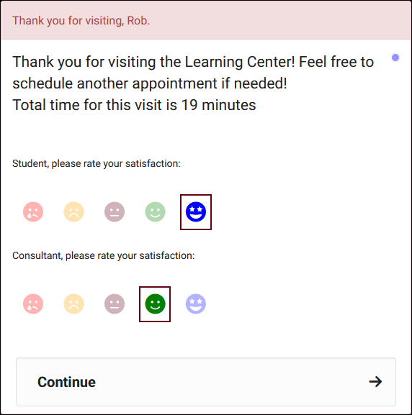
Visit Satisfaction ratings
It’s now possible to record student and consultant satisfaction as a visit is being concluded.
After enabling this option, you can control which permission groups have access to the responses.

Slide 4
Asynchronous appointments
Asynchronous appointments can be used to provide text chat and document upload functionality to your students and consultants. These sessions aren’t limited to a specific time and can be concluded or re-opened at any time.

Slide 5
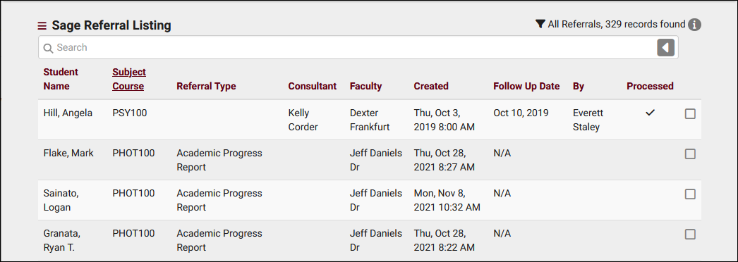
SAGE Referral listing
The Referral Listing offers a unique way to search for and manage your SAGE referrals. Click on the record you need to manage or even make batch changes to multiple referrals at once.

Slide 6
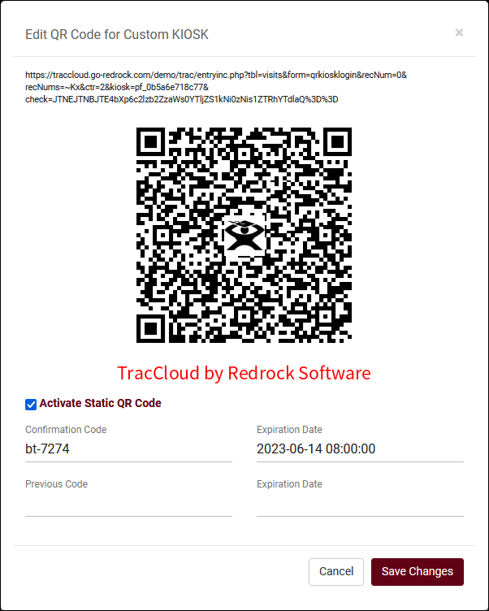
Static Qr codes
Static QR codes can be created as part of TracCloud’s custom kiosk functionality. The QR code itself doesn’t expire, but new confirmation codes are regularly generated to prevent inaccurate visit data from being created. Codes can be found in preferences or can be automatically emailed to the consultant linked to the custom kiosk.

Slide 7
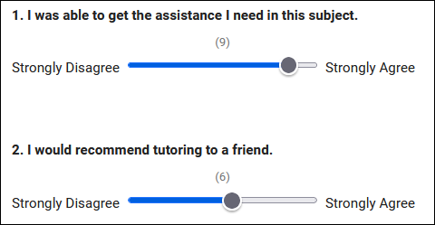
SurveyTrac slider options
This new question format offers a more intuitive way to answer certain types of questions. Choose the value & increments for the scale and the options at either end.

Slide 8
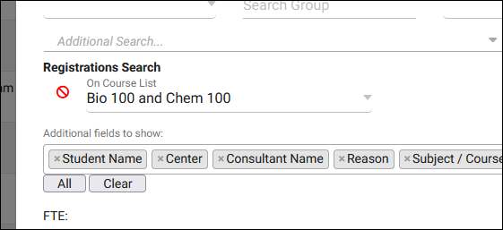
Search reports with course lists
In addition to wildcards and ‘or’ options in reports, you can now filter a report based on a course list. This can be easier than the alternative if you need to filter by many courses or sections at once.

Slide 9
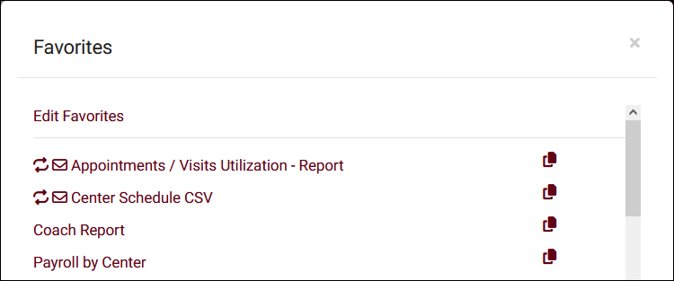
Duplicate favorite reports
A new “Copy” button can be found in your favorite reports list. This allows you to quickly duplicate existing favorite reports so that you don’t have to recreate a similar report from scratch.

Slide 10
Work plans
Work Plans offers similar functionality to Success Plans, but for your staff instead. Create a plan to track progress in staff training or certifications and send automated emails regarding recent progress or reminders.

Slide 11
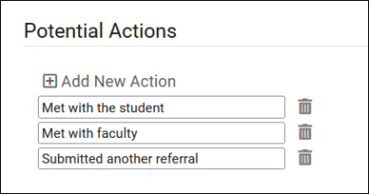
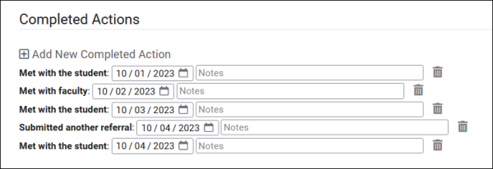
Sage potential actions
Potential Actions provide an additional way to log interactions and events surrounding a referral. For example, each time an advisor meets with a student or faculty.

Slide 12
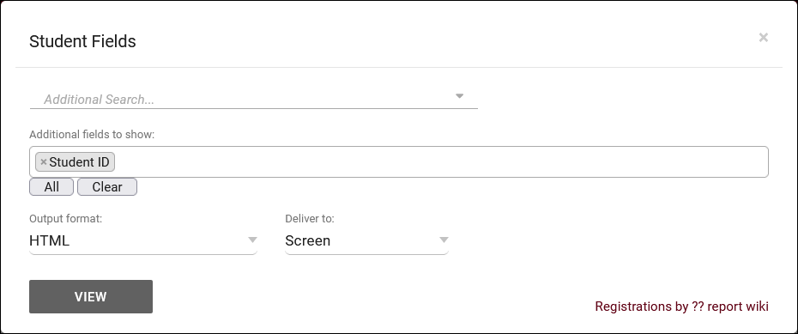
Student Fields report
This report allows you to export a list of students with a custom selection of fields to your browser or to a CSV file. This can be a great way to quickly obtain contact information for certain students or to simply export this data for archival purposes.

Slide 13
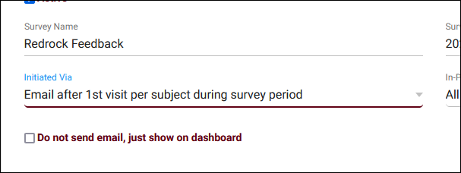
New ‘initiated via’ options
SurveyTrac has three new ‘Initiated Via’ options for sending surveys to your students based on the number of visits, or the first visit per subject or consultant.
• Email after # of visits
• Email after 1st visit per subject
• Email after 1st visit per consultant

Slide 14
More changes
• Student Search Availabilities report • Consultant Max Hours and Non-Duplicated Appt Time report • Add multiple to group rosters • Custom fields in batch visits • Search avail widgets linked to centers • Not/or in max appt rules • Custom Field Icons • Appointments Listing • Search Appointment Links and QR Codes
And more!

Slide 15
Module & profile discount
We like to reward our conference attendees! For those that attend the 2024 conference, we are offering 10% off all modules and/or profiles for TracCloud if a quote is requested at the conference and purchase is made by 5/15/2024.
Please see Laura or email her at laura@go-redrock.com to request a quote!

