Slide 1


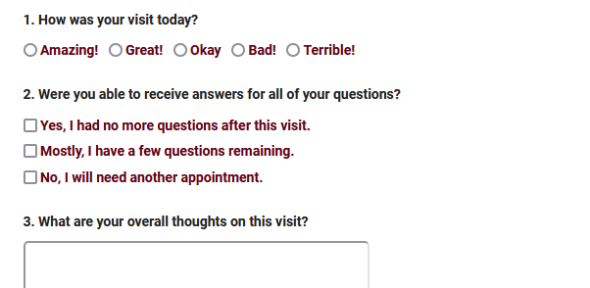
SURVEYTRAC
Sending Surveys through TracCloud with the SurveyTrac Module. Collect visit feedback and more.
Aidan Murray
2026 Virtual TracCloud Conference

Slide 2

What’s new in
SurveyTrac?
Link surveys to student lists
Static survey URLs
New “Initiated Via” option: Email after 1st booked appointment during survey period
Surveys can be sent based on modality (online, in-person, 1-on-1, etc)
Report on unanswered surveys directed to staff or faculty
2026 Virtual TracCloud Conference

Slide 3


What is SurveyTrac?
SurveyTrac is an add-on module which enables surveys to be sent to users manually or automatically based on an event such as a visit.
These surveys can be customized with different initiators, question formats, conditional questions, and more.
Surveys can be displayed within the TracCloud interface, or emailed to users directly.
2026 Virtual TracCloud Conference

Slide 4
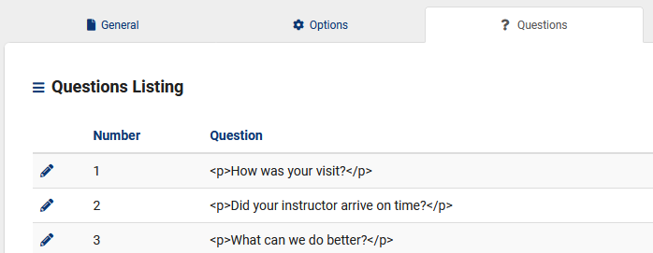
Creating a
Survey
Create and customize your own survey to determine the questions asked, when the survey is sent, who gets notified of responses, and much more. You can create an unlimited number of questions, as well as modify the layout and phrasing of the overall survey.
2026 Virtual TracCloud Conference

Slide 5
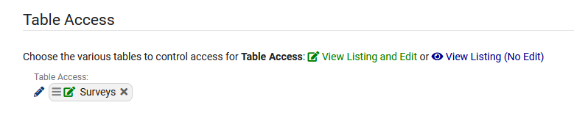
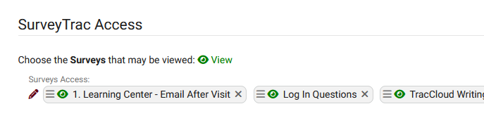
Group
Permissions
If additional staff members require access to Survey information, you will need to update their permission group.
Table Access to Surveys must be provided to give them access to any Survey information. This can be set to View and Edit or exclusively View.
We can also determine which surveys they can access from the same Admin / Modules tab of this group.
2026 Virtual TracCloud Conference

Slide 6
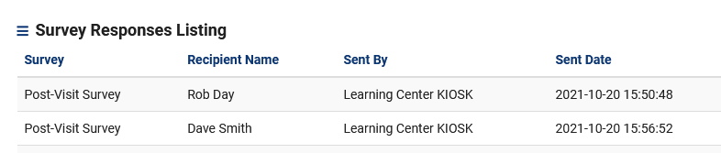
Reviewing
Responses
There are 3 ways to review Survey responses:
Viewing individual responses from the Survey entry page, and resending if needed.
Running the Survey Snapshot report.
Exporting Responses to a flat-text CSV file.
2026 Virtual TracCloud Conference

Slide 7
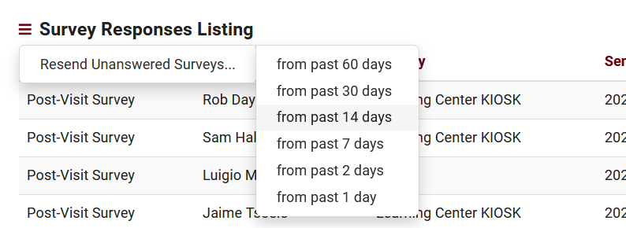
Resending
Unanswered Surveys
You can resend individual surveys from the response list, or resend all answered surveys within the past several days.
2026 Virtual TracCloud Conference

