Slide 1
Boost Student Success & Retention with SAGE In TracCLoud
Iliana Visser

Slide 2
What is SAGE?
What is Required?
SAGE (Student Alert and Group Events) is an additional module available for the Trac System. SAGE allows your faculty members to submit referrals, progress reports, or evaluations for the students enrolled in their courses. Based on the choices made while creating the referral, an automated email could be sent out to the student's assigned advisor, a professor, or otherwise, that way you and your staff can be as proactive as possible in helping your students.
Purchasing SAGE
Student and Course Import (Including Faculty Info)
Emails (Mail Server)
Faculty access to Trac(SSO)

Slide 3
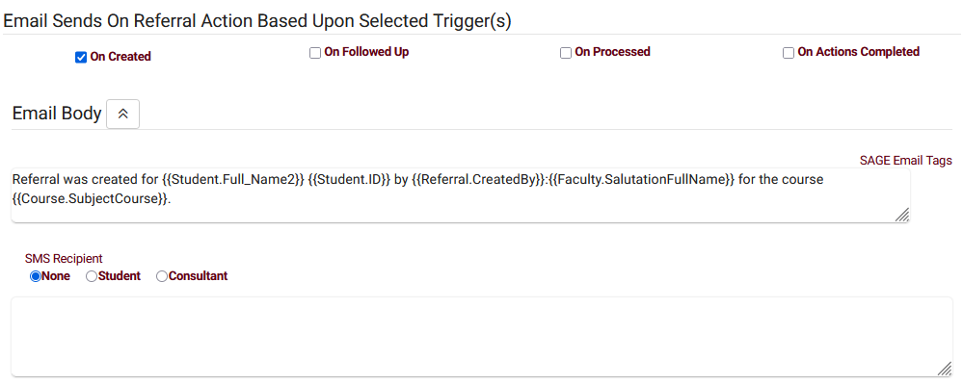
What's New with SAGE?
Sending texts in addition to emails
Processed notes shown on referrals listing

Slide 4
SAGE Process Example 1
Faculty creates SAGE Referral
Email to Student and Center
Outreach to Student
Referral completed and email to Faculty
Creation, a referral is submitted, emails are sent out.
Resolution, a final email is sent out to wrap everything up.

Slide 5
SAGE Process Example 2
Creation, a referral is submitted, emails are sent out.
Follow-up, more information is given, new emails are sent out.
Processed, a final email is sent out to wrap everything up.
Faculty creates SAGE Referral
Email to Student and Center
Outreach to student
Student arrives to designated Center
Referral completed and email to Faculty

Slide 6
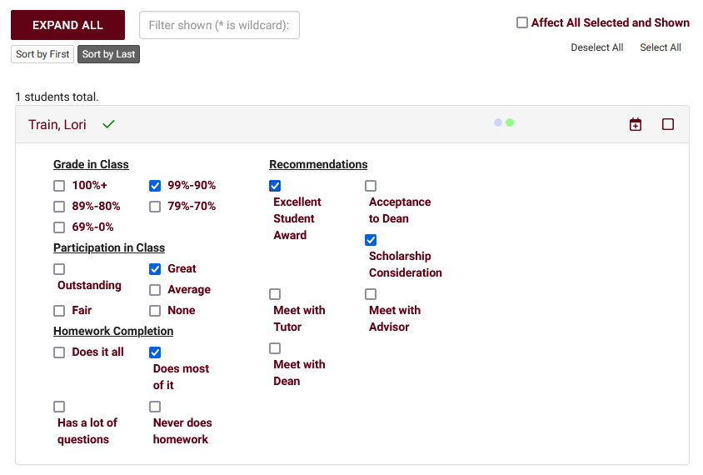
Creation Faculty View / Roster Annotations
Faculty Members are typically the primary user-type submitting referrals, they have a streamlined view of the referral submission process. Within the faculty dashboard, you'll find their class rosters along with the referrals that have been designated as Roster Annotations. This allows faculty to immediately access important referrals for each of their rosters.

Slide 7
Creation Individual Student Referrals
Referrals can also be submitted individually from students' profiles. As non-faculty users don't have access to the class roster view, this will be their primary tool for submitting referrals, but faculty can of course use this method as well. New referrals can be created through the Actions button, past referrals can be viewed on the student time line.

Slide 8
Follow-up next Step for Staff
In some instance, you may need to have a staff follow up with the student. This can be a simple check in with the student or for the staff to get more information
The follow-up email lets relevant users know how this referral is going, what has been done, and what we are doing to help this student.

Slide 9
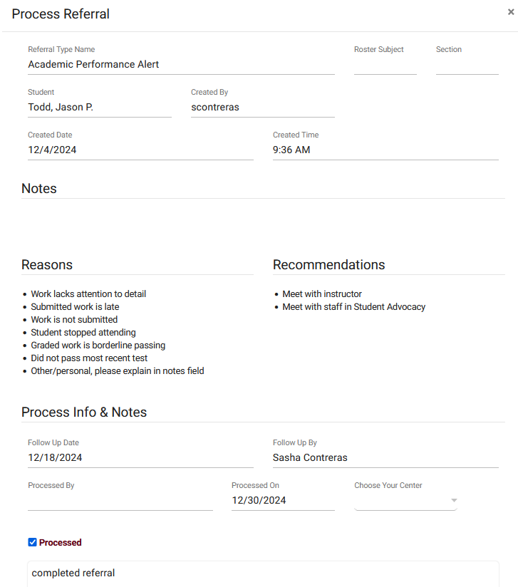
Processed Final Step for the Staff
After a referral is marked as processed, we will see the following screen summarizing basic information about this referral and providing a location to write additional notes about how this situation was resolved. Once saved, the final "Processed" email will be sent out.

Slide 10
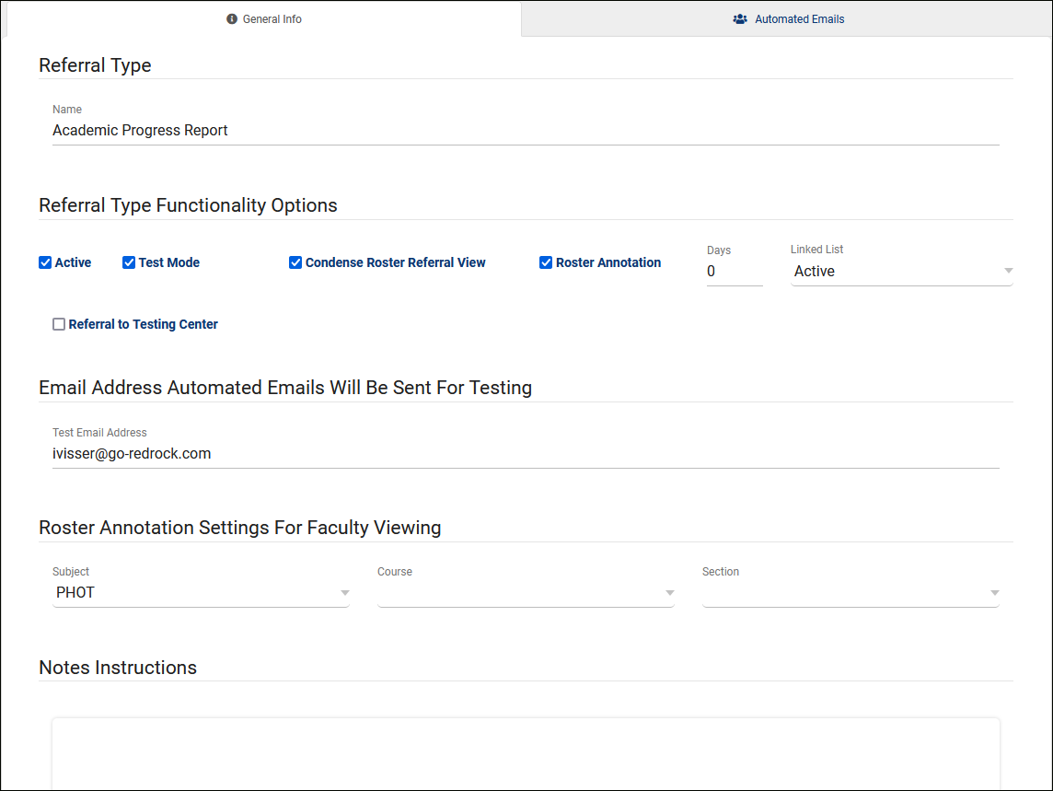
SAGE Management
When creating a referral, you will have option to have it in Test Mode, allow the faculty to see a Roster Annotation, Link referrals to List or even create a referral for a Testing Center.

Slide 11
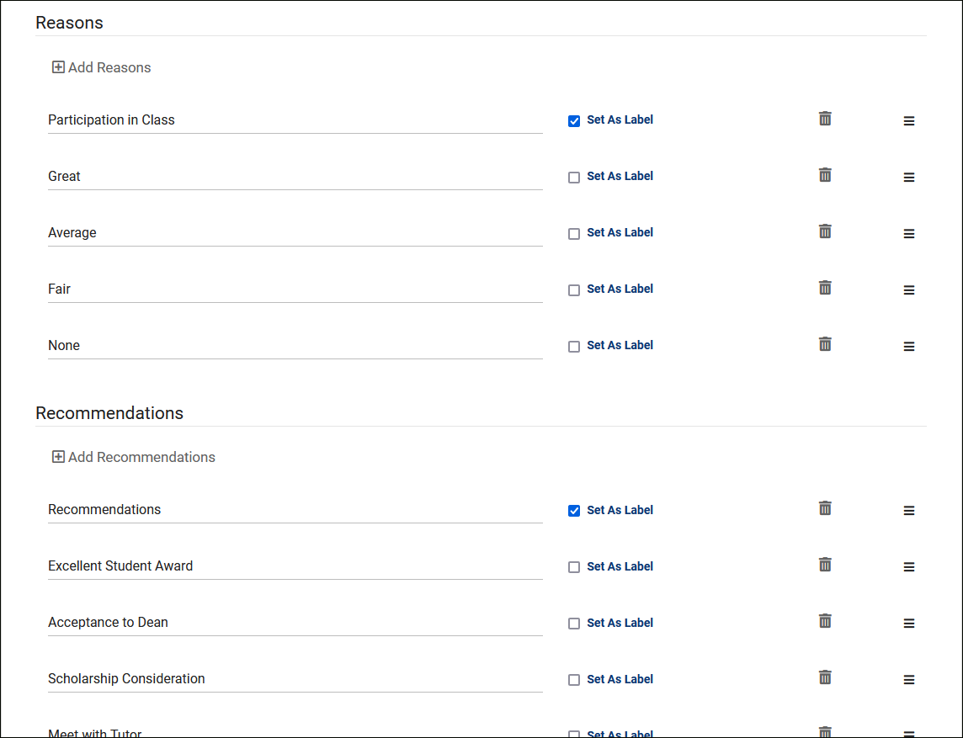
Reasons & Recommendations
Reasons and Recommendations can be one of the most important aspects in creating these referrals, as these options can also dictate which emails get sent out to whom. Typically, these would be configured to allow your faculty to quickly describe where the student is struggling and what they recommend as a solution.

Slide 12
Referral to Testing Center
This allows you to provide faculty the ability to book appointments for students that they're creating referrals for. Typically used for Testing Centers or Lab environments, where faculty would need to book appointments on behalf of students, or assign multiple students to the same Group Availability.

Slide 13
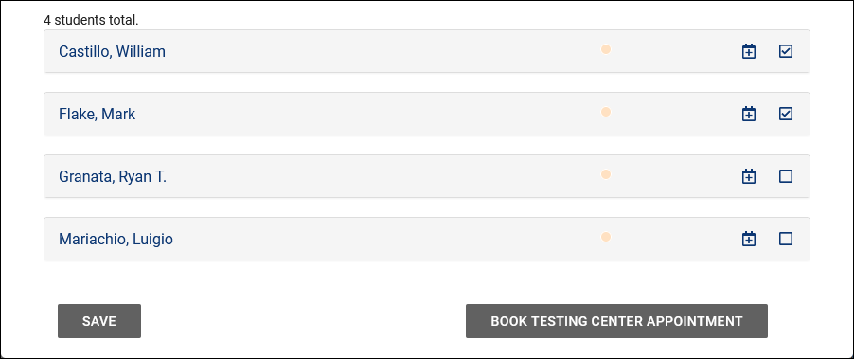
Referral to Testing Center
From the faculty perspective, there's a Schedule icon for each student in the roster referral listing, and/or the option to select multiple students and click "Book Testing Center Appointment" to schedule a group appointment for all selected students.

Slide 14
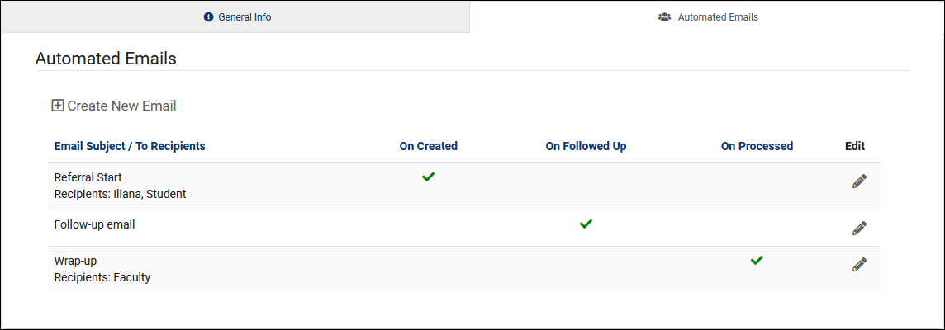
Automated Emails
The Automated Emails tab allows you to create custom emails that can be sent to one or more of your Potential Email Recipients upon referral submission. Common examples might be an email that is sent to the student when a referral is created for them. Faculty or other staff might also receive different versions of the same email, or a completely different email if configured in that way.

Slide 15
Email Tags and Logic
Email Tags
A full list of email tags is provided is a Wiki, but to give a quick example, you could format an email as such:
"Hello, {{Student.First_Name}}, this {{ReferralType.Name}} was submitted by {{Faculty.FirstName}}.“
Each of those tags would then be replaced by the relevant information when the email is sent.
Email Logic
This is where Twig gets slightly more complicated, but significantly more flexible. Let's say you want to add an extra sentence to your email, but only if a particular reason was selected. In that case, you could write your email like this:
{% if "Poor Attendance" in Reasons %}
Online Tutoring is now available! See example.edu/remote/ for more information.
{% endif %}
That sentence will only be included in the email body if that Reason was selected.

Slide 16
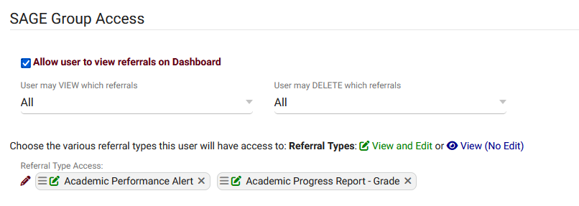
Group Access
In order for staff members to view and/or edit referrals, they must be provided access in their permission group. This also gives you the ability to fine-tune what they can and can't do in relation to these referrals.

Slide 17
SAGE Listing
If a permission group allows it, it's also possible to utilize the Referrals Listing to quickly access all referrals in your TracCloud instance. This can be accessed by going to Other > Listings > Referrals.

Slide 18
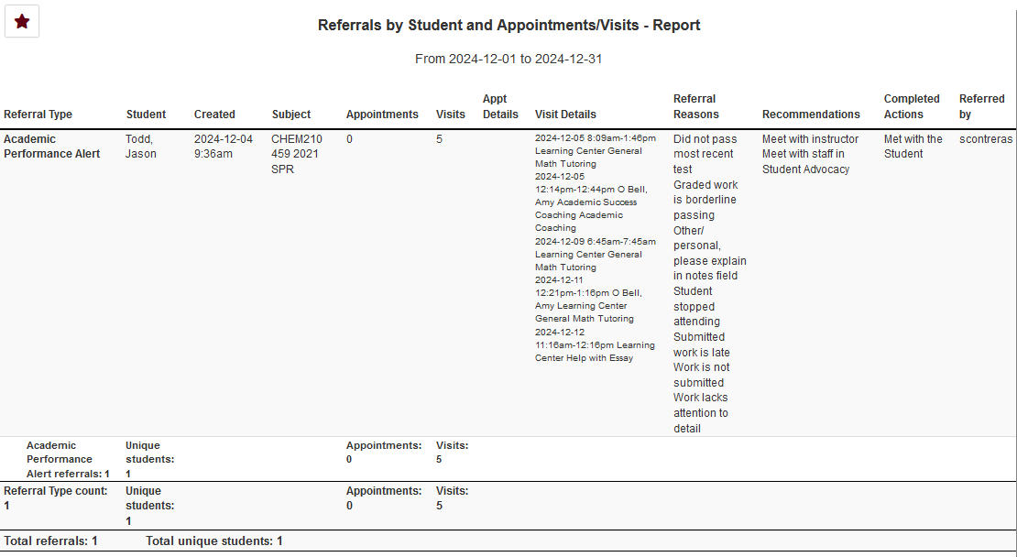
Reports
There are three SAGE-specific reports available in TracCloud, each providing a different way to view your referral data. These reports can be found in the Navigation Bar, under Reports > SAGE.

