Slide 1
Through the Student’s Lens
Navigating TracCloud
Erick Martinez

Slide 2
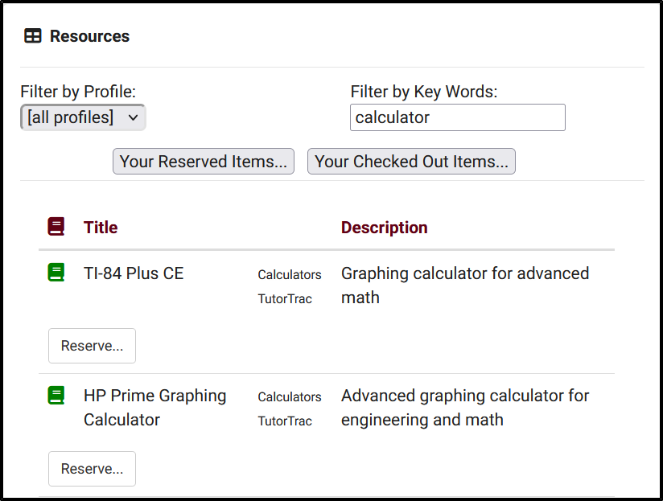
New features
Asynchronous appointment automatic message.
Search Appointment Link
Resource Reservations
Day of week and time or day for Announcements
Prospect Request feature for Prospective Students

Slide 3
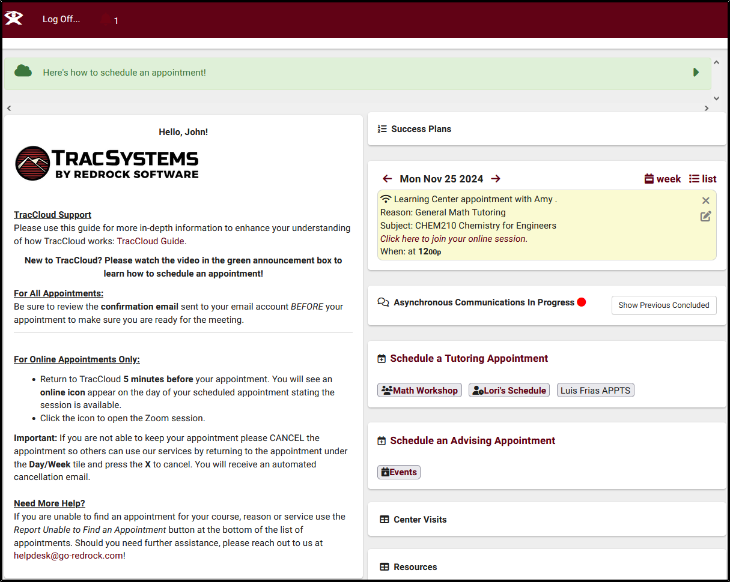
Student Dashboard
Confirm Bio
Announcements
Welcome Message
Upcoming Appointments
Availability Search Widgets & Asynchronous communications
Past Visits
Reserve Resources

Slide 4
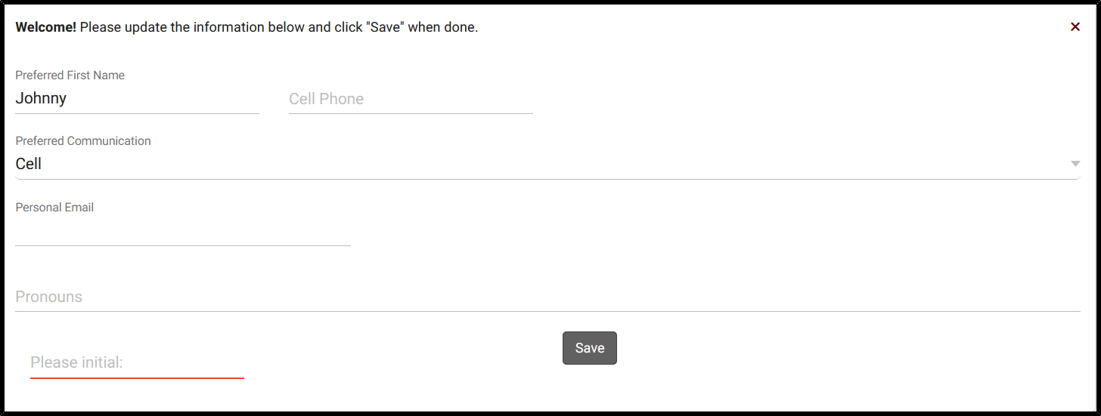
Student confirm bio
Allows students to manage their own information, what they’re allowed to view and edit is at your discretion.
Helps ensure that Student records contain the most current information, even if the information doesn’t match the data in your import file.
Students have the option to edit their bio at their convenience using a widget on their dashboard

Slide 5
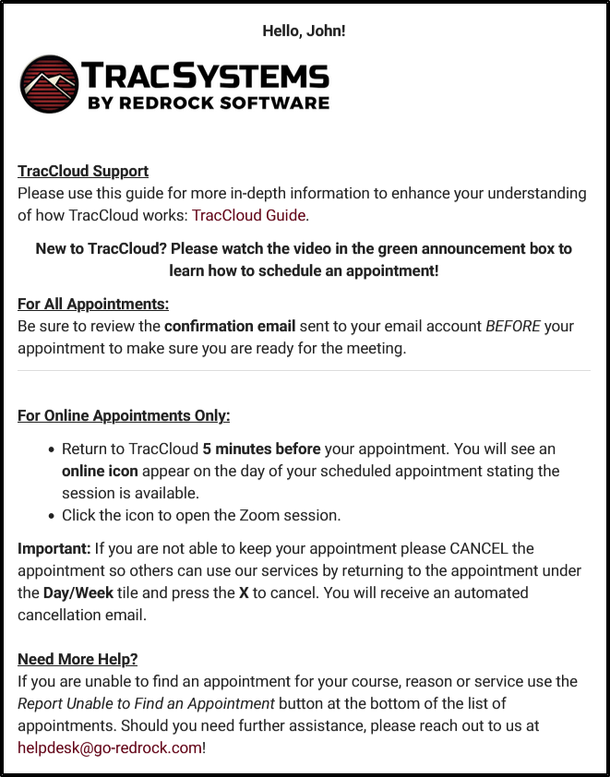
Welcome message
Provide students with a customized message on their TracCloud Dashboard
Twig & HTML supported messages
Allows you to embed images, vides, or redirect students to another web page.

Slide 6
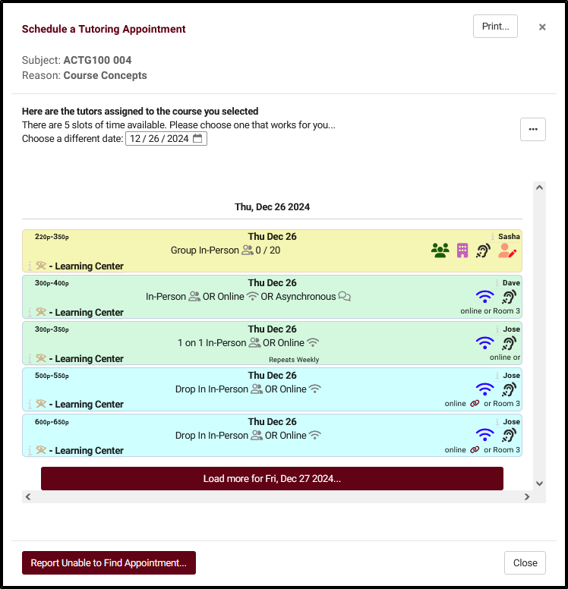
Availability Search
Search Availability Widget & Search Appointment Link
What information is provided to students when they search for an availability?
Search Availability Badges
Appointment details are provided on the Appointment Display widget on the Student Dashboard

Slide 7
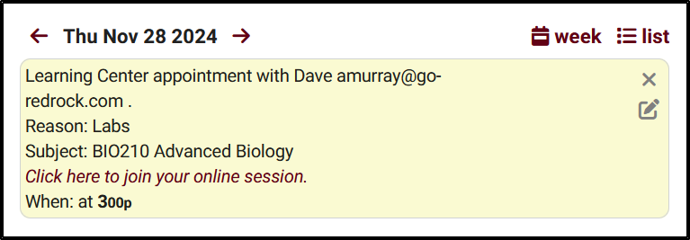
Appointment Display
Students can view upcoming appointments from their TracCloud dashboard.
Customize the format and content of the appointments and their details

Slide 8
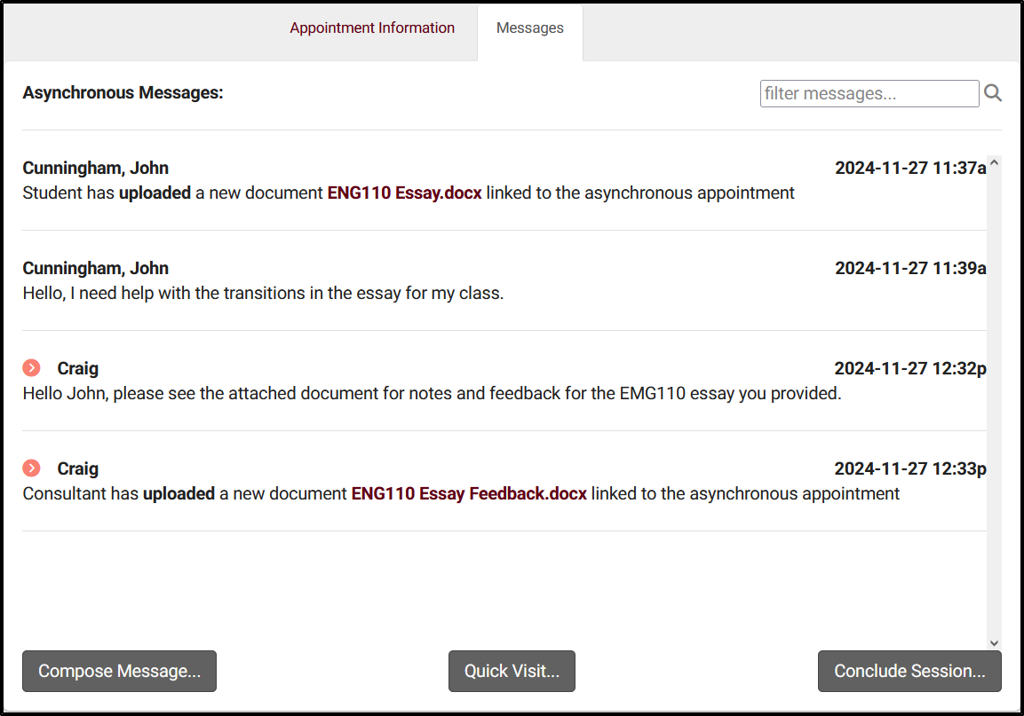
Asynchronous Appointments
Asynchronous Communications Widget
“Messages” displays the ongoing text chat between the student and consultant, including a log of document uploads and deletions.
Student can receive a notification when Consultants send a new message.
Who concludes the Asynchronous Appointment?

Slide 9
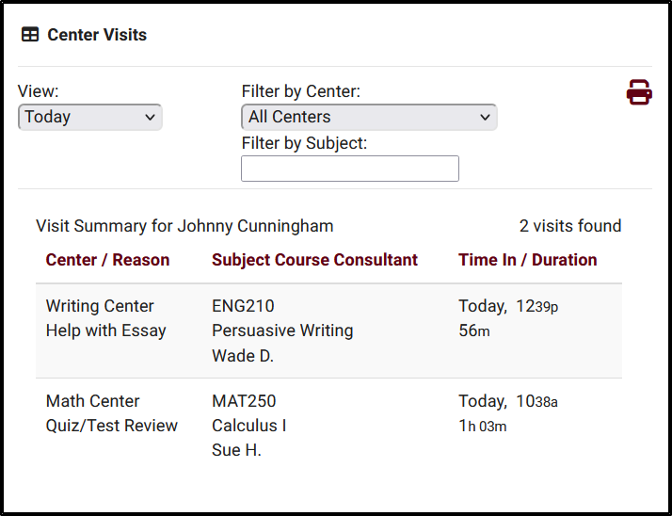
Center Visits
Provide Students with details regarding previous Visits directly on their dashboard
Filtering options provided to find Visits based on selected criteria
Provides the option for students to print out their Visit Summary

Slide 10
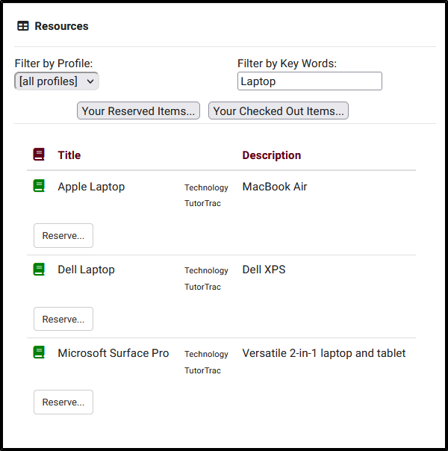
Resources
Allow students to reserve resources from their Student dashboard
Students can review Resources they have reserved and the Resources they have checked out from their Dashboard.
Configure the limit for reservations
Block Students assigned to a List from being able to reserve items

Slide 11
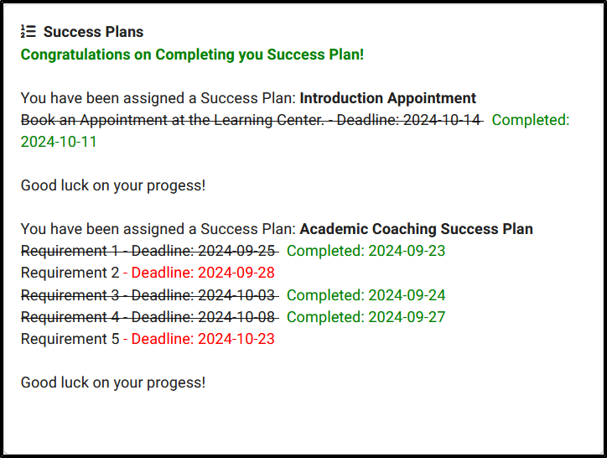
Success plans
Students who assigned a Success Plan can be shown details on their dashboard
Information and formatting can be customized using Twig and HTML
Requires the Success Plans Feature

Slide 12
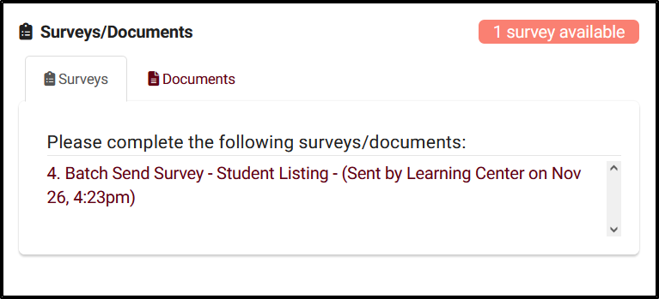
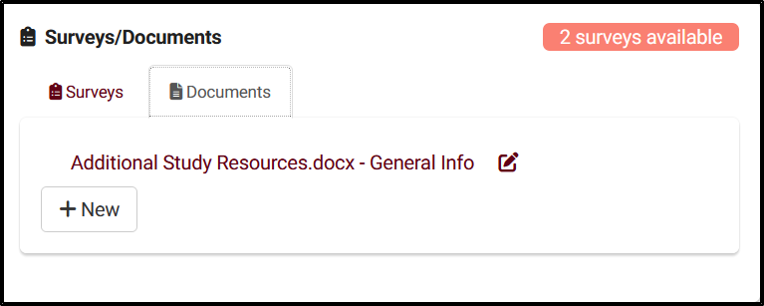
Surveys/ documents
Surveys
Documents
Students can access pending surveys from their TracCloud dashboard
Allow Students to view and upload documents from their Dashboard
Student must have access to viewing documents

