Slide 1
Unlocking the Power of Resource Management in TracCloud.
Learn how to create, set up, and manage a lending library.
By Sasha Contreras

Slide 2
What is a Resource?
Resources are items that are utilized in many different ways. They can be common items such as books, laptops and calculators. To more complex items as projectors, microscope and
Both students and staff can check out and reserve items.
TracCloud records items in the center, items that are checked out, and who reserved them. This feature also documents when they are returned and allows different reporting options to be accessed.

Slide 3
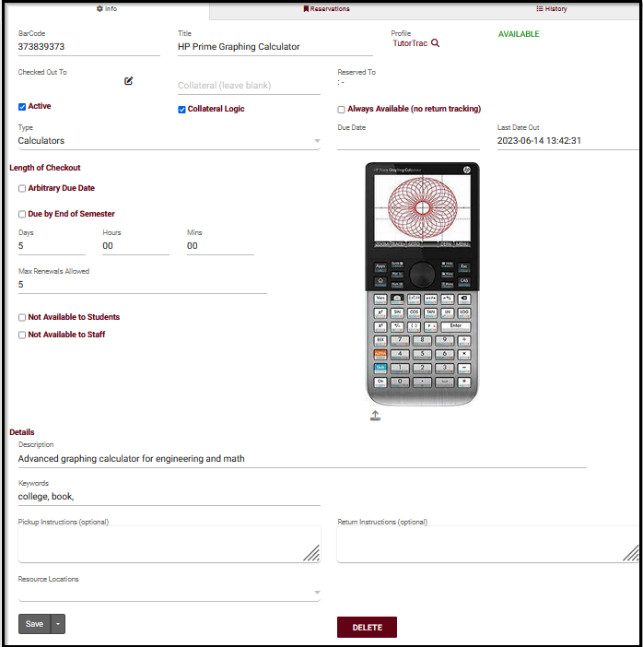
Creating a Resource
BarCode is the unique identifier for this item, think of it like an ID.
Title is the name of this resource.
Profile is the linked Profile for this resource.
Checked Out To shows which student currently has this item checked out (if applicable).
Collateral represents an item to be collected when this resource is checked out.
Collateral Logic enables collateral functionality if checked.
Reserved For shows who currently has this resource reserved.
Always Available indicates that this resource doesn't need to be individually checked out or reserved (example, towels for fitness center).
Reserved Date, Last Date Out, and Due Date display the exact times of reservations, checkouts, and when the resource is due to be returned.
Resource Type allows you to categorize this resource into a type for reporting purposes.

Slide 4
Creating a Resource
(continued)
Length of Checkout determines how long an item can be checked out.
Max Renewals Allowed determines how many times a checkout can be renewed.
Description is an internal description of this particular resource.
Keywords are the related words for this resource to be searched by.
Pickup Instructions can provide extra detailed instructions to students and staff getting a confirmation email.
Return Instructions can be entered and displayed in resource return email.

Slide 5
Resource Types
Resources can be grouped together for reporting purposes. If needed, lists can block certain students from accessing certain resources.

Slide 6
Permission Group
Other > Other Options > Groups > [Select Group] > Log In/Out.
Allow user to log resources in and out provides users in this group the ability to record resource usage.
Allow user to view what resource the student has logged out provides users in this group the ability to view a student's currently logged out item.

Slide 7
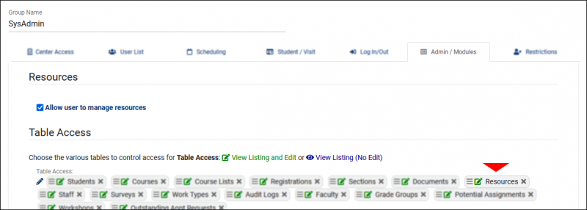
Permission Group
Other > Other Options > Groups > [Select Group] > Admin/Modules.
Allow user to manage resources provides the ability to modify resource records.
Table Access provides access to the Other > Listings > Resources view of resources.

Slide 8
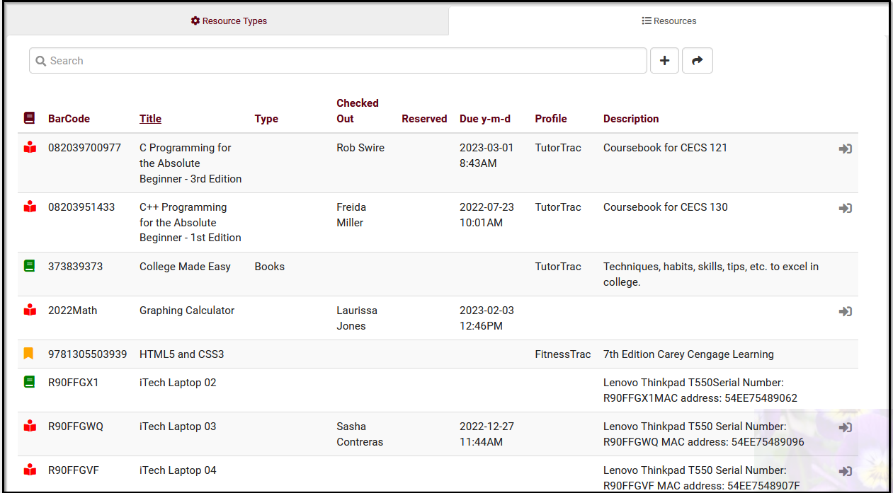
Resource Icons
Inactive
Active
Reserved
Checked Out

Slide 9
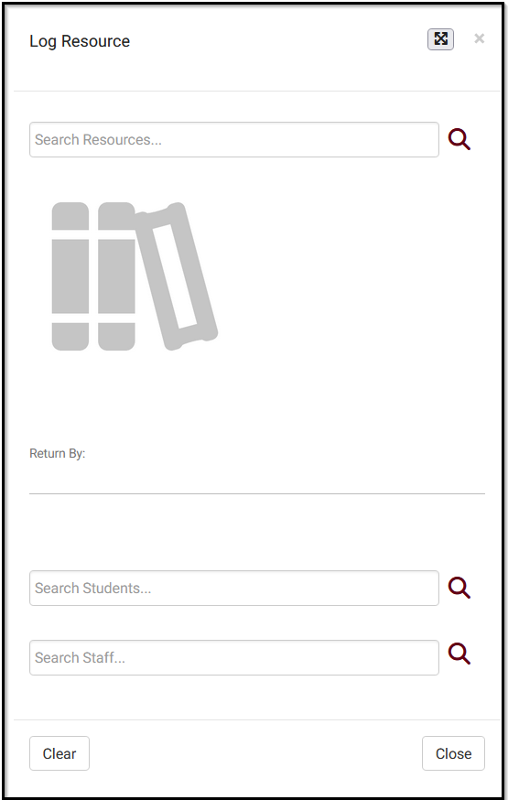
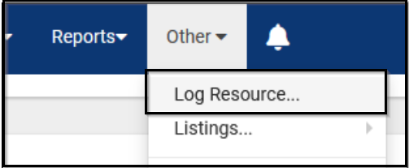
Checking Out Resources
Resources will have its own special log listing that staff will be able to access.
Once “Log Resource” is selected, a screen with two text entry areas will be available.

Slide 10
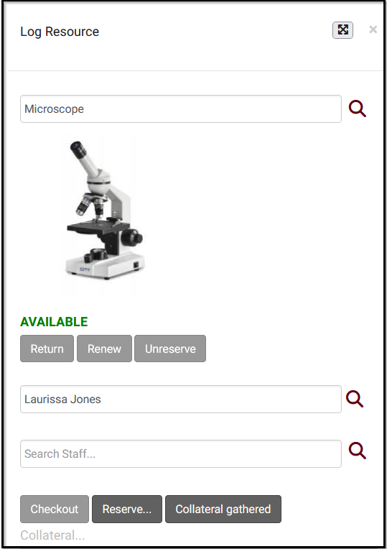
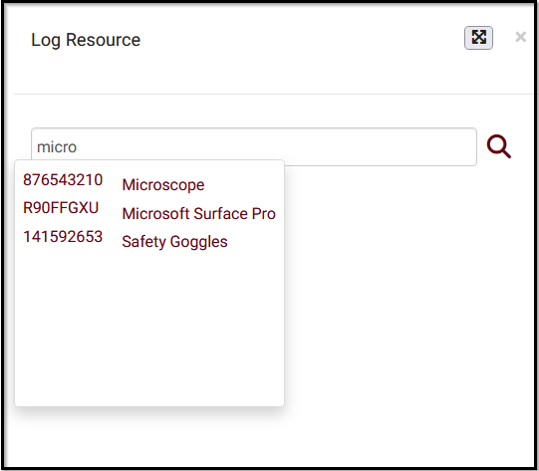
Checking Out Resources
(continued)
The first is where you select a resource (searching by Barcode, Title, or Keywords).
The second allows the user to select the student or staff member that item is being checked out for.

Slide 11
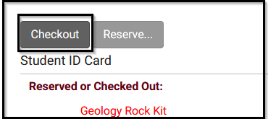
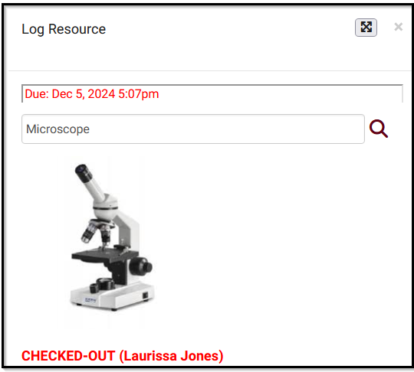
Checking Out Resources
(continued)
If the item being checked out requires collateral to be collected, a textbox field will appear. Once collateral is gathered, the item can be fully checked out.

Slide 12
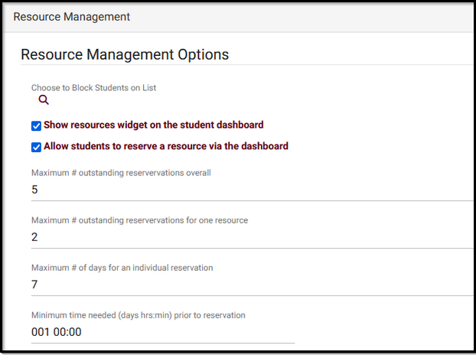
Resource Reservations
Students can now reserve resources from their dashboard!
This global preference can be enabled by going to Other > Other Options > Preferences > System Preferences > Resource Management.

Slide 13
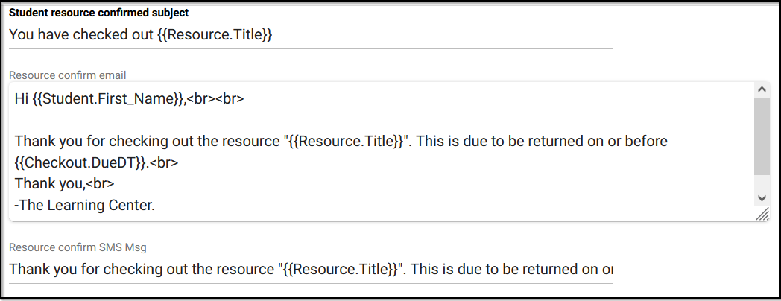
Resource Checkout Email(s)
A few emails can be configured with details for the item that was checked out as well as the return time.
These email are Resource Confirm, Resource Overdue, Resource Pickup Reminder (for reserved items), Resource Return, and Resource Return Confirmation.
Other > Other Options > Profile > Prefs > Emails > Resource Checkout Email.

Slide 14
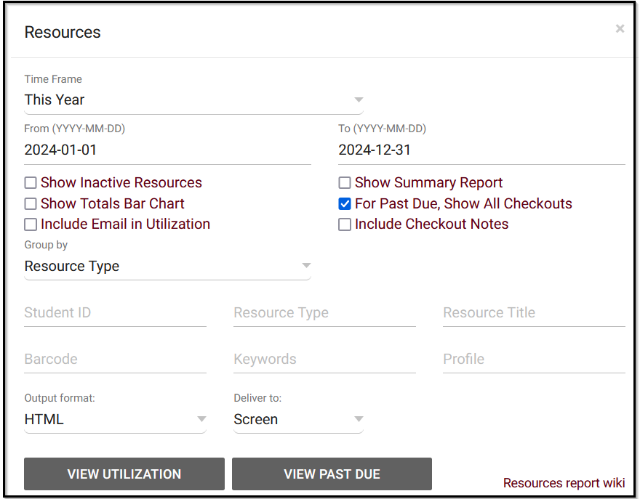
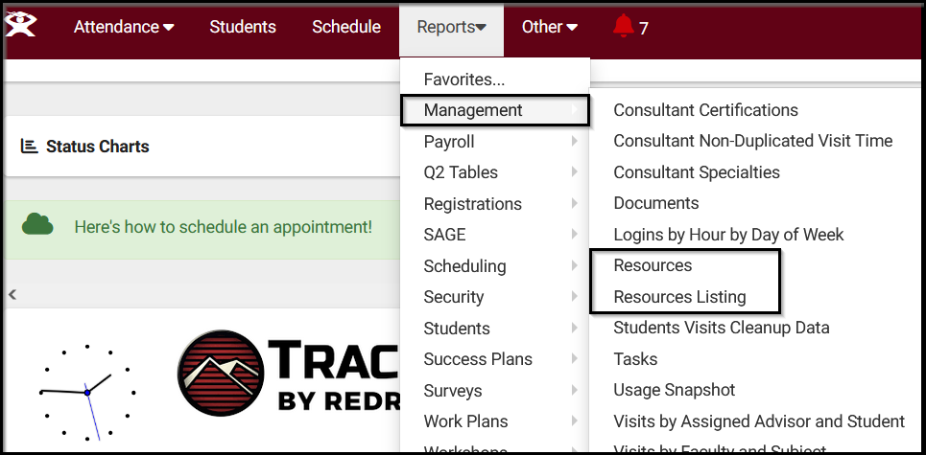
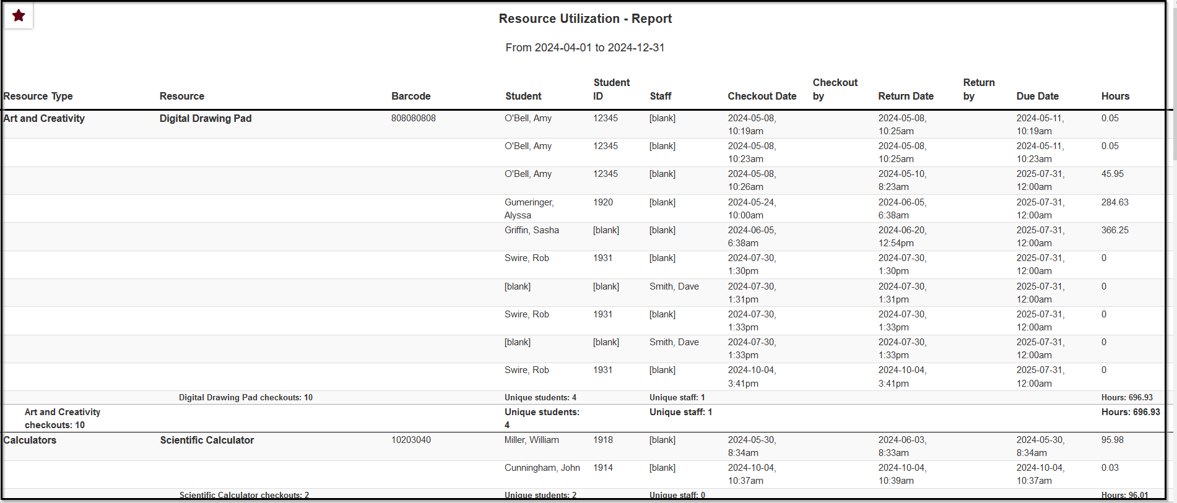
Resource Reports
This report shows the students and staff who have checked out a particular resource, the checkout date and time, as well as total hours
Reports have the option for CSV export (Raw data) or with grouping totals.

