Slide 1







Managing Staff Operations In TracCloud.
Staff Management, Work Visits, Scheduling, & Reporting.
Sasha Contreras
2026 Virtual TracCloud Conference

Slide 2


User Levels
Staff accounts can access different parts of the system, edit visit/appointment data, and create availability/appointments, etc. However, this user level cannot access the Center Profiles or Global Settings.
Profile Admins can have all the same permissions as a staff account, along with the ability to access and manage the List and Center Profiles. However, this user level will not have access to the Global Settings.
Super Admin are similar to Profile Admins, but with a few minor additions and the ability to provide access to select global preferences. Access to global preferences is configured in the super admin's staff account, next to 'Linked Centers. You can choose what Global Settings they have access to.
SysAdmin accounts have even more permissions than staff. SysAdmins can edit Staff profiles and Group Settings, as well as have full access to delete options, lists, and more. SysAdmins will have the ability to edit and view everything in the system, including the Center Profiles and Global Settings.
2026 Virtual TracCloud Conference

Slide 3


Groups
Permission groups determine what kind of access your staff have access to.
Each group has permissions to allow access to profile, centers, visits, student data, scheduling, custom questions and more. The settings also allow you to identify if that a staff member in this group can edit and view additional information such as visit notes.
TracCloud has no set limit on the number of groups you can create, allowing the flexibility to establish as many groups as needed for your institution based on roles and access.
2026 Virtual TracCloud Conference

Slide 4
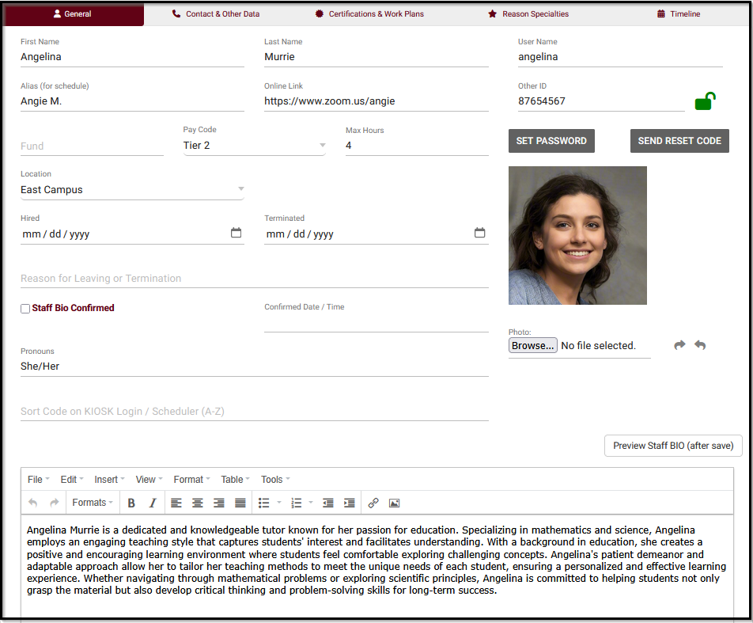
Creating Staff Record(s)
First Name, Last Name: The name that will display on reports & schedule.
Username: This is what will use to login. If SSO is to be used please coordinate with your IT and/or Redrock Software to determine what your username format should be (e.g., ID number, email address, etc).
Alias: An alternate name that will appear when searching for appointments.
Online Link: If appointments are held by online platforms (Zoom, Webex, etc), each of your consultants can have a unique invite link defined in their profile. When a URL is placed here, and their availability is set the online meeting type, the URL will be able to redirect the student to the meeting platfrom the session is being held on.
Other ID: A alternate ID of this staff member that can be used for searches. (Example: Employee ID).
Fund: This is used as the consultant's assigned fund, used for payroll.
Pay Code: This consultant’s pay code will determine their pay rate when running payroll report.
Max Hours: Can be used to limit the number of hours this staff member can be booked in a certain range of days, even if they have open availabilities on their calendar.
2026 Virtual TracCloud Conference

Slide 5
Creating Staff Record(s)
Location: The Location option will display as an option when creating availabilities on this consultant’s schedule.
Hired / Terminated & Reason: Hired/Termination dates can be added. If there is any documentation needed the reason for termination, that can be recorded.
Staff Bio Confirmed & Confirmed Date / Time: When and if this staff member has completed the confirm bio prompt.
Pronouns: This staff member's preferred pronouns, this information can be shared with students by using TWIG tags in emails if needed.
Sort Code on KIOSK Login / Scheduler (A-Z): During visit login/logout or on the staff schedule, where a list of consultants are shown, the results will be sorted alphabetically by last name. You can enter text in this field to override this.
Staff BIO: A written bio of this staff account. Can be displayed to students upon looking at the schedule and provide more information of the staff if the name is clicked on.
2026 Virtual TracCloud Conference

Slide 6
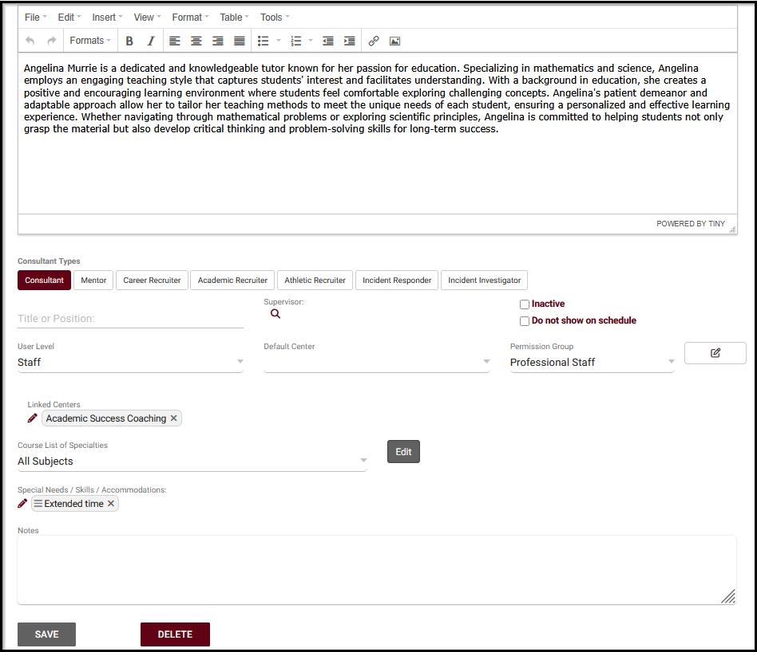
Consultant: If this checkbox is selected, this staff member will have an available option on the schedule and allows them to be linked to visits.
Creating Staff Record(s)
Title or Position: This staff member's position title for reference if needed.
Supervisor: This person's assigned supervisor will be able to view their mentorship (if module is purchased) and asynchronous appointment (setting turned on) from the dashboard.
Inactive This will hide them from view and prevent them from logging into TracCloud, but the record and related data remains available if needed, for historical reporting or later reactivation.
KIOSK: If the “KIOSK” checkbox is selected, the account is heavily restricted and many fields are removed. Simplifying the account so only a KIOSK can be opened.
Do not show on schedule: If checked, this consultant will not show up on the schedule.
Course List of Specialties: The course list determines which subjects this consultant can assist with. Aids with the filtration on the schedule when a student is looking for an appointment for a specific subject.
Accommodations: These are the skills/accommodations that this consultant can assist with. (language accommodation, extra time on test, ASL interrupter etc).
2026 Virtual TracCloud Conference

Slide 7

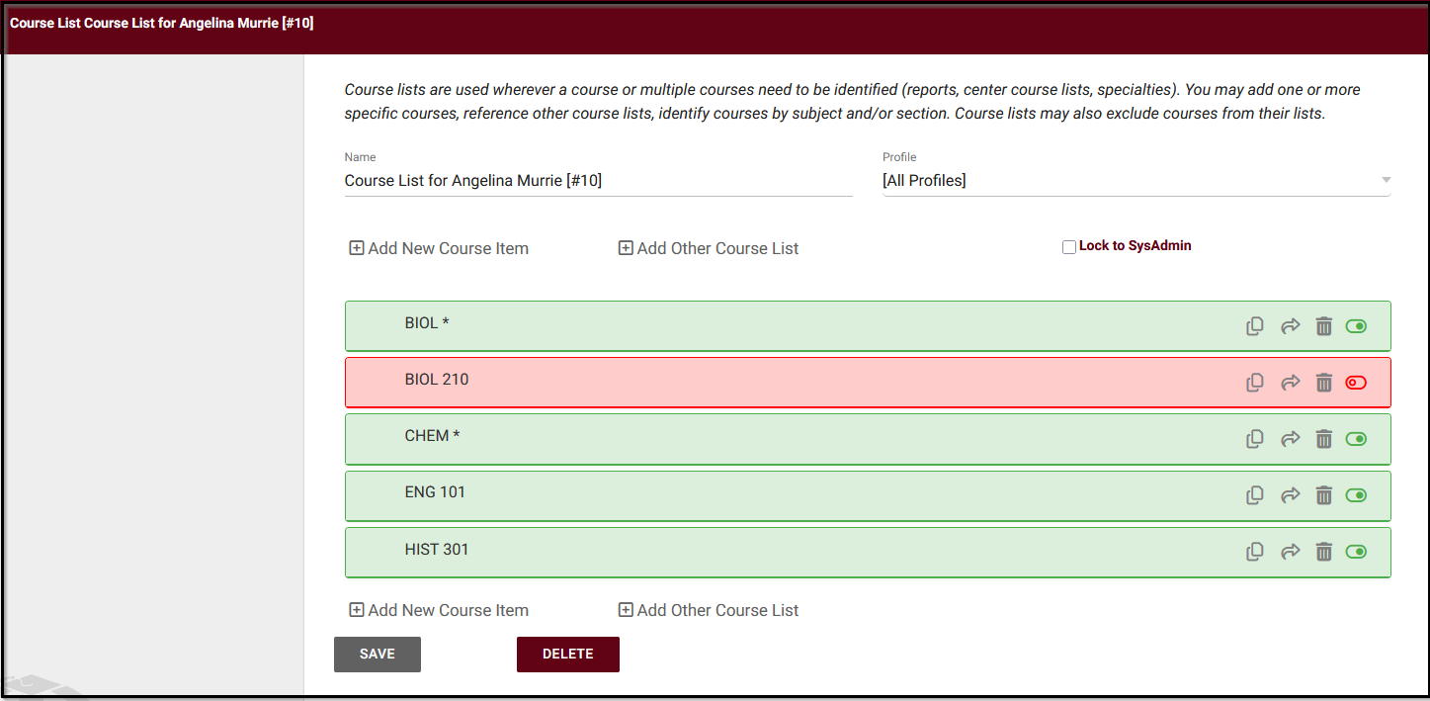
Managing Course Lists
Wildcards can be used to simplify what the consultant can assist with.
Certain sections can also be excluded from a course list for a quick set up.
2026 Virtual TracCloud Conference

Slide 8
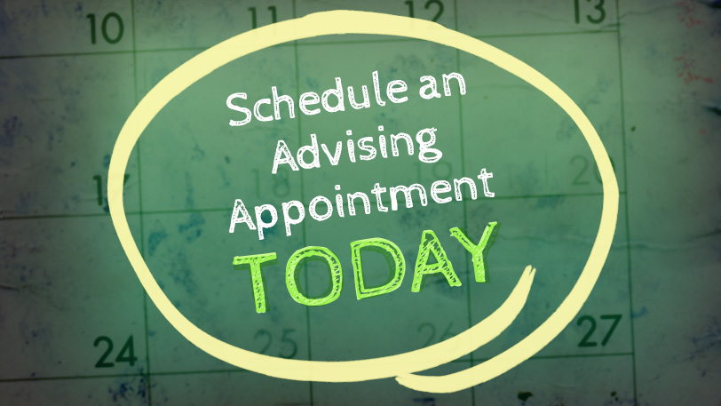
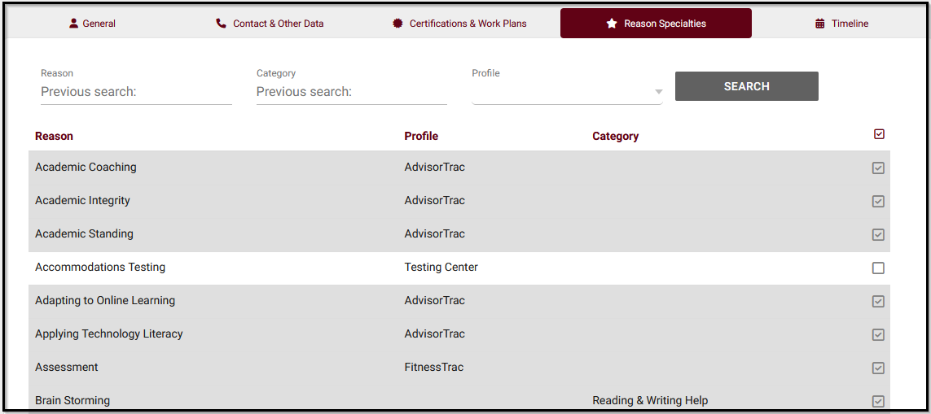

Reason Specialties
Reason specialties are used to aid in staff filtration when a student is looking for an appointment based on reason.
This is used commonly in advising centers.
2026 Virtual TracCloud Conference

Slide 9
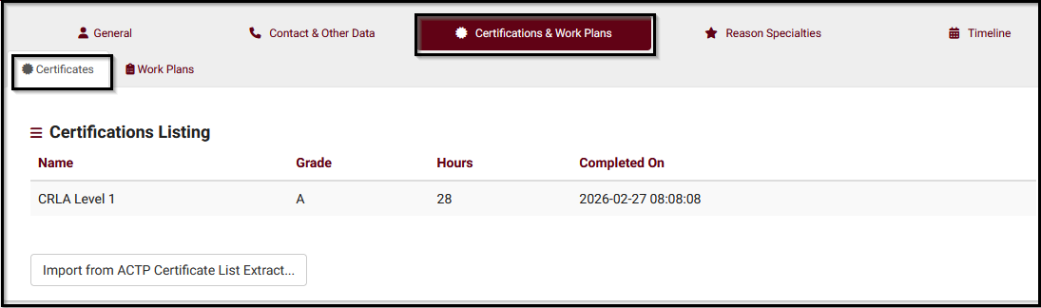
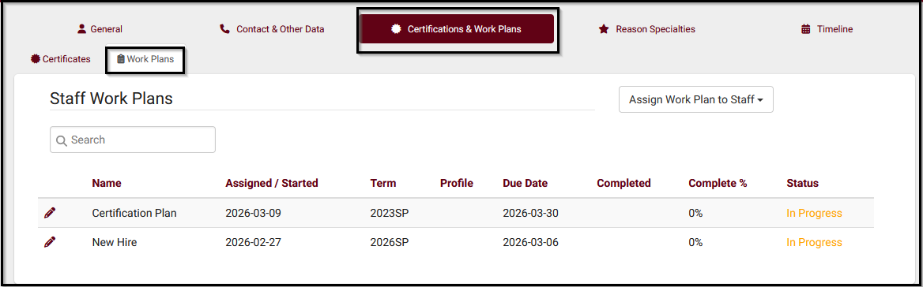
Certifications And Work Plans
Certifications allow you to track and manage different certifications a staff has right into TracCloud (e.g., CLRA, ACTP, etc). Certifications can be created for a individual staff record, or in a batch setting under the staff listing!
Work Plans allow you to track staff (consultant or advisor) progress on a set of tasks or training steps in custom plans, designed for staff development or projects. One example could be to complete a training session, achieving certifications, or fulfilling certain requirements as a newly hired staff.
2026 Virtual TracCloud Conference

Slide 10
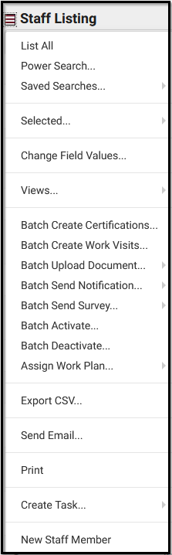
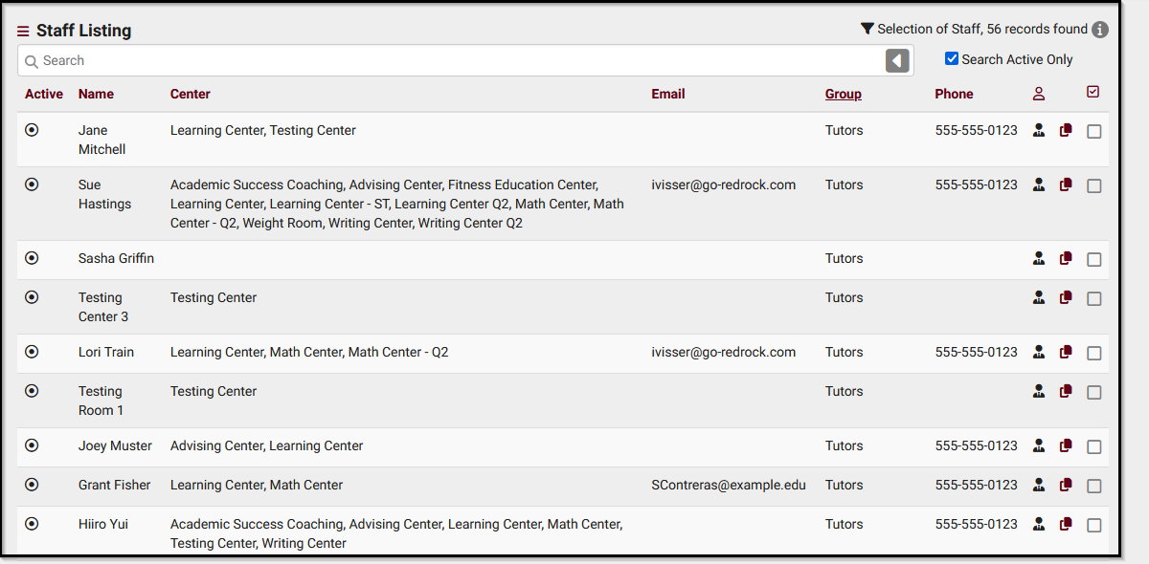
Staff Listing
Staff Listing can be used to create new staff members. This listing also allows other usages to happen such as searches, exports or sending a group email. Need to create certifications for multiple consultants? The staff listing will allow you to filter out the staff that need that documentation so you can create this at one time.
2026 Virtual TracCloud Conference

Slide 11

Thank You For Attending!
If you have any further questions that might be specific to your instance, please send us a ticket at helpdesk@go-redrock.com .
Respectfully,
Sasha Contreras
2026 Virtual TracCloud Conference

