Slide 1


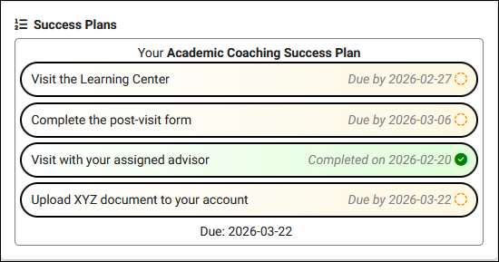
SUCCESS
PLANS
Create and manage success plans for your students
Aidan Murray
2026 Virtual TracCloud Conference

Slide 2

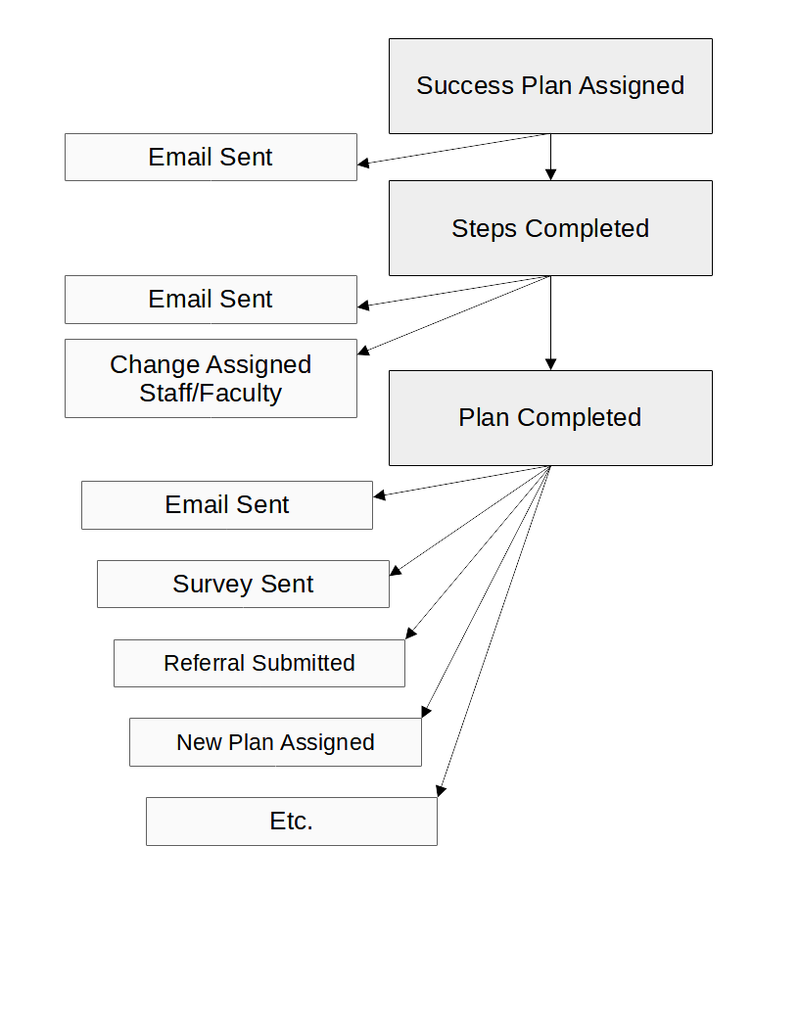
What are
Success Plans?
Assign a Success Plan to the student and track their progress across your defined Steps.
Each Plan contains multiple Steps to complete. Visiting a center, responding to a survey, etc.
Once the Plan is completed, TracCloud can automatically initiate emails, surveys, referrals, and more. A second plan can also be assigned.
2026 Virtual TracCloud Conference

Slide 3

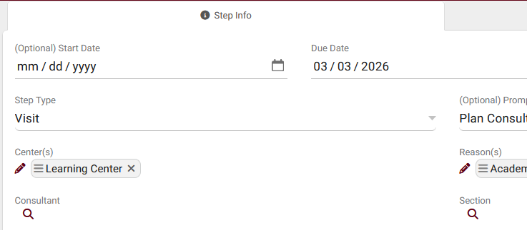
Creating a Success Plan
1. Steps
Each Step represents an action that the student must complete. TracCloud can automatically mark these Steps as Completed when that action takes place. The following records can be used as a basis for each step.
• Visits
• Survey Response
• Document Upload
• Task Completion
• Resource Checkout
• Notification Acknowledgement
• Prompt Confirmation
• Assessment Completion (New!)
2026 Virtual TracCloud Conference

Slide 4
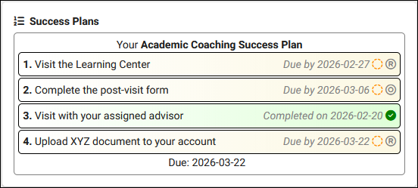
Creating a Success Plan
2. Dashboard Display
Your Dashboard Display determines how Success Plan progress is shown to students. The header, footer, and the individual steps/lines can be independently modified to ensure your students are viewing relevant information.
2026 Virtual TracCloud Conference

Slide 5
Creating a Success Plan
3. Emails
Emails can be automatically sent to students to update them on their Plan progress. Each email can further modify the Plan itself by changing the linked staff or faculty, or even initiating new Surveys or Referrals with Twig. Individual Steps and the overall Plan can be assigned emails independently of each other.
• Plan/Step Started This email is sent when a Plan is first assigned, or when a new Step is available to begin.
• Plan/Step Reminder Up to 3 reminder emails can be sent for the overall Plan, and an additional 3 emails can be sent for each Step.
• Plan/Step Complete This email is sent when a Step or the overall Plan is completed.
2026 Virtual TracCloud Conference

Slide 6
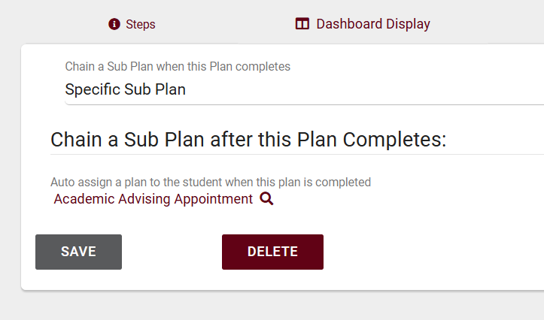
Creating a Success Plan
4. Chaining Sub-Plans
Upon Plan completion, TracCloud can initiate other processes, including assigning an additional Succuss Plan to the student.
• Specific Sub Plan Choose a Plan that will automatically be assigned upon Plan completion.
• Conditional Sub Plan Use Twig to add logic determining if a Plan needs to be created, and which Plan should be used.
2026 Virtual TracCloud Conference

Slide 7

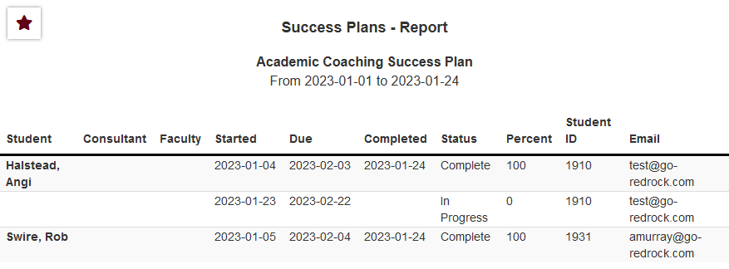
Success Plans Report
The Success Plans report can be used to show information about current and past Plans and their overall completion. This report can be sorted by student or date (start, due, completion).
2026 Virtual TracCloud Conference

Slide 8
What are Work Plans?
• Work Plans are configured similarly to Success Plans, but are assigned to and completed by consultants instead.
• Use Work Plans to track training and certification progress.
• Steps can be based on work visit hours, visits with students, and more.
2026 Virtual TracCloud Conference

Slide 9
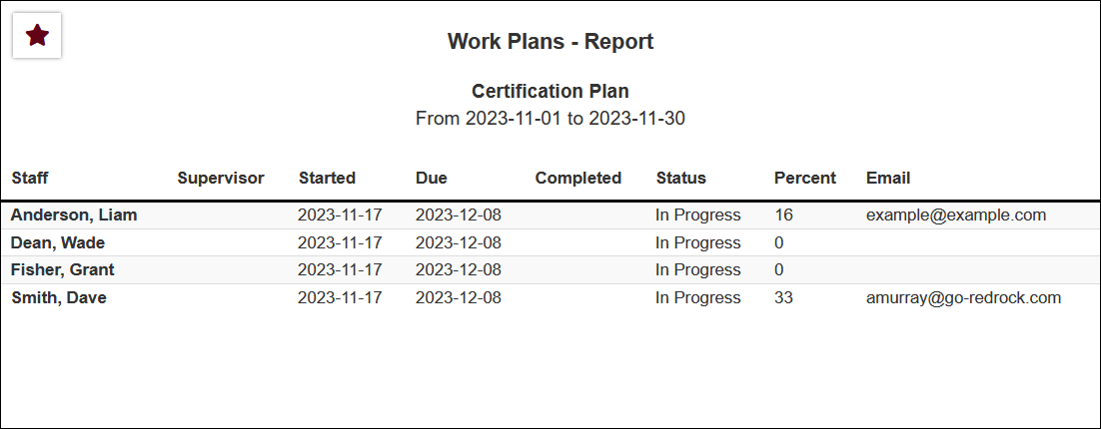
Work Plans Report
The Work Plans report can be used to show information about current and past Plans and their overall completion. This report can be sorted by consultant or date (start, due, completion).
2026 Virtual TracCloud Conference

