Slide 1
TracCloud Success Plans: Increasing Student Transparency, Engagement, & Compliance
Alaina Peters (she/her/hers)
University of Cincinnati | Learning Commons
Notes:
Alaina

Slide 2
Presentation Outcomes
Participants will be able to...
Summarize the UC Learning Commons' approach to managing campus-wide Success Plans for specific student populations of concern (first-year students, students on Alert or Probation, etc.)
Identify the technical and administrative processes needed to implement similar Success Plans at their own institution, including how these improvements can increase student compliance
Notes:
Jacob

Slide 3
UC Learning Commons
Large public university in Cincinnati – and growing!
36,402 undergrads, 11,512 grad/prof
1 "main" campus + 2 regional campuses
Free centralized academic support for UC students through various services
Provides services to help students and enhance their academic toolbox
13 Professional Staff, 6 Graduate Staff, & 300+ student staff
3 "Buckets", 10 Programs
First Year Experience
Content Support: drop-in tutoring, appointment-based tutoring, Supplemental Instruction, other group services
College Success: pre-scheduled one-on-one and group success skills-building
Fairly decentralized governance by college
Notes:
Alaina

Slide 4
Transition Context
Spring 2023
Success Plan management transitioned (to me!)
Prior to Summer 2022
No student view of Success Plans in Trac 4.0
Summer 2022
Learning Commons transitioned to TracCloud TutorTrac
Fall 2022
New Success Plan tracking approach implemented & management transition (Hannah Williamson)
Advisors encouraged to explore more creative/flexible plans
Notes:
Fall 2022-Spring 2023: TracCloud also working on building Success Plans module

Slide 5
Road Map
Overview of Success Plans at UC
Success Plan Tracking
Student Communication
Implementation (Our Version!)
Hot Topics

Slide 6
Overview of Success Plans at UC
Which students are on Success Plans, and why?

Slide 7
Success Plans by the Numbers
11 Campus Partners
9 colleges
2 first-year access/mentoring programs
1-3 different plans & deadlines per campus partner
Most Common Plans
5 Learning Commons Visits (College of Arts & Sciences)
7 Course Support Sessions (College of Engineering & Applied Sciences)
5 Academic Coaching Appointments (multiple colleges)
5 Success Skills Workshops (multiple colleges)
Currently 1128 students on Success Plans (Spring 2023)
1404 students on Fall 2022 Success Plans
Notes:
Boundary on plans – we only track Learning Commons services. Some colleges also require students on plans to meet with them, submit a reflection, or complete other requirements

Slide 8
Why Are Students on Success Plans?
Students who failed FYE course (new this year!)
Academic Alert
Cum. GPA < 2.0 but not yet attempted 30 credit hours
Academic Probation
Cum. GPA < 2.0 and attempted 30 UC credit hours
D, F, or W in critical course (Math, Chem, Biology, Stat, Phys)
First-year, first/second semester
Mentoring/access programs
As defined by Engineering & Nursing: Math, Chem, Bio, Stat, Phys
Notes:
Emphasize detemermined by COLLEGE/PROGRAM - not learning commons

Slide 9
Success Plan Tracking
Our Version – without the Success Plan Module! :-)

Slide 10
How are Success Plans tracked in TracCloud?
Student employee tracking
Real-Time Weekly/Daily Updates
Campus Partner Reports
Near-Real-Time Student Feedback
Student View

Slide 11
Campus Partner Reports
Weekly or daily reports sent to campus partners
Pulls visits for students on Success Plan list

Slide 12
Campus Partner Reports Example - Engineering

Slide 13
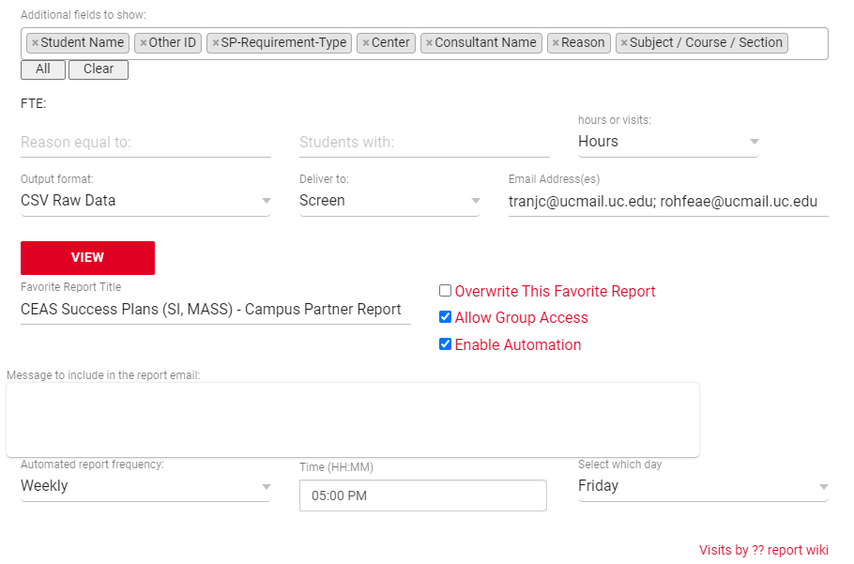
Campus Partner Reports Example - Engineering

Slide 14
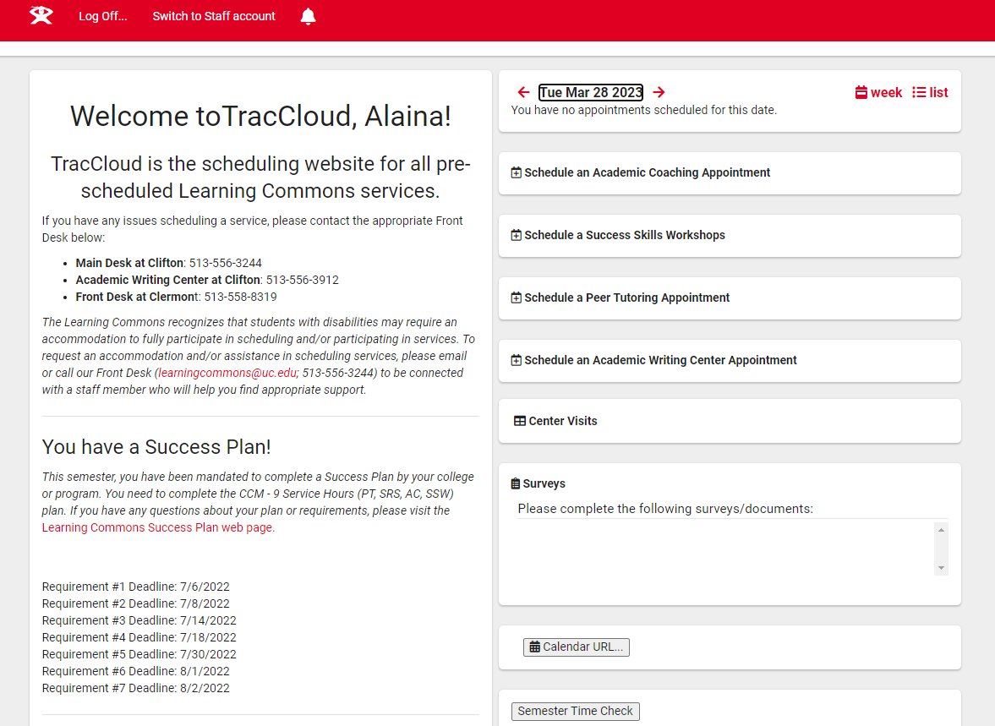
Student View
Notes:
Difference from SP modules – SP is on right-hand side

Slide 15
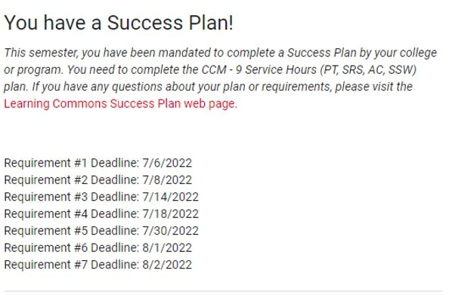
Student View (cont.)

Slide 16
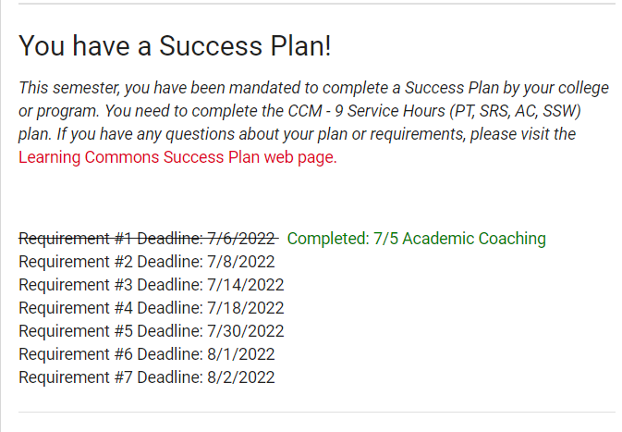
Student View – Checked Off

Slide 17
Why Focus On Student View?
Guiding value: improving student user experience to generate action and engagement
Gen-Z
"want instant gratification" & "continuous feedback" (Hubbard, 2021)
See digital and physical worlds as integrated (Petrock, 2021)
Notes:
Takes students 4-5 hours per week just to check off the Content Support plans – not counting the Academic Coaching and SSW checks

Slide 18
Student Communication
Centralized & Additional

Slide 19
Centralized Student Communication
Learning Commons: Contact students who have started Success Plan
Week 1
Introduction Email from Learning Commons
Week 3
Campus Partners: Contact students who have not yet started Success Plan
Week 6
Repeat Week 3 strategy
Week 8
Repeat Week 3 strategy
Repeat Week 3 strategy
Week 13
Goal:
Capitalize on pre-existing relationships with Advisors while fostering familiarity with Learning Commons

Slide 20
Sample Intro Email

Slide 21
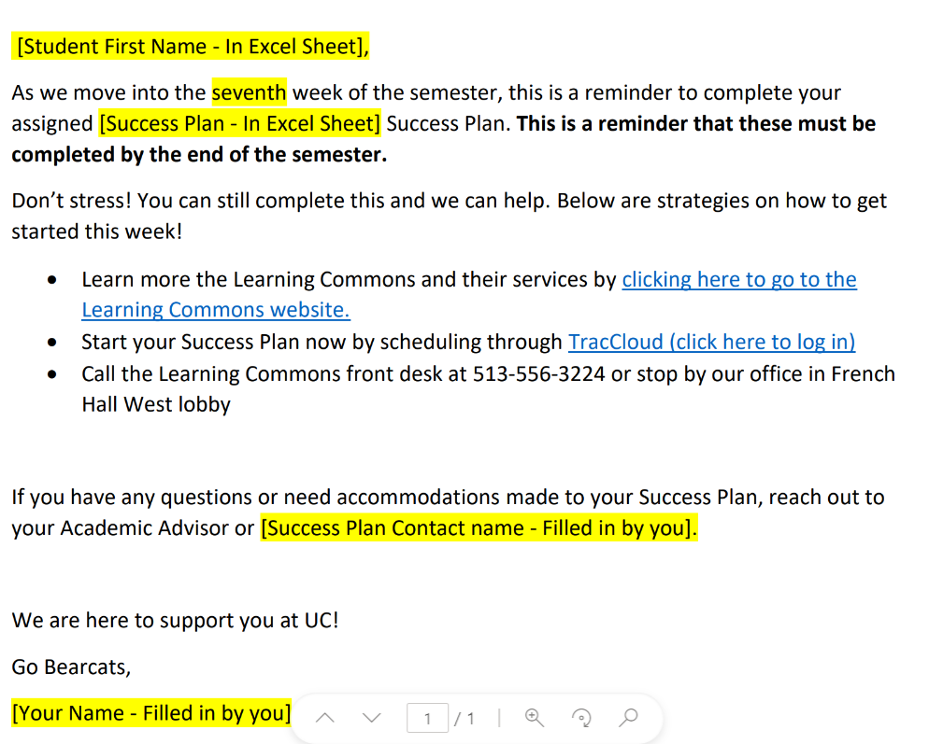
Not Yet Started - Week 7
Notes:
Other emails include student testimonials about using services. I asked "how would you sell your peers on coming to tutoring?" and got some great responses!

Slide 22
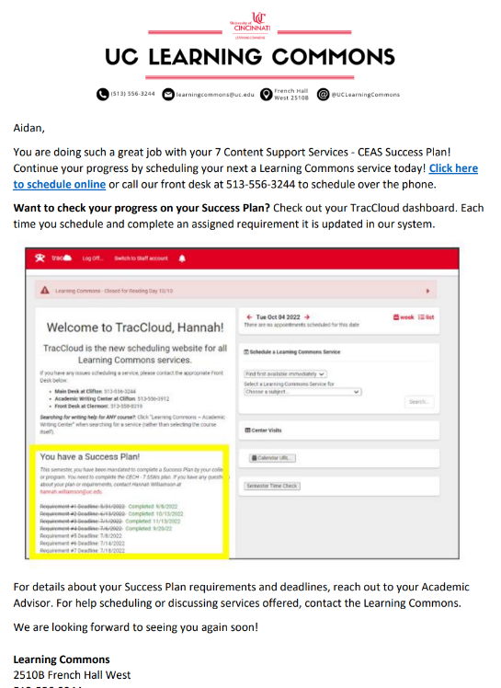
Started – Week 7

Slide 23
Additional Student Communication
[optional] Week 11
Campus Partners: Contact students who have had their Success Plans reduced from the beginning of the semester
Example: 7 Academic Coaching --> 3 Academic Coaching
Additional Campus Partner Approaches
Texting: TextingBase, OneCallNow, Remind
Canvas (LMS) page
Following up 1-2 weeks after the last appointment
Motivation: scheduling holds, financial incentives

Slide 24
Implementation
Our Version!

Slide 25
Technical Implementation
Worked with TracCloud to put separate tab on student profile
Created Custom Fields
SP Requirement Name (i.e. "5 Academic Coaching Appts – CEAS")
SP Requirement #1, #2, #3, etc (i.e. "SP Requirement 1")
SP Requirement Deadline #1, #2, #3, etc. (i.e. "4/5/2023")
Worked with TracCloud & IT to automate daily updates to Success Plan student profile
Pulls from file in WinSCP
Training for student staff

Slide 26
Creation of Student View in Welcome Messages

Slide 27
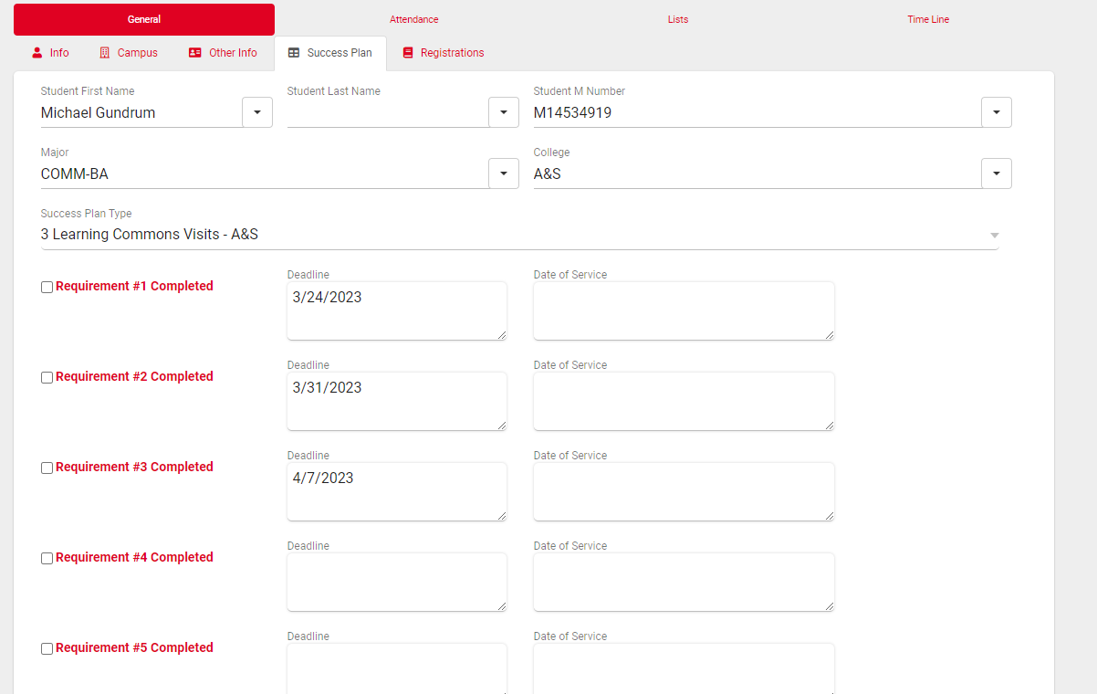
Student View Maintenance – Plan Not Yet Started

Slide 28
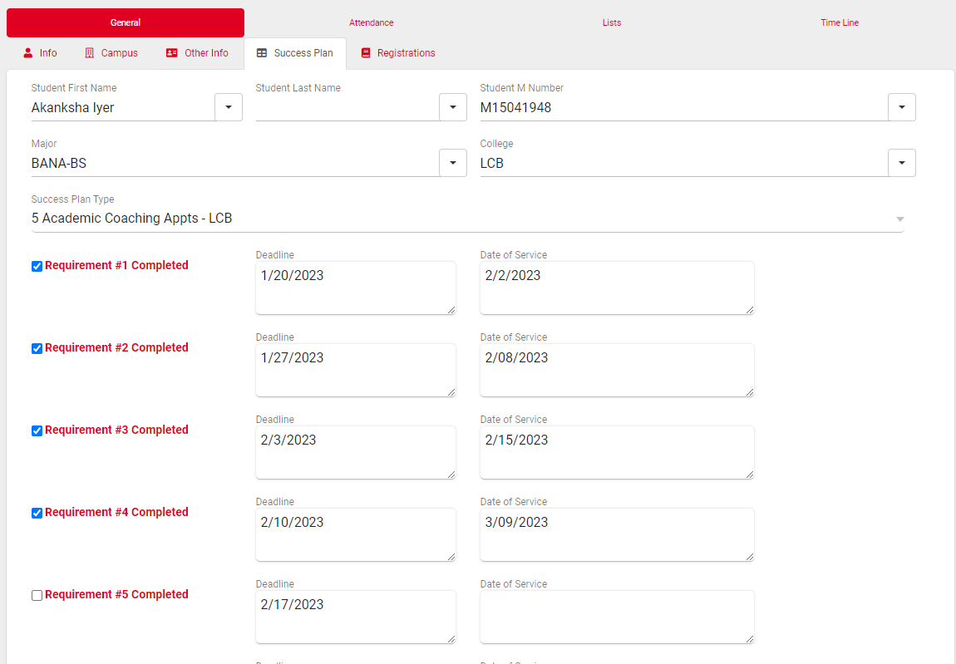
Student View Maintenance – Plan Started
Student Staff manually update
Academic Coaching: each consultant, after each appt
Success Skills Workshops: one SSW student leader, weekly
Content Services: two undergraduate assistants, weekly

Slide 29
Student View Maintenance: Content Support Reporting (Tutoring, SI)
Student staff receives "Visits/Appointments By" report that shows the following:
Student Name
ID
Date/Time of Service
Service Type (Peer Tutoring, Academic Coaching, etc.)
Success Plan Requirement (i.e., "5 Success Skills Workshops")
SP Requirement 1, 2, 3: date shown if already checked-off
Student staff checks off requirements for students on Success Plans in TracCloud

Slide 30
Campus Partner Implementation
Educating campus partners on student view
Learning Commons Success Plan Community (new Spring 2023)
What's going well/what are you proud of?
How are you communicating to students on Success Plans?
Barriers to coming to the first service

Slide 31
Hot Topics & Trends

Slide 32
Hot Topics: Current Conversations
Improved Compliance!
Fall 2021 to Fall 2022: completion rates increased from 8% to 23%
Fall 2022 to Spring 2023: half-way through semester, SP start rate had increased from 20.2% to 34%
Particularly high compliance for more flexible, higher-stakes plans, or plans that feel most relevant to students (course-based)
Ongoing Experiments
# of required services
Decreasing # of required services halfway through semester
Creating more flexible plans (i.e. choose any 5 Learning Commons services)
Notes:
Flexible – Arts & Sciences
Higher-stakes – b/c they failed FYE course, have incomplete grade and want to get that removed
Most relevant – course based (peer Tutoring). Also gotten feedback that students don't know exactly what to expect in an Academic Coaching appt

Slide 33
Hot Topics: Future Ideas
Expanding to other student populations
Students not on alert or probation but failed one course in the previous semester
Students returning from suspension
Students not on alert or probation but almost at that GPA (2.01 – 2.50)
First year, first semester students (not connected to an FYE program)
International students needing support navigating an American campus
Students needing writing support
Students who withdrew from one or multiple courses
Online degree seeking student
Assessing effectiveness of Success Plans beyond compliance
Comparing 1 semester pre-Success Plan versus 1 semester post-Success Plan
Reframing deadlines as "milestones" or "checkpoints"
Notes:
Other student populations – have to make sure we're ready to support them

Slide 34
Questions?
Alaina Peters | University of Cincinnati Learning Commons
Peer Tutoring Supervisor, Success Plans Manager, & TracCloud Co-SysAdmin
alaina.peters@uc.edu

Slide 35
References
https://www.alvaria.com/blog/using-gamification-to-motivate-millennials-gen-z
https://www.insiderintelligence.com/content/us-generation-z-technology-and-media-use

