Slide 1
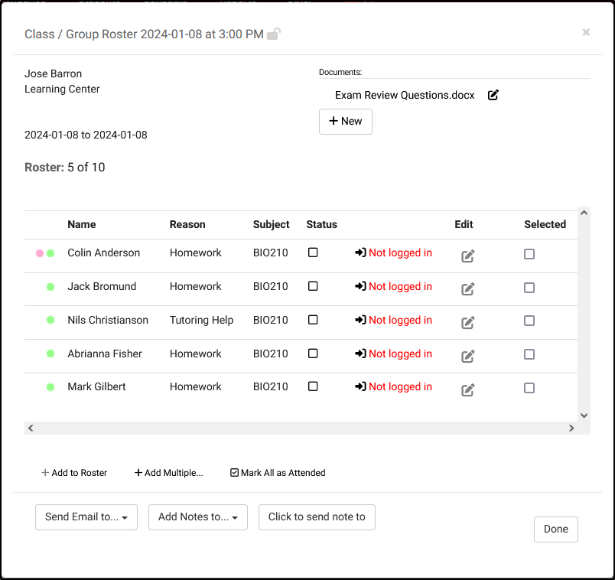
Student Consultations
Asynchronous and Group Rosters
Erick Martinez

Slide 2
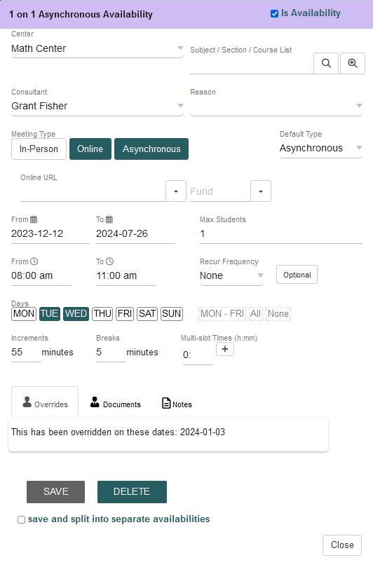
Asynchronous Availabilities
What are Asynchronous Appointments?
Profile Prefs
Creating Asynchronous availabilities

Slide 3
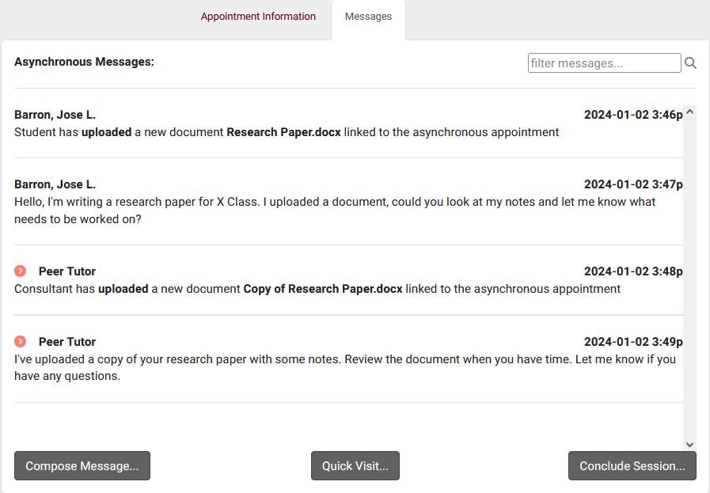
Asynchronous Communications
Where to access and manage your Asynchronous Appointment?
Appointment Information and Messages tab
Student or Consultant can conclude or reopen the session at any time
Student have the option to Cancel Asynchronous Appointments

Slide 4
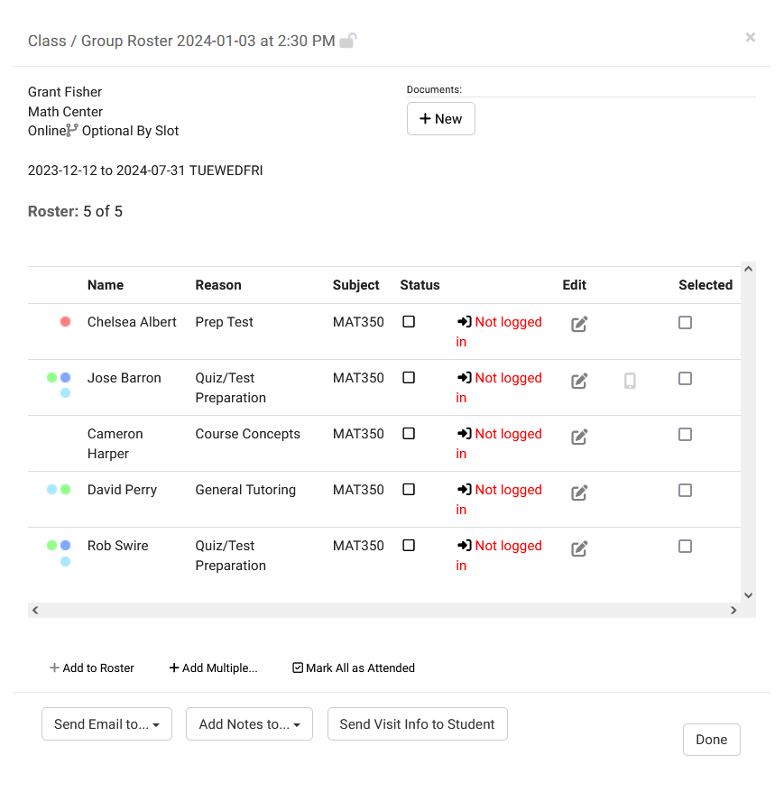
Group Roster
Exclusively for Group Availabilities
Managing Appointments from the Group Roster before and after the session
Lock Group Roster ensures the group availability remains hidden from the availability search
Add notes to the Visit Records for every Student who attended the appointment.

Slide 5
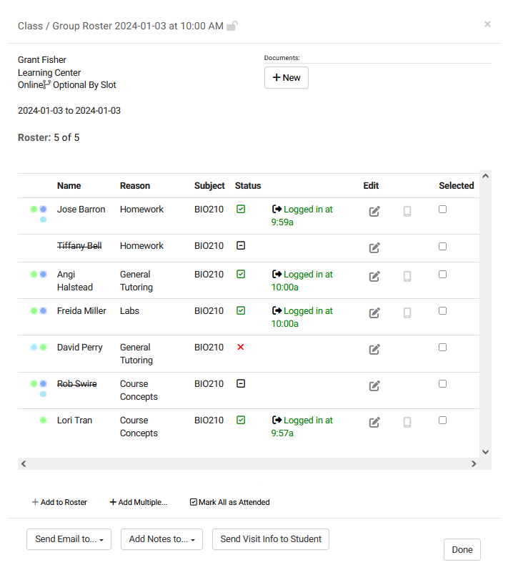
Managing Appointments from the Group Roster
Schedule Appointments directly from the Group Roster
Log students in and out for there Visit from the Staff Schedule.
Send an email to all students listed on the Group Roster, or send an email to students based on their Appointment Status.

Slide 6
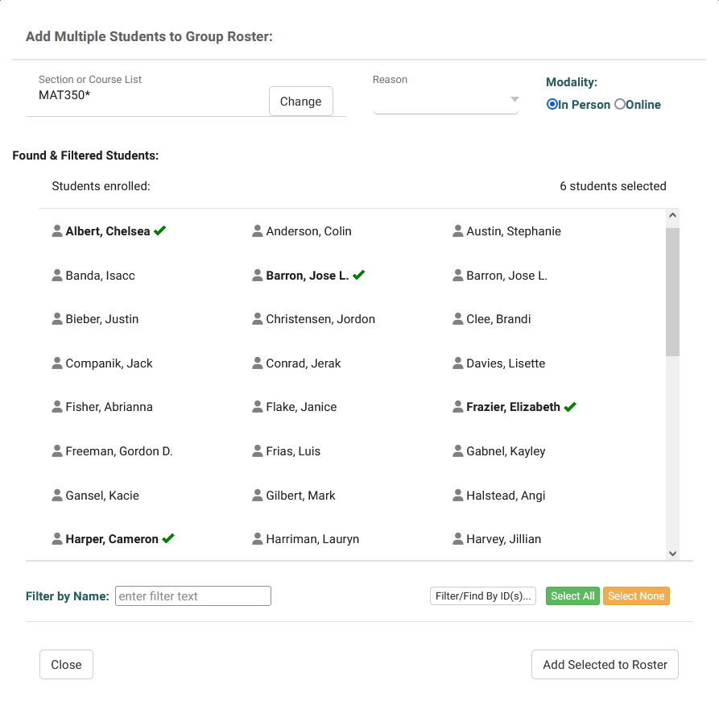
Group Roster “Add Multiple”
Add students to the Group Availability as a batch process, instead of adding them one at a time
Search for Students Enrolled in specific courses, assign a Reason.
Filter/Find Students based on the chosen ID field, similar to the Batch Scan for Batch Visits

Slide 7
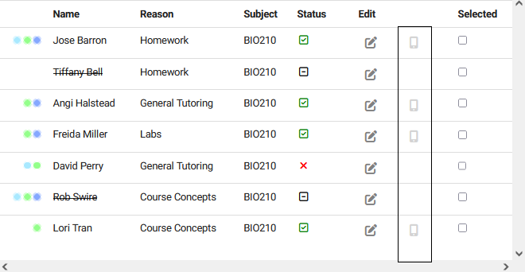
TracCloud Modules
SurveyTrac
TextAlerts
Adds the option to send a Survey/Quiz to students from the Group Roster
Based on SurveyTrac and Scheduling Access in the Group Permissions
Adds the option to send SMS messages to students from the Group Roster
Students must be opted in to receive SMS Alerts, and have a cell phone number on their Student Record

