Slide 1



TracCloud Reporting Basics
Yes! We can report on that!
Luis Frias
2026 Virtual TracCloud Conference

Slide 2
Topics We Will Cover
Status Charts, Utilization, Center Status
Layout & General Report options
Visit Reports
Schedule Reports
Usage/ Hotspot Reports
(Visit) Clean Up Report
Security Reports
Staff Reports
2026 Virtual TracCloud Conference

Slide 3

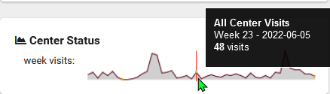

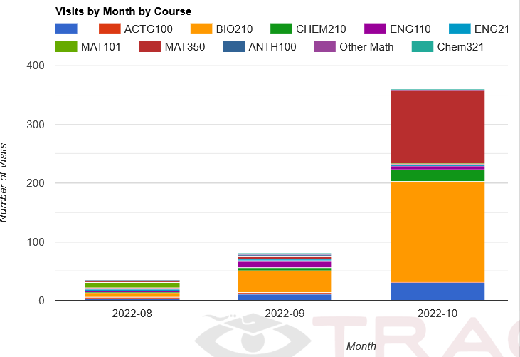
VISIT REPORTS
Visit By ??
Attendance By Hour By Day of Week
Logins By Hour By Day of Week
Usage Snapshot
2026 Virtual TracCloud Conference

Slide 4


SCHEDULING REPORTS
Center Schedule
Appointment Slot Utilization
Students Visits/Appointments by??
Outstanding Appointment Request
2026 Virtual TracCloud Conference

Slide 5

THANK
YOU
I appreciate your participation and look forward to any questions or discussions.
Questions
2026 Virtual TracCloud Conference

