Slide 1


Pencil Me In:
TracCloud Scheduling
Appointments & Availabilities
Luis Frias
2026 Virtual TracCloud Conference

Slide 2


What's New With Scheduling
January 2026 Workshop Module times show as reserved block on the Workshops Schedule. Student will not be able to book preexisting available times due to the overlapping workshop created for that staff.
October 2025 Prevent student/staff from booking an appointment if the appointment time conflicts with a current class schedule
September 2025 Added Block These and Allow Only icons on schedule for availabilities (Last year added options to allow and block list from scheduling available time slots)
June 2025 Added ability for students who work as tutors to show their classes on the schedule Interface
2026 Virtual TracCloud Conference

Slide 3

Topics We Will Cover
Creating Availabilities
In-Person, Online or Optional
Booking Appointments - Student
Booking Appointments - Staff
Scheduling based Reports
2026 Virtual TracCloud Conference

Slide 4

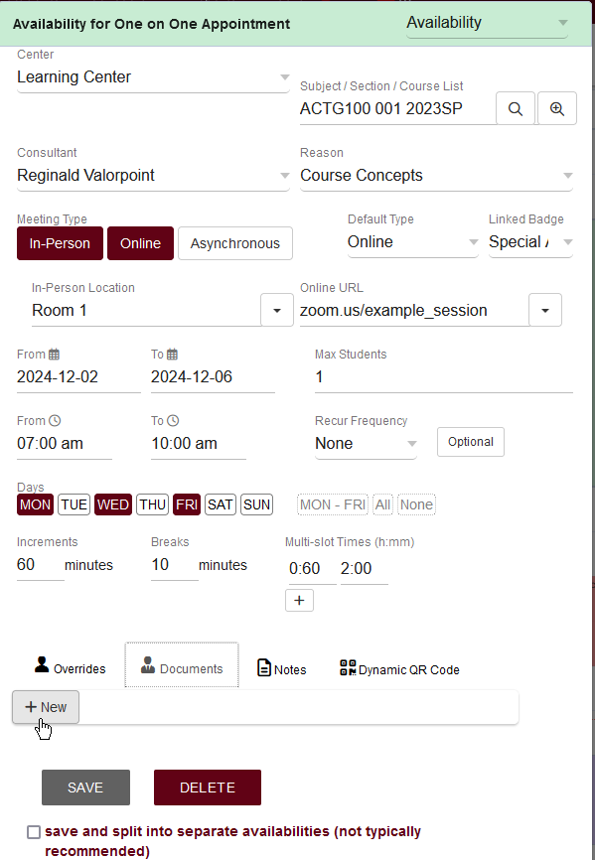
Availability Block Creation
Limit blocks to a specific subject or reason
Choose date range & days of week
Break apart slots into increments
Manage more then one center schedule for the staff member from one view
2026 Virtual TracCloud Conference

Slide 5


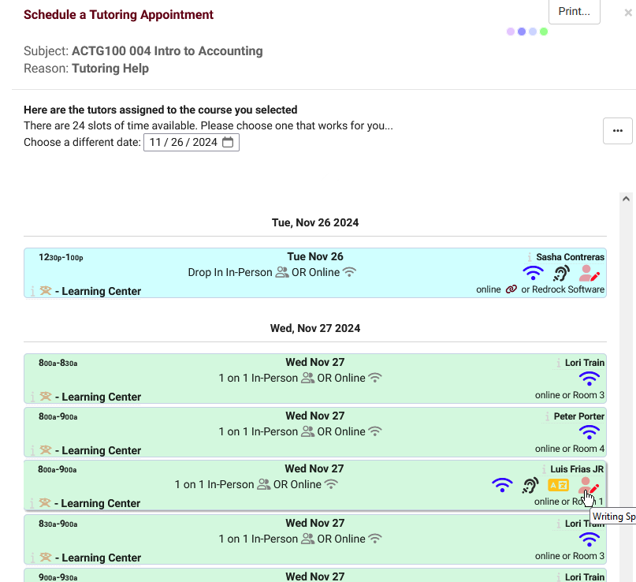
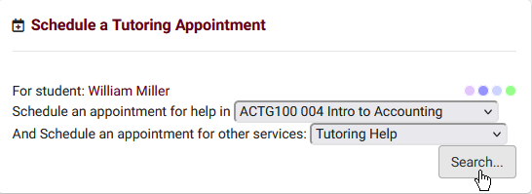
Scheduling Appointments
Staff can search and book the student using ID or Name
Students choose a subject or reason to filter their results
Results will be based on initial search criteria
2026 Virtual TracCloud Conference

Slide 6

Scheduling Reports
Students Visits/Appointments by ?? https://wiki.go-redrock.com/index.php/TracCloud_Report:_Students_Visits/Appointments_by_%3F%3F Center Schedule https://wiki.go-redrock.com/index.php/TracCloud_Report:_Center_Schedule Appointments/Availabilities by Hour by Day of Week https://wiki.go-redrock.com/index.php/TracCloud_Report:_Appointments/Availabilities_by_Hour_by_Day_of_Week
2026 Virtual TracCloud Conference

Slide 7
Related Sessions
Scheduling Rules
Group Roster
Reports
PRESENTATION
2026 Virtual TracCloud Conference

