Slide 1
Pencil Me In: TracCloud Scheduling
Appointments & Availabilities
Luis Frias TracCloud Software

Slide 2
What's New With Scheduling
Added a Listing for Availability Blocks – April
Custom Fields can be added to Availabilities – May
More Results Shown on the availability listing when search from Dashboard + Printing – June
Search appointment listing by appointments that conflict with class scheduled times – June
Search appointment links custom button text/description - June
HTML supported in Subtitle Additions field in Search Appt Links. - August

Slide 3
Topics We Will Cover
Creating Availabilities
In-Person, Online or Optional
Booking Appointments - Student
Booking Appointments - Staff
Scheduling based Reports

Slide 4
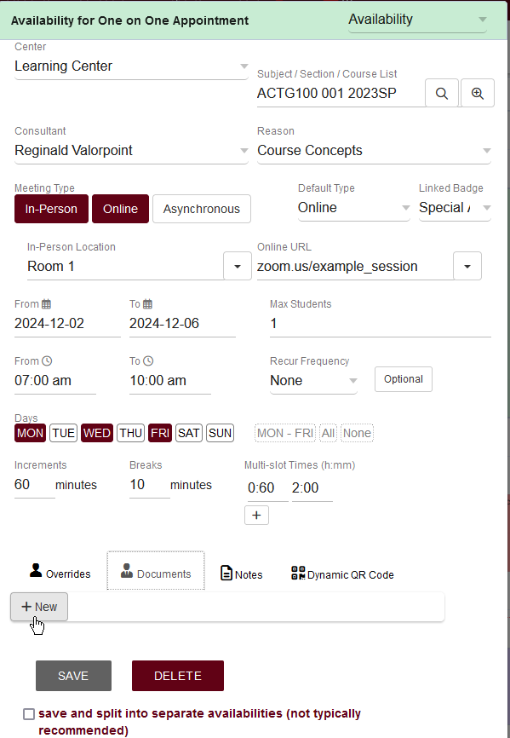
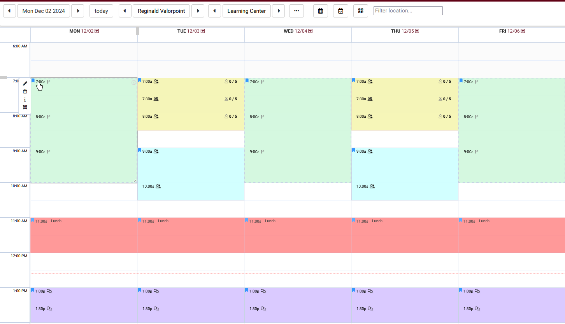
Availability Block Creation
Limit blocks to a specific subject or reason
Choose date range & days of week
Break apart slots into increments
Manage more then one center schedule for the staff member from one view

Slide 5
In Person, Online or Optional
No = In-Person (can display physical room location)
Yes = Online (will display online link for consultant that is saved in their profile)
Optional = Default is In-Person but can be booked as online
Optional Chosen = Default is Online but can be booked In-Person

Slide 6
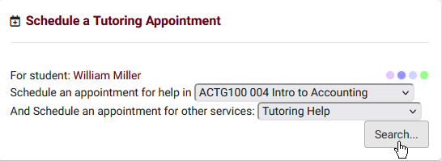
Scheduling Appointments
Staff will aid by choosing the student based off ID or name
Students (and Staff) will choose a subject or reason to filter their results
Results will display for only the subject or reason selected. All center availability that matches criteria will show.

Slide 7
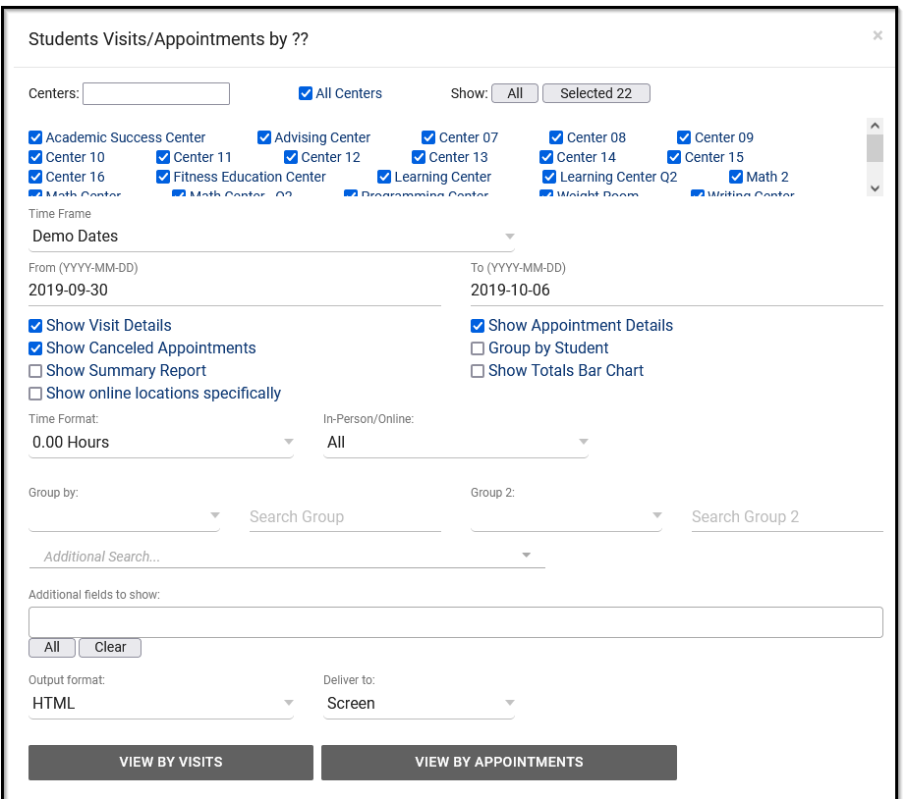
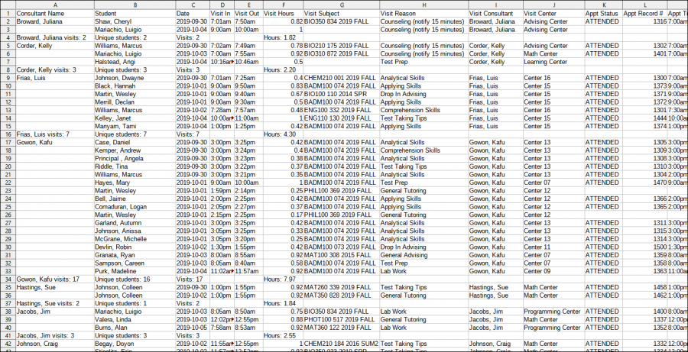
Reports
Attendance by Hour- Lists the number of visits that took place per specified time increment in a given date range, 1-hour by default.
Initial Visit - provide students' first visits in the time range specified
Students Visits/Appointments by ?? - This report will display the Visits and/or Appointments in your system that match the criteria you search by. This data can be grouped by different fields if needed.

Slide 8
Related Sessions

