Slide 1


SAGE Early Alerts:
From Referral to Resolution
Early Intervention Workflow
Iliana Visser
2026 Virtual TracCloud Conference

Slide 2
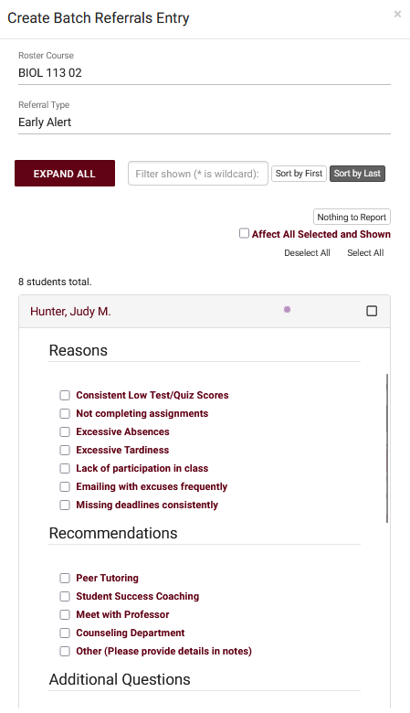
INTRODUCTION
The SAGE Early Alert module is TracCloud’s early-alert referral system. It allows faculty and support center staff to submit referrals or progress reports for students who may be struggling academically or have other concerns. Through an online form, a professor can flag a student and indicate the issue (e.g., poor attendance, low grades, personal concern) and SAGE will route that information to the appropriate support staff. Based on how the referral is configured, TracCloud can automatically notify relevant parties – for example, send an email to the student’s academic advisor or to a tutoring center coordinator to reach out proactively. SAGE basically creates a case for the student: support staff can record follow-ups, note whether the student was contacted, and close the loop. This helps colleges be proactive in connecting at-risk students with resources. This early-warning systems ensures no student “falls through the cracks” when faculty raise a concern.
2026 Virtual TracCloud Conference

Slide 3
What’s New Since
Last Year
Added an override date for SAGE Nothing to report Period start
Added referral record links to the SAGE Referrals by ?? report
Added SAGE custom question options to add styling to SAGE custom questions/labels
Added a new SAGE report, Faculty Referral Activity
Added a new report for faculty users, the SAGE Faculty Referrals by ?? report (#2800)
Added the option to export to ftp: SAGE Referrals by ??
Added an option in the SAGE Referrals By ?? report to email each faculty their part of the report if grouped by faculty (#2881)
2026 Virtual TracCloud Conference

Slide 4
MANAGING
Referrals
You can think of SAGE like a three-step process.
1. Creation, a referral is submitted, emails are sent out.
These emails could be sent to advisors, professors, or the student themselves, notifying us of something the student may be struggling with.
2. Follow-up, more information is given, new emails are sent out.
The follow-up email lets relevant users know how this referral is going, what has been done, and what we are doing to help this student.
3. Resolution, a final email is sent out to wrap everything up.
Once the referral has been processed, we can fill out some additional information letting the relevant users know what we did to help this student.
2026 Virtual TracCloud Conference

Slide 5
SAGE Process Example
Faculty creates SAGE Referral
Email to Student, Staff and Centers
Outreach to student for follow up meeting
Student arrives to designated Center for follow up
Faculty is sent a final email when referral has been completed
2026 Virtual TracCloud Conference

Slide 6
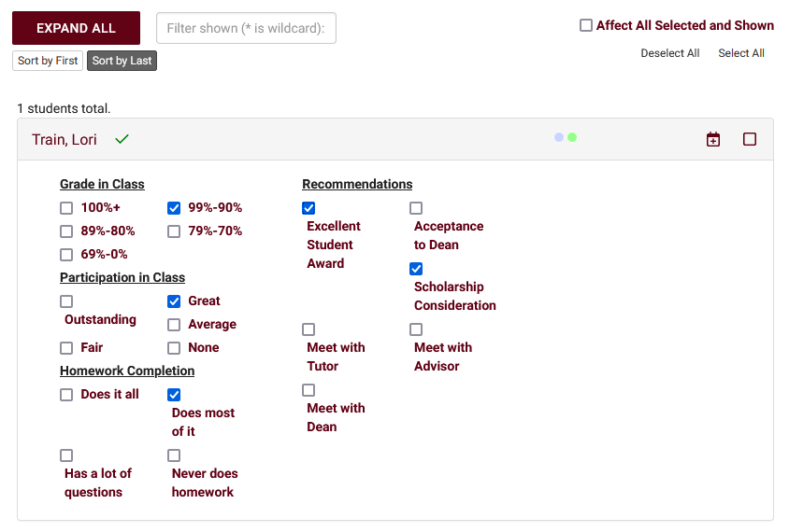
Creation – Faculty View
Roster Annotations
Faculty Members are typically the primary user-type submitting referrals, they have a streamlined view of the referral submission process. Within the faculty dashboard, you'll find their class rosters along with the referrals that have been designated as Roster Annotations. This allows faculty to immediately access important referrals for each of their rosters.
2026 Virtual TracCloud Conference

Slide 7
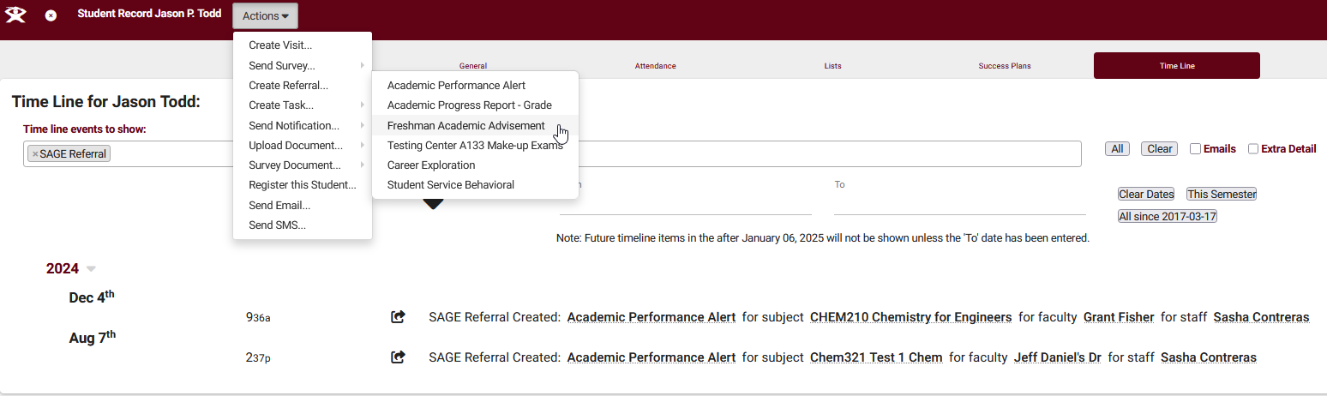
Creation
Individual Student Referrals
Referrals can also be submitted individually from students' profiles. As non-faculty users don't have access to the class roster view, this will be their primary tool for submitting referrals, but faculty can of course use this method as well. New referrals can be created through the Actions button in the Students account and past referrals can be viewed on the student time line.
2026 Virtual TracCloud Conference

Slide 8


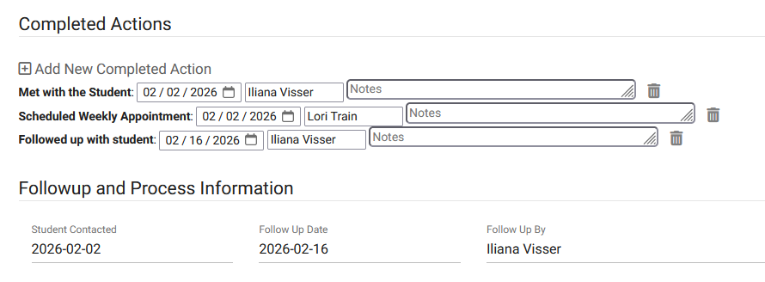
Follow-up
Next Step for Staff
In some instance, you may need to have a staff follow up with the student. This can be a simple check in with the student or for the staff to get more information.
The follow-up email lets relevant users know how this referral is going, what has been done, and what we are doing to help this student.
2026 Virtual TracCloud Conference

Slide 9
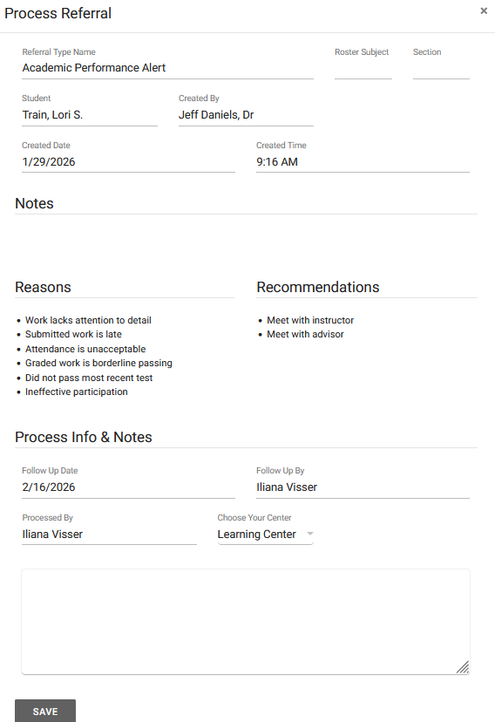
Processed
Final Step for the Staff
After a referral is marked as processed, we will see the following screen summarizing basic information about this referral and providing a location to write additional notes about how this situation was resolved.
Emails configured to send "On Processed" will send when the referral is marked as processed/completed/resolved (this phrasing may be configured differently for your system). This button will open a pop-up window to record additional information and the email sends when that pop-up is saved. Like the previous triggers, this email can only be resent by using Override and Resend with the "Processed" option.
2026 Virtual TracCloud Conference

Slide 10

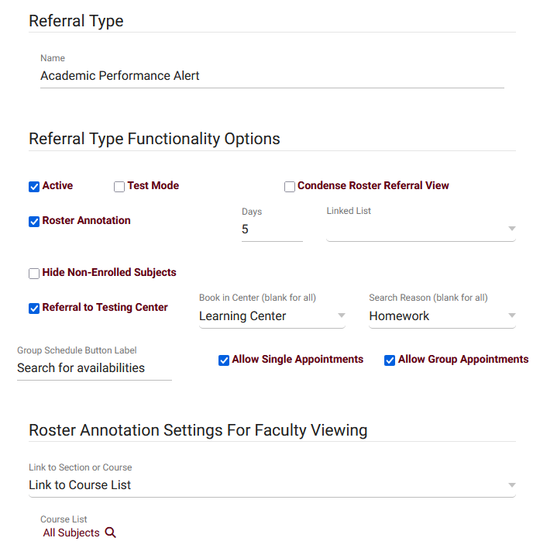
SAGE
Management
When creating a referral, you will have option to have it in Test Mode, allow the faculty to see a Roster Annotation, Link referrals to List or even create a referral for a Testing Center.
Referral for a Testing Center allows you to provide faculty the ability to book appointments for students that they're creating referrals for during the roster referral creation process. Typically used for Testing Centers or Lab environments, where faculty would need to book appointments on behalf of students, or assign multiple students to the same Group Availability.
2026 Virtual TracCloud Conference

Slide 11
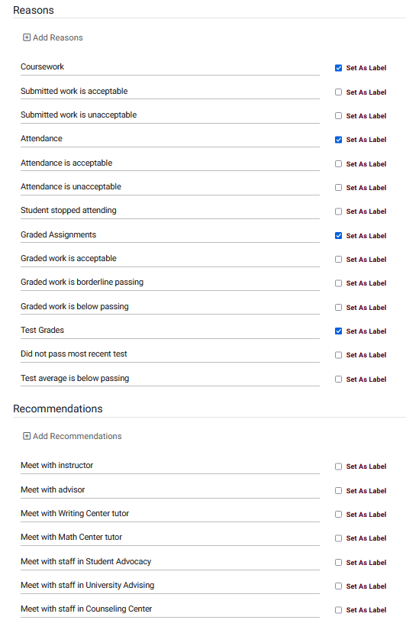
Reasons & Recommendations
Reasons and Recommendations can be one of the most important aspects in creating these referrals, as these options can also dictate which emails get sent out to whom. Typically, these would be configured to allow your faculty to quickly describe where the student is struggling and what they recommend as a solution. However, since these are entirely customizable, you can ask any questions you can think of to help make the referral creation process as straightforward as possible.
2026 Virtual TracCloud Conference

Slide 12
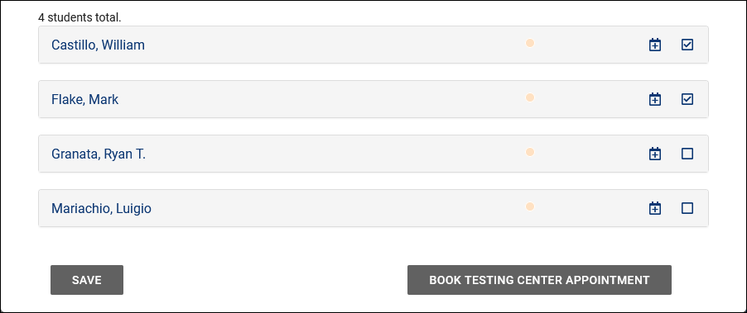
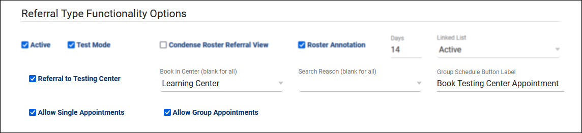
Referral
Testing Center
This allows you to provide faculty the ability to book appointments for students that they're creating referrals for. Typically used for Testing Centers or Lab environments, where faculty would need to book appointments on behalf of students, or assign multiple students to the same Group Availability. From the faculty perspective, there's a Schedule icon for each student in the roster referral listing, and/or the option to select multiple students and click "Book Testing Center Appointment" to schedule a group appointment for all selected students.
2026 Virtual TracCloud Conference

Slide 13

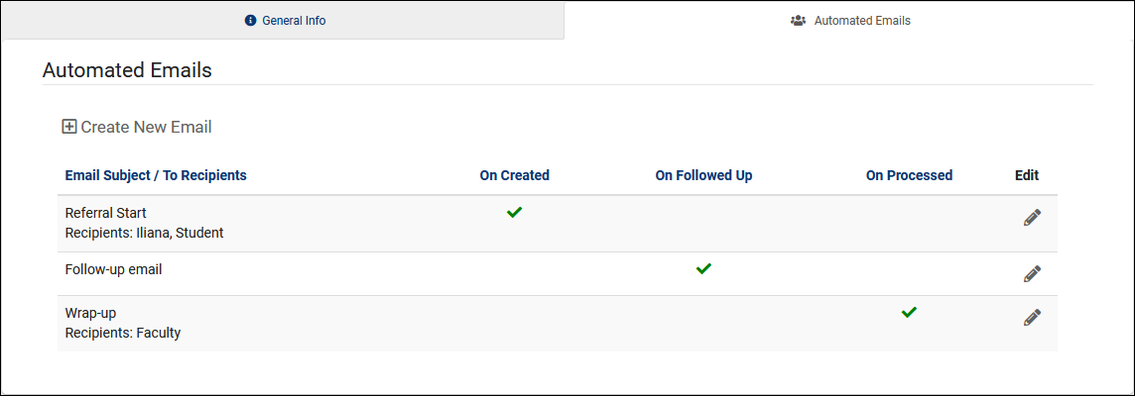
Automated Emails
The Automated Emails tab allows you to create custom emails that can be sent to one or more of your Potential Email Recipients upon referral submission. Common examples might be an email that is sent to the student when a referral is created for them. Faculty or other staff might also receive different versions of the same email, or a completely different email if configured in that way.
2026 Virtual TracCloud Conference

Slide 14
Tags and Logic
Email
Email Tags
A full list of email tags is provided is a Wiki, but to give a quick example, you could format an email as such:
"Hello, {{Student.First_Name}}, this {{ReferralType.Name}} was submitted by {{Faculty.FirstName}}.“
Each of those tags would then be replaced by the relevant information when the email is sent.
https://wiki.go-redrock.com/index.php/TracCloud:_Twig
Email Logic
This is where Twig gets slightly more complicated, but significantly more flexible. Let's say you want to add an extra sentence to your email, but only if a particular reason was selected. In that case, you could write your email like this:
{% if "Poor Attendance" in Reasons %}
Online Tutoring is now available! See example.edu/remote/ for more information.
{% endif %}
That sentence will only be included in the email body if that Reason was selected.
2026 Virtual TracCloud Conference

Slide 15
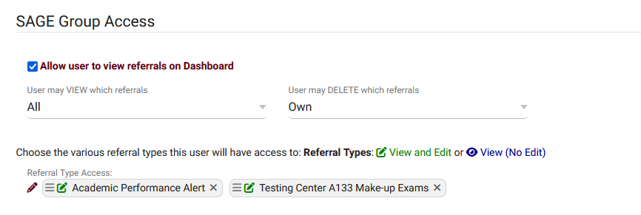
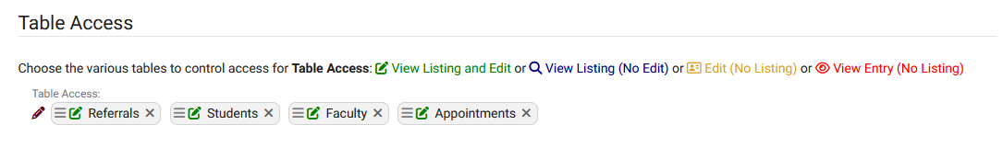
Group Access
In order for staff members to view and/or edit referrals, they must be provided access in their permission group. This also gives you the ability to fine-tune what they can and can't do in relation to these referrals.
2026 Virtual TracCloud Conference

Slide 16
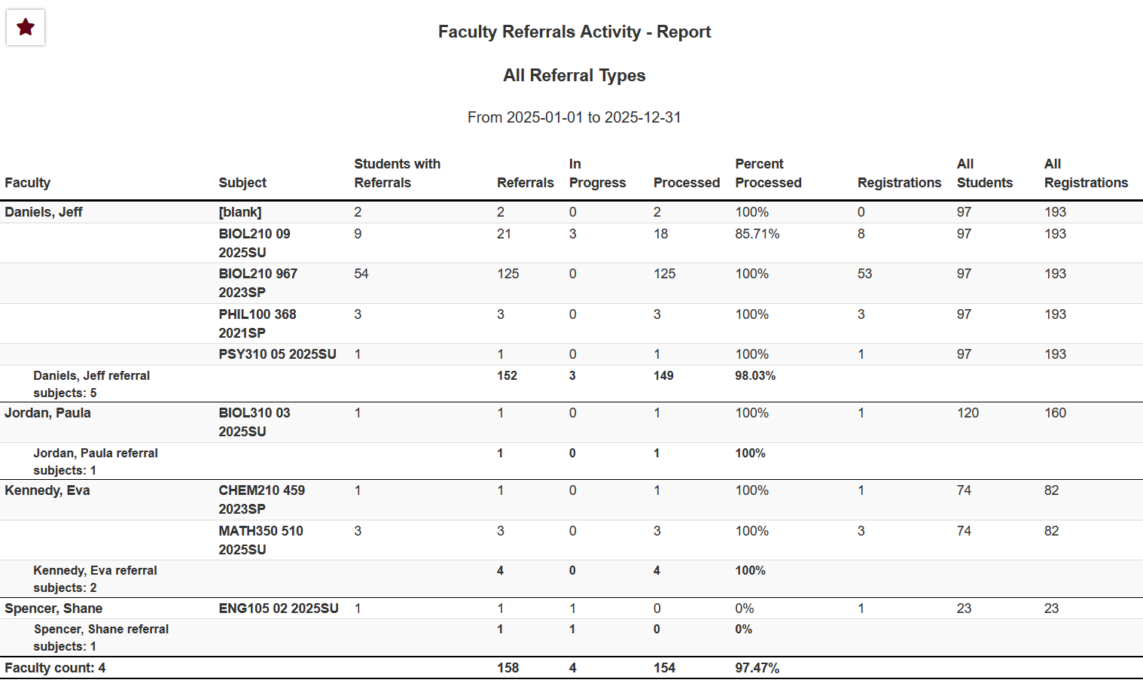
Faculty Referral Activity Report
This report displays faculty, their sections, and how many referrals their students are assigned to. Additionally, the total registrations linked to each faculty's sections, total registrations overall, and total unique students are shown. A bar chart can optionally be included, shown in the screenshot below.
2026 Virtual TracCloud Conference

Slide 17

For pricing or support,
go to
Helpdesk@go-redrock.com
https://wiki.go-redrock.com/index.php/TracCloud:_SAGE
2026 Virtual TracCloud Conference

