Slide 1
From Batch Visits to Workshops
Optimizing Student Tracking in TracCloud
Erick Martinez

Slide 2
New Features
Confirmation/Cancellation/reminder emails for Workshops
Updated Workshops roster listing
New option to create a QR code and link for students to self-enroll in a workshop
Student Maximum Enrollment
New Workshop Reports

Slide 3
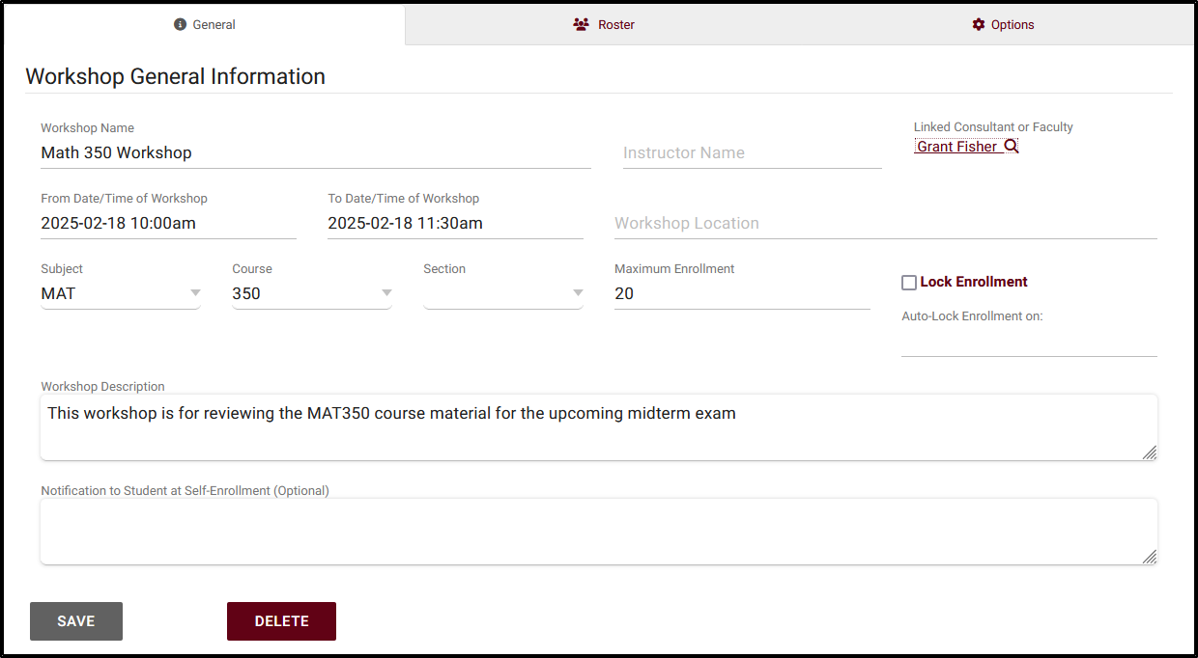
Workshops
Track student enrollment and attendance for large sessions
Who can access and manage Workshops?
Creating a new Workshop

Slide 4
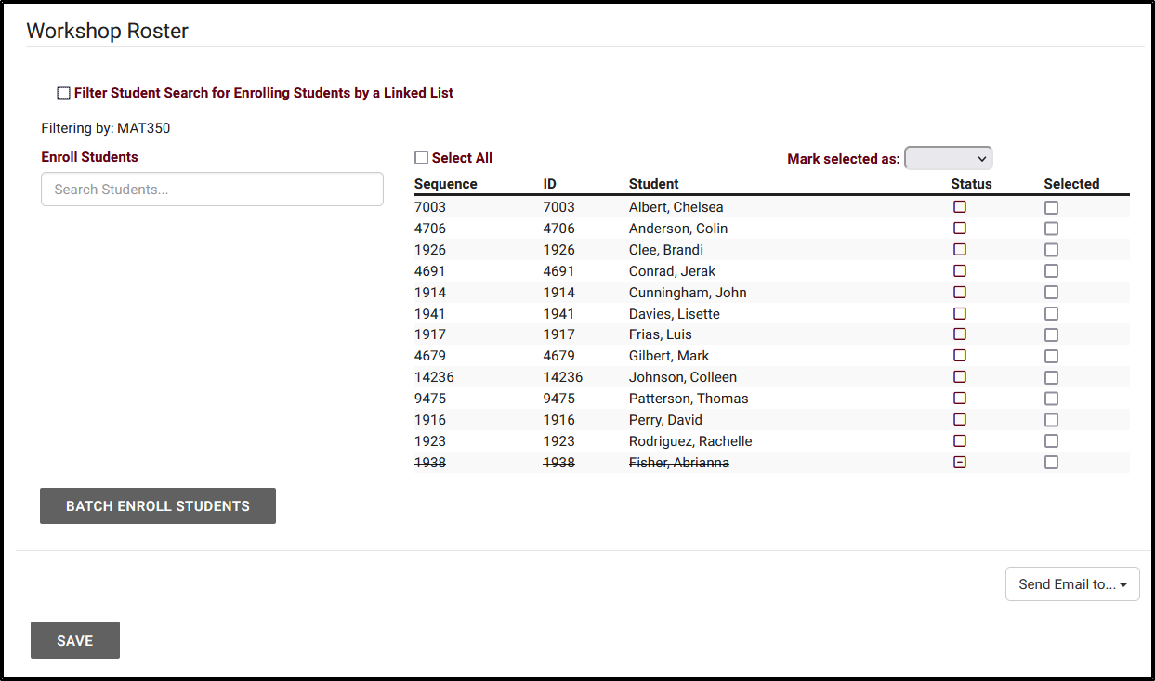
Enroll Students
Staff can enroll Students through the Workshop roster
Student Enrollment is filtered based on the Workshops assigned Subject/Course/Section
Enrollment can be further restricted to Students assigned to a selected list.
A QR code and link can be created for Students to self-enroll into a Workshop

Slide 5
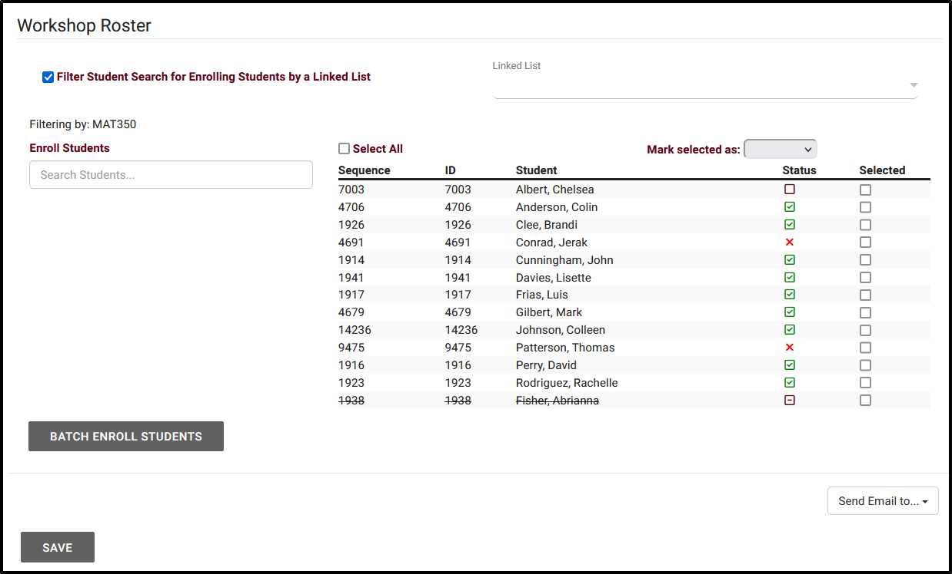
Managing workshop
Students enrolled into the Workshop will be added to the Workshop Roster
Manage the Status for Students enrolled in a Workshop from the Workshop Roster.
Send an email to students who have enrolled in a Workshop, either based on their status or by selecting specific individuals

Slide 6
Workshop Emails
Workshop emails can be sent when a student is enrolled to a workshop, removed from the workshop (canceled), and as a reminder the night before or morning of the Workshop
Workshop emails can be edited within each Profile
Assign a Profile under the Workshop Options in order to send out Workshop Emails to Students.

Slide 7
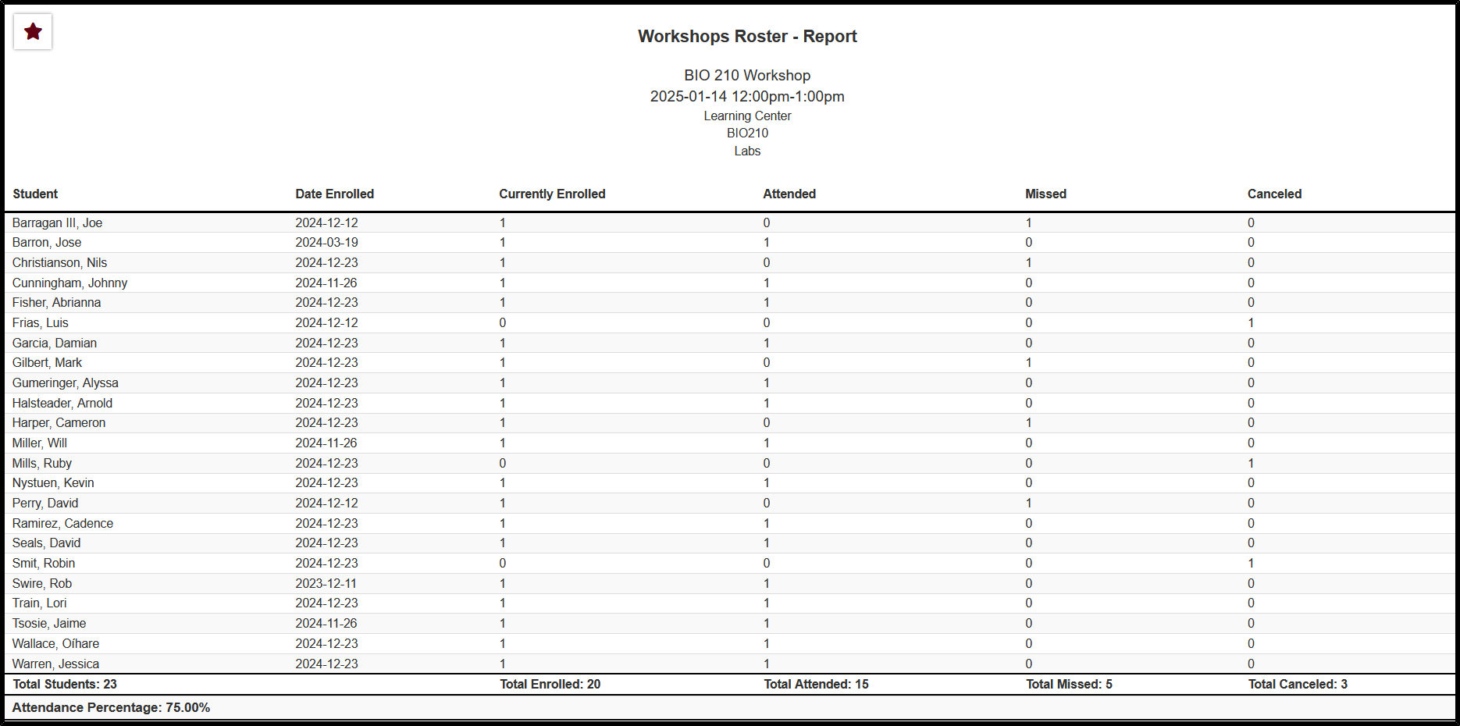
Workshop Reports
Student Workshops Attendance
Workshops Overview
Workshops Roster

Slide 8
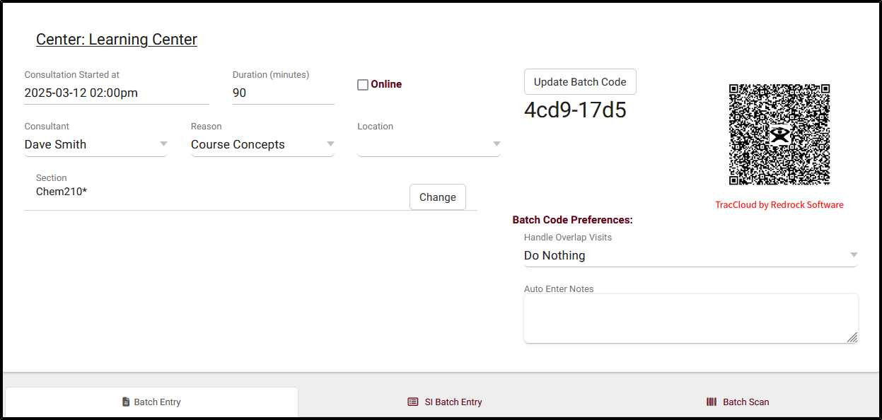
Batch Visits
Batch Visits allow you to record visits for multiple students at once. While commonly used for SI sessions and workshops, this feature is not limited to those purposes. You can access this feature under Attendance > Batch Visits.

Slide 9
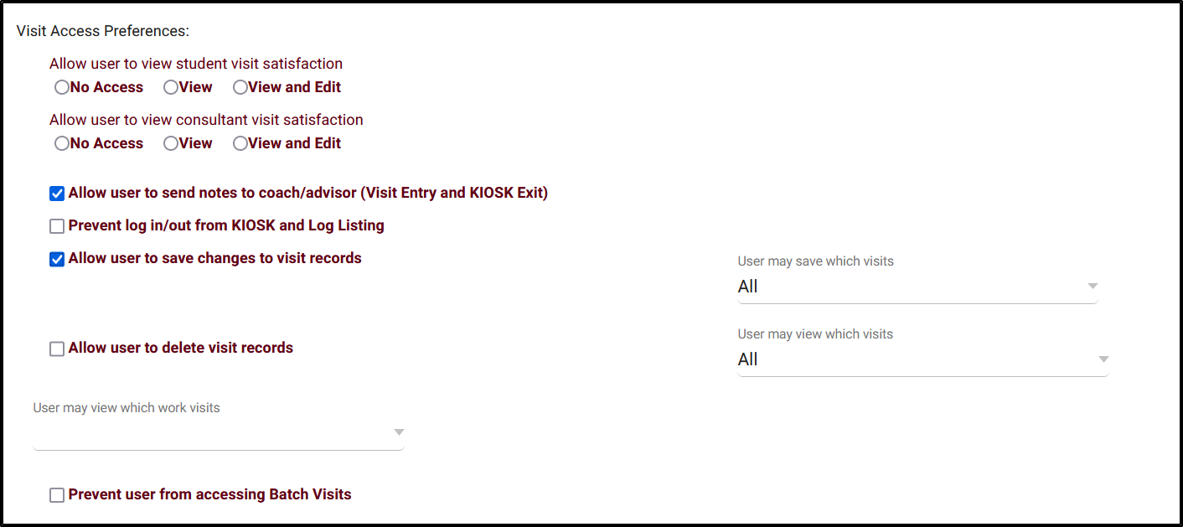
Permission Group Settings
Who has access to creating Batch Visits?
Permission Groups with access to Logging Visits for Centers will be provided access to creating Batch Visits for the Centers the Group has access to
Admins can designate which Permission Groups are prevented from accessing Batch Visits under the Groups Student/Visit Tab.

