Slide 1



From Chaos to Clarity: Resource Control in TracCloud
Unlocking the Power of Resource Management in TracCloud.
Sasha Contreras
2026 Virtual TracCloud Conference

Slide 2

What is a Resource?
Typical resources include laptops, calculators, and books that can be reserved, checked out, and returned in the system.
These items can be checked out to students or staff. Items can also be reserved from the students for future check out.
The Resources feature in TracCloud offers a comprehensive system for managing items. This includes reporting capabilities that allow administrators to generate detailed reports on resource utilization and status, including overdue resources.
2026 Virtual TracCloud Conference

Slide 3
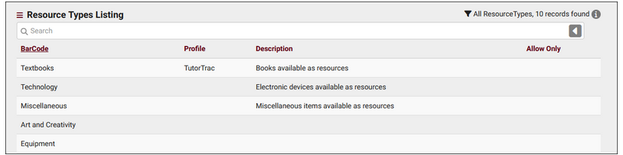
Resource Types
Resources can be grouped together for reporting purposes. If needed, lists can block certain students from accessing certain resources.
2026 Virtual TracCloud Conference

Slide 4
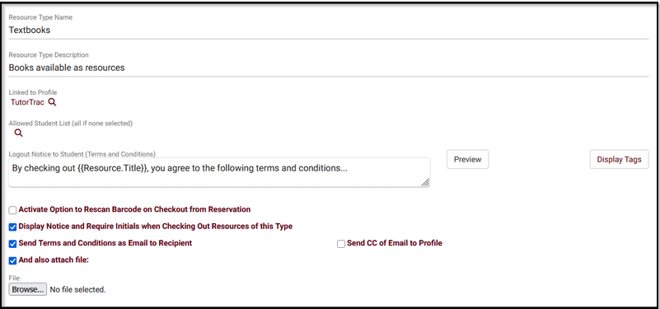
Resource Type Name:
The type/category for your resources.
Resource Types
Resource Type Description:
Information about this resource type.
Linked to Profile:
Allows you to link this Resource Type for use in a specific profile.
Allowed Student List:
Allows only students on a linked list to checkout this resource. If left blank, anyone can checkout this resource.
Activate Option to Rescan Barcode on Checkout from Reservation:
If enabled, when a staff member clicks on a reservation to check a resource out, they will be prompted to scan the barcode of any resource instead.
Display Notice and Require Initials when Checking Out Resources of this Type:
If enabled, a prompt will appear during checkout requiring that the user agree to terms and conditions before continuing.
Send Terms and Conditions as Email to Recipient.
A copy of the terms can be automatically forwarded to the student
And also attach file This copy of the terms and conditions can also include a file attachment uploaded.
Logout Notice to Student:
Terms can be entered in this field. (supported by HTML and TWIG).
2026 Virtual TracCloud Conference

Slide 5
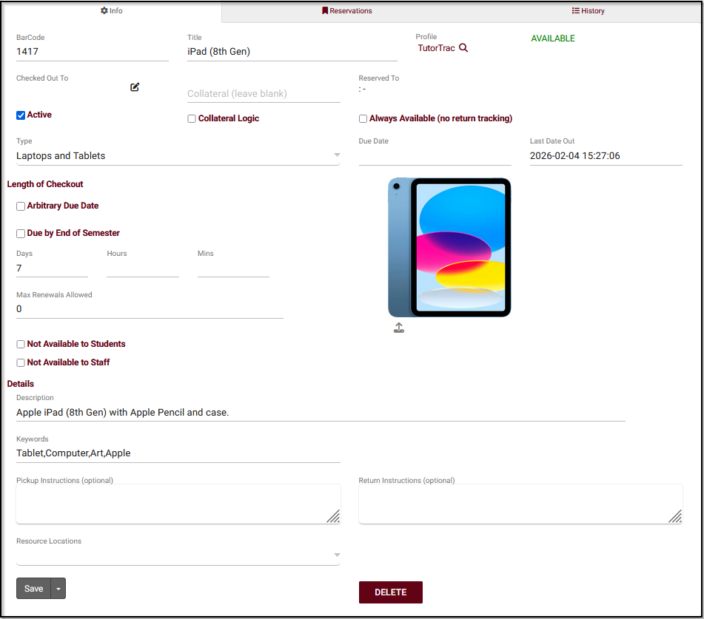
BarCode: is the unique identifier for this item, think of it like an ID.
Creating a Resource!
Title: is the name of this resource.
Profile: is the linked Profile for this resource.
Checked Out To: shows which student currently has this item checked out (if applicable).
Collateral: represents an item to be collected when this resource is checked out.
Collateral Logic: enables collateral functionality if checked.
Reserved For: shows who currently has this resource reserved.
Always Available: indicates that this resource doesn't need to be individually checked out or reserved (example, towels for fitness center).
Reserved Date, Last Date Out, and Due Date: display the exact times of reservations, checkouts, and when the resource is due to be returned.
Resource Type: allows you to categorize this resource into a type for reporting purposes.
2026 Virtual TracCloud Conference

Slide 6
Creating a Resource!
Length of Checkout: determines how long an item can be checked out.
Arbitrary Due Date: allows the staff member checking out the item to choose a due date during checkout.
Due by End Of Semester: will be based on your current semester end date.
Days / Hours / Mins: will automatically set a due date based on the amount of time specified. If chosen, a new field will appear to set the maximum of number of times the checkout can be renewed.
Not Available to Students / Staff: allows you to restrict this resource to one user type or the other. By default (both unchecked), the item is available to either user type.
Description: is an internal description of this particular resource.
Keywords: are the related words for this resource to be searched by.
Pickup/Return Instructions: can be entered and displayed in resource confirmation/return reminder emails as a twig tag.
2026 Virtual TracCloud Conference

Slide 7

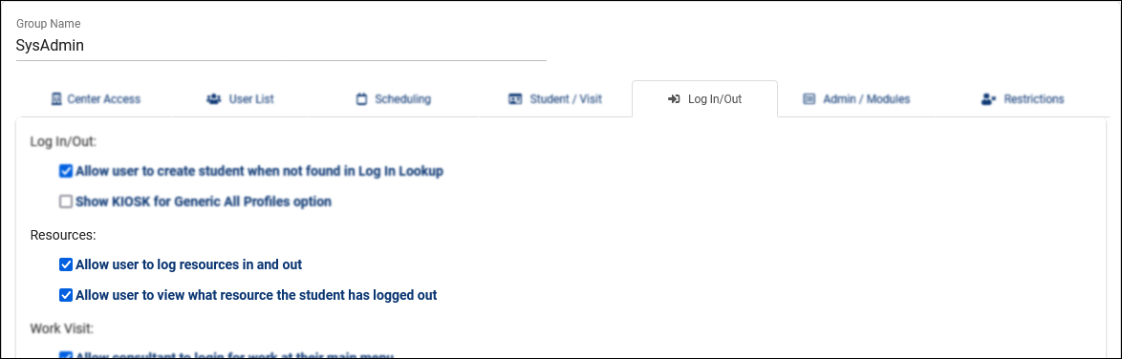
Permission Group
Other > Other Options > Groups > [Your Group] > Log In/Out
Allow user to log resources in and out provides users in this group the ability to check resources out to students and staff. Users in this group will only be able to checkout a resource if it is assigned to one of the same profiles as their group, or if the resource is linked to all profiles.
Allow user to view what resource the student has logged out provides users in this group the ability to view a student's currently logged out item.
2026 Virtual TracCloud Conference

Slide 8
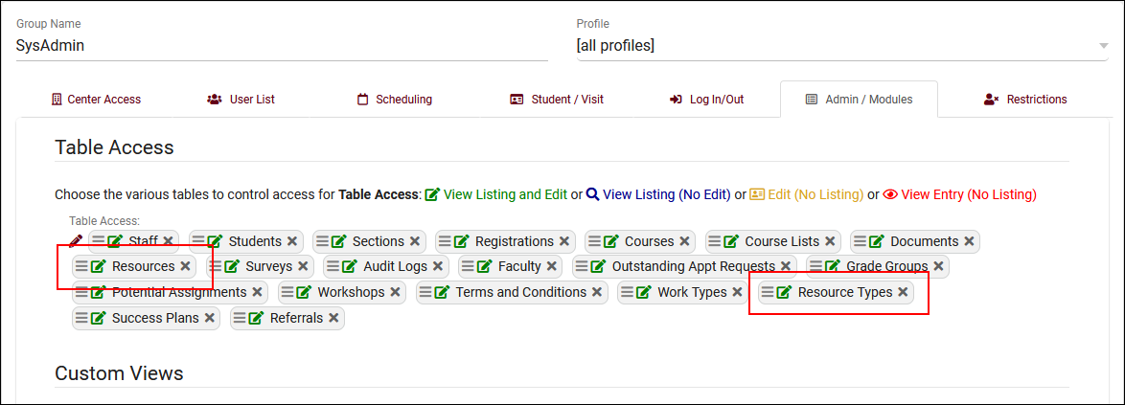
Permission Group
Other > Other Options > Groups > [Your Group] > Admin/Modules
Table Access: provides access to the Other > Resources view of resources.
Resource Types: allows this group to view and edit these as well.
2026 Virtual TracCloud Conference

Slide 9
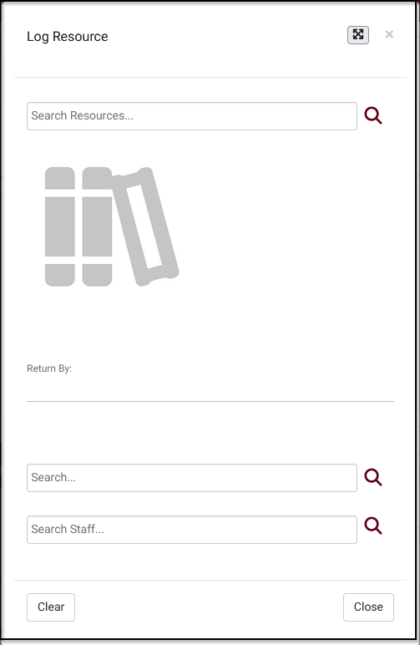
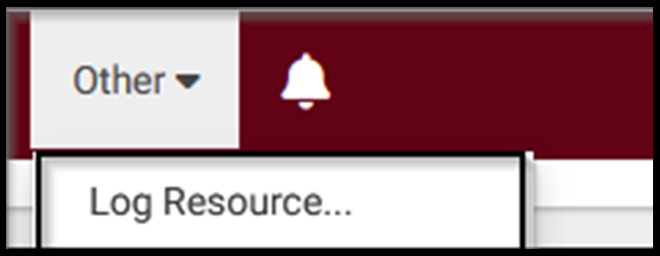
`
Checking Out Resources
Once “Log Resource” is selected, a screen with two text entry areas will be available.
The first text box is where you select a resource.
Staff (based on permissions) will be able to open up a special log listing dedicated to checking items in and out.
Other > Log Resource.
The second allows you to select a student or staff member to check out the item.
2026 Virtual TracCloud Conference

Slide 10
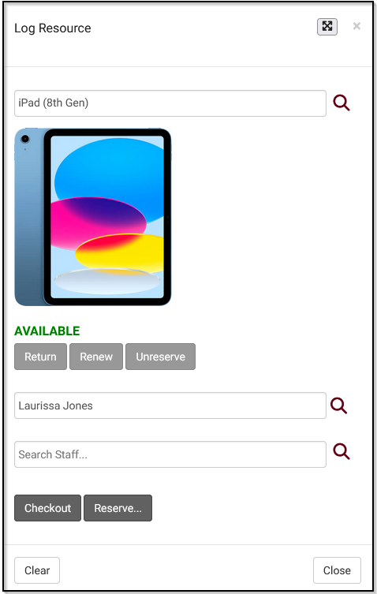
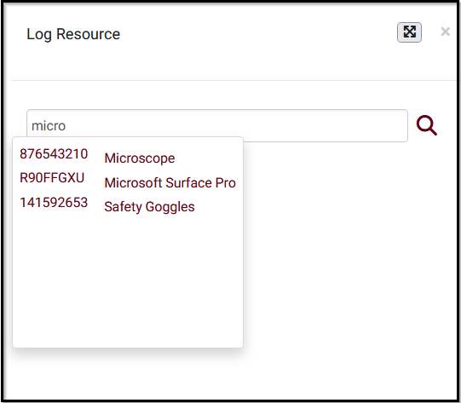
`
Checking Out Resources
(continued)
The second text box allows the user to select the student or staff member that item is being checked out for.
The first text box is where you select a resource (searching by Barcode, Title, or Keywords).
Once one or both fields are selected, additional options become available to check out, return, or reserve this item.
2026 Virtual TracCloud Conference

Slide 11
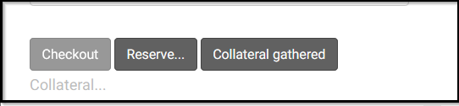
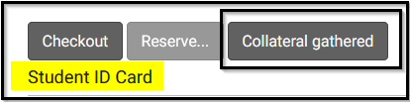

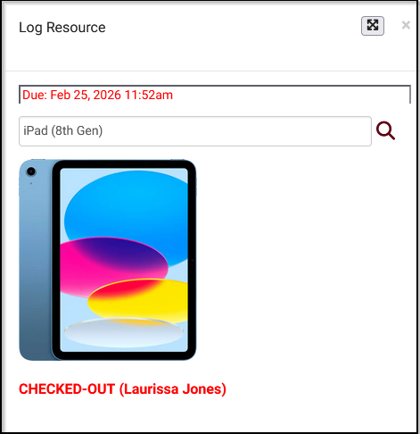
`
Checking Out Resources
(continued)
If Collateral Logic is being utilized, more options will be required in regards to collecting/returning the collateral item before and after checkout.
Once collateral is gathered, the item can be fully checked out.
2026 Virtual TracCloud Conference

Slide 12
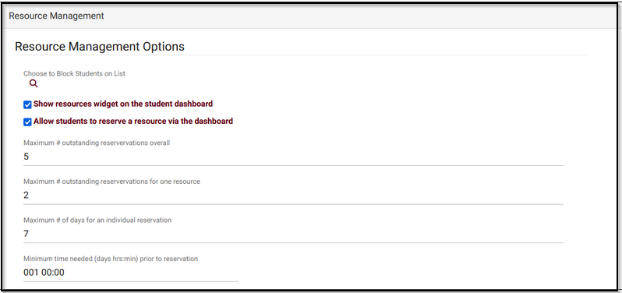
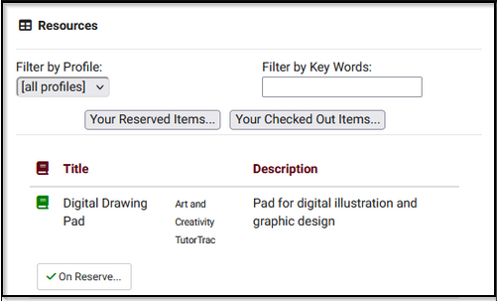
Resource Reservations
`
Choose to Block Students on List:
This can be utilized to block any resource access to certain students based on the linked list.
Allow students to reserve a resource via the dashboard:
Expands the above functionality to allow students to reserve resources for themselves.
Maximum # outstanding reservations overall:
How many total outstanding reservations can a student hold for your resources.
Maximum # outstanding reservations for one resource:
How many total outstanding reservations can a student hold for a single resource.
Maximum # of days for an individual reservation:
How many days can a student reserve a resource for? For example, allowing the student to reserve the resource from the 11th of the month to the 17th, but no longer, would mean this preference needs to be set to 7.
Minimum time needed (days hrs:min) prior to reservation:
Choose the minimum amount of time in advance needed in order to reserve a resource. This is to prevent students from reserving items in the very near future.
Other > Other Options > Preferences > System Preferences > Resource Management.
Show resources widget on the student dashboard
Adds a widget to the student dashboard to review currently reserved or checked out resources.
2026 Virtual TracCloud Conference

Slide 13
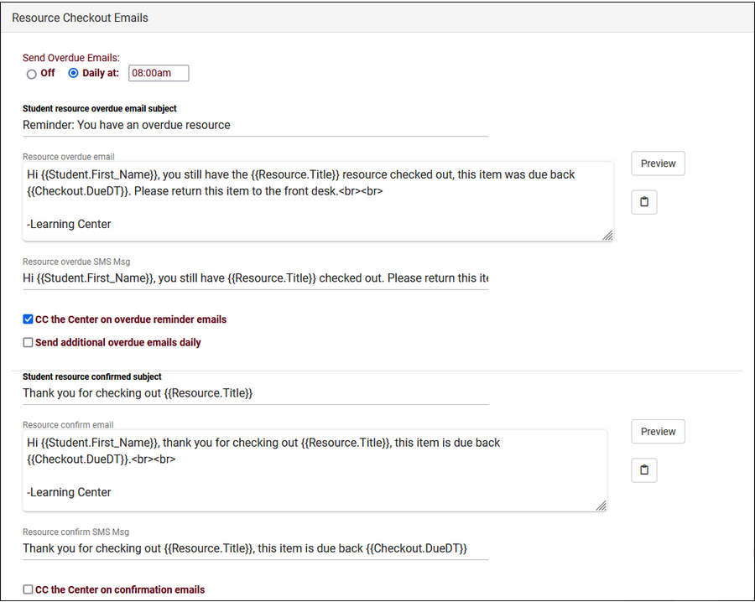
Resource Email(s)
`
Resource emails can be customized to inform students of the due date of their checked-out resource, or if the resource is overdue.
Emails templets that can be sent and personalized with TWIG are:
Resource Overdue Email: - sends an email is the student has an overdue checkout.
Student Confirmation Email: - that sends a email once a resource is checked out.
Resource Reminder Email: - for reservation reminders that the item is ready for pick up.
Resource Return Confirmation Email: - sends a email confirming the resource has been returned successfully.
Other > Other Options > Profiles > [Your Profile] > Prefs > Emails > Resource Checkout Emails.
PRESENTATION 2030
2026 Virtual TracCloud Conference

Slide 14
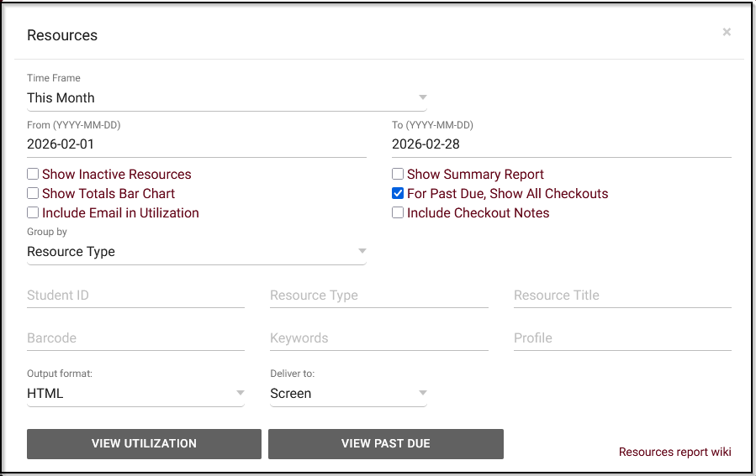
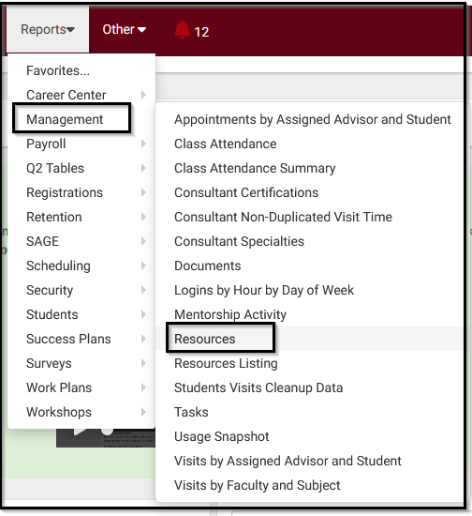
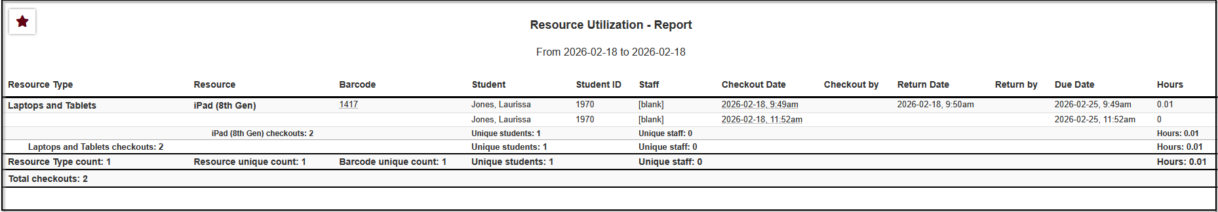
Resource Reports
`
Reports > Management > Resources
Utilization will show all checked out resources and the individual checkouts.
2026 Virtual TracCloud Conference

Slide 15
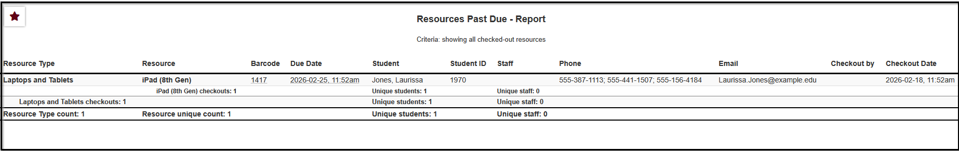
Resource Reports
`
Reports > Management > Resources
Past Due will only display overdue checkouts, items that were not returned soon enough, filtering out checkouts that were returned in time.
2026 Virtual TracCloud Conference

Slide 16
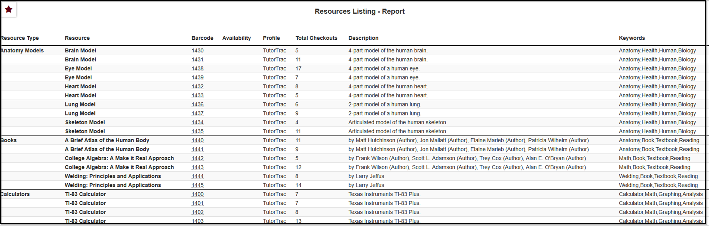
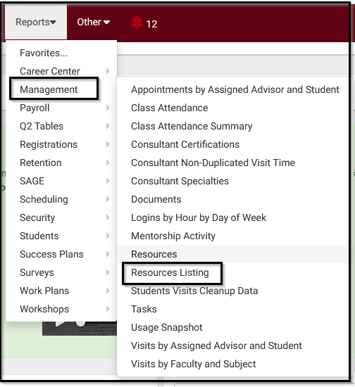
`
Resource Reports
Reports > Management > Resources Listing
The Resources Listing report will show you a list of resource records, along with information about the item and how many times it's been checked out. Data can be grouped by Resource Type if set in the Sort by field.
2026 Virtual TracCloud Conference

Slide 17

Thank You For Attending!
If you have further questions that are specific to your school, please contact us at helpdesk@go-redrock.com so we can schedule a time to review your questions or configuration with a Redrock Tech.
Respectfully,
Sasha Contreras
2026 Virtual TracCloud Conference

