Slide 1
Staff Setup
Creating New Hires and assign them to the proper permissions groups.
Establishing Course Lists – Easy filtering to narrow down the staff when looking for appointments based on subject.
Student View
Understand how user friendly the system is from a students perspective!

Slide 2
What are “Staff”?
All Administrators, Tutors, Advisors and Front Desk Workers are now defined as “Staff”.
Staff account will be assigned to a permission group.
Each Staff account can have access to the schedule - including SysAdmins.
Staff are organized within the Center Profile.

Slide 3
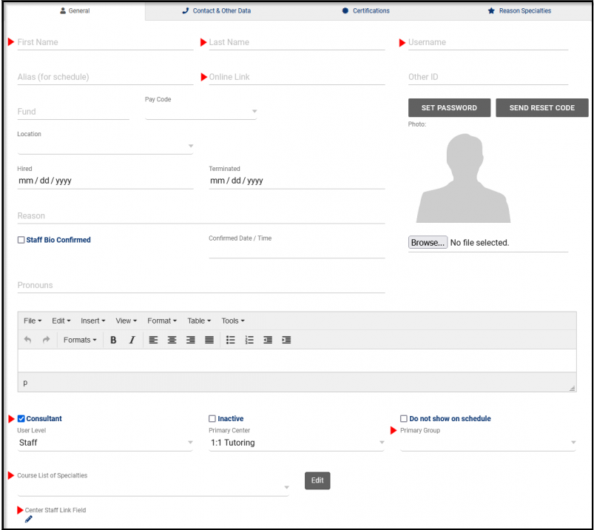
Other > Listing > Staff
General Tab
First Name
Last Name
Username
Online Link (used for virtual appointments)
User Level/Consultant Box
Primary Group
Course List of Specialties
Center Staff Link Fields

Slide 4
Staff Access
General Tab
Consultant: If checked this Staff member can record interactions with students via appointments.
Inactive: If checked, will deactivate the account and will prevent any further access to the system from this account.
Do not Show on Schedule: Prevents this Staff member from having a personal schedule. Student will not be able to book appointments with this staff member.
User Level
Staff won't have access to any administrative preferences.
Profile Admin will only have access to Profile Preferences and Groups.
SysAdmin has access to System and Profile preferences, Groups, and a few potentially sensitive features such as Editing visits and students.
Primary Center: Which Center they primarily work out of.
Primary Group: The permission group that this staff is assigned to.
Course List for: Consultants list of assigned sections
Center Staff Link Field: Centers that this consultant can hold availabilities in.
Special Needs/Skills/Accommodations: Easily identify a accommodation the staff can aid in. Example: ASL

Slide 5
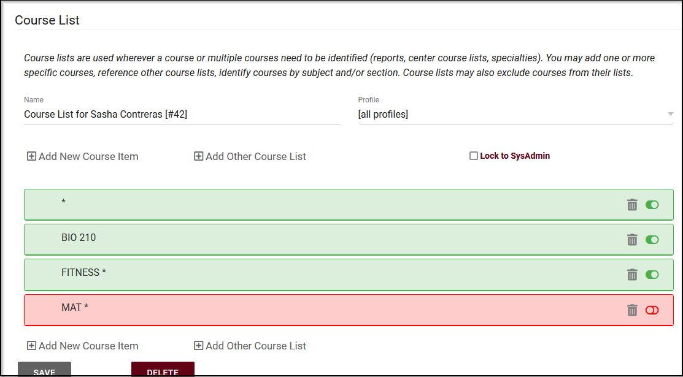
Staff > Course List
Course List
Add New Course Item allows us to add a new subject query. We can be as specific as needed here, we can specify the Subject, Course Number, Section Number, or Term Number, as well as faculty. This allows us to create a course list of all MATH 101 courses, regardless of section/term, or all ACTG courses period.

Slide 6
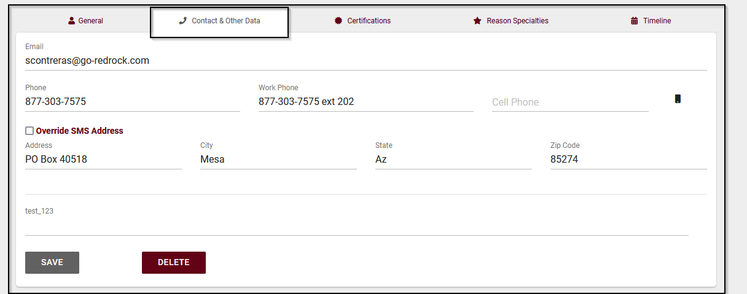
Other > Listing > Staff
Contact & Other Data Tab
Email (needed for email reminders in system)
Phone (for TextAlerts Module)
Address
City
State
Zip Code
Custom Fields (Any other additional information that is held on account used for reporting purposes).

Slide 7
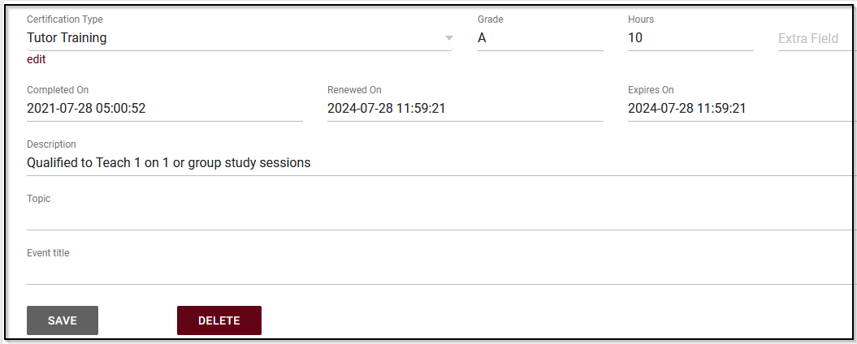
Staff > Certification Record
Document important certifications for staff directly on their profile. This can be anywhere from CPR/First Aid, to what type of tutor they are, to the type of CRLA Level program they are qualified in.

Slide 8
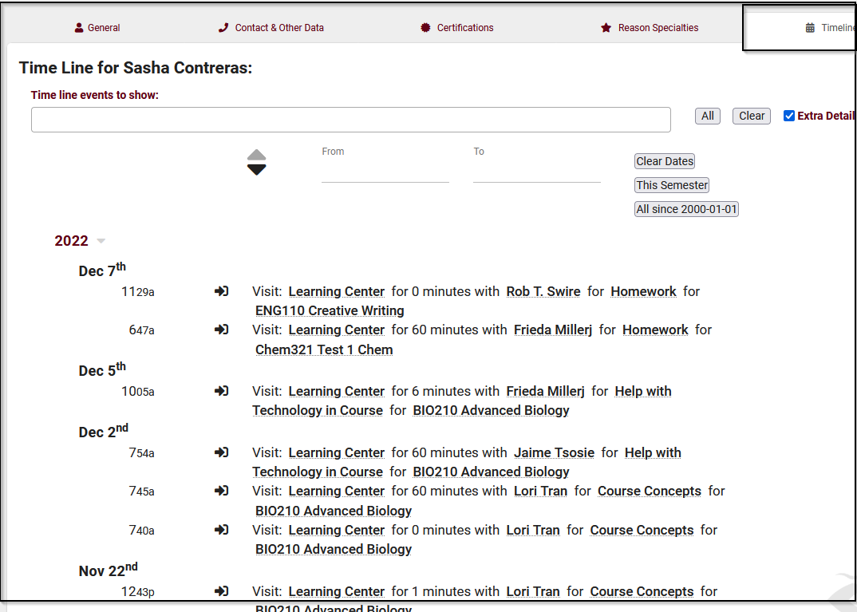
Staff > Timeline
Timeline will show you the interactions of staff in the system – From clocking in and out for work, attending an appointment with a student, completing a task or survey, etc.

Slide 9
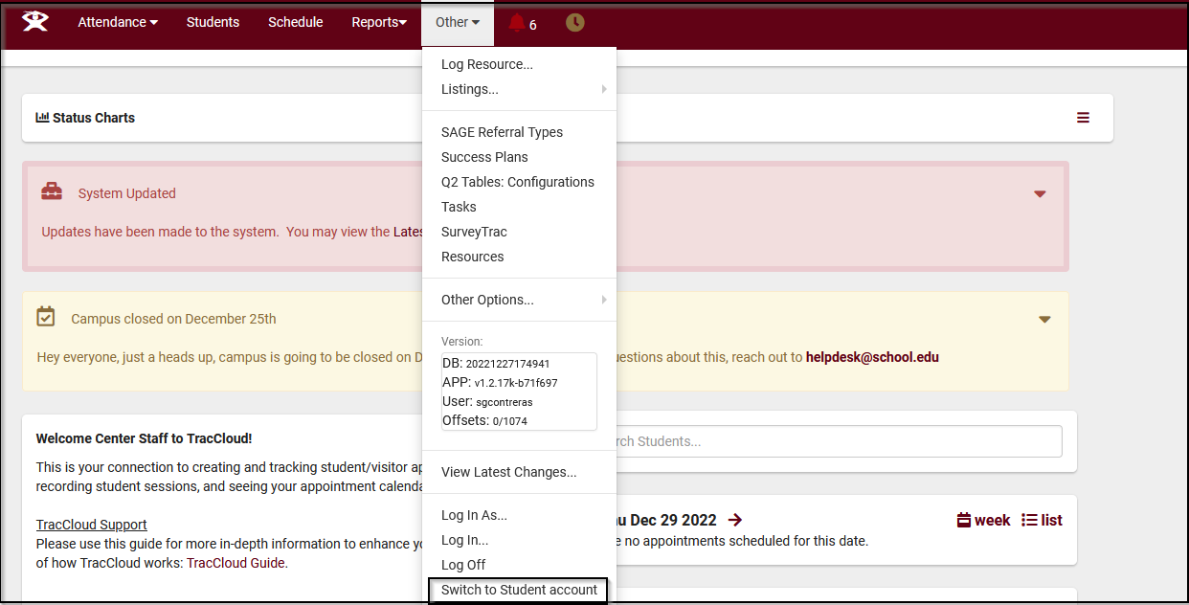
Peer Tutor
Managing both staff and student view
Making sure that the username is the same in both the staff and student account, the user can toggle between accounts based on permissions they need at that time.

Slide 10
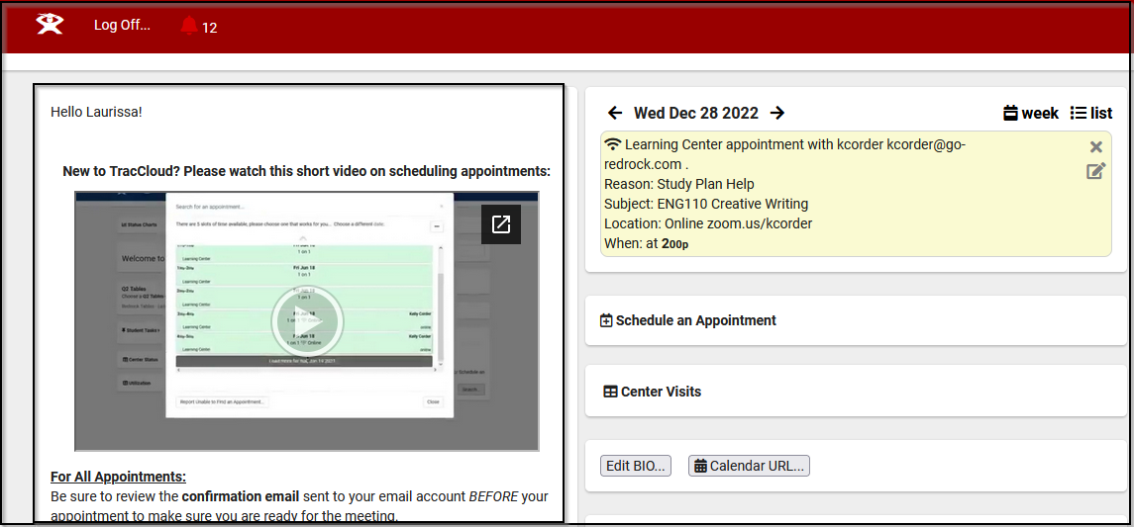
Student View
(Based on access granted to the student group)
Modest and Stress-free, the student view of the system makes managing their account straightforward and to the point.
Anywhere from viewing the welcome message, seeing their upcoming appointments, viewing past visits or searching for an new appointment.

