Slide 1
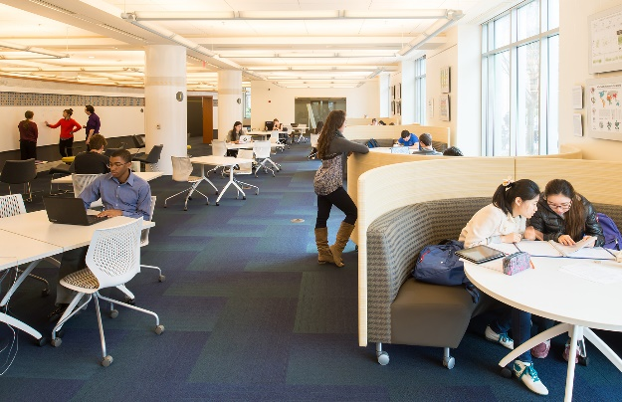
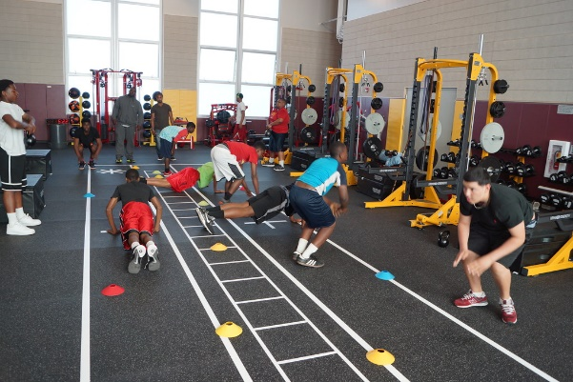
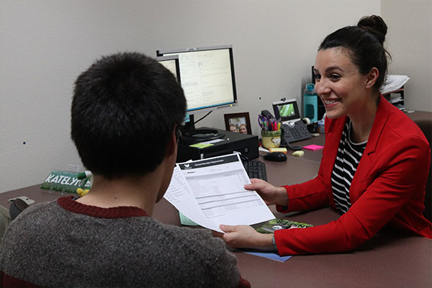
TracCloud Visit: Q&A Session

Slide 2
How can I run Reports on specific visit information?
How can I back log visits for students?
How do I add custom questions to the Visits? (student or consultant)

Slide 3
Who can create Visits/Work Visits?
What determines the choices shown when logging in for a visit?
How do I search for certain information in the attendance listing?

